Slide 1
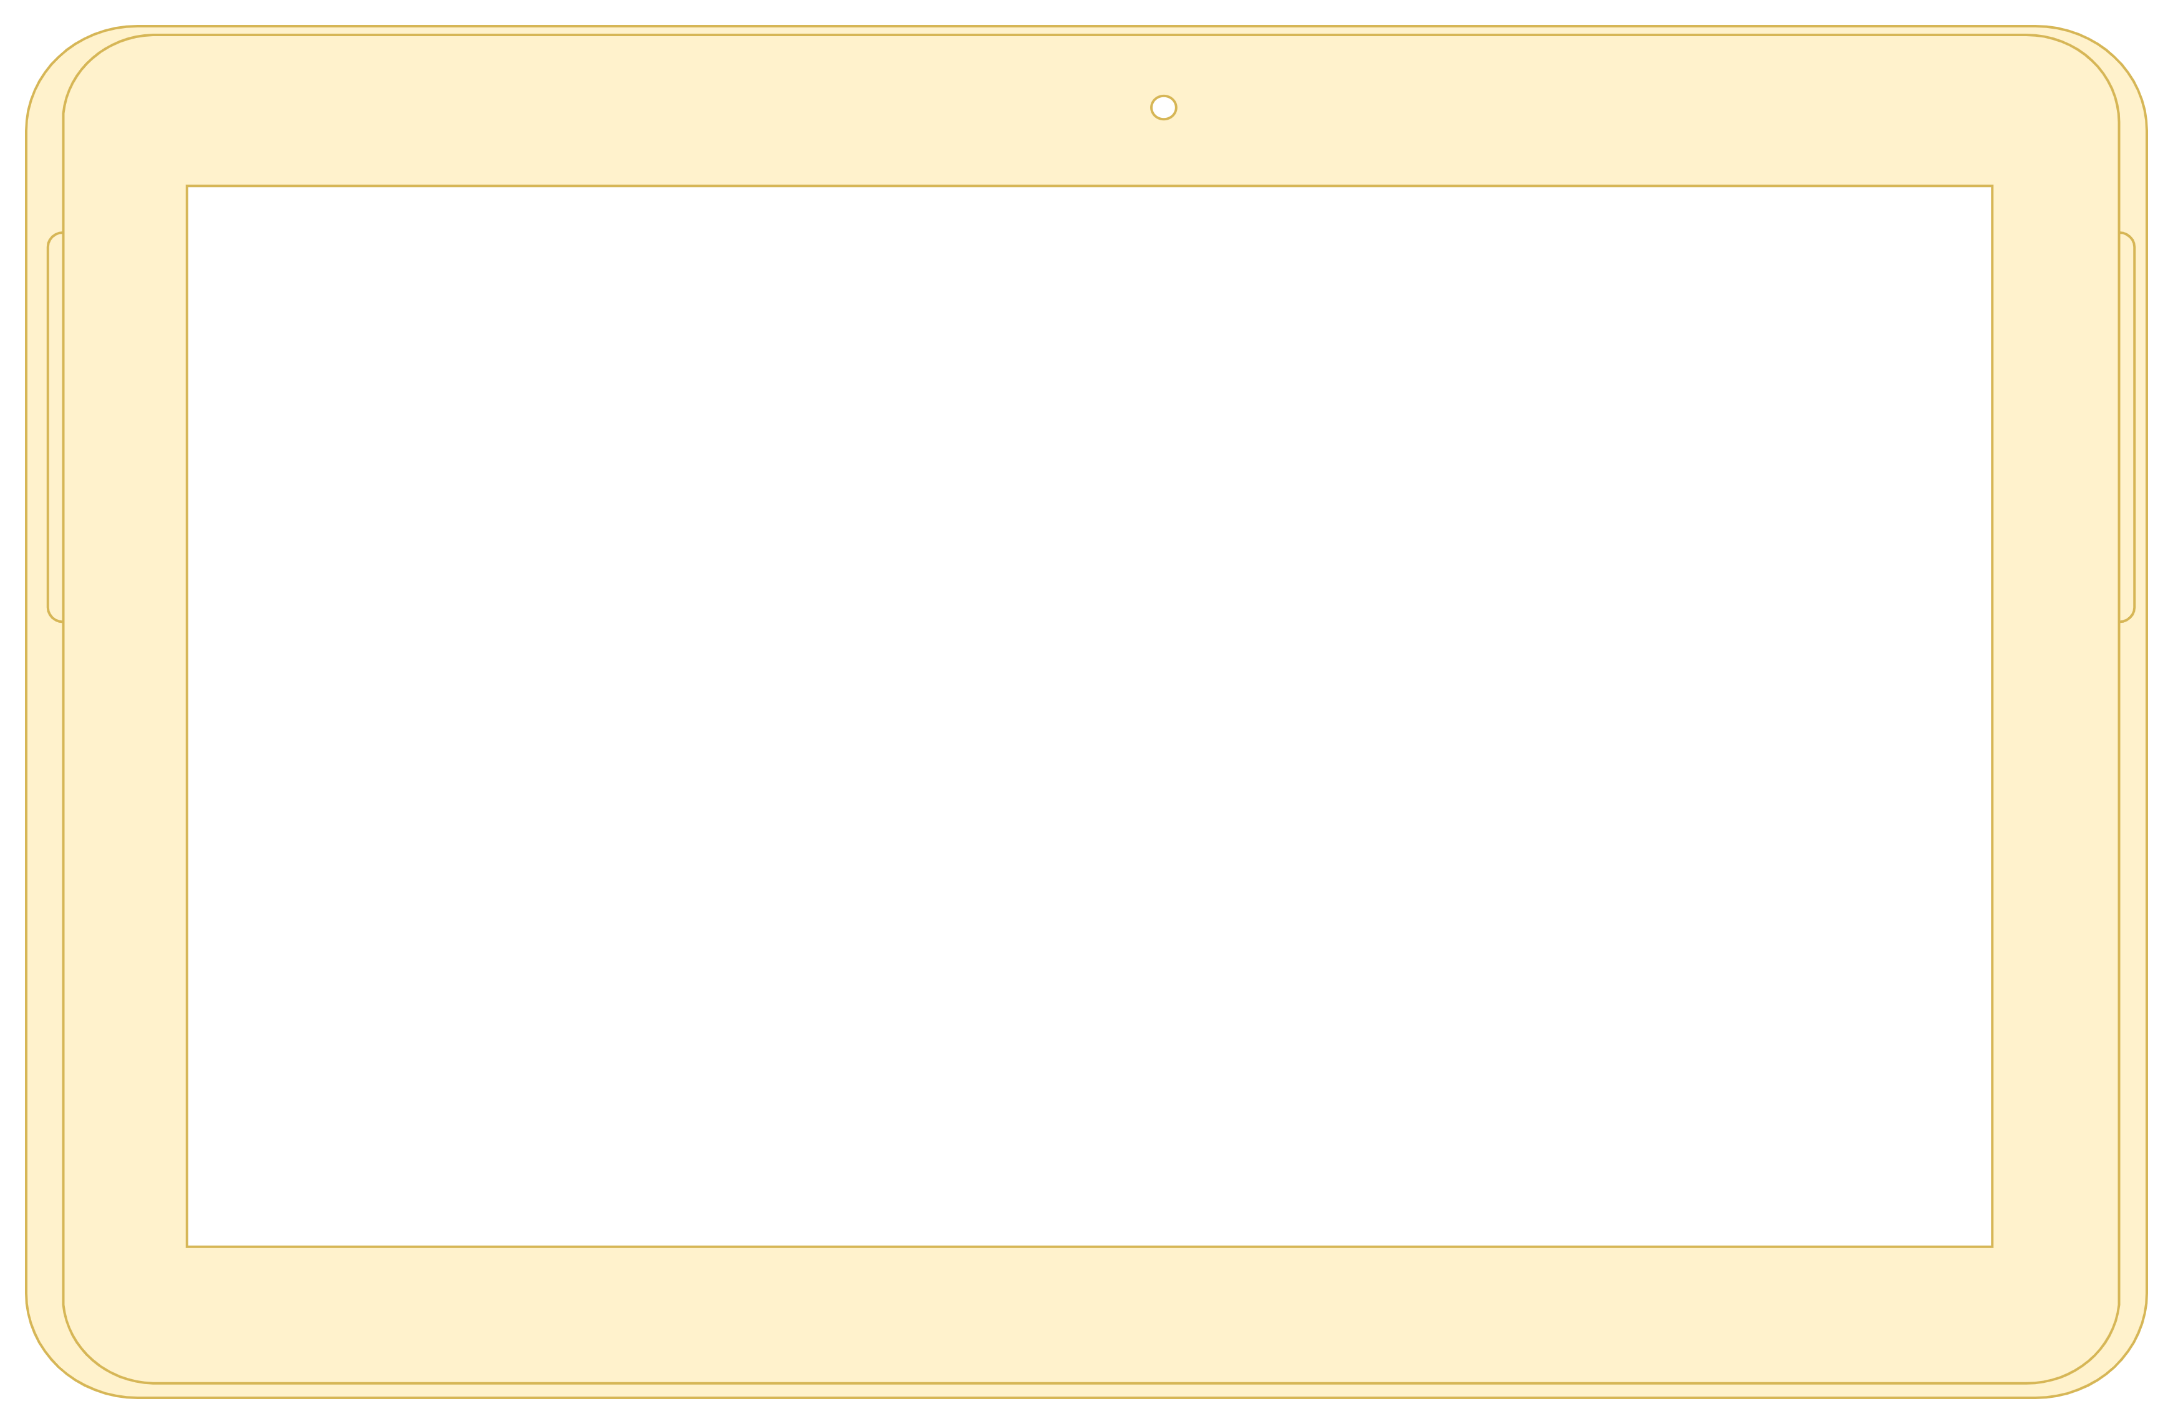


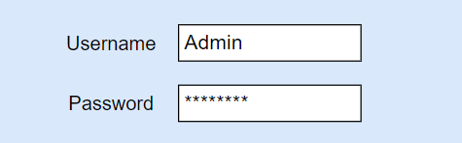
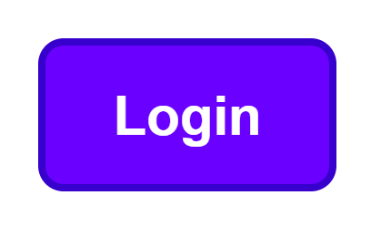

Slide 2


view
Exit

Slide 3





Packaging Production line 1
Info about Production
Type Packaging:
Time/Hr:
Info company or industry
Name:
Email:
Phone:
Packaging Production line 2
Info about Production
Type Packaging:
Time/Hr:

Slide 4
OEE | OEE-Availability | OEE-Performance
OEE - Quality | Planned Production | Production Count
Production Bad | Production Reworked | Production Scrapped
Production Remaining | Frequency - Hz | Current-Amps
Voltage - Volts | E/Stop | Cage Door Active
Trip Wire | VSD Ready

Slide 6
Exit

Slide 7
Login
page
Front page
overview
setting
Save
exit
data
configure
hardware

