Slide 1
Software Requirement
Trần Đình Quế
Ph.D, Assoc. Prof.
Posts and Telecommunications Institute of Technology (PTIT)
Học viện CN Bưu Chính Viễn thông
Mail: quetd2@fe.edu.vn
Master in SE (1998), Melbourne Univ, Australia (1995-1998)
Ph.D in Computer Science (2000), Vietnam Academy of Science and Technology
2001: Post Doc., Calgary Univ (Java Gosling), Canada
Phone: 0904066883

Slide 2
1) On-going Assessment - 3 PT: 30% - 02 Assignments: 30% 2) Final exam (60'): 40% Completion Criteria: 1) Every on-going assessment component >0 2) Final Exam Score >=4 & Final Result >=5

Slide 3
CHAPTER 1 The essential of software requirement
“Software is eating the world” —Marc Anderson, August 20, 2011, Wall Street Journal

Slide 4
Objectives
Understand some key terms used in the software requirements domain.
Distinguish product requirements from project requirements.
Distinguish requirements development from requirements management.
Be alert to several requirements-related problems that can arise

Slide 5
Contents
Software Engineering & Computer (hardware) Engineering
Why is requirement engineering?
Software requirements defined
Requirements development and management
When bad requirements happen to good people
Benefits from a high-quality requirements process

Slide 6
Software engineering
Engineering =/= technique, technology
Software engineering JOBS: https://en.wikipedia.org/wiki/Software_engineering
Software development process & Testing???
https://www.guru99.com/software-development-life-cycle-tutorial.html
Software process/life cycle/methodology: waterfall, spiral, agile, UP, RUP…. https://en.wikipedia.org/wiki/Software_development_process
Requirement: business analyst
Analysis: system analysis
Design: software designer/architect
Coder: java/.Net technology, web technology… smart phone tech (android, iOS…)
Tool: VP https://www.visual-paradigm.com/download/

Slide 7
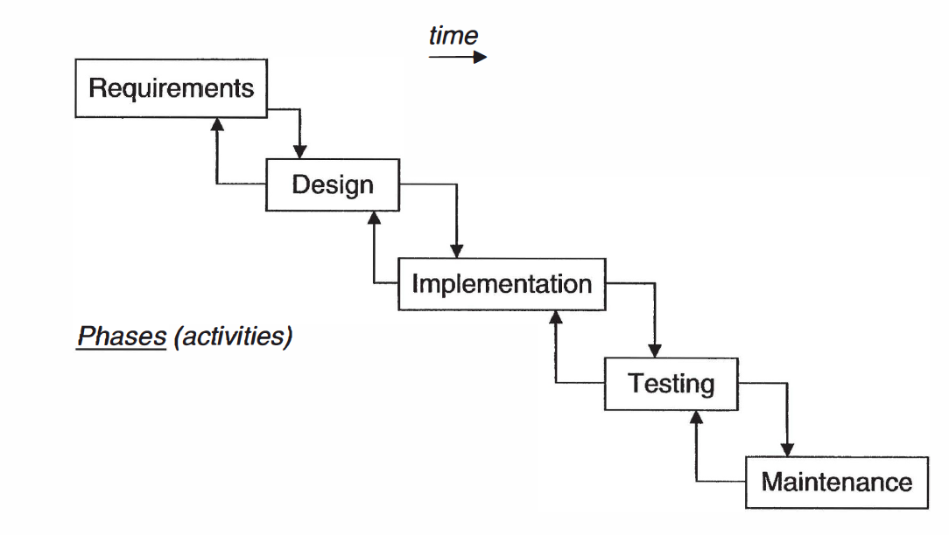

Slide 8
The More You Know The More You Realize You Don’t Know
“The More You Know The More You Realize You Don’t Know” Aristotle
===
You should discover this link
https://ardalis.com/the-more-you-know-the-more-you-realize-you-dont-know
How to study the subject? Slide/BOOK reading

Slide 9
Why is requirement engineering?
Distribution of Defects
Distribution of Effort to Fix Defects
Code
7%
Code
1%
Other
4%
Requirements
56%
Other
10%
Design
13%
Requirements
82%
Design
27%
Source: Martin & Leffinwell

Slide 10
Software requirements defined
Brian Lawrence: “anything that drives design choices” (Lawrence 1997)
“ Requirements are a specification of what should be implemented. They are descriptions of how the system should behave, or of a system property or attribute. They may be a constraint on the development process of the system” Ian Sommerville and Pete Sawyer (1997)

Slide 11
Terms
Stakeholder: customers, users, business analysts, developers…
Views from different persons
Business Req: vision, scope
User Req: use cases, user stories
SRS: Software Requirement Specification

Slide 12
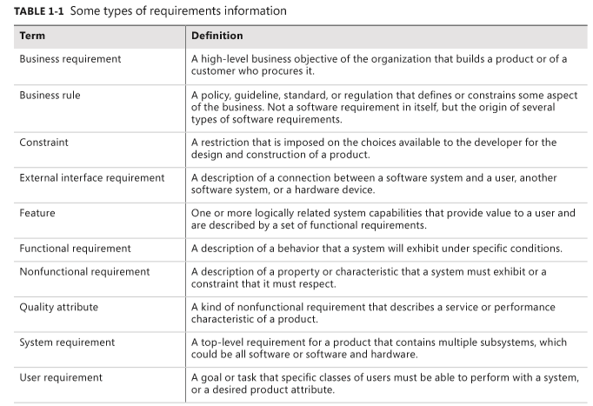
Types of requirements

Slide 13
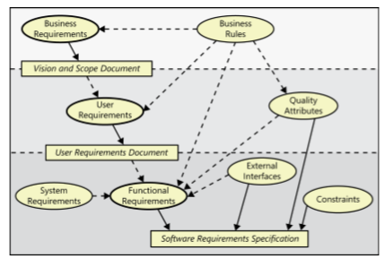
Levels and types of requirements

Slide 14
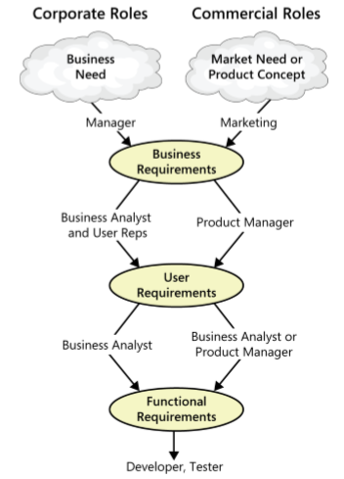
The participation of stakeholders in requirements development
Notes:
Working with three levels

Slide 15
Product vs. project requirements
Product requirements:
properties of a software system to be built
Projects requirements:
do have other expectations and deliverables that are not a part of the software the team implements, but that are necessary to the successful completion of the project as a whole
Notes:
Teacher should explain more detail about every type of requirements

Slide 16
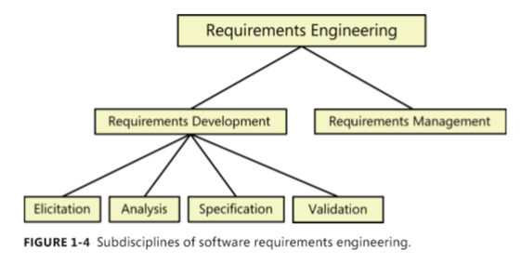
Requirements development and management
Notes:
Teacher should explain every step

Slide 17
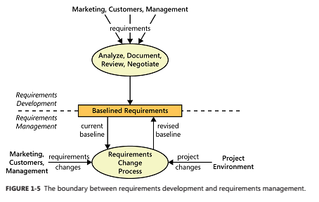
Requirement Management

Slide 18
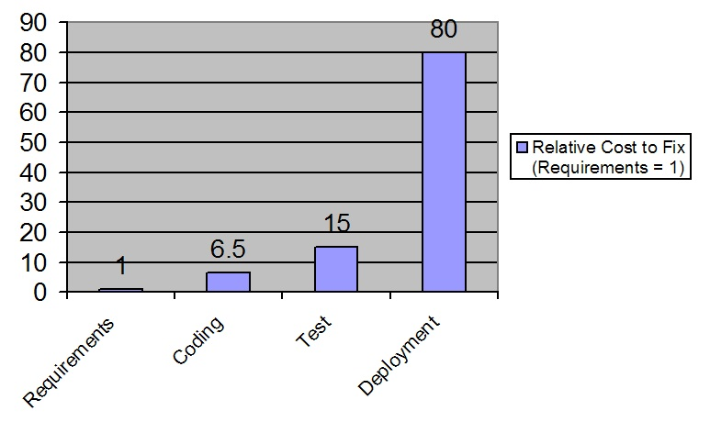
When bad requirements happen to good people
Insufficient user involvement
Inaccurate planning
Creeping user requirements
Ambiguous requirements
Gold plating
Overlooked stakeholders
Figure https://www.stickyminds.com/article/what-cost-requirement-error

Slide 19
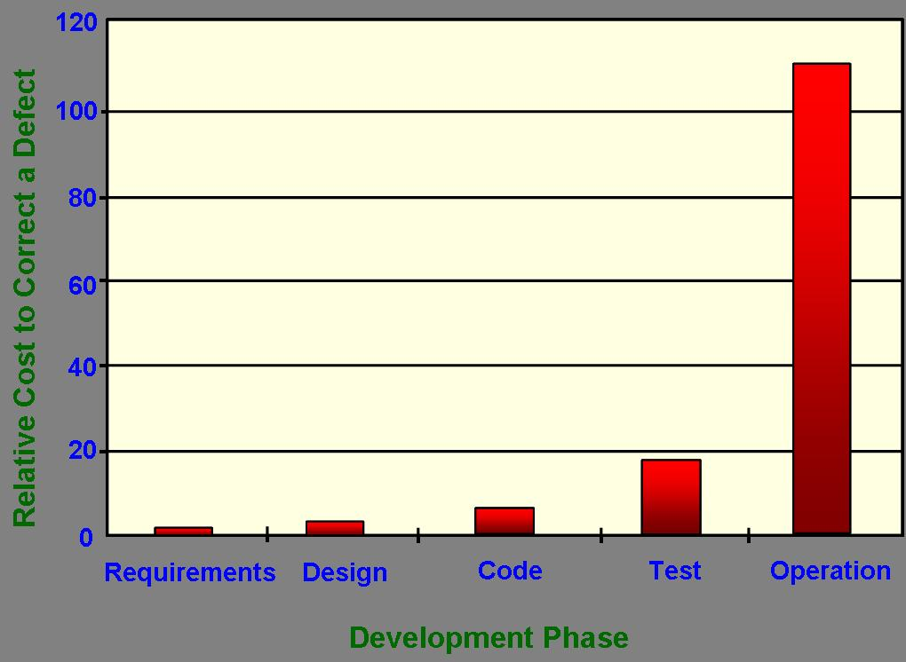
cost of discovering defect
https://www.jamasoftware.com/blog/when-bad-requirements-happen-to-nice-people/

Slide 20
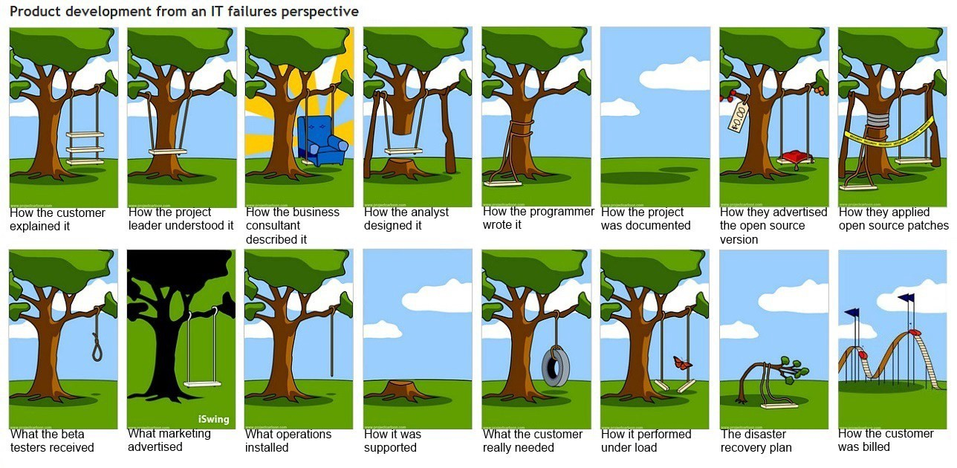
https://medium.com/@nerimbarakat/the-cost-of-poor-project-requirements-in-software-development-3c0d23df6e7c

Slide 21
Self-reading
Cost of poor quality in US-2018:
https://www.it-cisq.org/the-cost-of-poor-quality-software-in-the-us-a-2018-report/The-Cost-of-Poor-Quality-Software-in-the-US-2018-Report.pdf
Right req➔ avoid 10 Traps (given by IBM)
https://personal.utdallas.edu/~chung/SYSM6309/Getting_requirements_right-avoiding_the_top_10_traps.pdf
List of failed and overbudget custom software projects
https://en.wikipedia.org/wiki/List_of_failed_and_overbudget_custom_software_projects

Slide 22
Benefits from a high-quality requirements process
Fewer defects in requirements and in the delivered product.
Reduced development rework.
Faster development and delivery.
Fewer unnecessary and unused features
Lower enhancement costs
Fewer miscommunications.
Reduced scope creep.
Reduced project chaos.
Higher customer and team member satisfaction.
Products that do what they’re supposed to do.

