Slide 1
CHAPTER 2 Requirements from the customer’s perspective

Slide 2
Objectives
After finish this chapter, student should understand that the customer-development relationship is so critical to software project success.
This chapter also discusses the critical issue of reaching agreement on a set of requirements planned for a specific release or development iteration
Requirements Bill of Rights for Software Customers and a corresponding Requirements Bill of Responsibilities for Software Customers could bring to student the importance of customer—and specifically end user—involvement in requirements development.

Slide 3
Contents
The expectation gap
Who is the customer
The customer-development partnership
Requirements Bill of Rights for Software Customers
Requirements Bill of Responsibilities for Software Customers
Creating a culture that respects requirements
Identifying decision makers
Reaching agreement on requirements

Slide 4
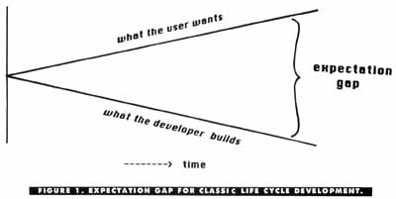
What is exp. Gap?

Slide 5
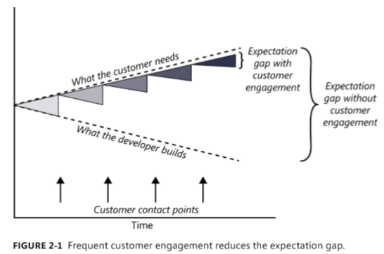
The expectation gap

Slide 6
Stakeholder & customer
End user: direct & indirect users
Example Bank: staff is direct users
you receive feedback from bank = indirect users!
STAKEHOLDER
CUSTOMER

Slide 7
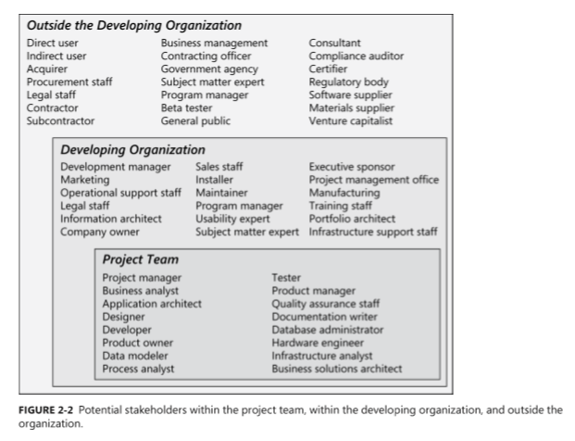
Who is the customer?

Slide 8
The customer-development partnership
Customers have the right to:
Expect BAs to speak your language.
Expect BAs to learn about your business and your objectives.
Expect BAs to record requirements in an appropriate form.
Receive explanations of requirements practices and deliverables.
Change your requirements.
Expect an environment of mutual respect.
Hear ideas and alternatives for your requirements and for their solution.
Describe characteristics that will make the product easy to use.
Hear about ways to adjust requirements to accelerate development through reuse.
Receive a system that meets your functional needs and quality expectations.
Notes:
Teacher should explain every the right of customers in requirements engineering activities

Slide 9
The customer-development partnership
Customers have the responsibility to:
Educate BAs and developers about your business.
Dedicate the time that it takes to provide and clarify requirements.
Be specific and precise when providing input about requirements.
Make timely decisions about requirements when asked.
Respect a developer’s assessment of the cost and feasibility of requirements.
Set realistic requirement priorities in collaboration with developers.
Review requirements and evaluate prototypes.
Establish acceptance criteria.
Promptly communicate changes to the requirements.
Respect the requirements development process
Notes:
Teacher should explain every the responsibility of customers in requirements engineering activities

Slide 10
Identifying decision makers
decision leader
decision rule: describe how to arrive at decisions
- Decision leader makes the choice with or without
discussion with others
- Group votes and majority rules
- …
(ref. Text Book pg. 38, student discuss rule decision!)

Slide 11
Reaching agreement on requirements
Parties involve in reaching agreement:
Customers agree that the requirements address their needs.
Developers agree that they understand the requirements and that they are feasible.
Testers agree that the requirements are verifiable.
Management agrees that the requirements will achieve their business objectives.
The requirements baseline: set of requirements being reviewed & agreed upon and serves as basis for further development
Baseline ➔ confidence (pg. 40)
What if you don’t reach agreement?
Agreeing on requirements on agile projects (seft-study)

