Slide 1




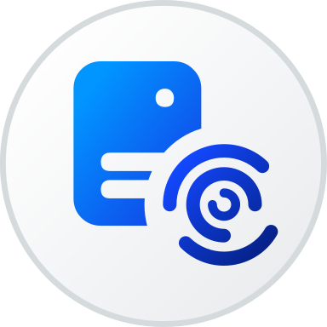
How it works
Users
SAP BTP
Systems
Orchestrator
People
SAP, M365, Jira, Slack
Specialist agents
SAP AI Core
Joule
Notes:
People chat with the orchestrator in the browser; SAP Joule reaches the same agents over the A2A protocol.
Everything runs in one SAP BTP subaccount on Cloud Foundry, behind an Application Router and XSUAA (single sign-on, roles user / admin / a2a).
The orchestrator does not do the work itself: it picks the right specialist agent and hands the request over. Specialists can also call each other.
Every agent thinks with an LLM from SAP AI Core's Generative AI Hub - model can differ per agent.
Specialists reach business systems through MCP servers (on BTP or any vendor) or built-in connectors: Microsoft 365 (Outlook, Teams), Gmail, Slack, Jira, SMTP, SAP for Me, SAP security notes.
Not on the slide: the Job Scheduling Service also triggers agents and multi-step workflows on a schedule, e.g. a daily report mail.

Slide 2

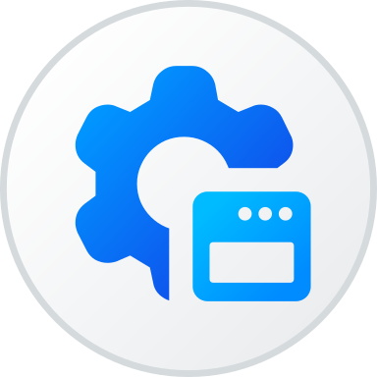
Agents are configured, not coded
Admin UI
describe the agent
Saved
in PostgreSQL
Live
no redeploy
Reload, and the new agent is in the chat.
Notes:
An admin defines an agent in the admin UI: name, instructions, which MCP servers or built-in tools it may use, which skills it can load, which peers it may delegate to, optionally its own LLM.
Skills are reusable instruction blocks shared between agents.
The definition is stored in PostgreSQL on BTP. Pressing reload rebuilds the orchestrator and all specialists from the database and swaps them in atomically - no build, no cf push.
Same for workflows: a main line, a fan-out over work items, per-item branches and a join, with deterministic steps (condition, transform, http, python) between agent steps.
Admin access is protected by the admin role in XSUAA.

Slide 3
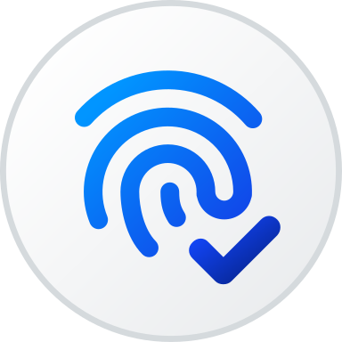

It acts as you
You
sign in
XSUAA
checks roles
Agent
passes token
System
your data only
Same rights as in the system itself.
Notes:
You sign in once through the Application Router; XSUAA issues a JWT and checks your role.
The backend validates that JWT and keeps it with your request all the way down to the agent that makes the call.
Each MCP server receives your token (JWT forwarding), so it applies your own authorizations. Every agent run opens its own MCP session, so two users never share a connection.
For systems outside BTP, each user signs in once with OAuth 2.1 (Microsoft, Google, remote MCP servers); tokens are stored per user and refreshed automatically.
Technical credentials (Jira, Slack, SMTP) live in the BTP Destination service, never in the app; destinations can also exchange your token for a token of the target system.

