Slide 1
Do you really need an agent army?
Notes:
Hey everyone.
I'm here today to speak about AI. Waaaaaaw so original isn't it ?
I don't know if like me, you felt overwhelmed by the AI topic … almost sick of it.
So I'll try today to be interesting. I like interactions, so feel free to jump in. Let's start by getting to know each other.

Slide 2
Context
Agent
Skill
Hook
Harness
Notes:
Who heard about the following concepts already :
- Context ?
- Agent ?
- Skill ?
- Hook ?
- Harness ?

Slide 3
Notes:
Ok great. Let me introduce myself now. I've mainly been an ABAP Developer for almost 20 years, and I've always been really interested in software engineering and architecture. I spoke here last year about the importance of software architecture and governance in development.
I've always been interested in new technologies and of course I've been super enthusiastic the first time I heard about ChatGPT a few years ago. I've been using it extensively and at that time a new job appeared: "prompt engineer". I thought it was funny and kept going on with my stuff. Then new platforms like Make or N8N appeared and allowed us to make workflows to make different APIs interact together and I remember being so clever as to imagine a tool/service/platform that would allow a contractor to have his emails read automatically from his inbox, then do a first request to ChatGPT to determine the content and then based on the content fork to different processes, with a connection to Notion or something to have a kind of draft ready to be sent to the potential customer with a quotation estimation.
Seems pretty useless today when you see everything that an agent can do isn't it ?
Anyway, then something incredible happened: Claude Code. And a little bit after or at the same time OpenClaw.
I jumped in, bought a Mac Mini and was ready to have my own personal Jarvis, I was already dreaming of being Tony Stark … How delusional was I …
I set up a Discord and I was dreaming about being able to ask my assistant to just "build me things".

Slide 4
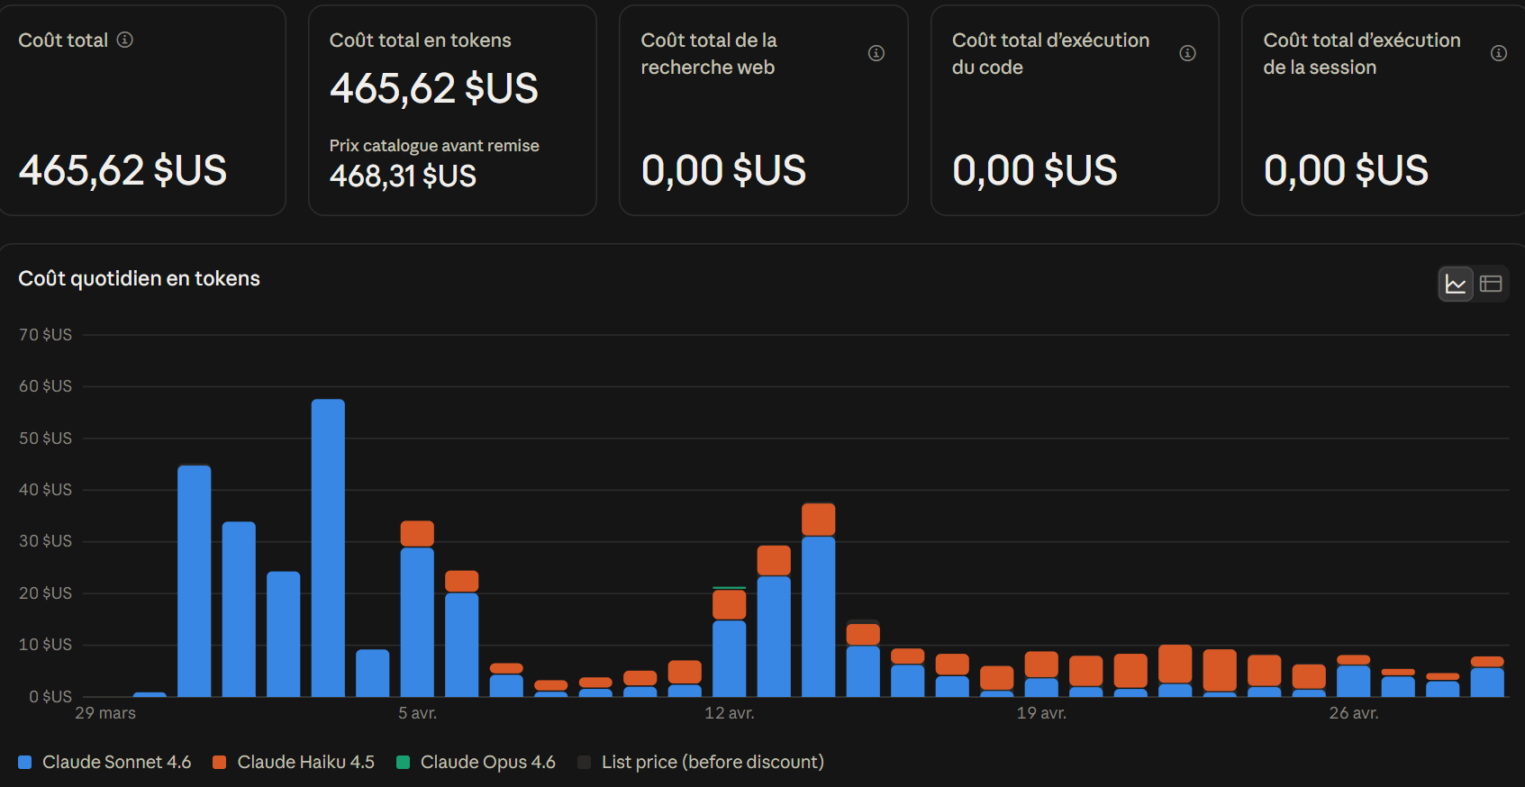
Notes:
Then I watched it burning tokens ...
That's how I learned the hard way about context ...

Slide 5
What do I want to do with AI?
Notes:
So I was already using Claude AI, I was using projects and stuff, but it was time I jumped into the CLI world. Ok but what now ? My experience with OpenClaw was frustrating and expensive. I wanted to have more or less the same. So I started asking myself, what do I want to do with AI ?
Spoiler alert: that should be the first question any company should ask themselves before jumping in. But we'll come to that later.
So I wanted to use it to help me with my day-to-day tasks of course, maybe in SAP Development, but I also wanted to build a product, something I would be proud of. Ok but what ? No idea at the time, but I knew that if I had the idea, I would need a development team because I wouldn't be able to build an online SaaS myself.
Where should I start ? Well let's start with the internet of course ... And boy ... I must say I wasn't ready for this ...

Slide 6
Second Brain
Jarvis cockpit
Agent swarm
Claude Code one-shotted me …
The new repo that will change your life
Notes:
Quick question who heard about the following ones :
- Second Brain ?
- Jarvis cockpit ?
- Agent swarm ?
- Claude Code one-shotted me …
- The new repo that will change your life ?
I was overwhelmed by the amount of information I had. I thought to myself "Oh my god, how can I know so little ? What a fool I am ?" Off course I needed all of those otherwise I would just be outdated, so far behind. So I watched a lot of videos, read a lot of articles, until it finally clicked. All of that content was created by content creators, not real engineers. They were creating content for you to watch.

Slide 7
never write a file myself
never take any shortcut
Notes:
So I took a step back and I started building what I needed. I gave myself a few rules I tried to stick with:
- never write a file myself
- never take any shortcut
So I knew I needed an agent to create me config files, including skills, agents etc ...
That's how I started. So I created what I'll call an entity which is a Claude project that will work only internally and only create things to help the system. Compared to classic projects that are products.
So I created my builder, the only one that would be allowed to change config. And in the meantime, I had an idea for a product I wanted to build.

Slide 8
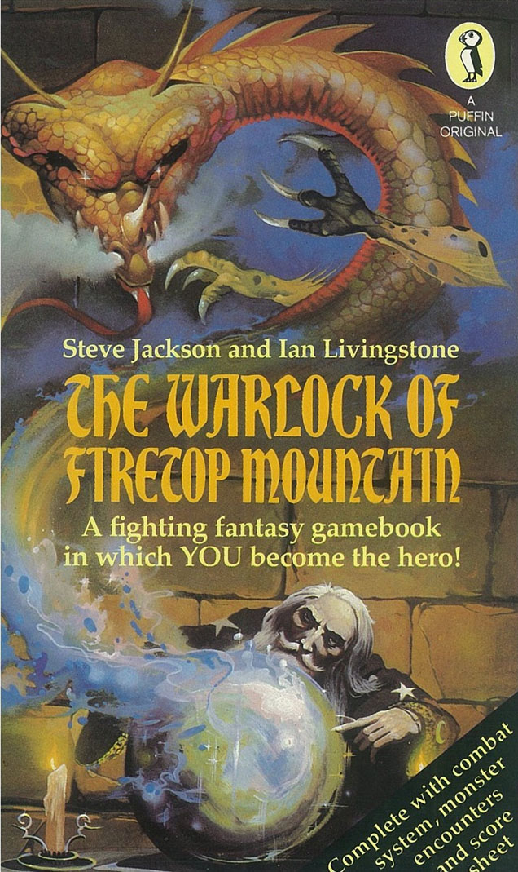
Notes:
Who knows the books "You Are the Hero" ? I loved them when I was a kid. And I've always wanted to have a young child version for my daughter. There are some but not that many. And my daughter loved it when I was inventing stories for her with choices ... So I wanted to build that.

Slide 9
me → orchestrator → the other agents
Notes:
So I needed another entity, a storyteller/composer. But why an entity and not simply an agent ?
Well because what I call an entity is in fact multiple agents. But I only interact with one of them, the main one. All the other agents are called by the main one, which I call the orchestrator.
Why ? Well I must say that like everything I've done until now, I've experienced it the hard way, by making mistakes, like a lot. When I understood the concept of context and hallucination, it was because my agent started telling me total nonsense. I was using compact, then I watched an Anthropic engineer explaining the dumb zone. But I needed to build agents that were autonomous, not needing guidance all the time. So I used Object Oriented patterns and concepts. I started visualizing agents like classes, skills and commands like a kind of method. And also I realized how confident my agent was in his own results.

Slide 10
"wow yes so brilliant, let me explain why"
"yes, I was wrong, let me explain why"
Notes:
All of you must have felt so clever when your agent is telling you "wow yes so brilliant let me explain why" and then a few moments later you realize it wasn't so bright and you ask him again and then he tells you with so much confidence "yes exactly I was wrong and let me explain why" …
So what I wanted then was to have an agent that wouldn't trust me or agree with me directly, and also, I wanted him to ask another agent to do the work and then check its result.
I had a much better result working that way.

Slide 11
Notes:
So now I do have an entity that helps me build and tweak my setup. And I want him to create me an entity that will help me create the stories.
But creating stories isn't that easy. There is the story itself, but with choices, which should be meaningful, the story should be appealing, but also you have rules within a universe that you want to set and cannot break otherwise it'll ruin your story. Imagine if in a Star Wars movie you could start healing yourself with the Force or fly in space …
Then if you have iconic characters you should recognize them across your different stories. And you shouldn't write the same story twice.
And if you want to add music, it should match the tone of the scene, same for the picture. If you want to add narration, you must be sure that what is written is what is being said.
And you must explain all of that to an AI Model.
And once the story is built, that's just the beginning, because after that you need to have your product available to your audience. So a development team is needed.
And how to pass the story to the development team ? One of my rules is that I can't do it myself.

Slide 12

Notes:
So … I created something very original … an inbox for the different entities to interact with each other.

Slide 13
Not persisted → it's dead.
Not loaded at launch → it doesn't exist.
Notes:
Same for the follow-up of the different things to do. Everything was in my head because an AI agent doesn't know anything once it wakes up. Everything said during a conversation and stored in the context is dead unless it is persisted.
And even if it is persisted, if it isn't known or loaded at launch, it doesn't exist.

Slide 14
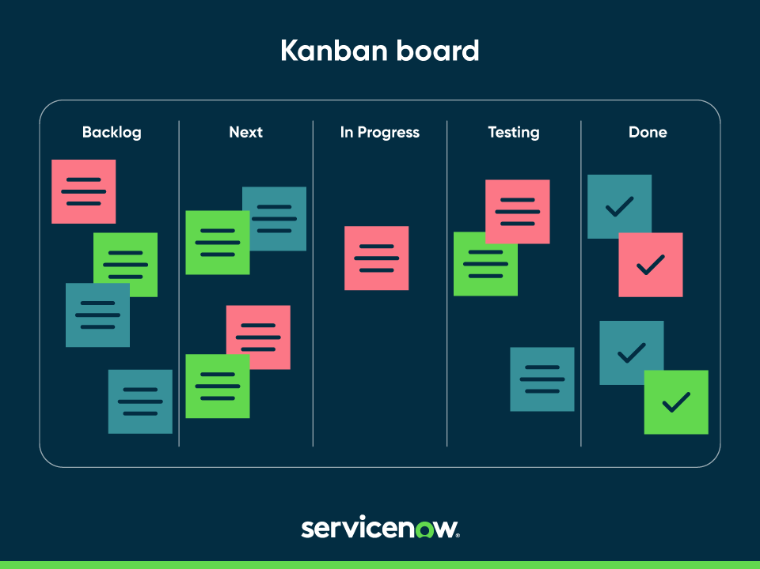
Notes:
And each entity has its own internal kanban as well with tickets, with status, creation date, comments … and a board that is created at launch so he knows what's ongoing, what he has to do etc …

Slide 15
developer · analyst · tester · architect · reviewer
spec → planner → sub-tasks → developer → test → review
Notes:
Ok let's go back to the development team now. Of course, I need a developer, but I also need an analyst that will check what is already built or not, and see if a request is valid. And I need a tester also. Of course I want my code to be as good as possible, so I need to define coding practices, development guidelines but I also need to have an architect for governance.
Reviewer also to see if what was asked is what was built, that the development process has been followed, that test evidence has been created etc …
But now I need a spec. So let's create an entity for that. So that I'm sure all my specifications will have the same level of quality and structure.
And when the spec is created, it's sent to the dev team inbox, then the planner takes it, creates the ticket, passes it to the analyst, who will split it into different sub-tasks that will be implemented in sequence, tested and reviewed.
Quick side note here.
So in the meantime, I was still reading the internet and we went from "vibe coding" to a concept that is now being called "spec-driven development". Looks interesting isn't it ? So what is this new concept ? Well … before starting to code you ask your agent to build a specification … Crazy isn't it ?

Slide 16
spec → dev → test → deploy
Notes:
Another crazy idea ? First write a spec, then develop it, then test it, then deploy it. Doesn't it look like a waterfall approach ?
Because yes, the way agents are built, they aren't good at working together on the same piece of code, they are better at working sequentially.
We went agile to go faster. Or at least to give the impression we were going.
What agile really gave you was the right to change your mind in the middle of the development. And here's what changed: AI finishes the work before you can change your mind. So yes, it looks like waterfall. But waterfall was risky because you committed for six months before seeing anything. Here I commit for an afternoon. Same shape, completely different bet.

Slide 17
skill
→
one authorization object
pack
→
the role
entity
→
the user
Notes:
So coming back to my system, I now had a setup-builder that was creating and fixing entities when they had an issue. A storyteller entity. A spec creator entity. An inbox, a kanban.
But I realized also that even if something is written in a config file,

Slide 18
SessionStart
inject the board
UserPromptSubmit
inject the contract — every single turn
SubagentStart
inject the claim floor
PreToolUse
8 guards — before the tool runs
Notes:
just because it is loaded doesn't mean it is always followed. That's why you do have hooks that are called automatically by the harness at some point. A little bit like a BADI.
And you also have commands and scripts, or loops, that are basically like a workflow with agents being called instead of methods.

Slide 19
Notes:
I could speak for hours about that topic … But I must say also that sometimes it can be harsh.
It's harsh because you can be overwhelmed by the amount of information you perceive, you have to remove all the "noise". It's difficult also because it looks so "easy", and it's a bit like the Dunning-Kruger effect. It looks easy at first but as you dig into it, you realize AI isn't magic and it isn't easy.
You need governance, you need control. And I hear and see more and more people saying we need to slow down. And I might agree. When you're working with AI agents, it goes so fast that you are the bottleneck. So it puts pressure on you and it might overwhelm you.
I am a gamer you know, and I know this feeling of "just one last game", well I had the same "just one last prompt" …

Slide 20
1500+
800+
changes deployed to the system config
still waiting in the backlog
Notes:
But in the end, my app is working and it's live now. My system keeps evolving and running as we speak now. My system-builder entity has deployed more than 1500 changes to the system config, and more than 800 are still waiting in the backlog, I have several entities that I want to create, I still want to push for more autonomy, earned step by step, as each entity proves it's reliable.
It helped me learn a lot of things because I wanted to build something real.
And yes my story app is live and running.

Slide 21
How is all of that useful in SAP ?
Notes:
Well … I also have a SAP specialist entity and it connects through a MCP to the SAP System, it has everything my other entities have such as kanban board, log and so on, but also my knowledge, my way of coding.
But in general, my main point here is, if it required so much work to make an AI help me build stories and have something reliable. How could we just give the keys of our SAP system to an AI without any setup and expect good result ?
Like in Development, I believe that in AI, you need to have AI Oriented Architecture and Governance.

Slide 22
Do you really need an agent army?
Notes:
And to answer the initial question, no you don't need an agent army.
Maybe you just need one, maybe you don't need one. It depends on what you want to do.
A friend of mine is using claude code with 2 skills and no sub-agent. That’s it, and it’s working for him.
Me … Well I showed you.
And what about your customers ?

