Slide 1
Estimating patterns of geographic variation and the social determinants of health that impact breastfeeding outcomes using natural language processing and electronic health records

Slide 2
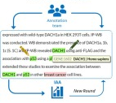



Annotation Workflow
Post-Processing
Teamtat
Machine Learning

Slide 3



RedCap Workflow
API System
Extract Data
Format Data
Build Report
Teamtat

Slide 4
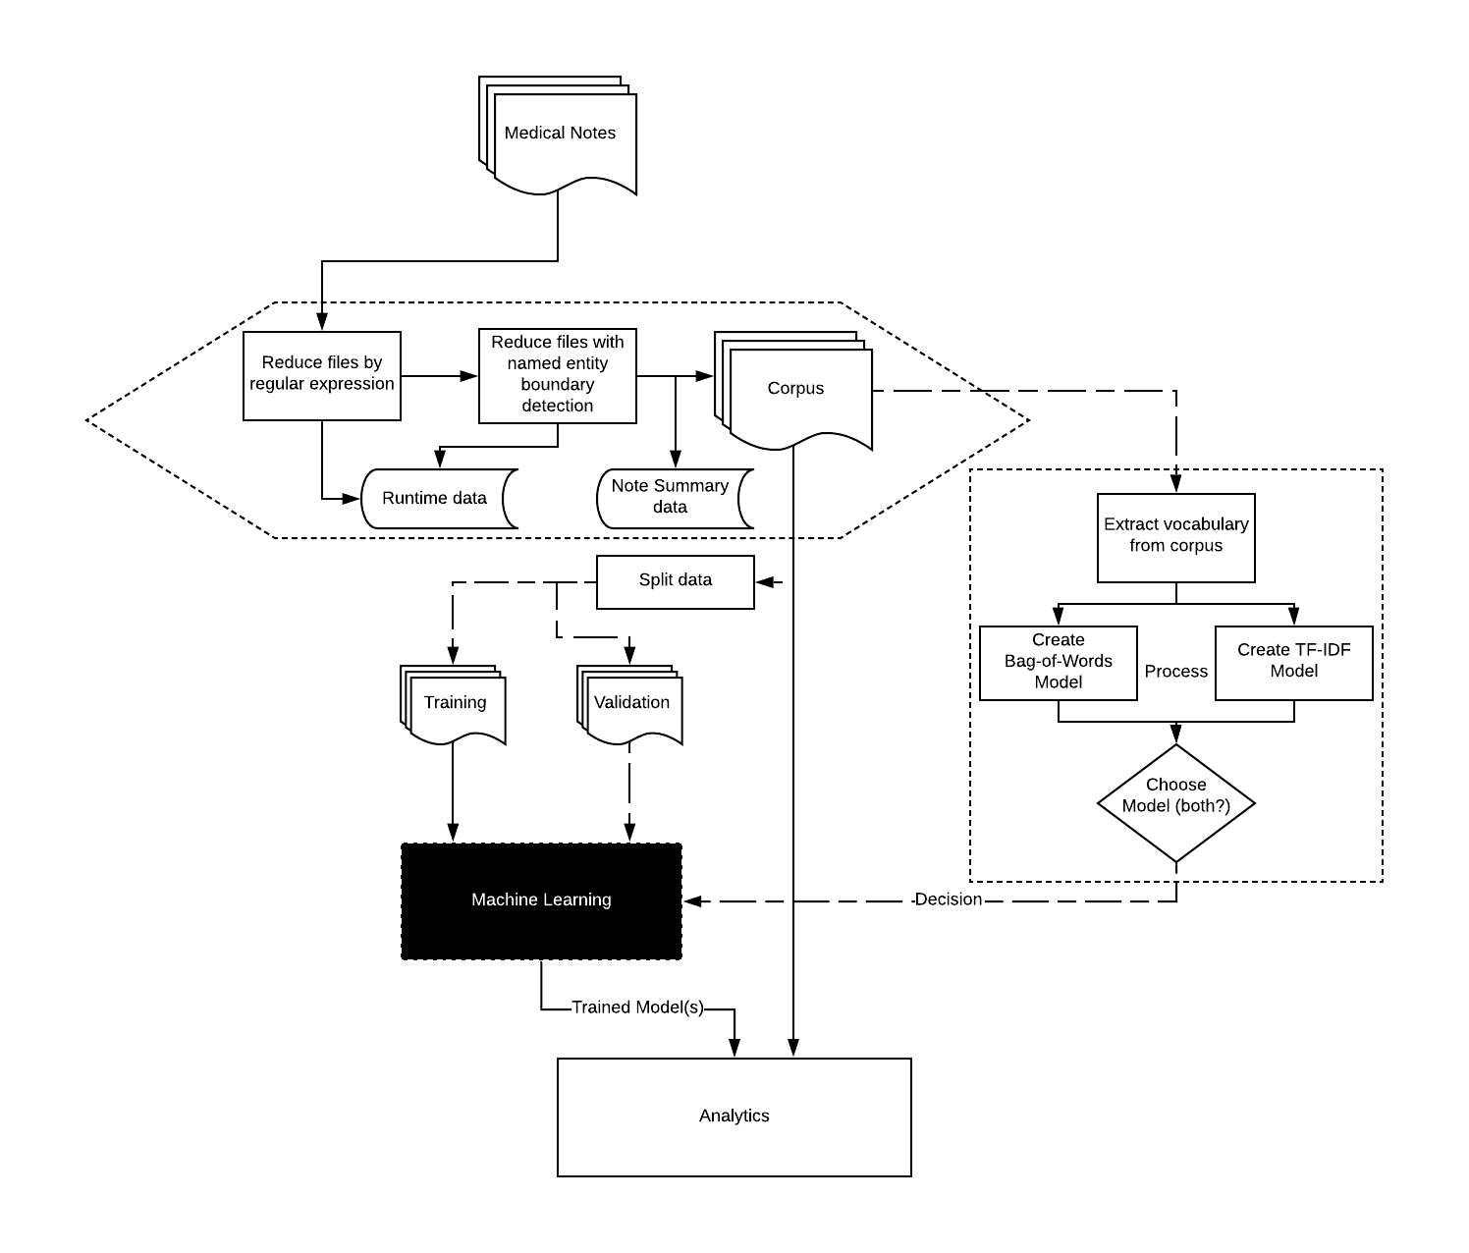
Workflow Overview

Slide 5
Project Objective
Leverage mom-baby linked EHR and biomedical informatics to estimate geospatial patterns in breastfeeding and characterize the SDoH that impact breastfeeding outcomes in vulnerable and hard-to-reach populations.
Specific Aim 1: Design and evaluate a natural language processing tool that will extract structured breastfeeding outcomes from mom-baby linked electronic health records.
Specific Aim 2: Determine geographic variation in breastfeeding outcomes using maternal residential location and mom-baby linked electronic health records.

Slide 6
Project Goals
Create structured computable breastfeeding outcomes using EHR.
Demonstrate feasibility of using mom-baby linked EHR to characterize longitudinal breastfeeding outcomes.
Identify geospatial clustering of breastfeeding disparities.
Organize community stakeholder group related to breastfeeding.
Make informatics tools will be publicly available in accordance with the CTSI data sharing policies.
Integrate underlying data, code, and publications with relevant UF Precision Health tools.
Submit a state-wide breastfeeding grant that leverages OneFlorida data.

Slide 7
Mom-Baby EHR Data Collection, 2011-2017
Delivery
Prenatal Wellness (Maternal) | Delivery (Maternal/Infant) | Postnatal Wellness (Infant)
Height/weight Medications Vaccines | Demographics Height/weight Medications Vaccines | Height/weight Medications Vaccines ICD9/10

Slide 8
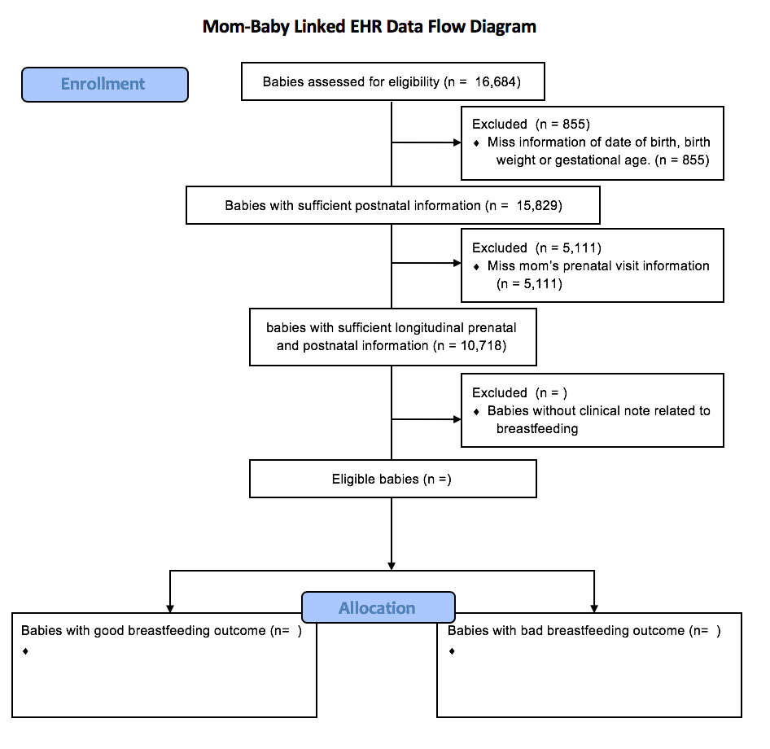
Results
Information from run
Boxplot
This box plot will represent the values on slide 2
Line Graph
y-axis is frequency (generic integer values)
x-axis is the reduction steps (start, step1, step2)
One line to represent the file count
A second line to represent the number of unique patients
consort diagram
fill out on confluence and put here

Slide 9
Milestones
IRB Approval
Data Extraction (16K infants):
2011-April 2017
Zipcode at delivery
Notes at delivery (600K+)
Data Storage:
UFRC for clinical notes
Redcap for mom-baby link EHR
Publication(s):
Pediatric antibiotic episodes are not associated with mode of delivery (n=4,024, p=0.08) in UFHealth EHR. Lemas et al. 2020. 15(3):e0229861
Students:
BMI Masters student working on NLP classifier.
BMI PhD students that can help with data management/analysis.
Grad students from other labs.

Slide 10
Project Timeline
Task | Date of Completion
IRB-Approval | 11/03/2016
IDR Data Extraction | 09/2020
Specific Aim 1: Natural Language Processing (NLP) | 12/2020
Specific Aim 1: NLP Manuscript Submission | 02/2021
Specific Aim 2: Social Determinants of Health (SDoH) | 04/2021
Specific Aim 2: SDoH Manuscript Submission | 07/2021
NIH R21 1st Submission | 05/2021
NIH R01 1st Submission | 09/2021

Slide 11
Next Steps
Monthly Meeting with subsequent workgroups, as needed.
Adding all team members to IRB in June.
Magda will be in touch.
Updating IRB with new data collection Summer 2020
linked EHR 2011-2020
Clinical notes at all visits
ICD9/10 codes
Other data
Start Analysis Fall 2020
Stakeholder group meeting August 2020-
breastfeeding month
Need to develop contact list

Slide 12
Comments and questions?
Thanks for being part of the team!

