Slide 1
Slide Deck Objective
This slide deck is used for creating workflows that are embedded in r-markdown files.

Slide 2
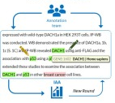



Annotation Workflow
Post-Processing
Teamtat
Machine Learning

Slide 3



Get_RedCapData Workflow
API System
Extract Data
Format Data
Build Report
Teamtat

Slide 4
BEACH Analysis Workflow
Get
Format
build

Slide 5
BEACH Analysis Workflow: get()
Reports
Report Name
Report ID
NOTE: Make sure all variables of interest are included in the report.

Slide 6
BEACH Analysis Workflow: format()
Raw Data:
Contains ALL variables
Variables are not formatted or analysis ready.
Analysis Ready Datasets

Slide 7
BEACH Analysis Workflow: build()
Fancy report
Not Fancy report

Slide 8
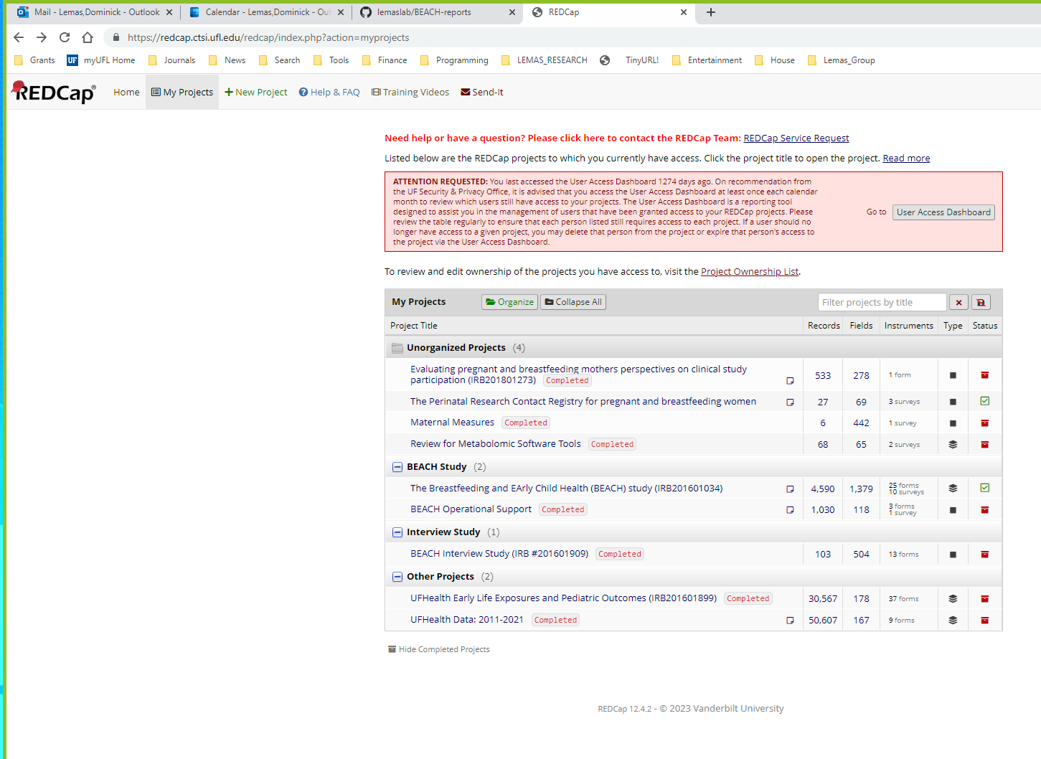
Select:
BEACH Study

Slide 9
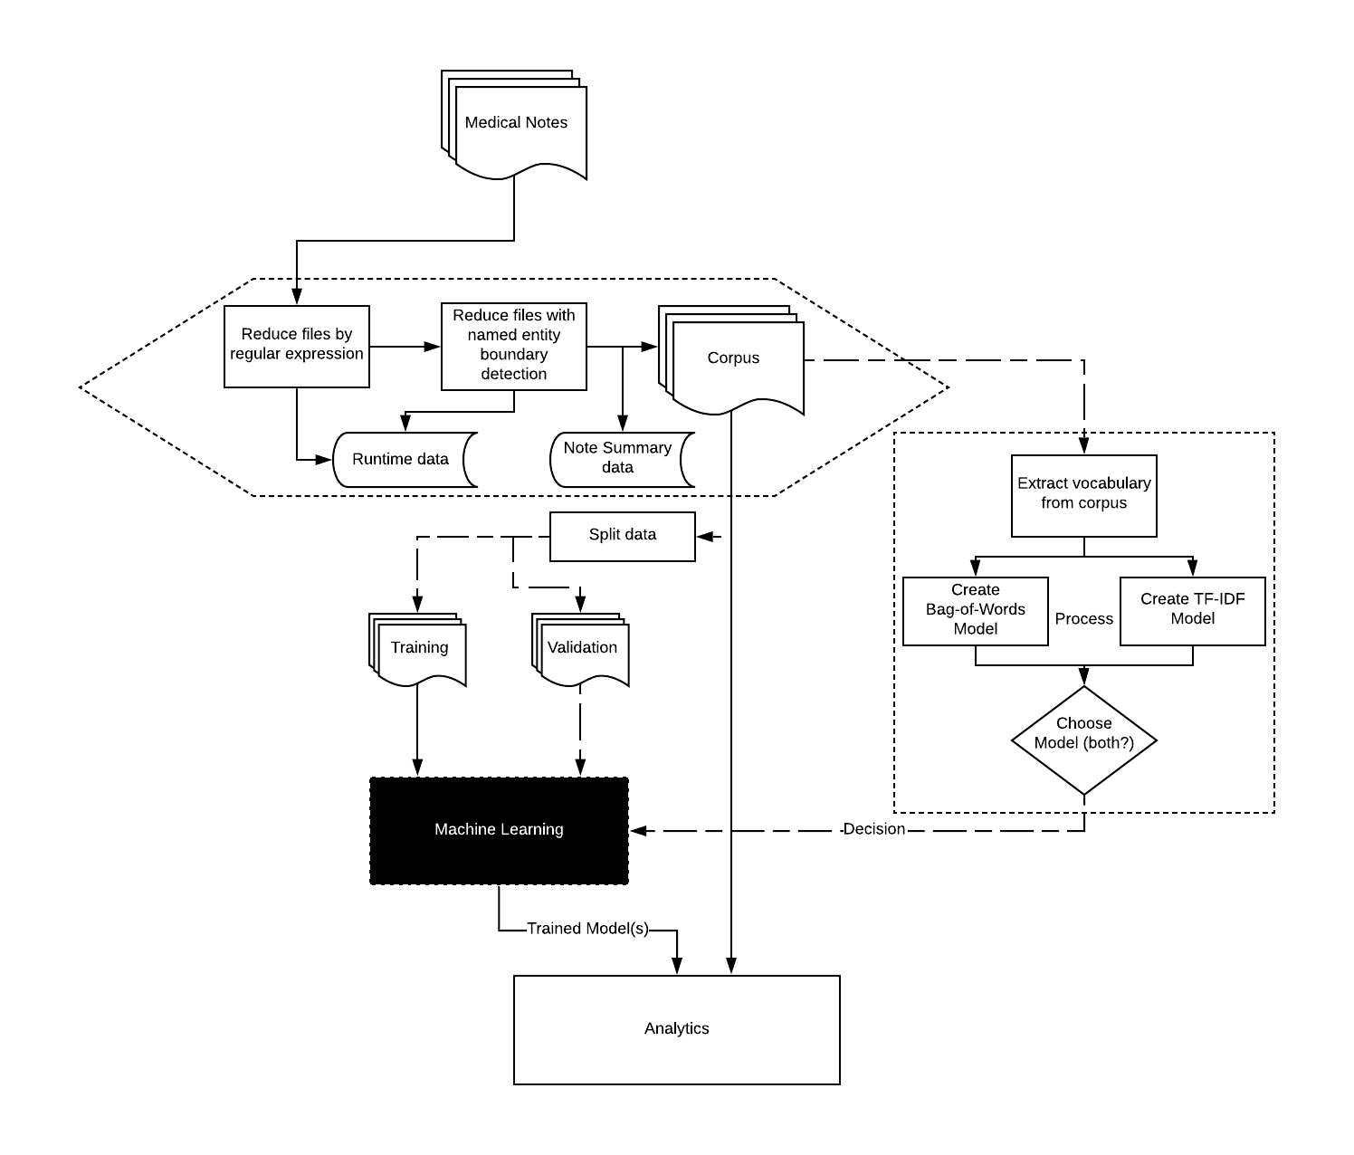
Workflow Overview

Slide 10
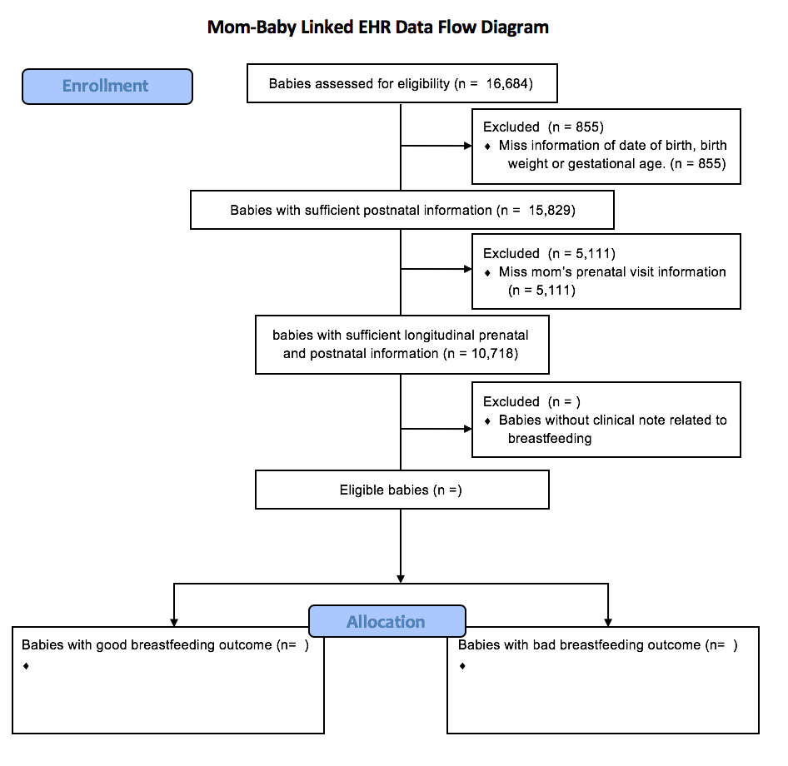
Results

