Slide 1
Slide Deck Objective
This slide deck is used for creating workflows that are embedded in r-markdown files.

Slide 2
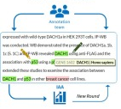
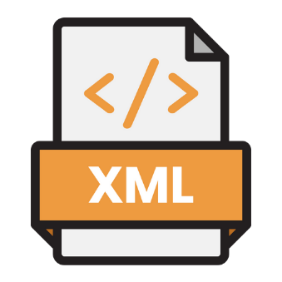


Annotation Workflow
Post-Processing
Teamtat
Machine Learning

Slide 3



Get_RedCapData Workflow
API System
Extract Data
Format Data
Build Report
Teamtat

Slide 4
Format_RedCapData Workflow

Slide 5
report Workflow

Slide 6
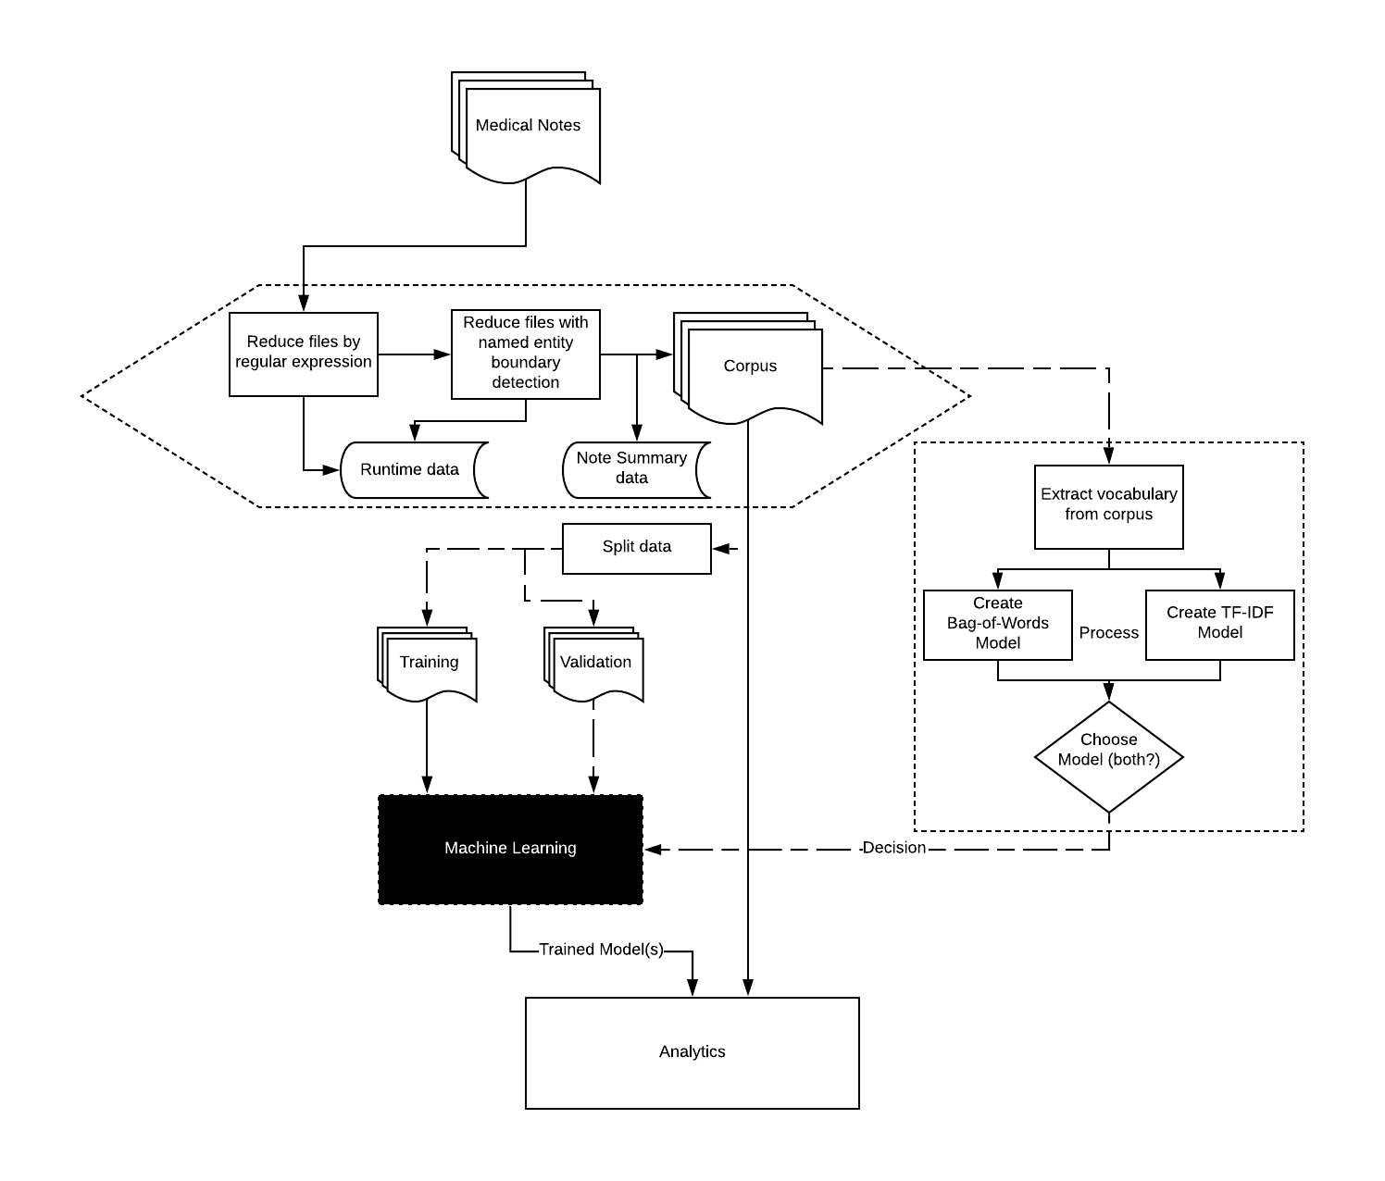
Workflow Overview

Slide 7
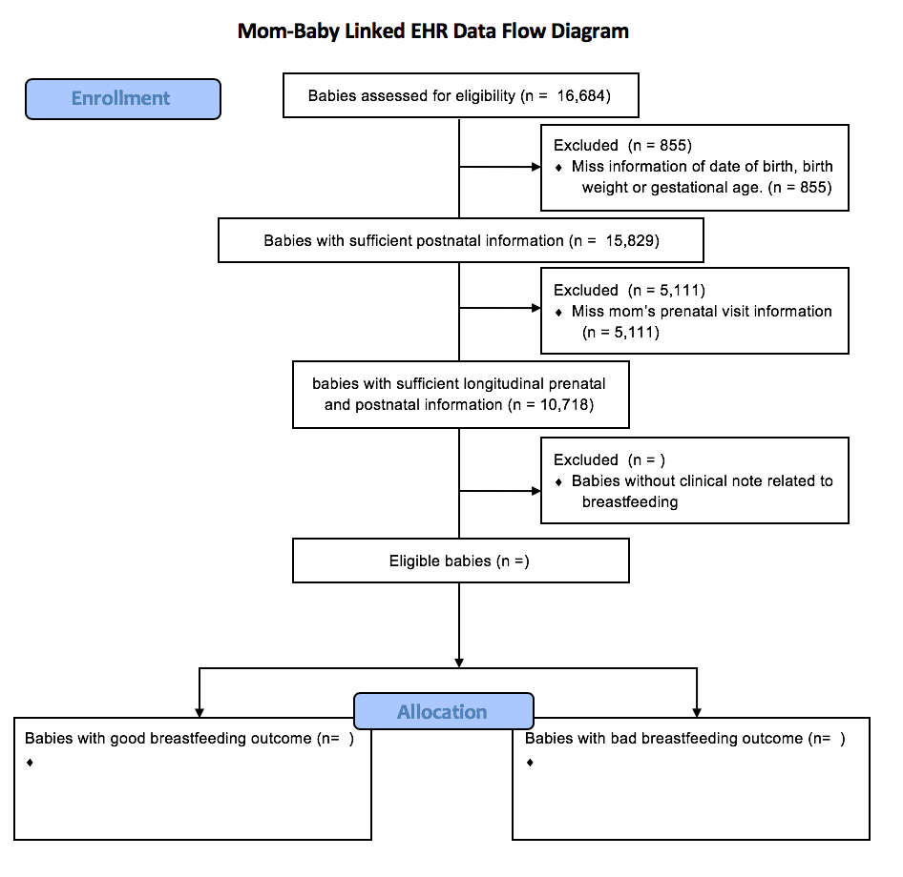
Results

