Slide 1
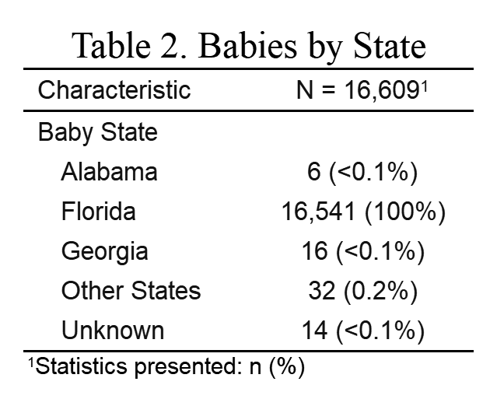
Mom-Baby EHR Data, 2011-2017
Prenatal Wellness (Maternal) | Delivery (Maternal/Infant) | Postnatal Wellness (Infant)
Height/weight Medications Vaccines | Demographics Height/weight Medications Vaccines Clinical Notes Zip codes | Height/weight Medications Vaccines ICD9/10
Table 1. State Residence
Eligible Cohort- regularly visit UFHealth
Delivered at Shands
>1 prenatal visit
>1 postnatal visit

Slide 2
UF Health Mom-Baby EHR: Data Dictionary (09/2021, version 1.0)
PRENATAL
DELIVERY
POSTNATAL
WELLNESS (initial)*
-ID
-DATE
-HEIGHT
-WEIGHT
-SYSTOLIC BP*
-DYSOSTOLIC BP*
-CLINIC*
-ENCOUNTER
-PREPREG BMI*
-GEST-AGE*
WELLNESS (routine)
-ID
-DATE
-HEIGHT
-WEIGHT
-SYSTOLIC BP*
-DYSOSTOLIC BP*
-CLINIC*
-ENCOUNTER
-BMI*
-GEST-AGE*
MATERNAL DEMO
-ID
-RACE
-ETHNICITY
-AGE
-GENDER
-ZIP5
-ZIP9
-CONSENT2SHARE*
LINK
-ID (MOM)
-ID (BABY)
PEDIATRIC DEMO
-ID
-RACE
-ETHNICITY
-DOB
-GENDER
-ZIP5
-ZIP9
-CONSENT2SHARE
WELLNESS (baby)
-ID
-DATE
-HEIGHT
-WEIGHT
-HEAD CIRCUMFERENCE
-SYSTOLIC BP*
-DYSOSTOLIC BP*
-CLINIC*
-ENCOUNTER
WELLNESS (mom)
-ID
-DATE
-HEIGHT
-WEIGHT
-HEAD CIRCUMFERENCE
-SYSTOLIC BP*
-DYSOSTOLIC BP*
-CLINIC*
-ENCOUNTER
DELIVERY
-ID
-BIRTH_WEIGHT
-MODE OF DELIVERY
-ADMIT DATE
-GESTATIONAL AGE
-NICU LENGTH OF STAY
-INSURANCE
-HEIGHT
-HEAD CIRCUMFERENCE
CLINICAL NOTES
-ID
-DATE
-NOTE
-SOURCE
CODES*
-ID
-DATE
-MEASURE
-SOURCE
-CLINIC*
-ENCOUNTER
LABS*
-ID
-DATE
-MEASURE
-SOURCE
-CLINIC*
-ENCOUNTER
CODES*
-ID
-DATE
-MEASURE
-SOURCE
-CLINIC*
-ENCOUNTER
CLINICAL NOTES
-ID
-DATE
-NOTE
-SOURCE
LABS*
-ID
-DATE
-MEASURE
-SOURCE
-CLINIC*
-ENCOUNTER
ABX-MEDICATION-OP
-ID
-DATE ORDER
-NDC*
-DESCRIPTION
-GENERIC NAME
-THERAPY CLASS
-PHARMACY CLASS
-PHARMACY SUBCLASS
ABX-MEDICATION-OP
-ID
-DATE ORDER
-NDC*
-DESCRIPTION
-GENERIC NAME
-THERAPY CLASS
-PHARMACY CLASS
-PHARMACY SUBCLASS
MEDICATION-OP
-ID
-DATE TAKEN
-NDC*
-MAR ACTION
-DESCRIPTION
-GENERIC NAME
-THERAPY CLASS
-PHARMACY CLASS
-PHARMACY SUBCLASS
MEDICATION-OP
-ID
-DATE TAKEN
-NDC*
-MAR ACTION
-DESCRIPTION
-GENERIC NAME
-THERAPY CLASS
-PHARMACY CLASS
-PHARMACY SUBCLASS
MEDICATION-IP
-ID
-DATE TAKEN
-NDC*
-MAR ACTION
-DESCRIPTION
-GENERIC NAME
-THERAPY CLASS
-PHARMACY CLASS
-PHARMACY SUBCLASS
ABX-MEDICATION-IP
-ID
-DATE TAKEN
-NDC*
-MAR ACTION
-DESCRIPTION
-GENERIC NAME
-THERAPY CLASS
-PHARMACY CLASS
-PHARMACY SUBCLASS
Medications
Labs
ICD9/10 Codes
Wellness Visit
Clinical Notes
Perinatal
Demographics
Mom-Baby Link

Slide 3
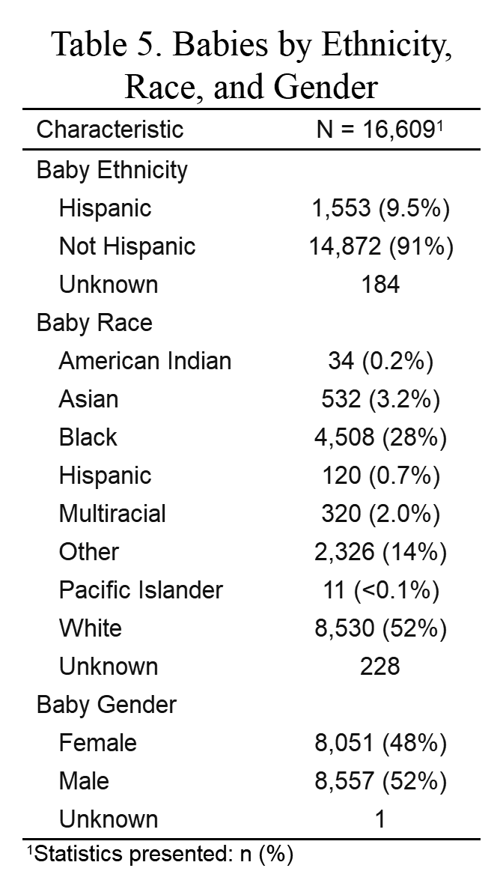
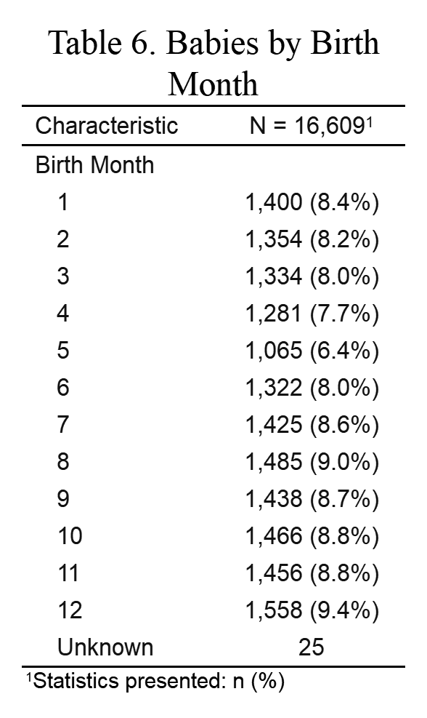
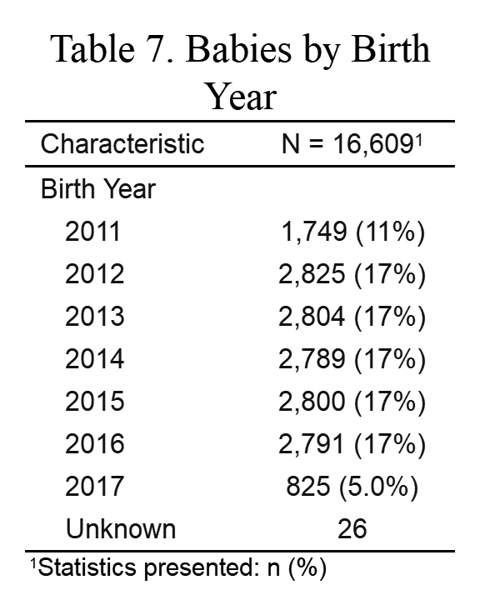
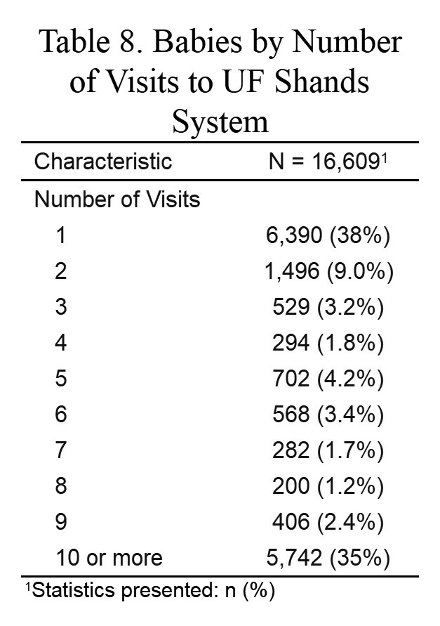
AIMS
Demographics of Full Cohort, 2011-2017
Table 2. Infant Demographics
Table 3. Deliveries by Month
Table 4. Deliveries by Year
Table 5. Postnatal Visits for Infants Delivered at UFHealth
Infant race/ethnicity reflects Alachua County demographics.
UF Health Shands delivers ~2,800 infants annually.
~40% of deliveries have at least 1 postnatal wellness visit.

Slide 4
Overview of data set
Prenatal
Delivery
Postnatal
Vitals
Inpatient
Laboratory
Medications
Free Text
ICD9/10
Inpatient
Outpatient
Emergency
Demographics
Zip Code
Vitals
Inpatient
Laboratory
Medications
Free Text
Vitals
Inpatient
Laboratory
Medications
Free Text
ICD9/10
Inpatient
Outpatient
Emergency

Slide 5
Workflow and Projects
Analysis Cohort (x=?)
Delivery data
Birth weight
Demographic
Ect
Prenatal data
>1 visit
Postnatal data
> visit
All Data (16K)
Prenatal
Delivery
Postnatal
Data Inventory
Raw data compared to redcap data. Needs to be a separate repo and project with milestones in github.
Basic Analysis
What are overall trends in data? Seasonality of deliveries?
NLP and Clinical Notes
This project is looking at breastfeeding outcomes at delivery. Needs repro, projects, milestones.
Medications and Geography
This project is looking at variation in maternal medications according to zipcode. Project needs repo, milestones.

Slide 6
Data Inventory
Need to create code to compare raw and redcap data. Need to identify missing, counts, as well as areas that need to be fixed (i.e. things don’t match).
I have created 3 tables that will help to summarize. This is only a starting place. These tables need to be generated in markdown and transferred to powerpoint.

Slide 7
Data Inventory: Prenatal
Domain | Example | Counts of people with 1+ measure | Missing
Demographics | Age Sex Race/ethnicity
Vital Signs | Blood pressure Height/wt BMI
Outpatient encounters ICD9/10 codes | asthma: Obesity
Inpatient Encounter ICD9/10 codes | ICD9/10 codes
Medication | IP Antibiotics (date, type, med therapy class, Rxnrom code) OP antibiotics (date, type, med therapy class, Rxnrom code)
Problem List | ICD9/10: depression, CVD, cancer
Free Text | Clinical Notes

Slide 8
Data Inventory: Delivery
Domain | Example | Counts of people with 1+ measure | Missing
Maternal Demographics | Age Sex Race/ethnicity
Infant Demographics | Pediatric Gestational Age Sex Race/Ethnicity
Maternal Vital Signs | Blood pressure Height (in) & height (cm) Weight (kgs) & weight (lbs) BMI
Infant Vital Signs | Birth Weight (g)
Outpatient encounters ICD9/10 codes | asthma: Obesity
Inpatient Encounter ICD9/10 codes | ICD9/10 codes
Medication | IP Antibiotics (date, type, med therapy class, Rxnrom code) OP Antibiotics (date, type, med therapy class, Rxnrom code)
Problem List | ICD9/10: depression, CVD, cancer
Delivery Details | Pediatric Delivery Type Admit Date

Slide 9
Data Inventory: Postnatal
Domain | Example | Counts of people with 1+ measure | Missing
Demographics | Age Sex Race/ethnicity
Maternal Vital Signs | Blood pressure Height/wt
Infant Vital Signs | First head circumference First height Wellness Visit (Date), Height, Weight, head circumference
Outpatient encounters ICD9/10 codes | asthma Obesity Ear Infection Eczema Food allergy Hemangonia Nevus Sebor Toxicum Vaccines
Inpatient Encounter ICD9/10 codes | ICD9/10 codes
Infant Medication | IP antibiotics (date, type, med therapy class, Rxnrom code) OP antibiotics (date, type, med therapy class, Rxnrom code)
Maternal Medication | IP antibiotics P antibiotics
Problem List | ICD9/10: depression, CVD, cancer
Free Text | Clinical Notes

Slide 10
Analysis Cohort
NLP project.
outline figure to help navigate process of moving forward.
Run code on super computer using sbatch
Report preliminary results
Maternal medications
Create table with counts according to zipcode
Plot counts as maps to see variation (Alachua county).
https://www.r-bloggers.com/drawing-beautiful-maps-programmatically-with-r-sf-and-ggplot2-part-2-layers/
Zip code | Mom with at least 1+ medication (any) | Mom with at least 1+ antibiotic (any) | Mom with at least 1+ opioid (any)

