Slide 1

OneFlorida Recruitment Study: Data Cleaning
Hailey Ballard
December 1st, 2020

Slide 2






The Necessity for Clean Data

Slide 3
OneFlorida Recruitment Study
Evaluating pregnant and breastfeeding mothers’ perspectives on clinical study participation (IRB # 201801273)
Received surveys from over 400 pregnant and breastfeeding women throughout Florida
Collected:
Demographics
Location (latitude/longitude)
Opinions on clinical research participation (past and present)
Attitudes towards COVID-19 and pregnancy and clinical research

Slide 4




Workflow using Rstudio & Github
Generate Table 01
Import Data
Clean Data
Generate Table 02
Generate Table 03

Slide 5
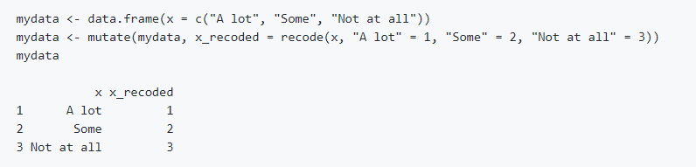
Types of Variables
Four types of variables:
Numeric variables (weight, height)
Categorical variables (relationship status, type of insurance)
Recoded and shortened
MRCV variables (maternal race, study time preferences)
Separated and counted
Likert variables (Strongly agree, agree, neutral, disagree, strongly disagree)
Ordered and assigned numerical variables

Slide 6
Multiple Response Categorical Variables (MRCVs)
Questions were participants could select more than one answer
“Which of the following applies to you? (Check all that apply)”
When imported into R Studio, responses with multiple answers selected were not counted individually
So, there must be a way to extract all the MRCV responses:
Separate each answer choice out
Re-group each answer choice & keep assigned to participants
Put back into main data set analysis

Slide 7
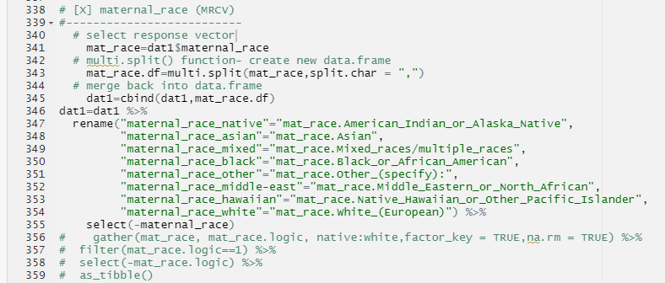
Example: Maternal Race
Select
Select the response variable
Create
Create a new dataframe and split each response on the comma “,” to separate each response
Merge back
Merge back into dataframe
Rename
Select out
Select out the original maternal_race variable
Rename each variable option and shorten

Slide 8
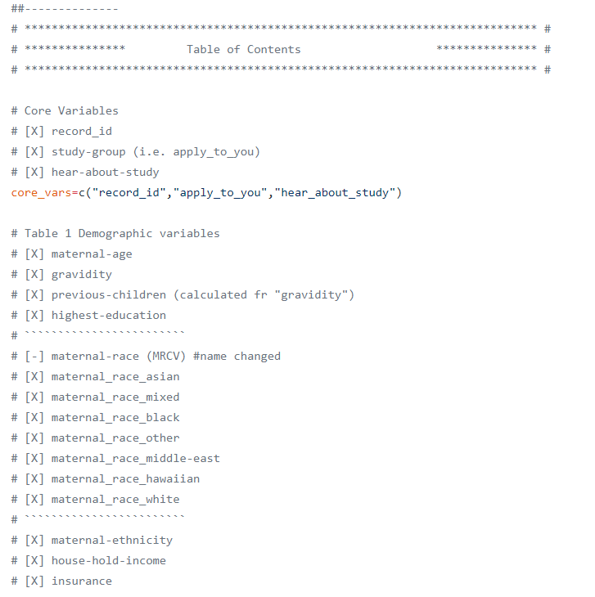
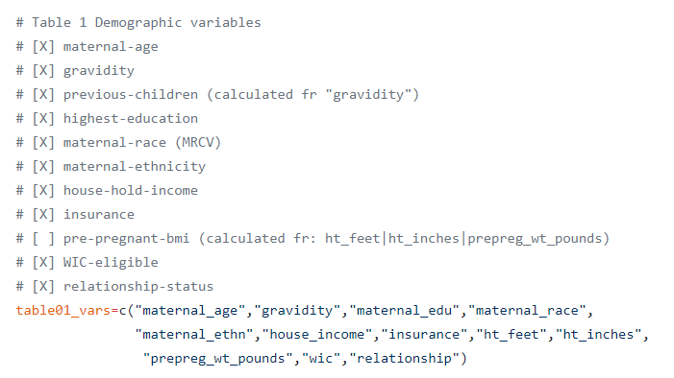
Organization of Variables

Slide 9
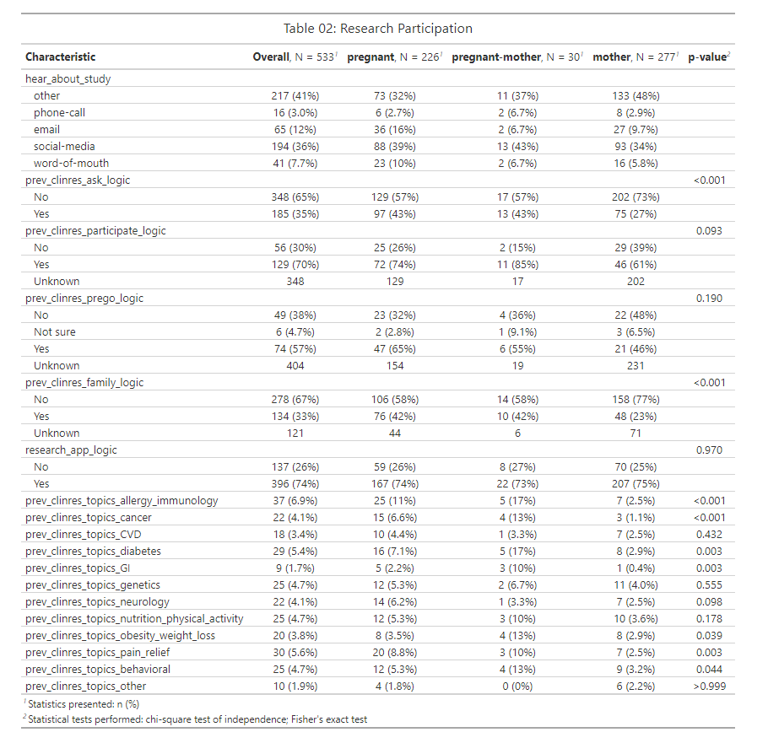
Table 02 File: Producing the Table
Categorical Variables
MRCV Variables

Slide 10


Acknowledgements
Dominick J. Lemas, PhD
Callie F. Reeder, MD
Ke Xu,
Xinsong Du,
Nisha Y. Chachad,
Sabrina A. Shams,
Thu Kim
Luran Manfio,
Yasmine S. Gillespie,
Lemas Lab

