Slide 1
Slurm Workload Manager
Emmanuel ELias

Slide 2


About Me
Hi, I’m Emmanuel Elias
Graduated from Terra in 2020
Second year Electrical Engineering major
Born and raised in Miami, Fl
Moved to Gainesville in early 2021

Slide 3
Outline
Slurm Overview
How it works and why it’s beneficial
Resource Allocation
Bash commands to set computing power
Quality of Service Limits
Computing power limits
Code Example

Slide 4
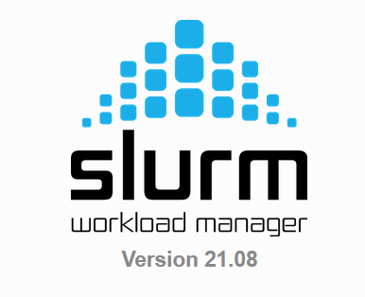
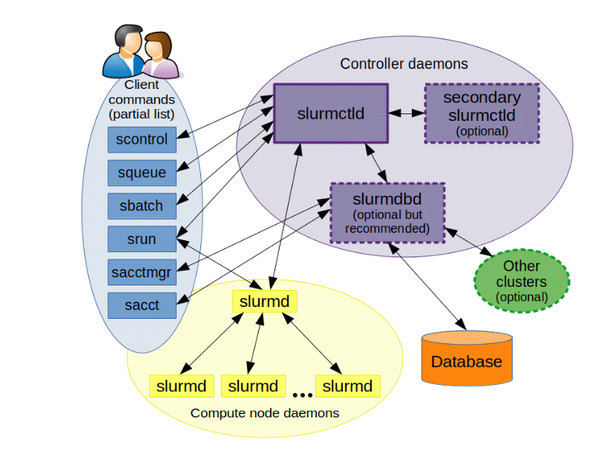
Slurm Overview
Slurm is an open sourced, cluster management and job scheduling system
Users can allocate access to resources for a set duration
Provides a framework for starting, executing, and monitoring work
Manages a queue of pending work

Slide 5
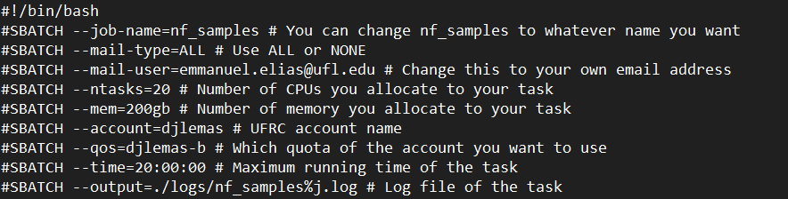
Resource Allocation
Slurm can be used to manage memory and CPUs used for jobs
--ntasks sets # of CPUS
--mem sets # of memory

Slide 6
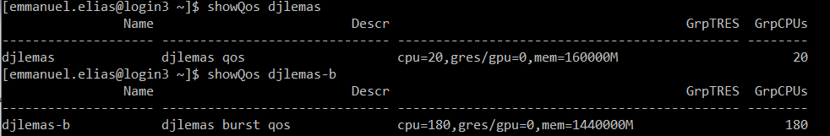
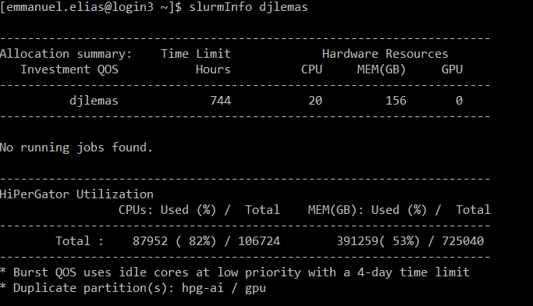
QOS Limits
Quality of service – amount of computing power we are allocated
2 types, normal and burst
When using sbatch, jobs will only be executed when there’s enough free resources

Slide 7
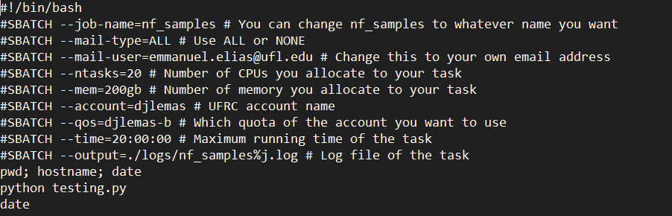
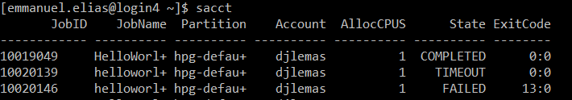
Running Code
Bash script with allocating resources and code that needs to be executed
Submit job with sbatch
Check job status with sacct

