Slide 1

Support vector machines (SVM)
Hailey Ballard
22Sep2020

Slide 2
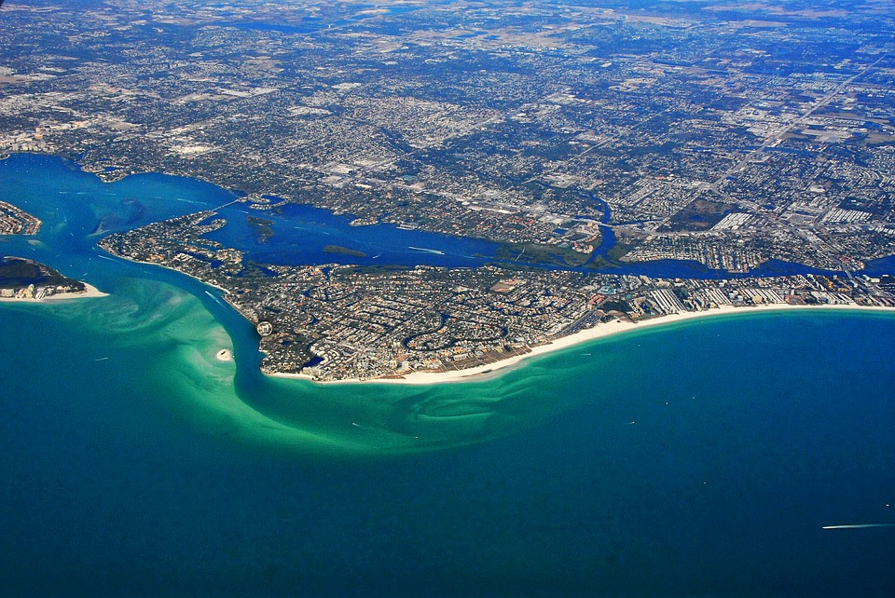
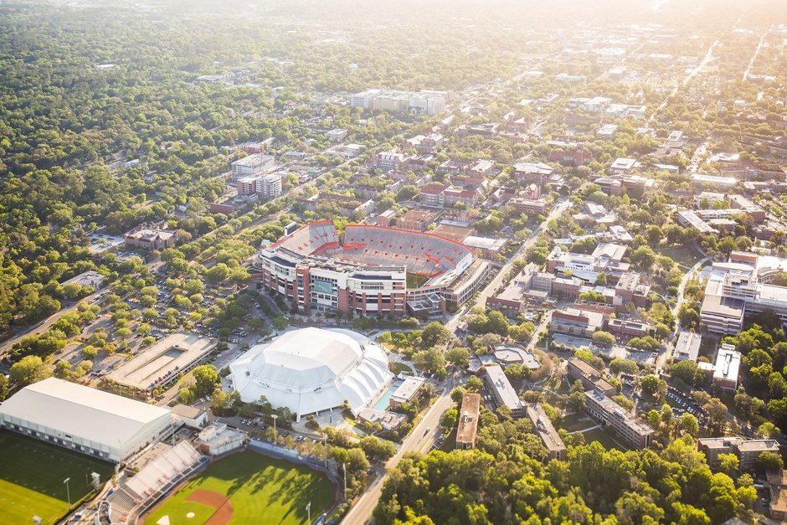



About me

Slide 3
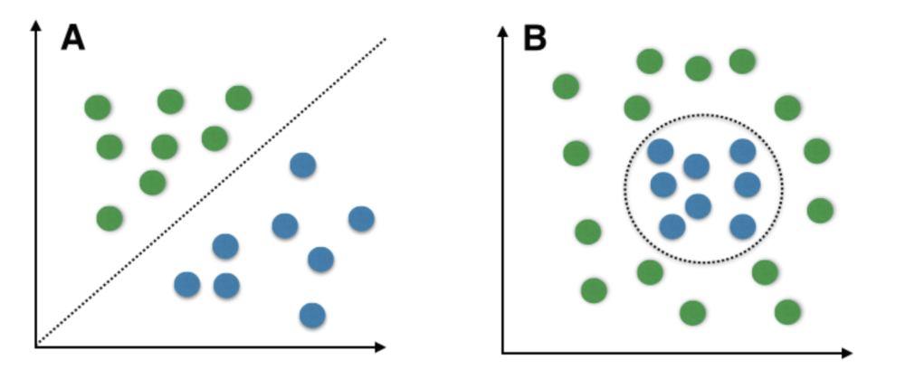
Support Vector Machines (SVMs)
Used in Machine Learning to analyze and classify data
Each data point in a dataset is plotted in N-D space
N is the number of features/attributes
Separate data based on binary attribute
Linear SVM
Non-Linear SVM

Slide 4

Linear SVMs and RUMP
Use of SVM in RUMP Data is to separate and classify peak height values based on the corresponding label:
NOC vs N
Because N = 2 attributes, a linear SVM was used
Resulting Image would be the top ten most and least contributing peak height values

Slide 5
Creating the SVM
Import data from RUMP and separate into peak height values into NOC and N categories (convert to arrays)
Average all NOC and N peak height values for each of the 815 metabolites
Combined NOC and N averages into array (X value)
Y value was binary, with 1 = NOC and 0 = Not NOC
Generate Feature Names from row m/z and row retention time
Used Linear SVM and fit to X and Y values
Generated Feature Selection Graph

Slide 6
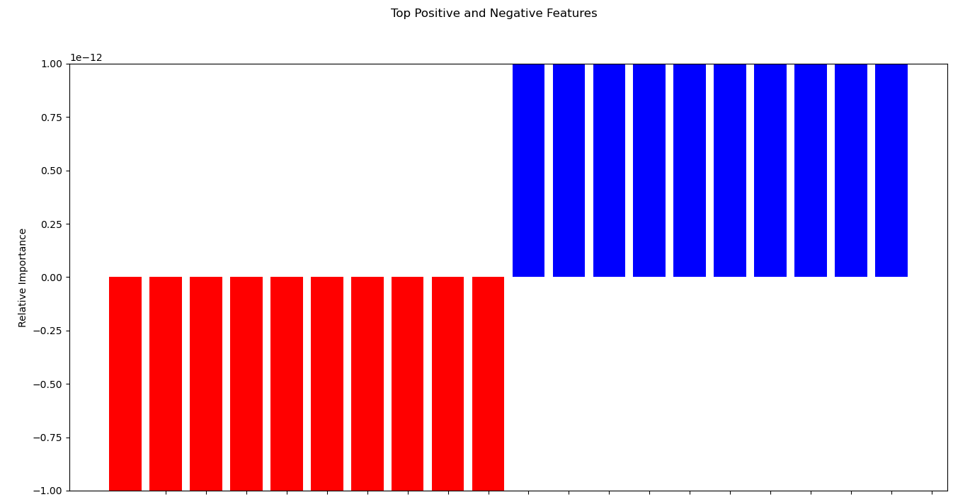
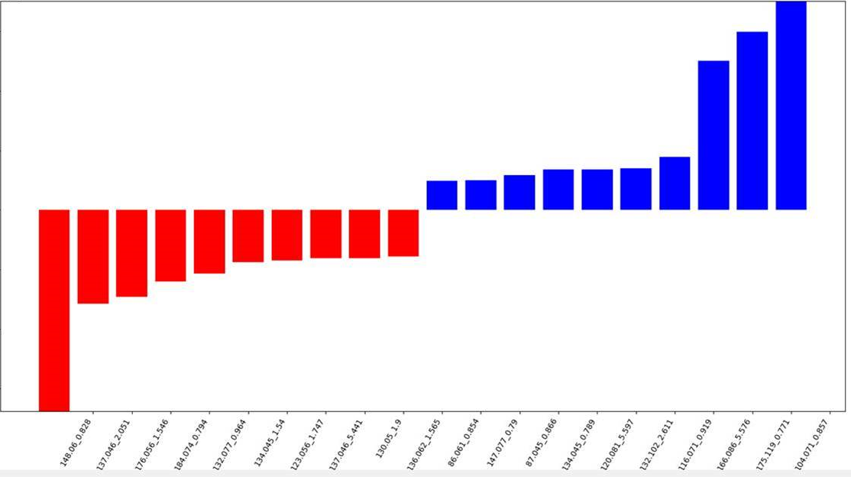
End-result

