Slide 1
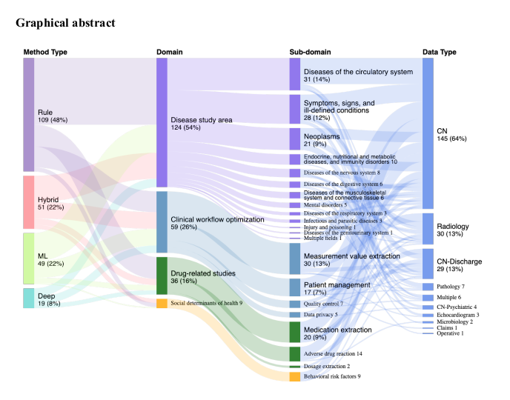
Infant Feeding Class
Breast
Bottle/
Formula
Mixed
NA
https://www.sciencedirect.com/science/article/abs/pii/S1532046420301544

