Slide 1

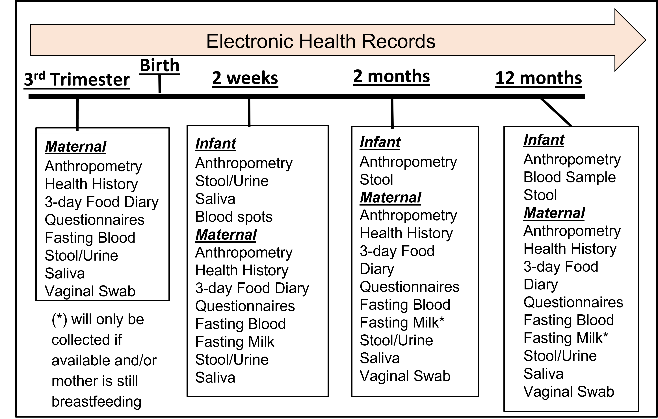
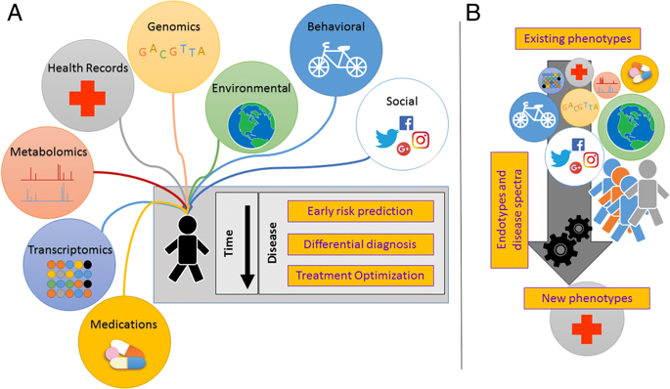


The Breastfeeding and EArly Child Health Study
Health Outcomes &
Biomedical Informatics
Dominick Lemas, PhD, Lauren Wright, Magda Francois, Lynn Chen, Austen Hentschel, Huan Chen, PhD, Elizabeth Flood-Grady, PhD, Josef Neu, MD, Elizabeth Shenkman, PhD, Janice Krieger, PhD
College of Medicine
Introduction
Results
Conclusion
Breastfeeding is associated with positive health outcomes in mom and baby.
Recent data suggests the health benefits of breastfeeding may, in part, mediated through interactions with the mother-infant microbiome.
Despite these observations, effective recruitment and retention of pregnant and breastfeeding mothers in longitudinal clinical research trails remains a significant challenge.
Objective
The primary objective of this project is to characterize maternal perspectives on longitudinal clinical microbiome research studies.
Methods
Recruitment: Recruitment included fliers posted at UFHealth and social media ads run through CTSI Recruitment Services.
Data Collection: Participants self administered biological sample kit (stool, urine, saliva, swabs) and questionnaires related to mom-baby health.
Interview: Participants also completed a 1-hour in-depth semi-structured interview focused on understanding, attitudes and motivations related to research participation.
Acknowledgements
We are grateful to our funding source, NIDDK (K01DK115632), University Scholars Program, the CTSI STEM Translational Communication Center and our amazing participants.

