Slide 1

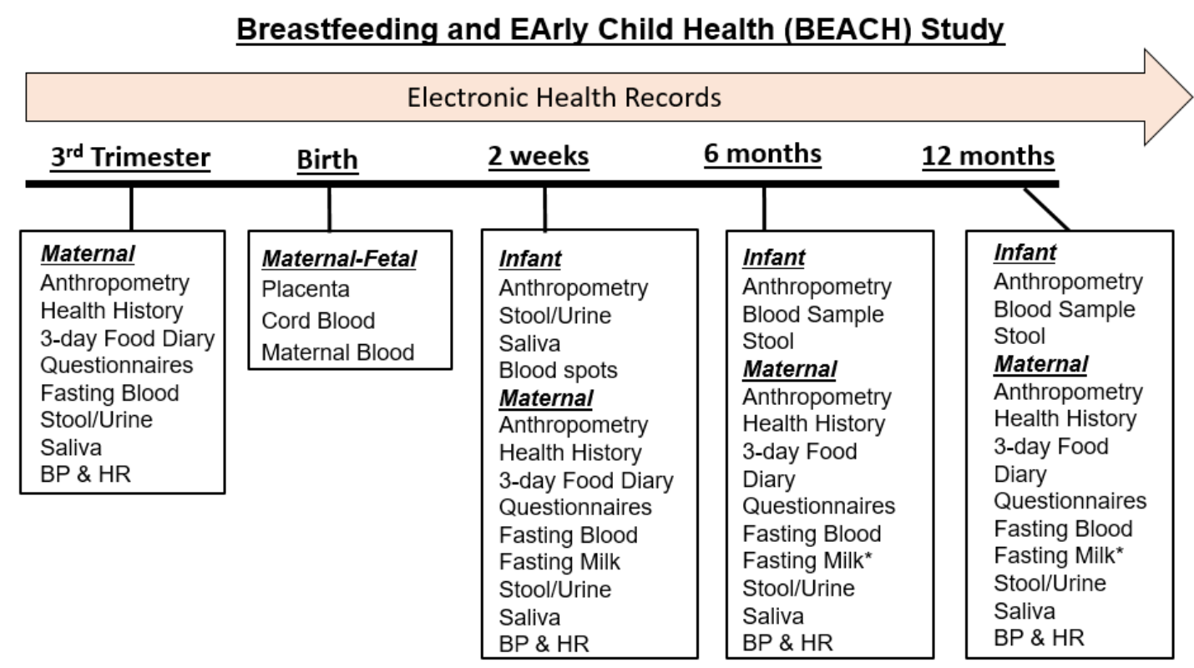
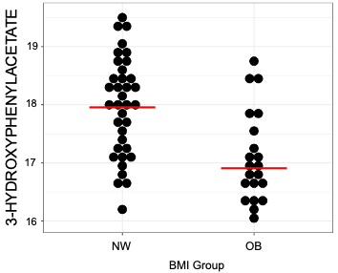
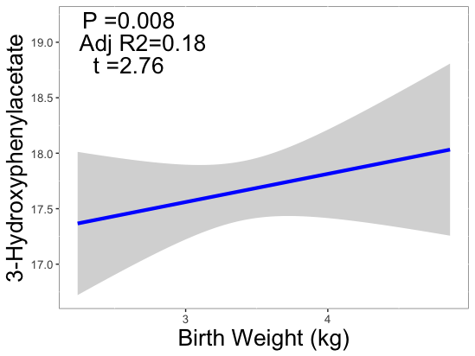
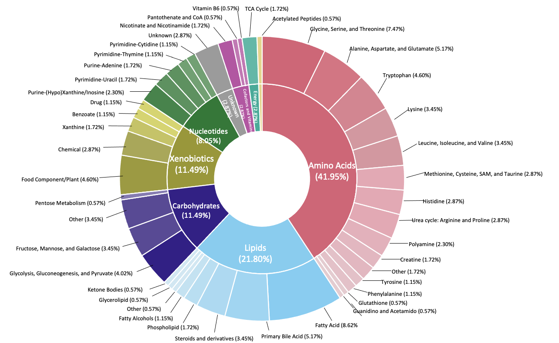
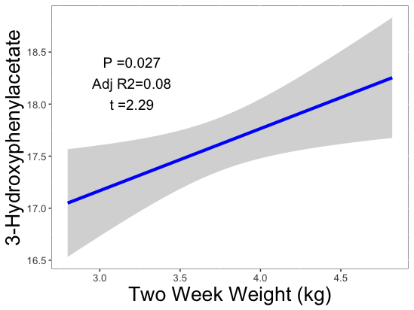

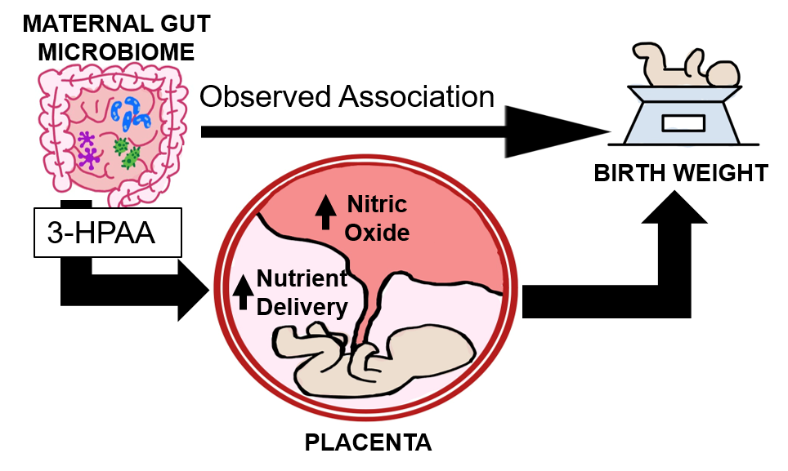



Impact of the 3rd Trimester Untargeted Plasma Metabolome on Infant Growth During the First Year of Life
DJ Lemas, A Dobrowolski, C Pugol, M Francois, M Himadi, A Louis-Jacques, TJ Garrett, LA Thompson, MS Loop, H Jones
Obesity during pregnancy is associated with birth complications, including delivering a large-for-gestational-age (LGA) newborn.
Although the positive association of maternal pre-gestational BMI (pgBMI) with birthweight and infant growth is well known, the underlying mechanisms are not completely understood.
Table 1: Clinical Characteristics of BEACH cohort
Characteristic | NW | OW/Ob | p-value
n | 46 | 37
BMI | 22 | 33 | <0.001
Gestational Age (weeks) | 38.7 | 39.3 | 0.024
Maternal Age (years) | 32.0 | 30.1 | 0.12
Breast-feeding Months | 10.6 | 9.7 | 0.11
Infant Birth Weight (kg) | 3.3 | 3.6 | 0.027*
Background
Objective
1. Examine the associations between pgBMI and plasma metabolites during 3rd trimester.
2. Identify plasma metabolites associated with birthweight and infant weight during the first year of life in a cohort of breastfed infants.
Figure 1: Overview of the Breastfeeding and Early Child Health (BEACH) Study.
A)
Methods
Experimental Design (n=83 dyads)
-NW (n=46), ppBMI <25.0 kg/m2
-OW/Ob (n=37) ppBMI >25.0 kg/m2
-3rd Trimester plasma samples
-Birth weight at delivery
Analytical Procedures
-Plasma untargeted metabolites using High Resolution Mass Spectrometry (HRMS)
Statistical Analysis
R-statistical programming language
T- test for between groups comparisons.
Linear regression models were used to test associations of birth weight with metabolite intensity
Figure 3: Maternal obesity is associated with lower levels of 3-HPAA (p<0.01).
B)
Figure 4: 3-HPAA is positively associated with infant growth at delivery (A) and two-week (B).
Figure 2: Donut plot with chemical taxonomy of the maternal plasma samples at 3rd trimester. Blue star indicates obesity is associated with changes in tryptophan metabolism, 3-hydroxyphenylacetate (3-HPAA).
The project was supported by NIDDK (K01DK115632), NCATS under University of Florida Clinical and Translational Science Awards UL1 TR000064 and UL1TR001427.
Figure 5. Hypothesized mechanism of action. 3-HPAA impacts infant growth through interactions with placenta.

