Slide 1




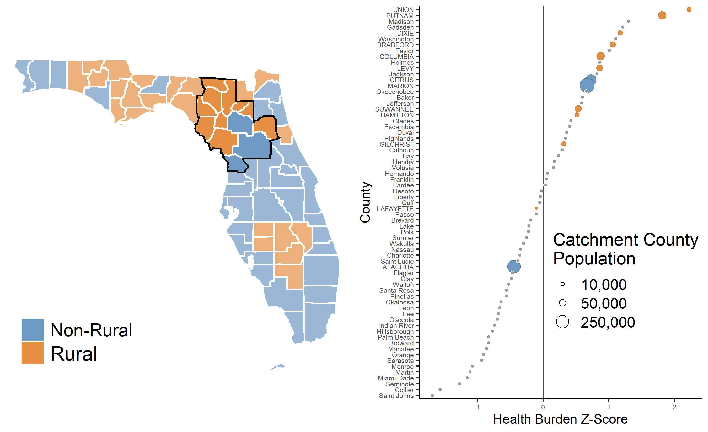
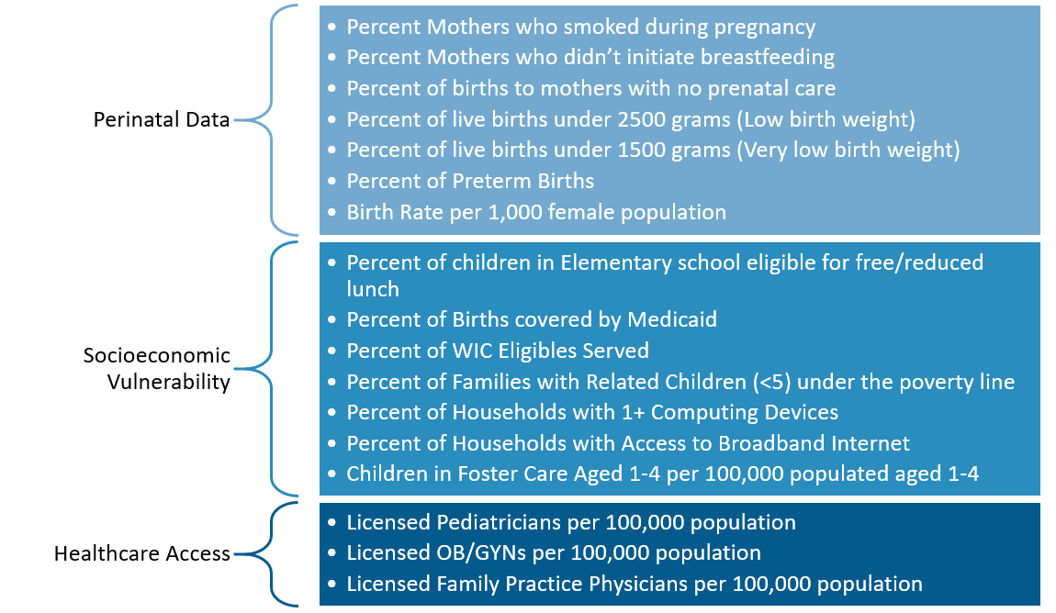
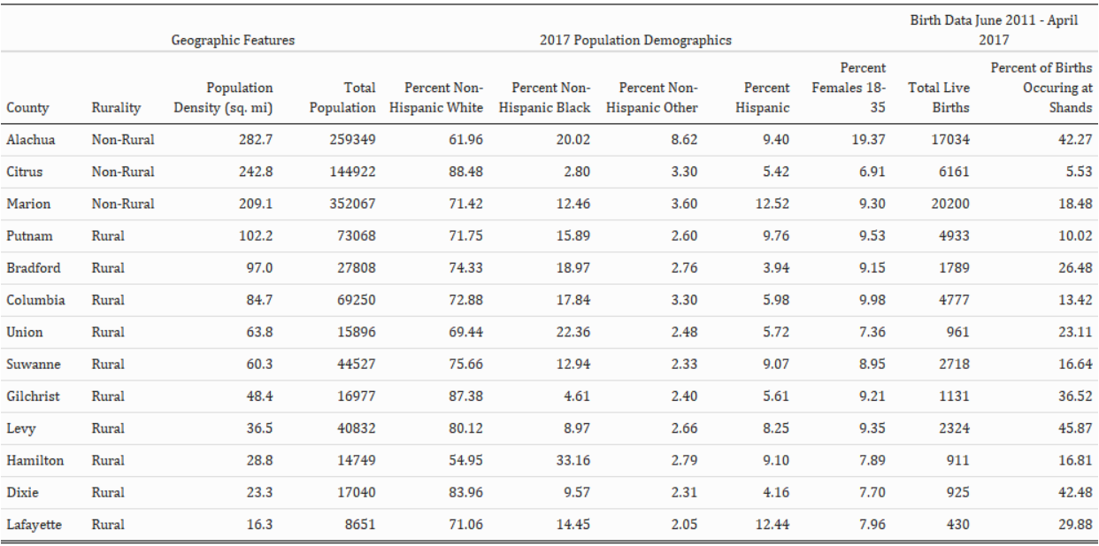
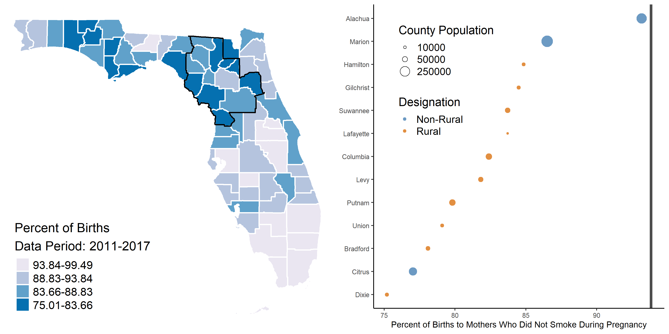
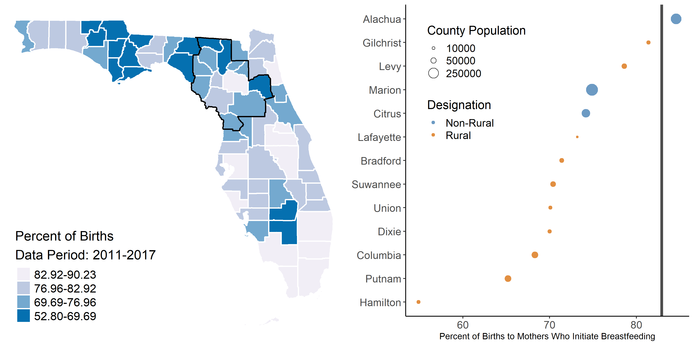
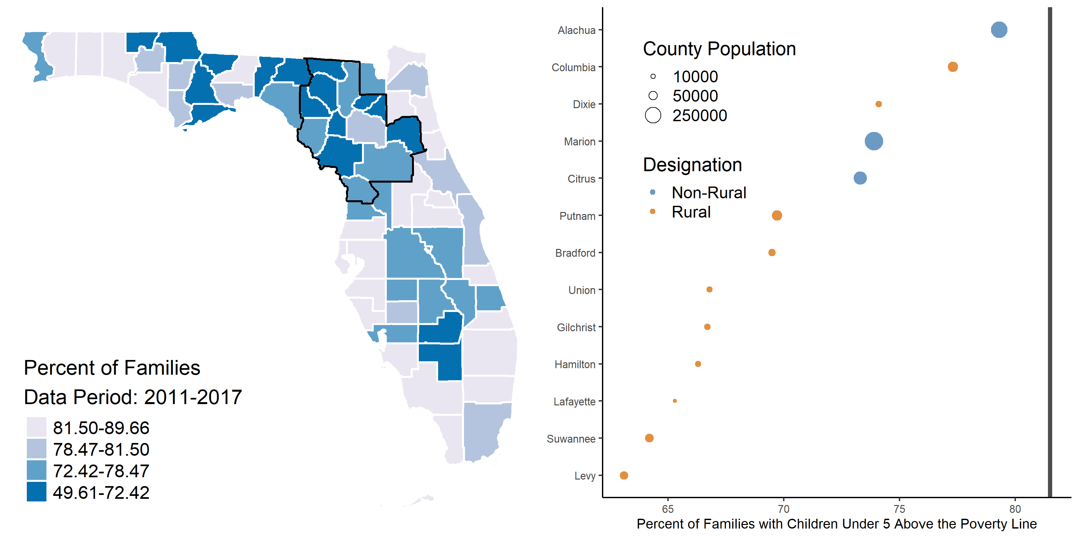
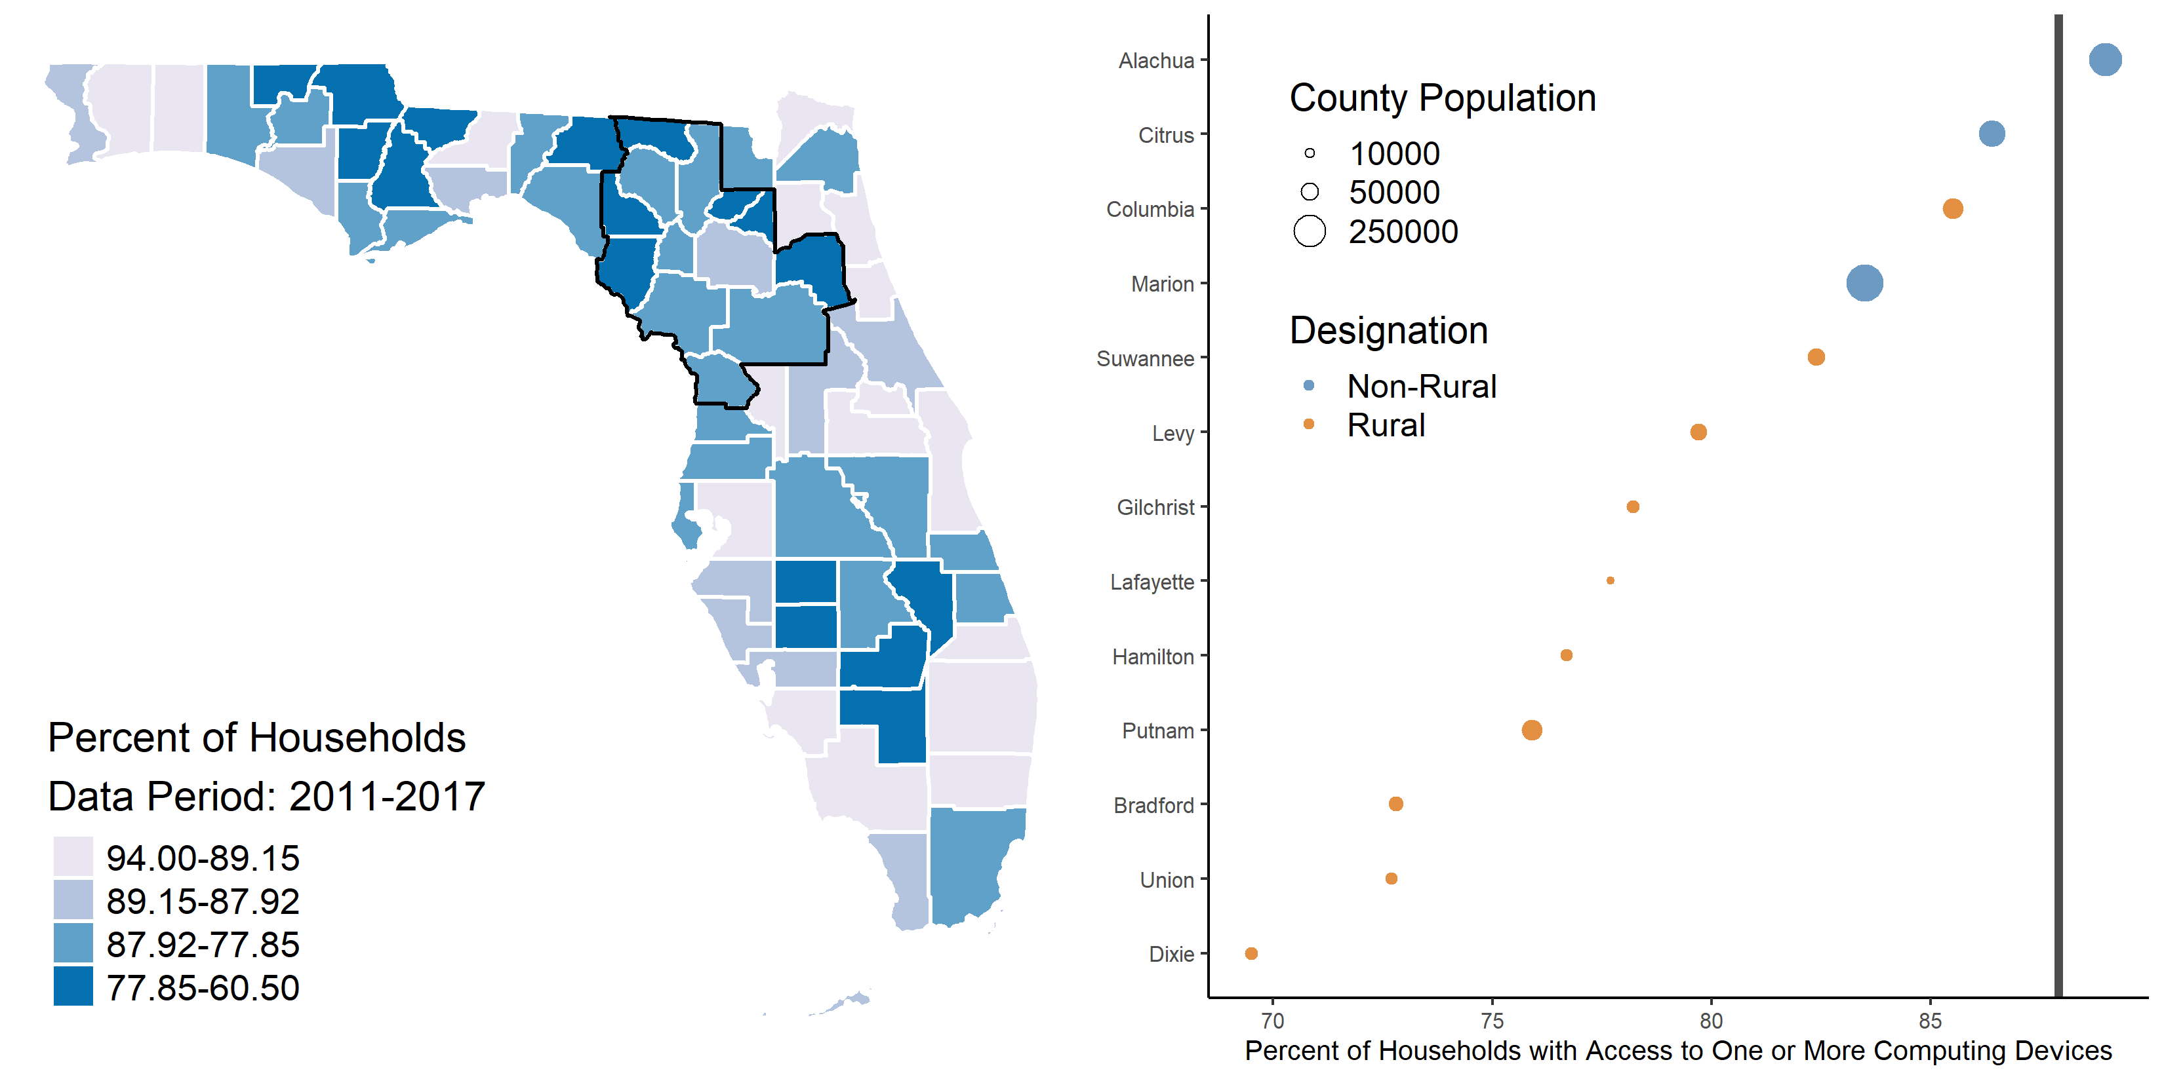
County-Level Analysis of Health Indicators within the
UF Health Perinatal Catchment Area
Dominick J. Lemas, PhD;¹ Claire Layton;¹ Hailey Ballard;¹ John C. Smulian, MD., M.P.H.;² Matthew Gurka, PhD;¹ Matthew Loop, PhD;³ Jaclyn Hall, PhD¹​
¹ Department of Health Outcomes and Biomedical Informatics, University of Florida ​
² Department of Obstetrics & Gynecology, University of Florida​
³ Division of Pharmacotherapy and Experimental Therapeutics, Eshelman School of Pharmacy, University of North Carolina at Chapel Hill
Background
Results
Perinatal health outcomes are influenced by a variety of complex factors including income, education, race, ethnicity, employment status, socioeconomic status, and geographic location.
Rurality has been associated with perinatal outcomes including higher rates of delayed prenatal care initiation, increased pregnancy-related hospitalizations, low birth weight, preterm births, and infant mortality.¹
In 2014, less than half of all rural counties in the United States had hospital-based obstetric care.²
^{A)}
^{B)}
Table 1: Demographic of UF Health Perinatal Catchment Area. Rurality defined by Florida Statute§288.0656
UF Health
^{b.}
Figure 1. (A) Rurality of sixty-seven Florida counties. (B) County Health Rankings Health Outcomes z-scores (right), where positive z-scores represent greater health burden compared to the average of counties in Florida.
Figure 2: UF Health Perinatal Catchment Domains. A sampling of four variables are displayed in Figures 3-6, which represent the data domains of Perinatal Data and Socioeconomic Vulnerability.
Objective
^{A)}
^{B)}
^{A)}
^{B)}
Summary
The objective of this study was to:
1) define to the UF Health Perinatal Catchment Area
2) evaluate the perinatal health burden among mothers and babies residing within the catchment area.
The UF Health Perinatal Catchment Area (PCA) is defined by 13 counties served by UF Health Shands.
Our analysis revealed the PCA has poor perinatal health outcomes that include low breastfeeding initiation and high smoking during pregnancy.
The PCA includes rural and non-rural counties with low broadband connectivity, which exacerbates disparities in other social determinants of health.³
Alachua county is the only county with perinatal health outcomes above the state median.
FL rate:
93.8
FL rate: 82.9
Methods
Figure 3: (A) Mothers who did not smoke during pregnancy (SDP), (B) SDP in the thirteen catchment counties ordered by rate. All thirteen catchment counties had maternal non-smoking rates below the statewide rate (93.8), indicating higher levels of health burden within the catchment.
Figure 4: A) Breastfeeding initiation rates, B) Breastfeeding initiation rates in the thirteen catchment counties ordered by rate. All catchment counties, except Alachua, had breastfeeding initiation rates below the statewide rate (82.9), indicating higher levels of health burden within the catchment.
We included 16,566 mom-baby linked records that were extracted from UF Health between 2011-2017.
Residential address at the time of delivery was geocoded to define the county of residence.
Counties where > 5% of all babies were delivered at UF Health were included in the catchment.
County-level outcomes were obtained from the Floridahealthcharts.com to further identify the perinatal health burden within the catchment area.
County Health Rankings data was from 2015-2017.
^{A)}
^{B)}
^{A)}
^{B)}
Future Directions
Updating PCA to include recent data (2017-present).
Evaluate health outcomes using mom-baby linked EHR within PCA.
Examine Social Determinants of Health (SDoH) and impact on perinatal health outcomes at census tract and census block levels.
FL rate: 81.5
FL rate: 87.9
Figure 5: A) Children under the age of five living above the poverty rate (APR), B) APR in the thirteen catchment counties ordered by rate. All thirteen catchment counties had APR rates below the statewide rate (81.5), indicating higher levels of health burden within the catchment.
Figure 6: A) Households with computing device access, B) Computing device access in the thirteen catchment counties ordered by rate. All catchment counties, except Alachua, had device access rates below the statewide rate (87.9), indicating higher levels of health burden within the catchment.
References
Acknowledgments
¹ Liu, L., Oza, S., Hogan, D., S., Mathers, C., & Black, R. E. (2015). Global, regional, and national causes of child mortality in 2000-13, with projections to inform post-2015 priorities: an updated systematic analysis. Lancet (London, England), 385(9966), 430–440. https://doi.org/10.1016/S0140-6736(14)61698-6
² Kozhimannil KB, Hung P, Henning-Smith C, Casey MM, Prasad S. Association Between Loss of Hospital-Based Obstetric Services and Birth Outcomes in Rural Counties in the United States. JAMA. 2018;319(12):1239–1247. doi:10.1001/jama.2018.1830
³ Bauerly, B. C., McCord, R. F., Hulkower, R., & Pepin, D. (2019). Broadband access as a public health issue: the role of law in expanding broadband access and connecting underserved communities for better health outcomes. The Journal of Law, Medicine & Ethics, 47(2_suppl), 39-42.
We are grateful to our funding source, NIDDK (K01DK115632), University Scholars Program, the CTSI Precision Health Program and the Integrated Data Repository.

