Slide 1
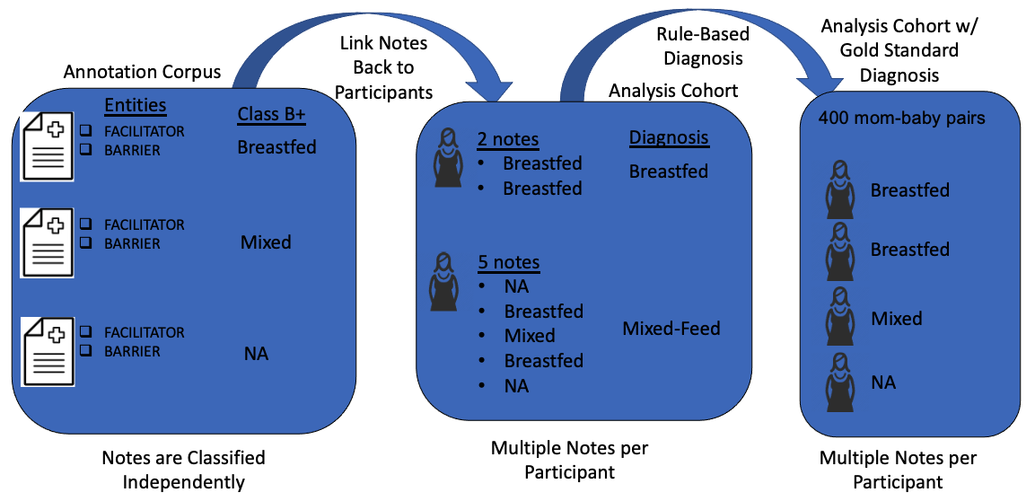



CLASSIFYING INFANT FEEDING STATUS FROM CLINICAL NOTES USING NATURAL LANGUAGE PROCESSING AND MACHINE LEARNING
Dominick J. Lemas, PhD^{1,2*}; Masoud Rouhizadeh, PhD^{3,4}; Braeden Lewis¹; Simon Frank¹; Lauren Wright¹; Marina Magalhães³; Ke Xu¹; Xinsong Du¹; Leslie Parker, PhD; Chris Harle, PhD¹; Adetola Louis-Jaques, MD²; Borui Zhang, PhD; Lindsay Thompson, MD; William R. Hogan, MD; François Modave, PhD^{1,6}
Department of Health Outcomes and Biomedical Informatics, University of Florida College of Medicine, Gainesville, Florida. ² Department of Obstetrics and Gynecology, University of Florida College of Medicine, Gainesville, Florida.³ Department of Department of Pharmaceutical Outcomes and Policy, University of Florida College of Medicine, Gainesville, Florida.⁴ Biomedical Informatics and Data Science Section, Division of General Internal Medicine, Johns Hopkins University School of Medicine, Baltimore, Maryland.⁵ Department of Pediatrics, Division of Neonatology, University of Florida College of Medicine, Gainesville, Florida.⁶Department of Biostatistics and Data Science, UTHealth School of Public Health, Center for Community Health Impact, El Paso, Texas.
BACKGROUND
RESULTS
Breastfeeding is the optimal source of infant nutrition during the first year of life.
Despite these observations, only 1 in 4 children will exclusively breastfeed through the first 6 months of life.
Natural language processing (NLP) is an informatics technique with potential to extract infant feeding status from clinical notes and this information could be used to improve precision public health interventions focused on improving exclusive breastfeeding.
Table 1. Patient Characteristics for Training and Testing Sets
Variables | Entire Cohort | Eligible Cohort | Analysis Cohort
N | 16108 | 1888 | 746
Note Number | 659576 | 55699 | 1000
Maternal Age (yrs) | 27.6 ± 6.0 | 27.3 ± 5.8 | 26.6 ± 5.9
Gestational Age (wks) | 38.2 ± 3.2 | 38.9 ± 2.0 | 38.9 ± 2.1
Birth Weight (g) | 3075.9 ± 738.4 | 3179.8 ± 565.9 | 3144.4 ± 569.0
Gender
Female | 7799 (48%) | 940 (50%) | 369 (49%)
Male | 8308 (52%) | 948 (50%) | 377 (51%)
Infant Feeding(%) | 12.49 | 16.31 | 80.2
Table 2. Description of Analysis and Modeling Corpus
Classes | Analysis³ | Mod⁴ | Training⁵ | Test⁶
Breastfeeding | 225 (22.5%) | 61 | 49 | 12
Bottle Feeding | 154 (15.4%) | 61 | 48 | 13
Mixed Feed | 31 (3.1%) | 0 | 0 | 0
Pump/Express | 61 (6.1%) | 61 | 49 | 12
Not Related | 528 (52.9) | 61 | 49 | 12
Table 3. Model Comparison
Model | Acc | Pre | Recall | F1 Score | AUROC
SVC | 0.939 | 0.951 | 0.939 | 0.94 | 0.959
Logistic Regression | 0.918 | 0.918 | 0.918 | 0.918 | 0.946
Decision Tree Classifier | 0.898 | 0.899 | 0.898 | 0.898 | 0.932
XGB Classifier | 0.878 | 0.884 | 0.878 | 0.879 | 0.918
Random Forest Classifier | 0.837 | 0.84 | 0.837 | 0.835 | 0.891
K Neighbors Classifier | 0.796 | 0.838 | 0.796 | 0.801 | 0.864
STUDY OBJECTIVE
Table 4. SVC model performance across infant feeding classes
Classes | Acc | Pre | Recall | F1 Score | AUROC
Breastfeeding | 1 | 0.8 | 1 | 0.889 | 49
Bottle Feeding | 1 | 1 | 1 | 1 | 48
Pump/Express | 0.917 | 1 | 0.917 | 0.957 | 49
Not Related | 0.833 | 1 | 0.833 | 0.909 | 49
To classify infant feeding status from clinical notes using NLP.
METHODS
Study Population & Analysis Corpus
Maternal-infant electronic health records were collected from UFHealth Shand's Hospital between year 2011 and 2017.
Eligible cohort involves infants with delivery visit and at least one well-visit on record.
Analysis corpus → randomly selected de-identified clinical notes from the eligible cohort at time of delivery.
All models were trained with 80% training data and evaluated on 20% test data using 5-fold cross-validation.
Note-Level Classification
Breastfeeding (MESH: D001903)
Formula Feeding (MESH: D041943)
Express/Pump Feeding (MESH: D061186)
Mixed Feeding
Not Applicable
Data Processing
Clinical notes were annotated using Teamtat.
Each note was classified according to infant feeding status using Medical Subject Headings (MESH) terms.
The Clinical Language Annotation, Modeling, and Processing (CLAMP, version 1.6.4) tool was used for NLP and python scripts were used for machine learning.
Models were evaluated based on overall accuracy, precision, recall, F1-score, and AUROC.
TRANSLATIONAL IMPACT
Figure 1. NLP Workflow to Diagnose Exclusive Breastfeeding from Clinical Notes
CONCLUSIONS
Our results demonstrate that natural language processing can be applied to clinical notes stored in the electronic health record to classify infant feedings status.
Early identification of breastfeeding status using NLP on unstructured EHR data can be used to inform precision public health interventions focused on improving lactation support for postpartum patients.
ACKNOWLEDGMENT
The work reported in this publication was supported by the National Institute of Diabetes and Digestive and Kidney Diseases (K01DK115632), National Center for Advancing Translational Sciences of the National Institutes of Health under University of Florida Clinical and Translational Science Awards UL1 TR000064 and UL1TR001427.
Notes:
Conclusion, method, additional figures
Changed the pptx size(56inchX44 inch) as per the Ai DAY pptx recommend(4ftx5ft)
Any deletion required from acknowledgement?
Any additional Authors to be added?
Only changes made to the shared link pptx is auto-synced and not the shared file through email.

