Slide 1


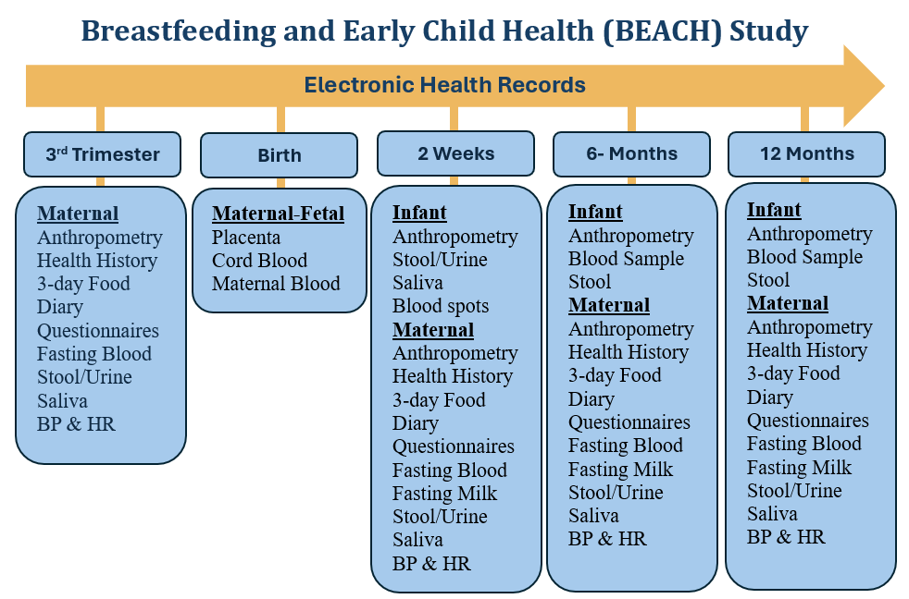
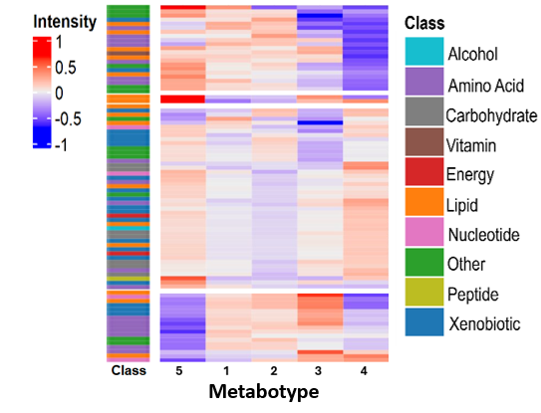
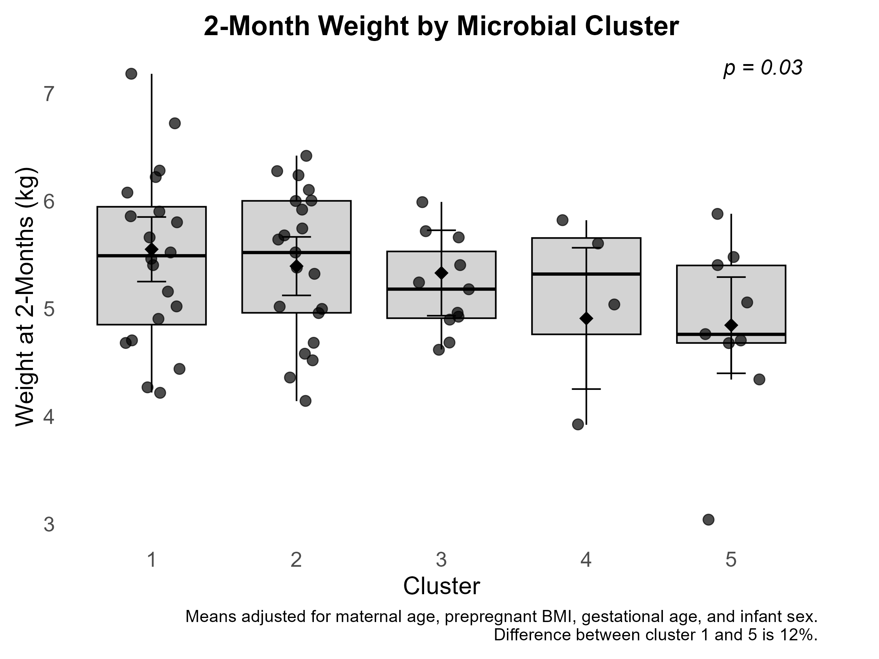
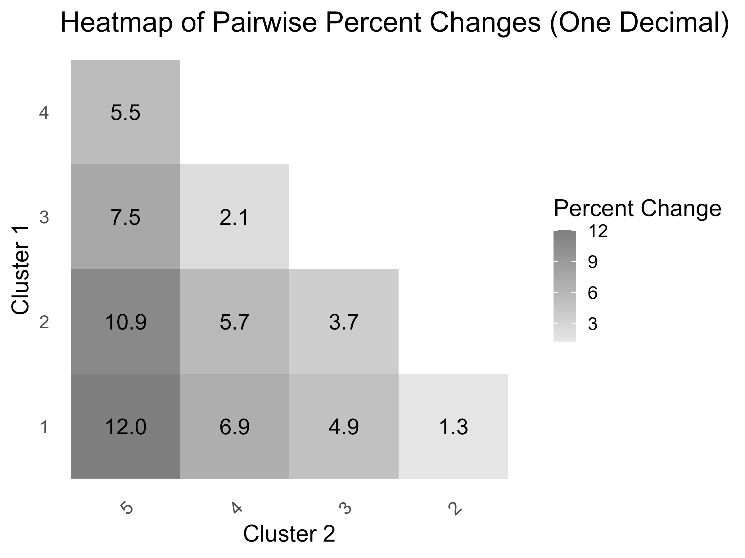

Untargeted Plasma Metabolomics Reveals Maternal Microbial Metabotypes Associated with Infant Growth Trajectories
Samih Samaan, Xinsong Du, Caroline Pujol, Michele Himadi, Zara Haruna, Isabella Guenzler, Kathryn Humes, Magda Francois,
Timothy J. Garrett, Larissa Strath, Dominick J. Lemas
BACKGROUND
RESULTS
Maternal obesity increases offspring risk for pediatric obesity.
Underlying biological mechanisms remain unclear.
The gut microbiome is a key modulators of the metabolic environment and may influence infant health.
Table 1: Characteristics of BEACH Study
Characteristics | NW | OW/OB | P-Value
N | 46 | 37
BMI | 22 | 33 | <0.001
Gestational Age (wks) | 38.7 | 39.3 | 0.024
Maternal Age (yrs) | 32.0 | 30.1 | 0.12
Breastfeeding (mo) | 10.6 | 9.7 | 0.11
Infant Birth Weight (kg) | 3.3 | 3.6 | 0.027
Table 2. Microbial Derived Plasma Metabotypes Are Dominanted By Bile Acids
Metabotype | N | Top Metabolites
1 | 27 | Taurocholic Acid 2,3-dihydroxyisovalerate
2 | 24 | Phenylacetylglutamine Succinate
3 | 12 | 5-Hydroxyindoleacetate Glycocholic acid
4 | 6 | Guanidinoacetate Taurochenodeoxycholic Acid
5 | 12 | 2,3-Dihydroxyvalerate 7-Ketochenodeoxycholic acid
OBJECTIVE
1) Leverage untargeted plasma metabolomics to identify maternal microbial-derived metabotypes.
2) Assess their associations with infant outcomes during the first year of life.
A)
7
METHODS
6
Weight (kg)
Experimental Design
N = 83 mother-infant dyads
NW, BMI <25.0 kg/m2
OW/Ob, BMI >25.0 kg/m2
Maternal plasma samples collected during the 34–38 weeks of gestation
Analytical Procedure
Plasma analyzed using untargeted metabolomics on a Thermo Q-Exactive Orbitrap (HR-LC-MS)
Statistical Procedure
K-means clustering on microbial-derived metabolites
Adjusted linear regression models used to evaluate associations between these metabotypes and infant outcomes.
5
1
2
3
4
5
Figure 1: Overview of the BEACH Study
Metabolites
B)
Metabotype
4
Table 3: Dietary Fiber During Pregnancy is Associated with Metabotype
Metabotype | 1 | 2 | 3 | 4 | 5 | p-value
n | 18 | 13 | 4 | 4 | 7
Fat (g) | 376.6 | 306.5 | 369.6 | 392.7 | 249.6 | 0.18
Protein (g) | 378.1 | 232.6 | 330.7 | 343.3 | 287.5 | 0.31
Carbohydrate (g) | 1117.2 | 874.7 | 834.9 | 1113.5 | 632.8 | 0.21
Fiber (g) | 83.7 | 53.2 | 46.61 | 114.9 | 53.7 | 0.01
Sugar (g) | 442.8 | 359.1 | 352.5 | 410.9 | 293.5 | 0.61
Metabotype
3
2
1
5
4
3
1
Metabotype
Figure 2: Heatmap of 2-Week Human Milk Metabolite Intensities Across Metabotypes (p<0.05)
Figure 3: A) Box-plot of 2-Month of Infant Weight Across Metabotypes (p=0.03). B) Pairwise Differences in Infant Weight by Metabotype.
CONCLUSION
Key point: Together, these findings support the hypothesis that maternal dietary fiber during pregnancy influences plasma metabotypes and the bile acid pool via gut microbiome which ultimately impacts milk composition at 2-weeks and subsequent infant growth trajectories during early life. .
The project was supported by NIDDK (K01DK115632), NCATS under University of Florida Clinical and Translational Science Awards UL1 TR000064 and UL1TR001427.

