Slide 1
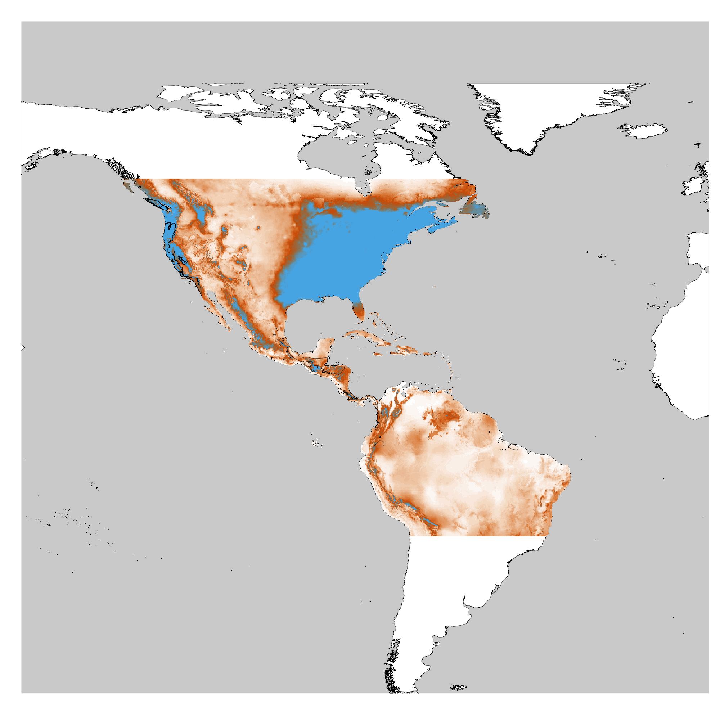
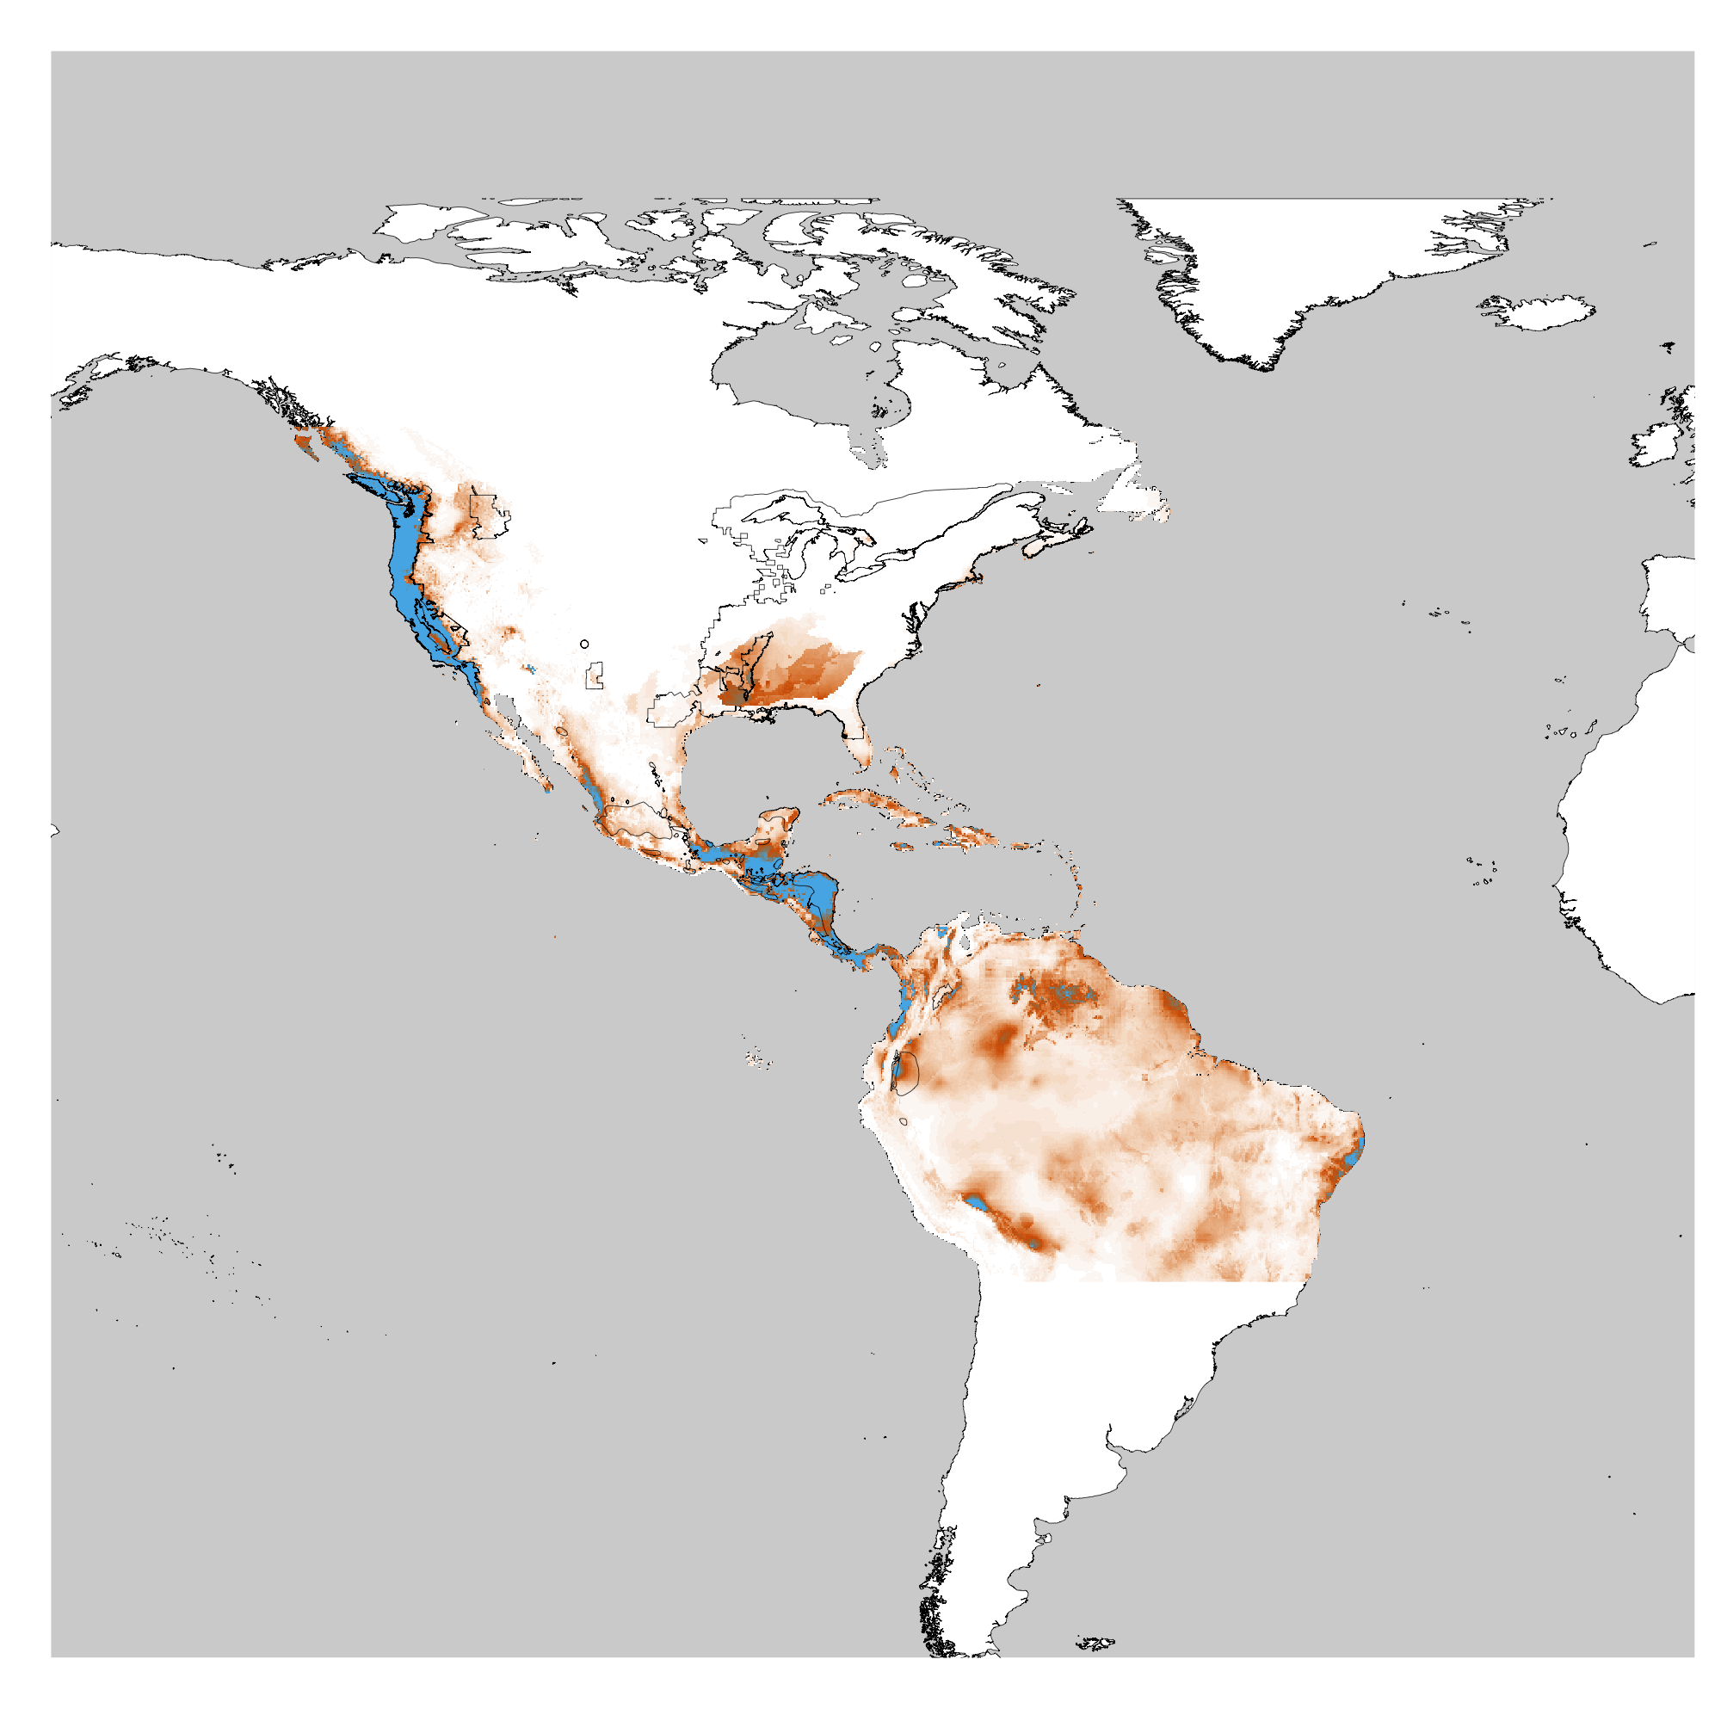
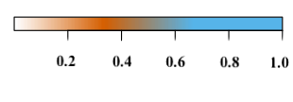
Terrestrial Suitability Model
Arboreal Distribution
4.1%
Overlap
Terrestrial Distribution
MAXENT Suitability
50.7%
Overlap
Arboreal Suitability Model

