Slide 1
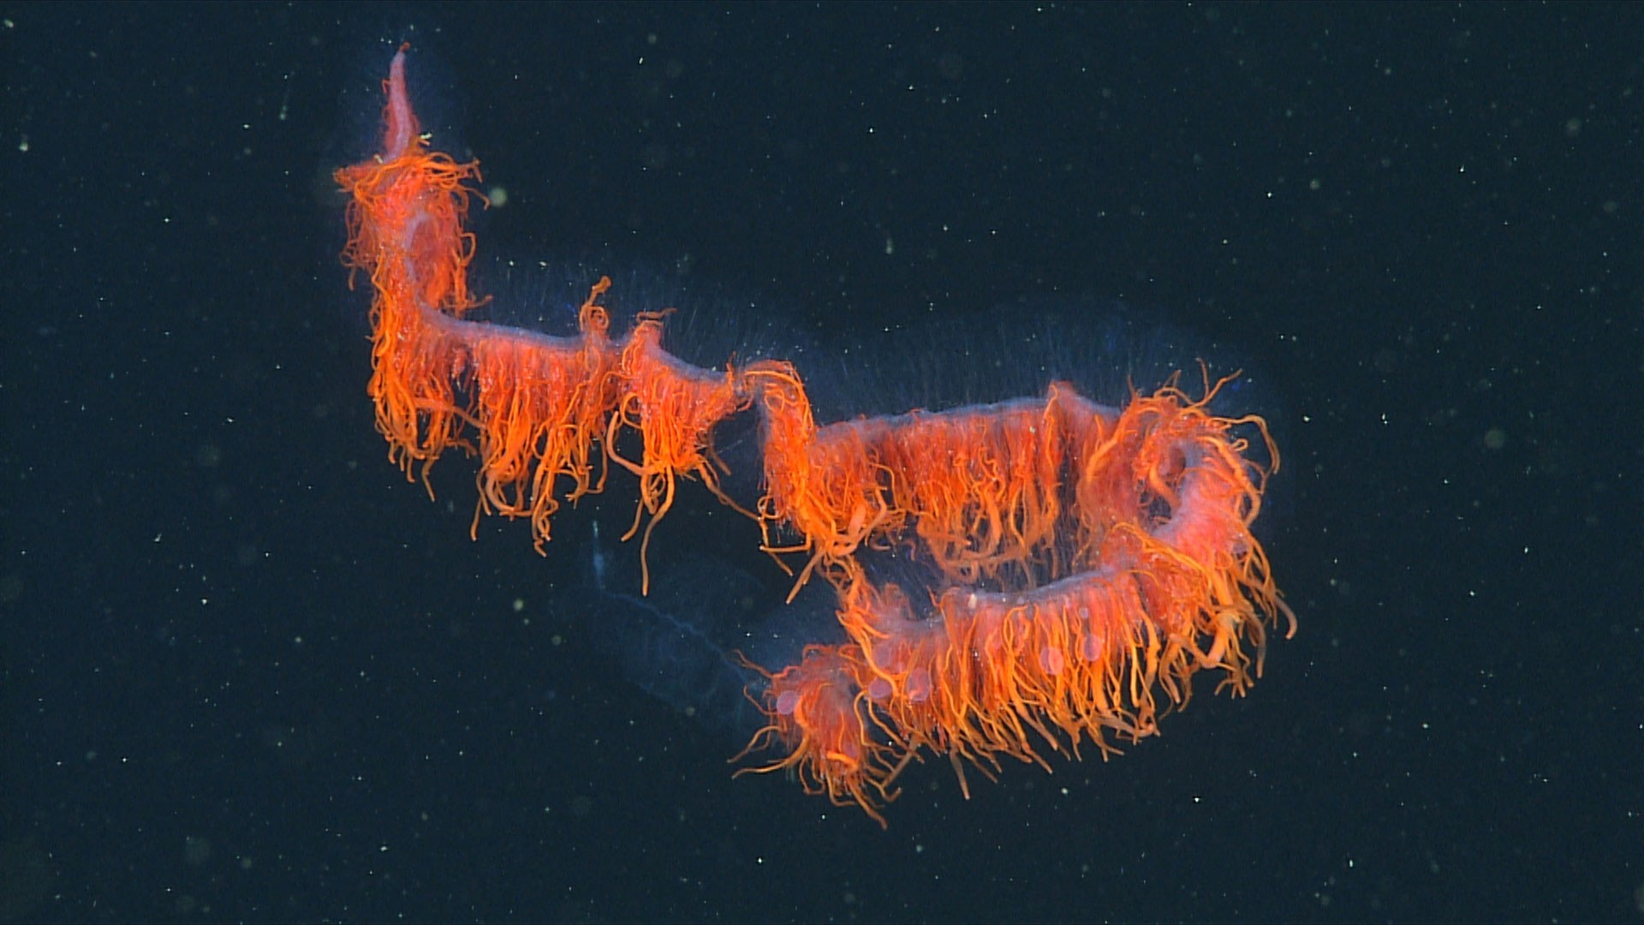
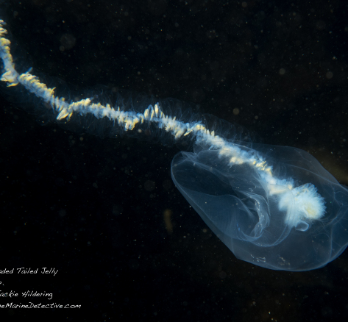
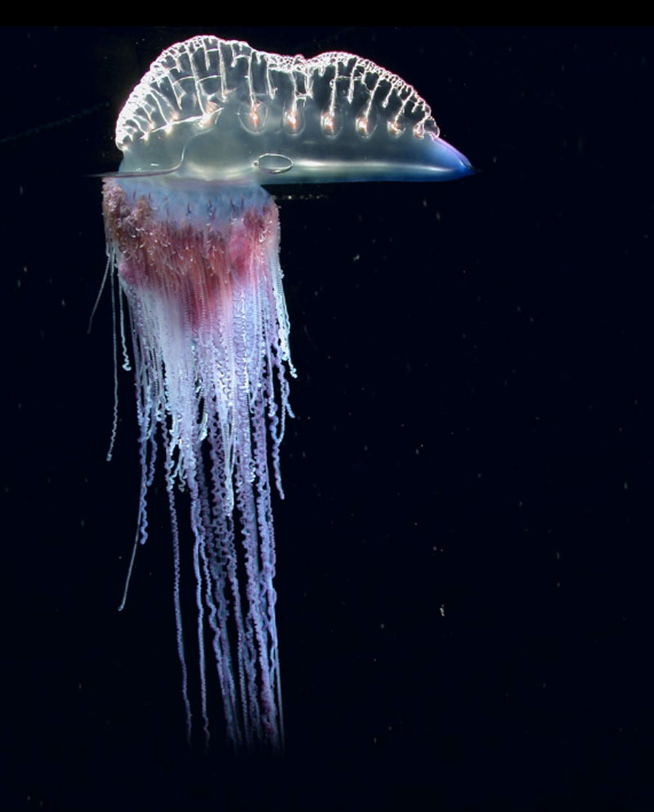
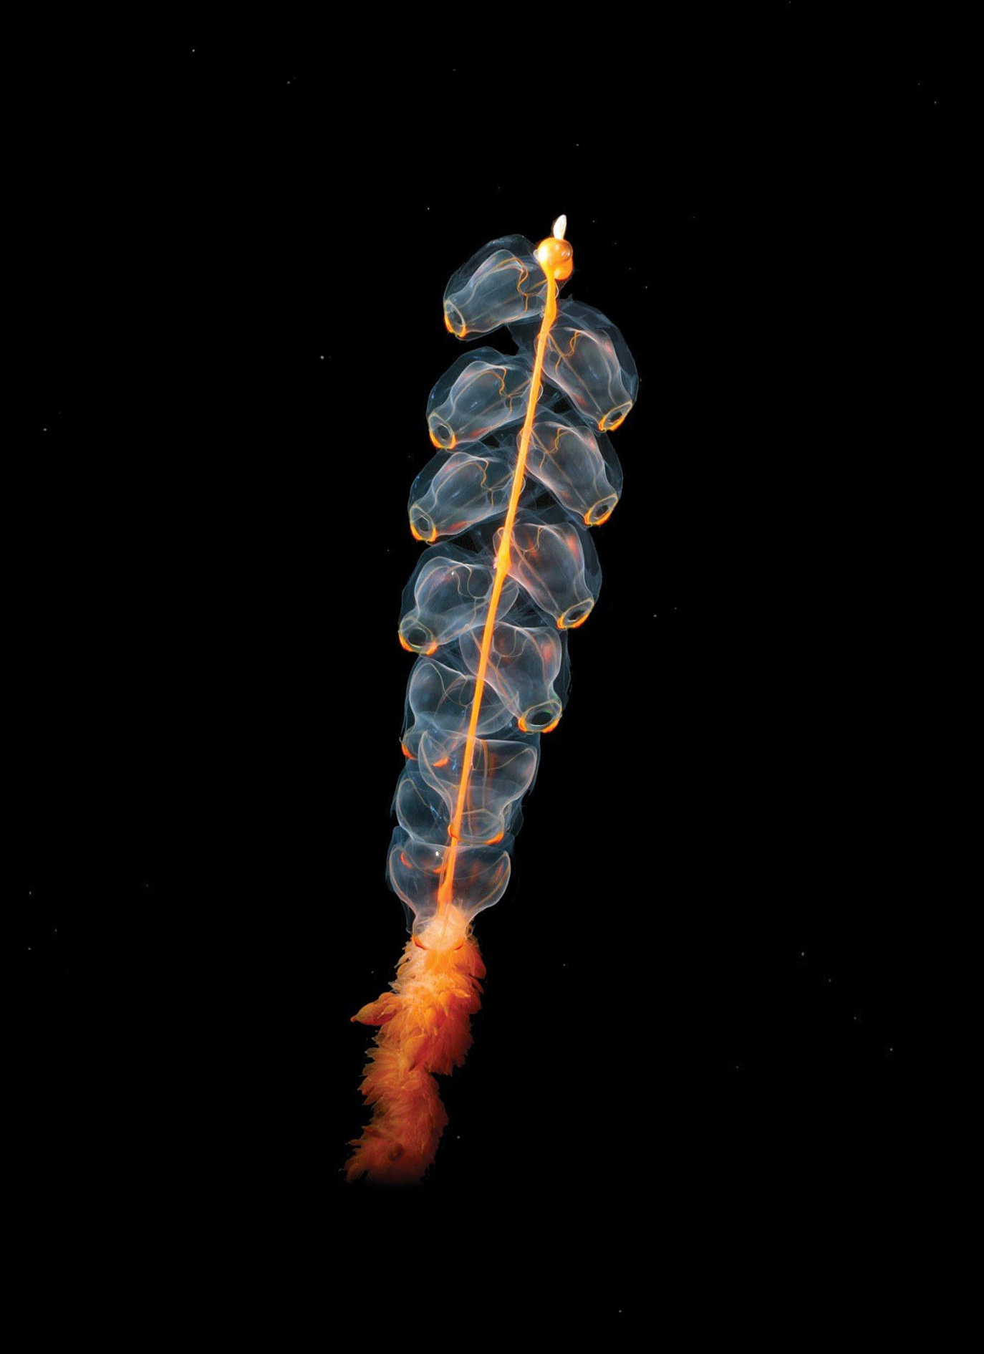
Siphono-what?
Lauren Mellenthin

Slide 2
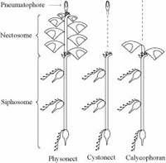
Introduction: What are siphonophores
Phylum: Cnidaria
Class: Hydrozoa
Order: Siphonophorae
~175 species currently known
Colonial animals with specialized zooids with each one function
There are three main ‘types’ of siphonophores based on the types of zooids present

Slide 3
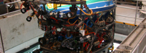
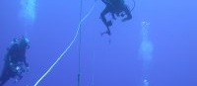
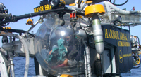
Introduction: Why are they hard to study
With the exception of one species, most siphonophores are found deep within the water column because they are predatory, ambush animals
Can collect by blue water diving by hand
Can collect with ROVs
Have not been able to grow and maintain siphonophores in laboratory environment YET!

Slide 4
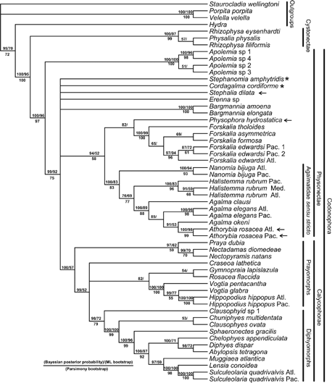
Introduction: What is known?
The first phylogeny from two genes from Casey Dunn in 2005
Nuclear small subunit ribosomal RNA gene (18S) and the mitochondrial large subunit ribosomal RNA gene (16S)
Consensus tree of all post burn-in trees for the Bayesian analysis of the combined data set
Systematic Biology, Volume 54, Issue 6, December 2005, Pages 916–935, https://doi.org/10.1080/10635150500354837

Slide 5
New phylogeny
New phylogeny published in 2017 by Catriona Munro
Used new transcriptome data from 29 species
Maximum likelihood
Many deep relationships were uncovered because of it
Used both molecular and morphological (binary) data

Slide 6
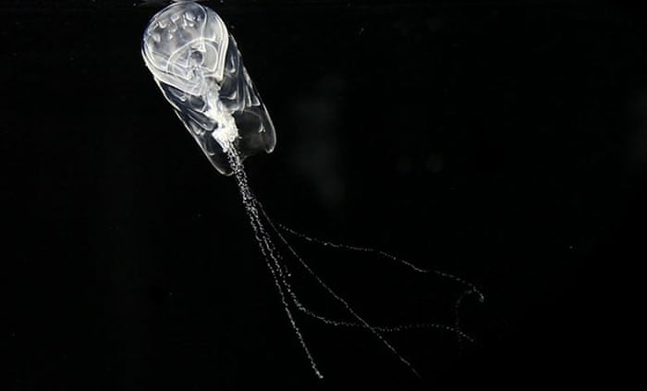
My questions
After taking phylogenetics, I am compelled to understand the decisions these top scientists have made
I want to explore how different phylogenetic methods vary and how that can change the outcome
In the paper they reported that they used maximum likelihood approaches
I wanted to investigate exactly how parsimony methods might affect these results, if they do so
I want to do this mainly because it is parsimony methods that are not used anymore, or rarely, and utilizing them will allow me to understand why and more specifically why that is the case in this organism
Also, parsimony is one approach that I am not familiar with and had no previous experience using, so I also wanted to explore the methods at a deeper level

Slide 7
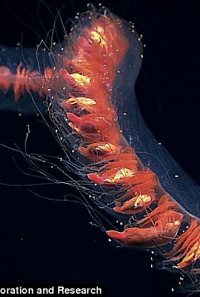
Parsimony goals
The goal of parsimony is to seek a tree that minimizes the amount of evolutionary change to explain the data at hand
Parsimony, in short, maximizes congruence and minimizes homoplasy
Further, maximum parsimony depends on the idea of the fit of a character to a tree which is defined by the minimum number of steps required to explain the observed distribution of character states among taxa
Parsimony was the reigning method in phylogenetic analysis for a long time, and it still used sparsely today
The reason it is not still reigning is because there were some major problems that came from these trees, and as new methods came about, these problems became more and more apparent like convergent evolution, long-branch attraction, and constraints in tree space

Slide 8
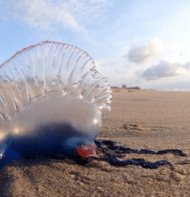
Maximum likelihood goals
The goal of maximum likelihood is to find the tree that makes the data the most probable
Maximum likelihood also still has its problems, many the same, such as long-branch attraction
However, maximum likelihood allows us to consider different models of evolution and that allows us to answer many deep divergence estimates with more accuracy
The authors of this paper chose a maximum likelihood tree, and I not only wanted to compare maximum likelihood and parsimony but also test the consistency of parsimony and how that may differ when compared to the published tree

Slide 9
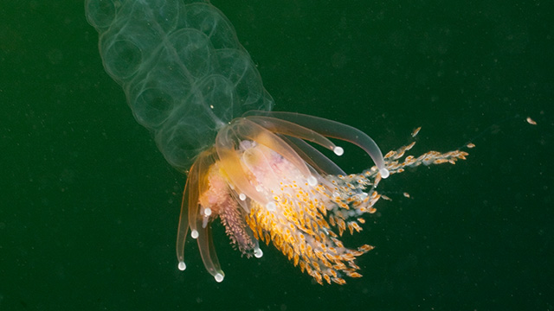
Programs and alignment
TNT
PAUP
Aligned data from supplementary information in fasta format with WAG+G model of evolution

Slide 10
TNT parsimony
The program used was TNT and I used the aligned protein file from Munro et al. 2017 paper. It was bootstrapped with 20 replicates.

Slide 11
PAUP parsimony
PAUP maximum parsimony tree (hsearch.tre). This was made with the PAUP program and the aligned protein file from Munro et al. 2017.

Slide 12
PAUP parsimony #2
PAUP additional parsimony analysis (parstree.tre). The program used was PAUP and I ran the analysis with the aligned protein file from Munro et al. 2017.

Slide 13
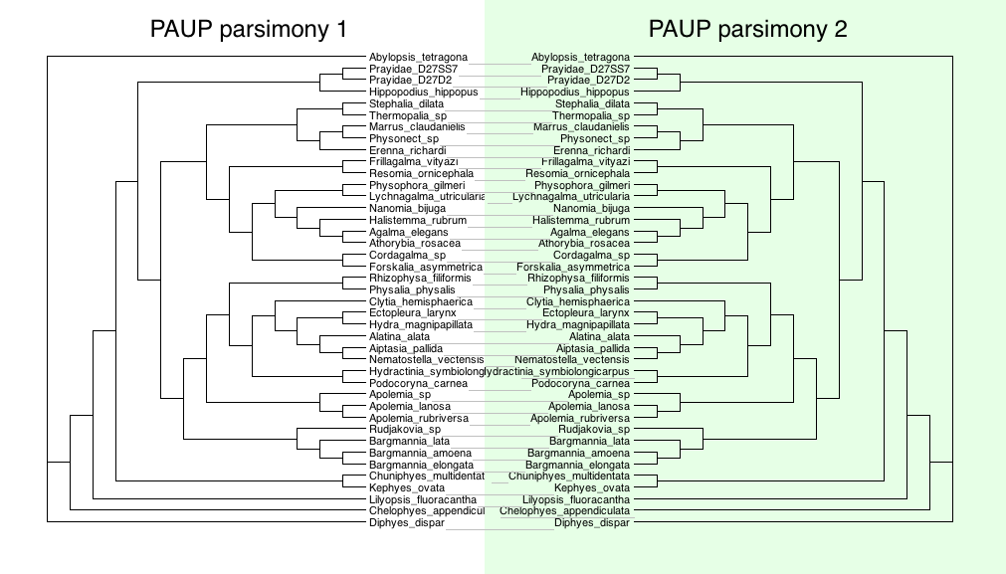
Parsimony #1 vs parsimony #2
PAUP parsimony vs parsimony 2. No changes were seen when comparing the two-parsimony analysis.

Slide 14
PAUP parsimony bootstrap
PAUP bootstrap parsimony tree (bootMajRule.tre). The program used was PAUP with 20 replicates and using the aligned protein file from Munro et al. 2017.

Slide 15
PAUP bootstrap parsimony #2
PAUP additional bootstrap analysis (bootstrap.tre). The program used was PAUP and I used the aligned protein file from Munro et al. 2017.

Slide 16
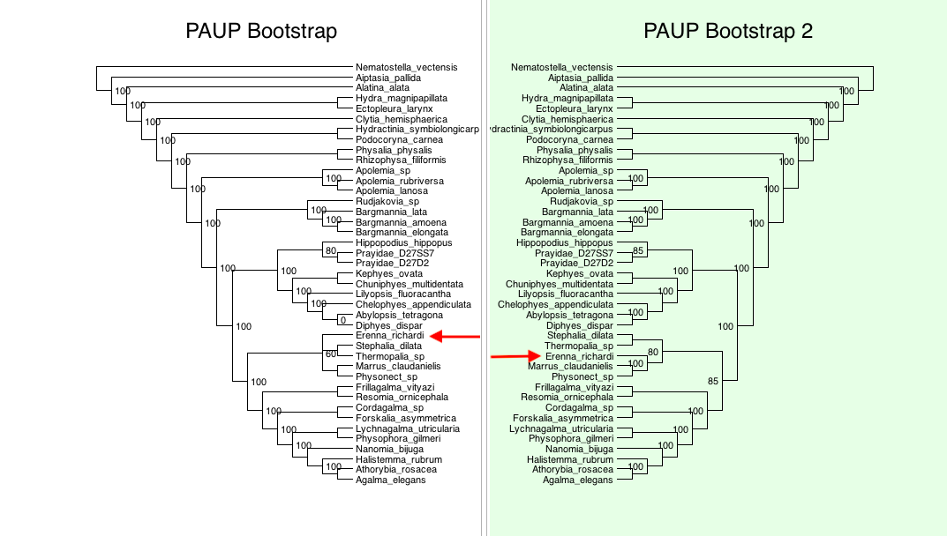
Parsimony bootstrap #1 vs parsimony bootstrap #2
PAUP bootstrap vs bootstrap 2. One slight change was seen from the PAUP bootstrap analysis #1 and the PAUP bootstrap analysis #2. The arrows indicating the different places that the species was assigned that differed between them.

Slide 17
PAUP jackknife
PAUP jackknife tree (jackknife.tre). I used the program PAUP with the jackknife function with the aligned protein file from Munro et al. 2017.

Slide 18
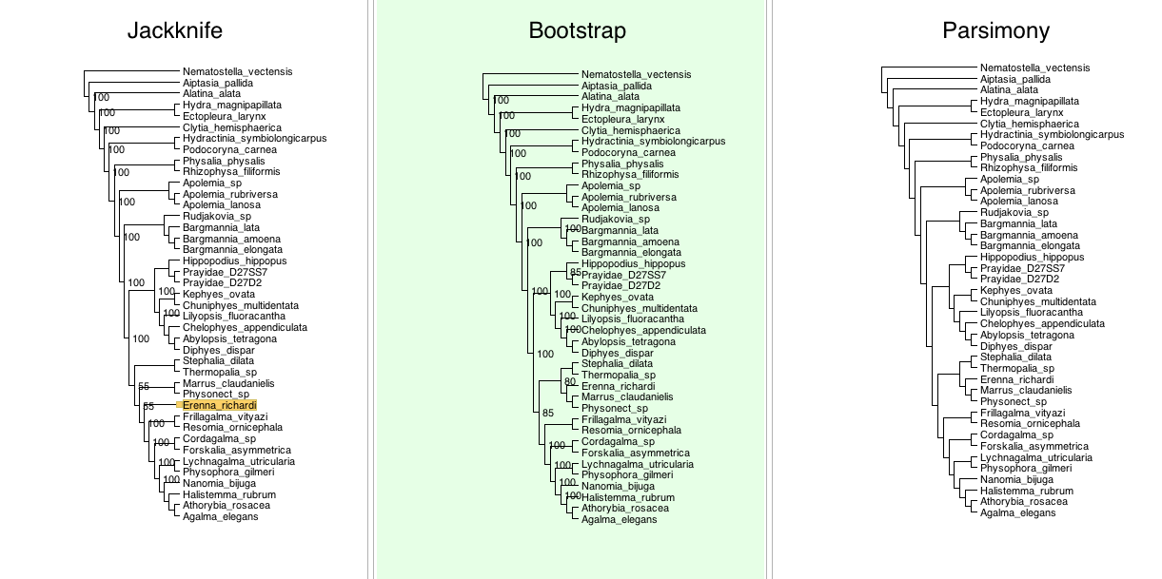
Parsimony methods

Slide 19
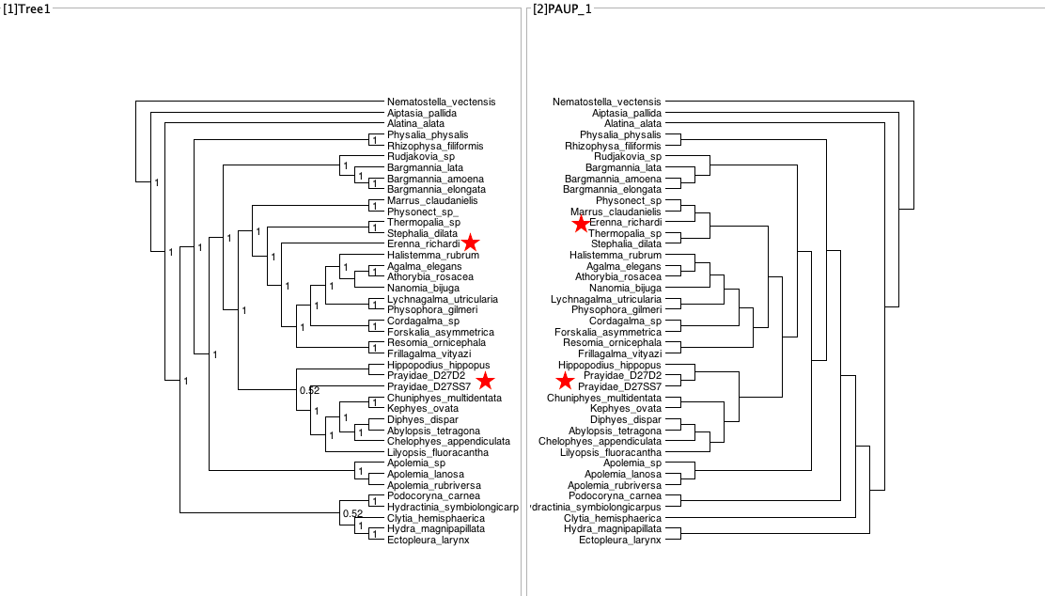
Original tree vs parsimony tree
This is the original tree from Munro et al. 2017 compared to the parsimony tree from the PAUP analysis using the aligned protein sequence. The stars indicate the differences in the placement of specific species/clades.

Slide 20
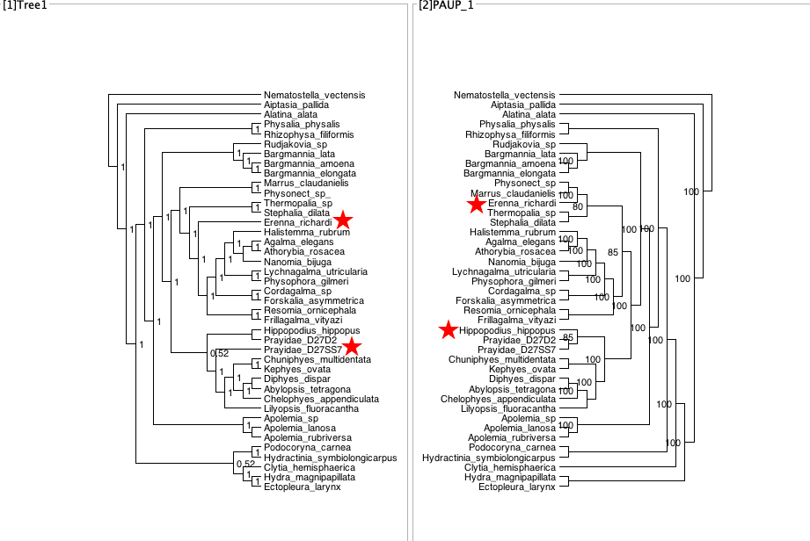
Original tree vs bootstrap parsimony
This is the original tree from Munro et al. 2017 compared to the bootstrap parsimony tree from the PAUP analysis using the aligned protein sequence. The stars indicated the species that are changing across the two trees.

Slide 21
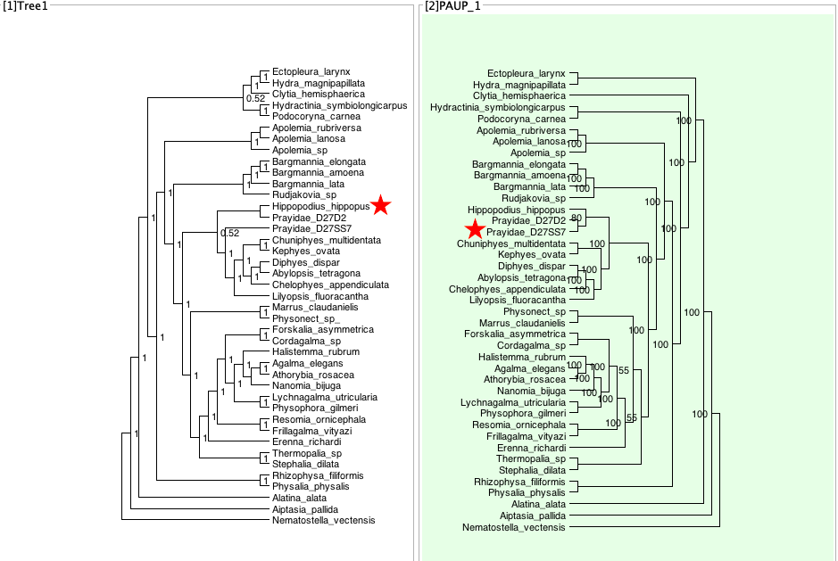
Original tree vs jackknife parsimony
This is the original tree from Munro et al. 2017 compared to the jackknife parsimony tree from the PAUP analysis using the aligned protein sequence. The stars indicate the differences in the species that changed from the two phylogenies.

Slide 22
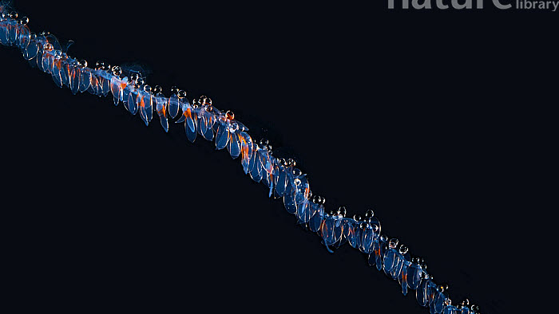
Main findings
By directly comparing the original phylogeny from Munro et al. 2017 to the parsimony, bootstrap parsimony, and jackknife parsimony, the same inconsistencies appeared every time while comparing them, it was never the same as the original tree
By comparing the original tree from the paper to the various parsimony analyses, it was very obvious to see there were major clade differences among them.
I came to the same conclusion that this species may not have enough support using parsimony alone. It is for this reason; the logical next step would be a maximum likelihood and/or Bayesian analysis

Slide 23
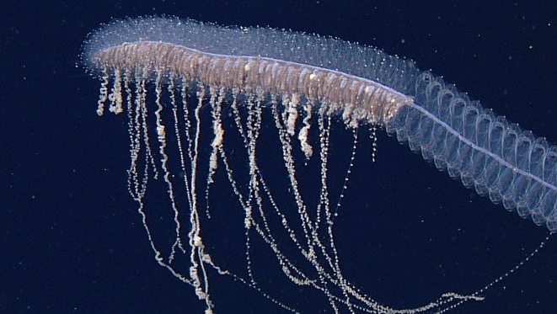
Conclusions
From the results of this paper, I can now compare and contrast different phylogenetic methods
But more importantly, I understand the justifications that scientists make when using them
The methods are there, they will continue to be there, and they will continue to grow and develop but they all mean nothing if they are not informed with the data we have, the questions we are asking, and the insights the methods are going to give us
Along with this, we need to know the assumptions and limitations of each method.

Slide 24

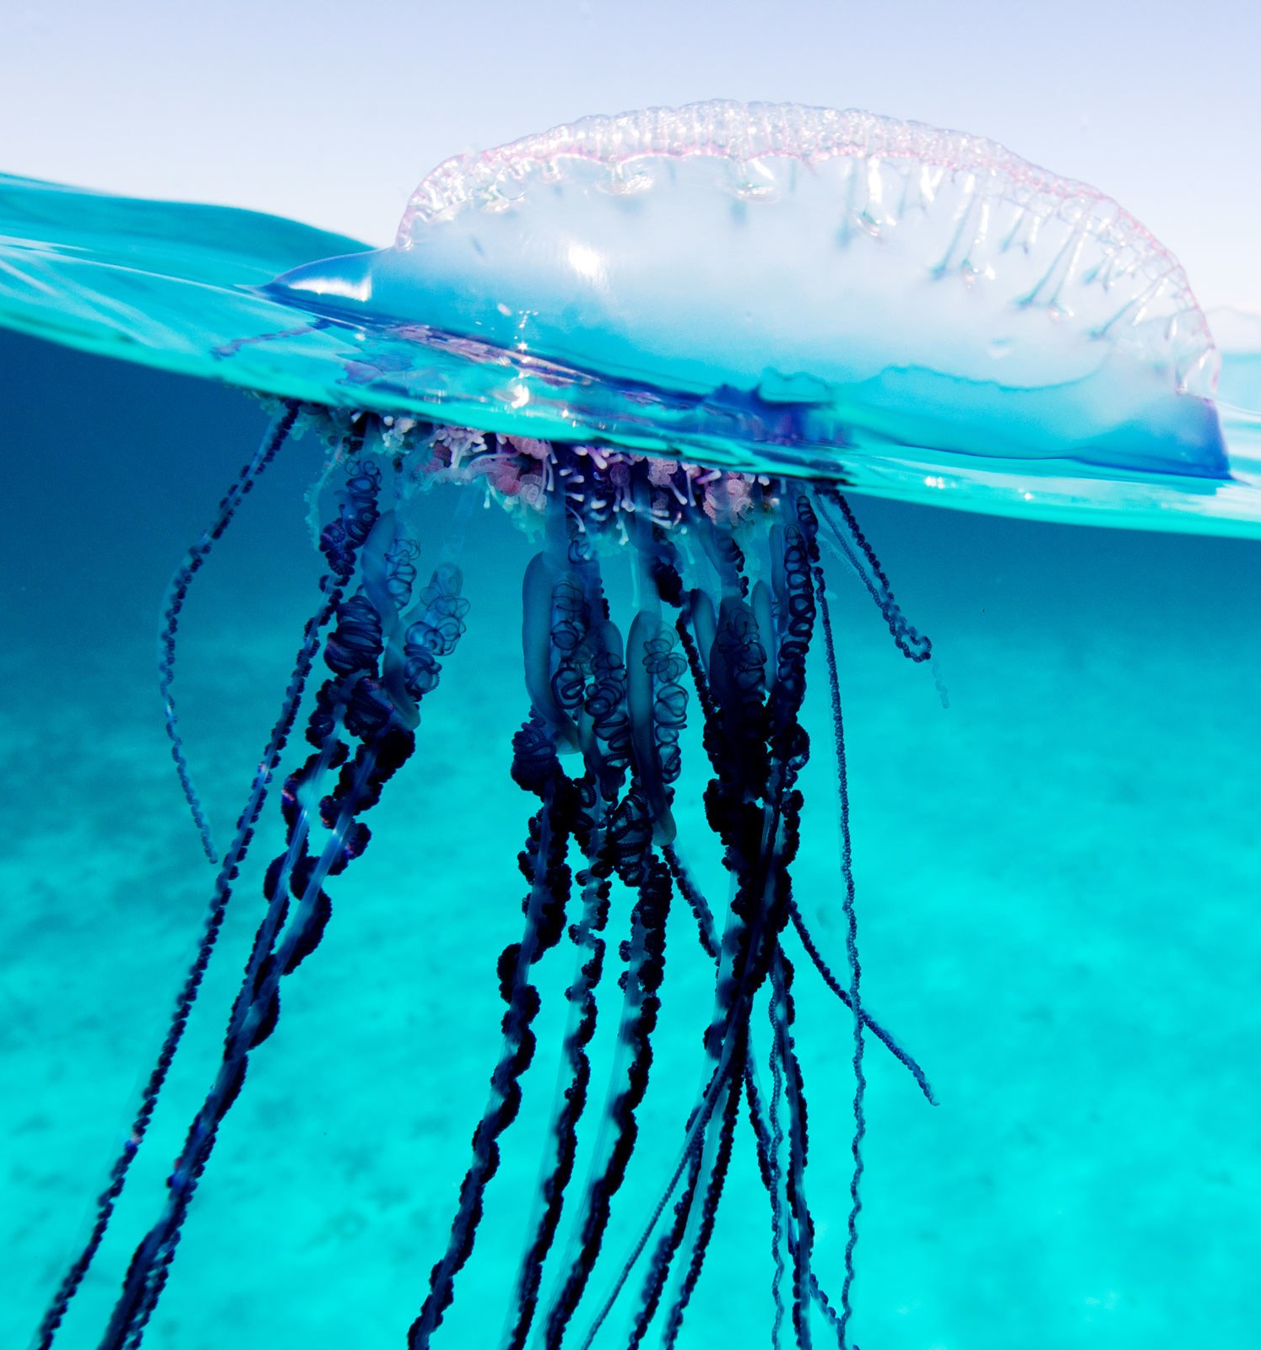
Future Directions
Even though I was not able to recover the specific tree that was published, the major clades were similar, except for one moving taxon
I think that the additional step in the paper of adding morphological characters strengthened the existing dataset further
The more we know about these creatures, the more informative the results are
From this experience, I was able to see how limited some of these raw datasets are. I now understand why scientists are continuing to expand them
In conclusion, from exploring the phylogenetic methods out there, I have a better understanding of the decisions that the scientist makes when making phylogenic trees and especially the differences between parsimony and maximum likelihood.

Slide 25
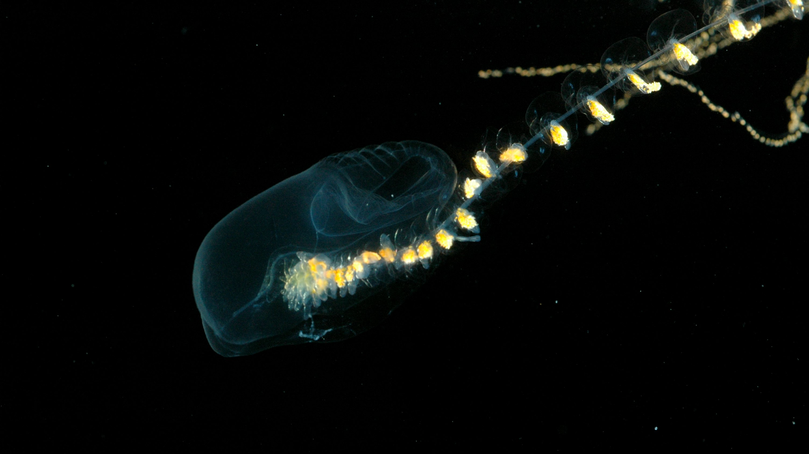
Citations
Munro, C., Siebert S., Zapata, F., Howison, M., Damian-Serrano, A., Church S.H., Goetz F.E., Pugh, P.R., Haddock, S.H.D., Dunn C.W. Improved phylogenetic resolution within Siphonphore (Cnidaria) with implications for trait evolution. Molecular Phylogenetics and Evolution
GitHub account for the data: https://github.com/caseywdunn/siphonophore_phylogeny_2017
My GitHub account: https://github.com/lemellenthin/Phylo

Slide 26
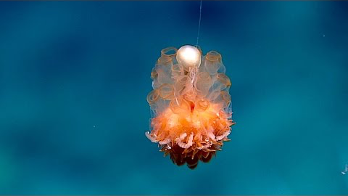
Fun video

