Slide 1


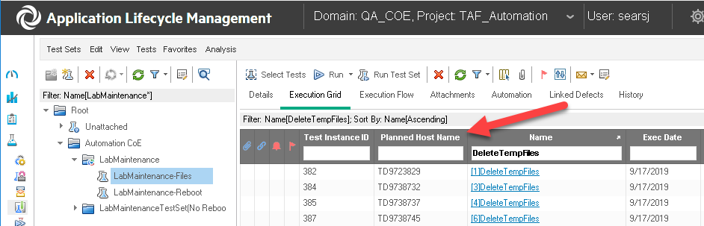
Jenkins
RunMode=PlannedHostList
Each Test runs on any available PC in the HostList.
HostList
Each test on the run on a QC HostList created Quality Center(QC). I follow your example and I set the RunMode to PlannedHost and set it to a Host List and not a HostName.
This works as long as I don’t need the test to run on a specific PC.

Slide 2
Jenkins
RunMode=PlannedHostName
Each Test must run on designated PC
Each test on the left must run on the “Planned Host Name” in Quality Center(QC). The MF Plugin fails to acknowledge the Host Name is populated in QC.
What RunMode in the plugin is needed so that when the test runs, it uses the “Planned Host Name”?
The Jenkins ticket suggested I populate the HostName but to make this process work, I would need a Jenkins job for each Test Case so I could force one test to run on one PC. That isn’t how the older Plugin worked.

Slide 3
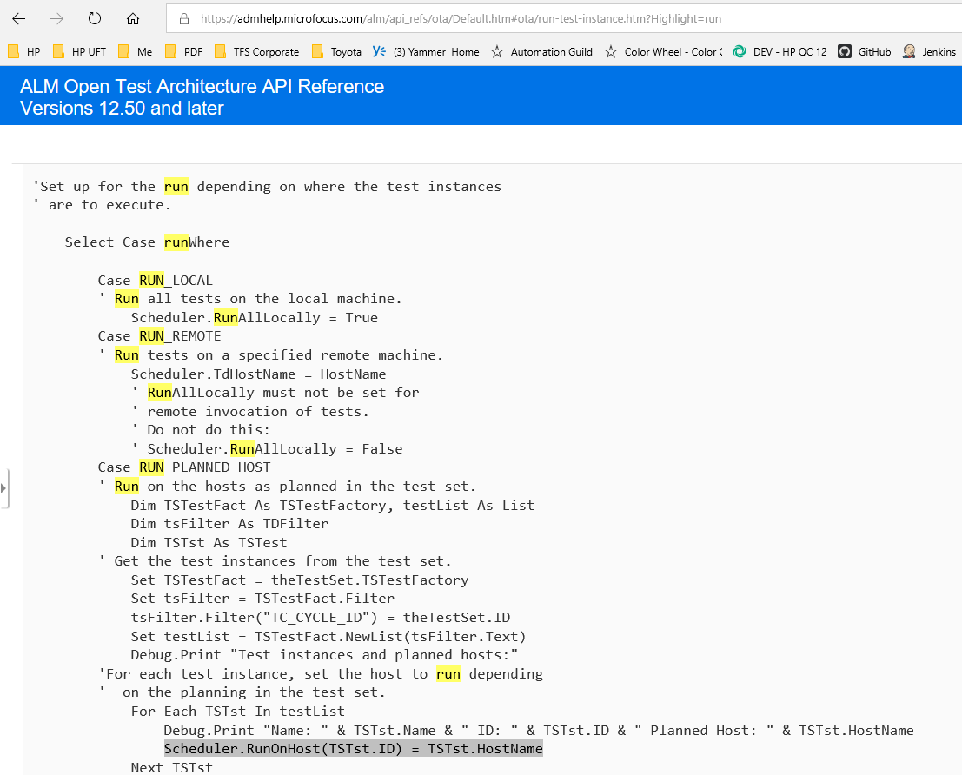
ALM OTA – How to run on a designated PC (HostName)
https://admhelp.microfocus.com/alm/api_refs/ota/Default.htm#ota/run-test-instance.htm?Highlight=run
Should the Jenkins plugin be using the “Planned HostName” listed in QC when the “RunMode” is set to “Run Remotely”?

