Slide 1
The Raspberry Pi Startup Workshop
Charles Shapiro, September 2018

Slide 2
What is it Good For?
Raspberry Pi is Not Arduino
  Has its own multitasking/multiuser OS
  Capable of serving web pages out of the box
  Can connect with TCP/IP out of the box
Possible uses:
  Web server for hardware control
  Computer Vision or Voice Command Processing
  Trap for Telemarketers
  Brain for your city-conquering Robot

Slide 3
Goals
Show some ways to control hardware with the Raspberry Pi
Learn basic setup and configuration of a Brand-New Pi
Gain some experience working on the Raspberry Pi linux command line
Understand how to connect a Raspberry Pi to your home network
Gain some crude understanding of web development

Slide 4
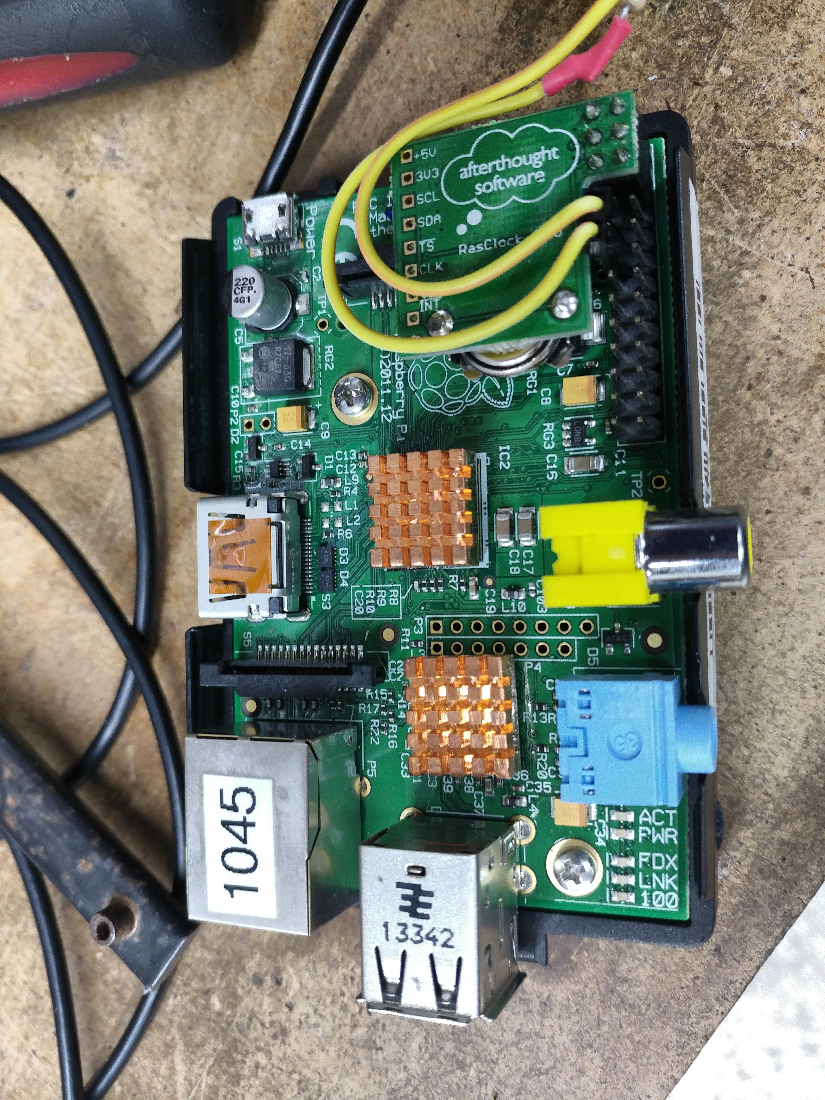
Connect the LED
Connect the LED to GPIO 7 ( Left side, 6 from top) and Ground ( Left side, 5 from top)
Resistor Side should be on GPIO 7 (6 from top)
Thread the LED through the GPIO slot and put the cover back on the Raspberry Pi.

Slide 5
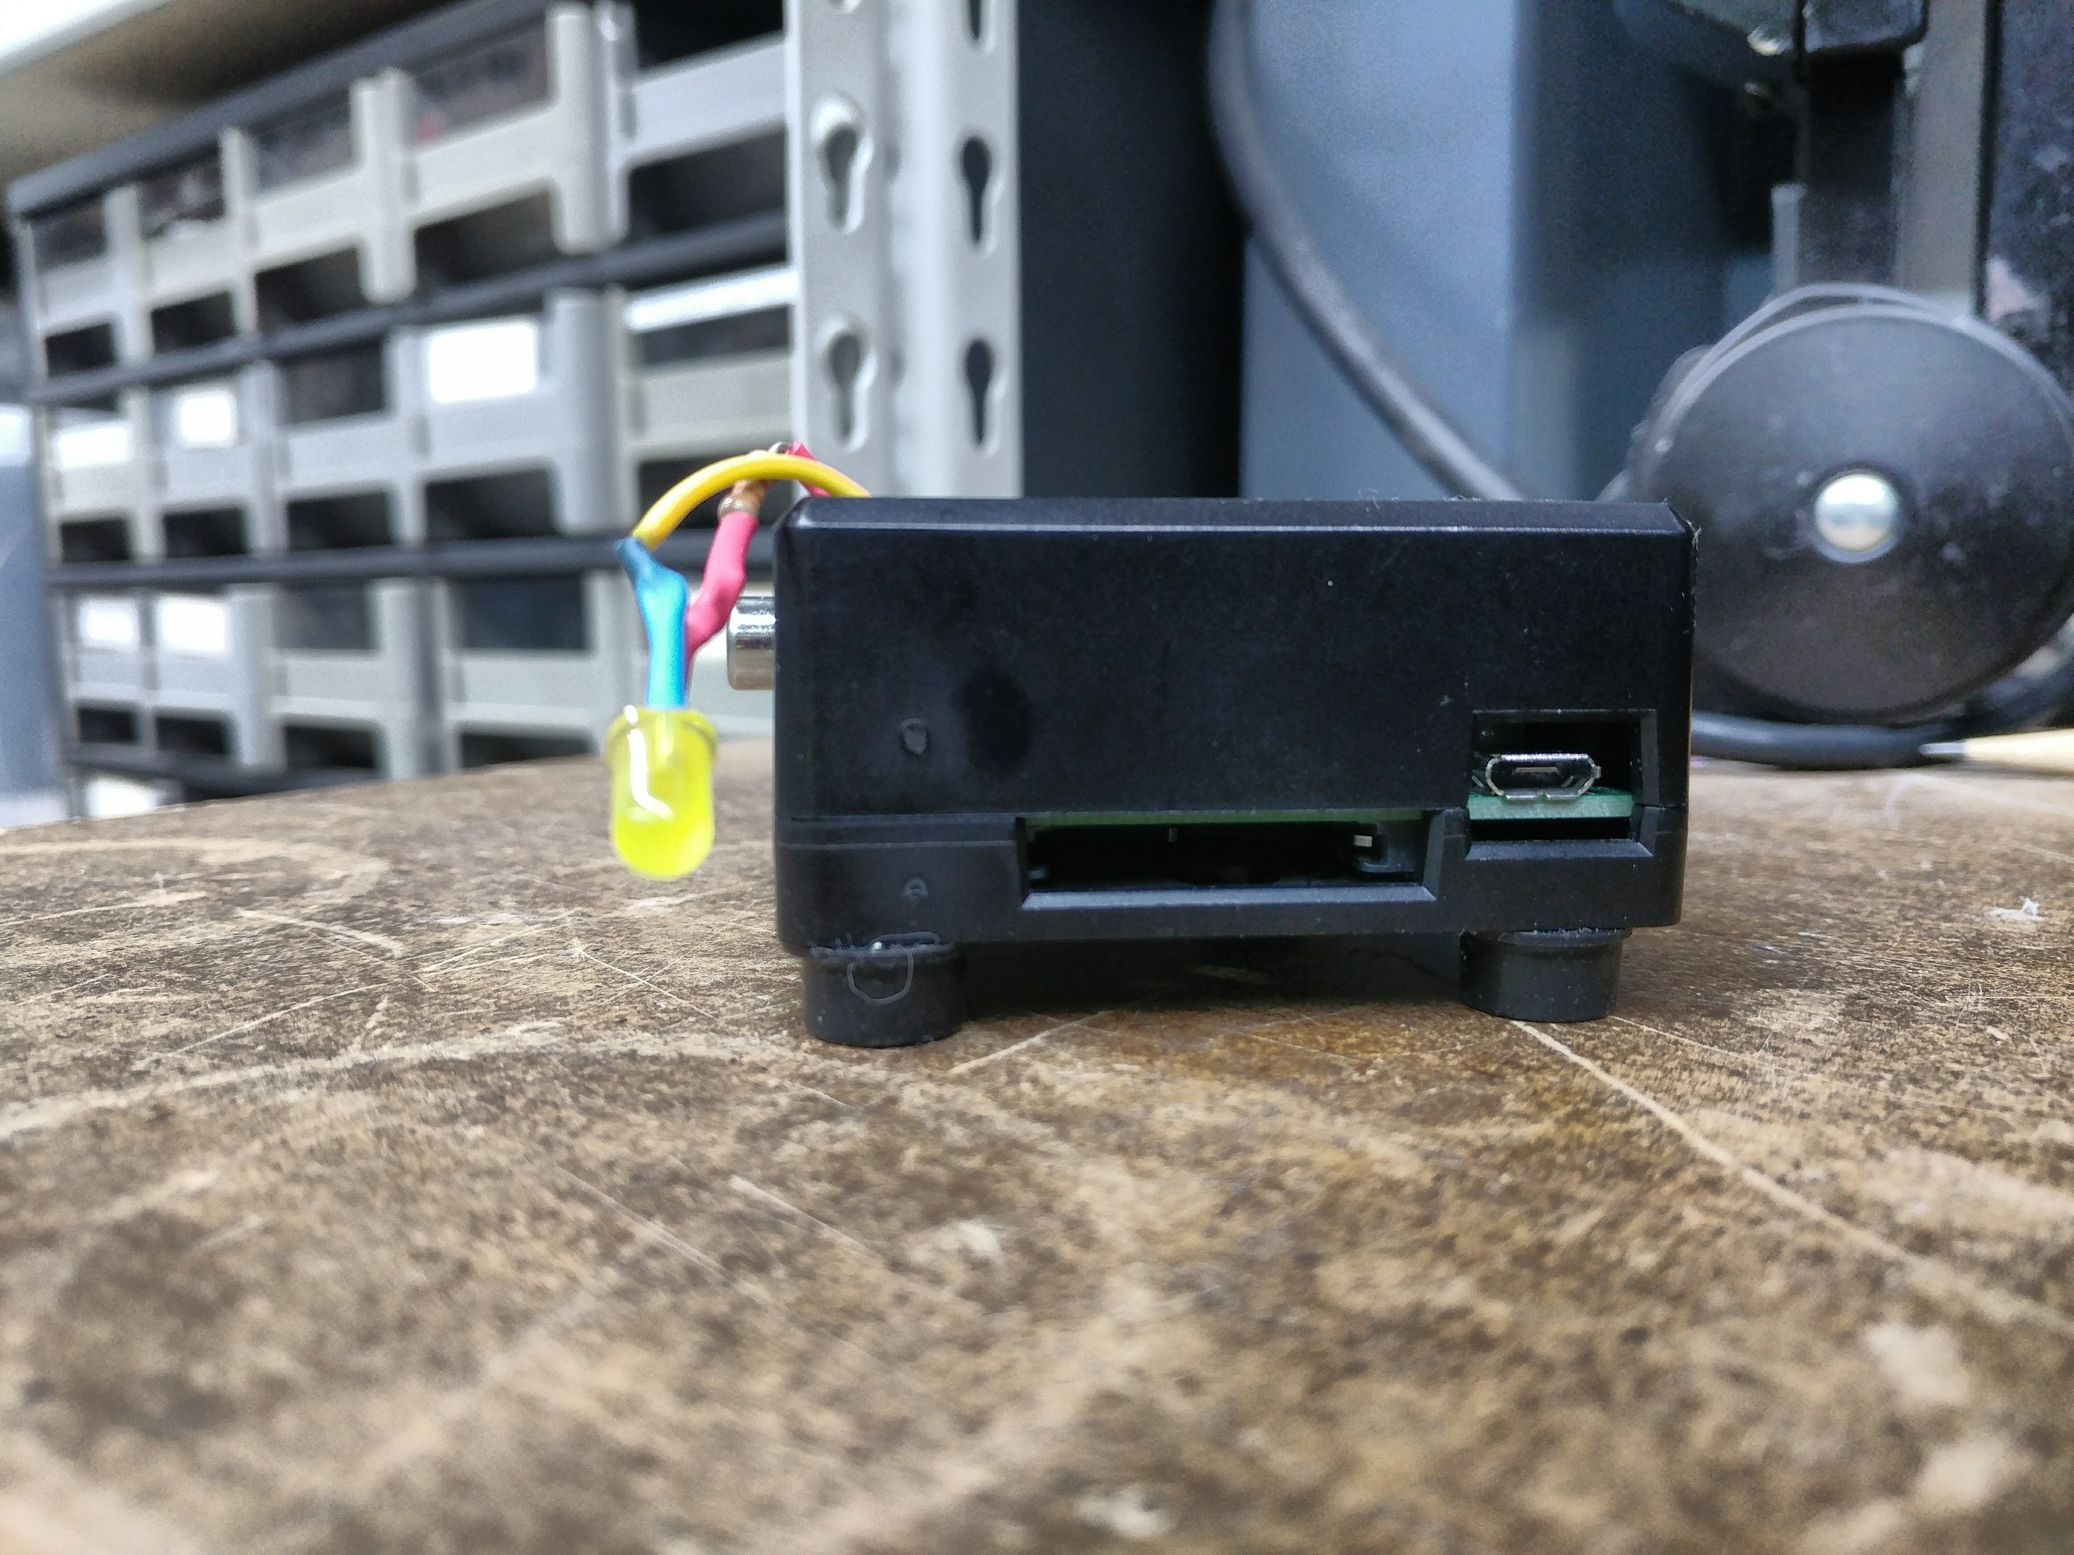
Insert the SD Card
SD Card goes into the Large Slot
Shiny Contacts should be facing Up

Slide 6
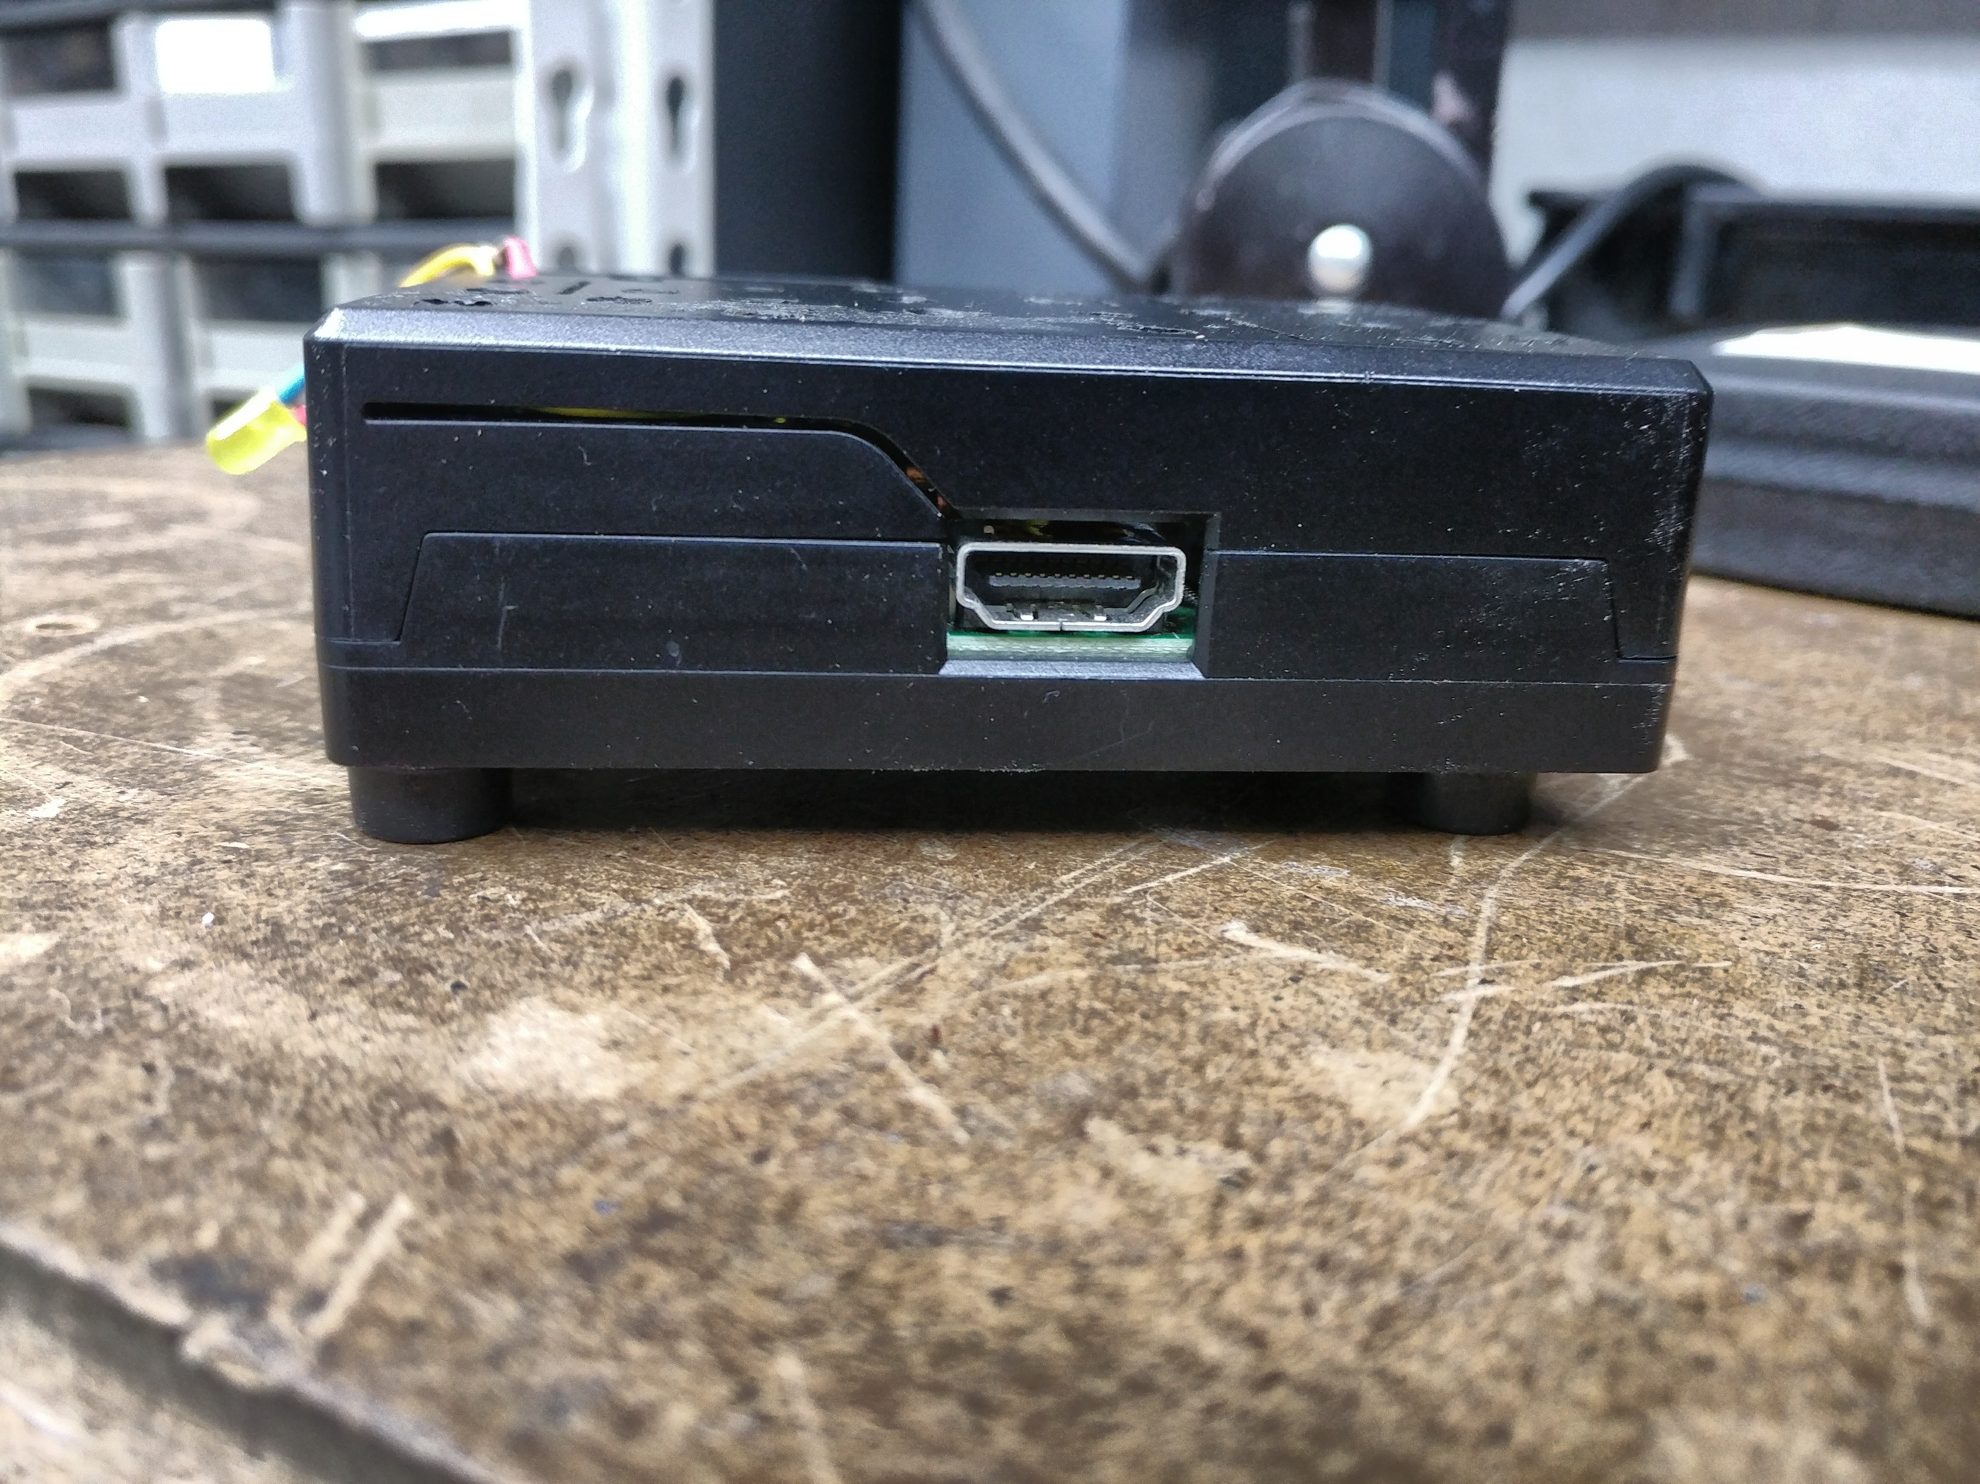
Connect the Monitor
Plug your HDMI Plug Here
Use your HDMI to VGA adapter As Necessary

Slide 7
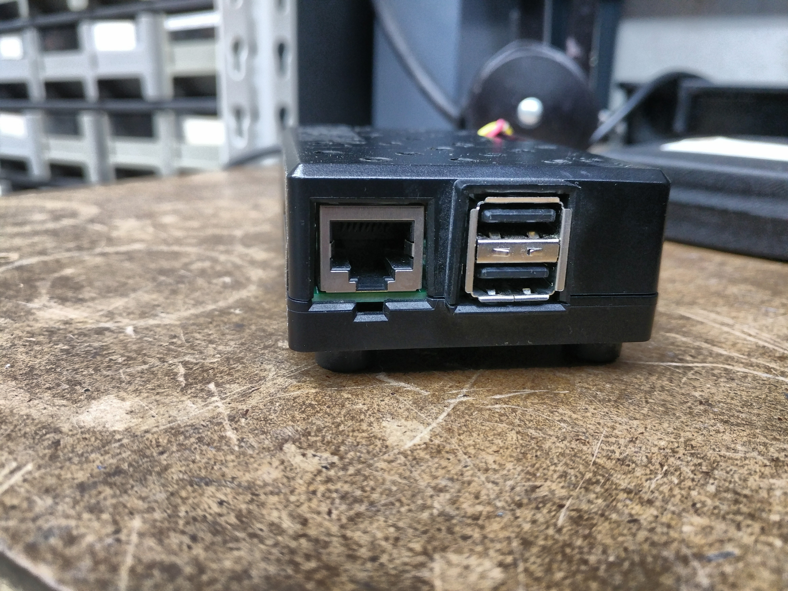
Connect the Keyboard
Plug the Keyboard into one of the two USB slots on the Right
It doesn't matter which one

Slide 8
Power It Up!
Connect wall wart to the USB Mini B connector next to the SD Card Slot
Plug the other end into the power strip. You should see lights blinking on the board, and they should eventually stabilize to one steady green and one steady red
You should see boot messages scrolling across your screen to a login prompt.

Slide 9
Name Your Pi
Login: pi
Password: raspberry
pi@raspberrypi:~$ sudo /bin/bash
# raspi-config
2 Network Options <enter>
N1 Hostname <enter> <enter>
Enter your first name or firstnamelastname as hostname
<tab><enter>
<tab><tab><enter>
Would you like to reboot now?
<tab><tab><enter>

Slide 10
Keyboard Troubles
Try to type the “|” character. You will get “~” instead. The “|” is crucial at the Unix command line, so we must fix this Trouble before moving on. Other characters are also affected – try “#” (the comment character in many applications), or even the quote (“) character.
We'll fix this by changing the “keyboard layout” from English to American.

Slide 11
Setting the Keyboard Layout
# raspi-config
4 Localization Options
l3 Change Keyboard Layout
Generic 101-key PC
Other
English (US)
<enter until top menu, then Finish>

Slide 12
Power Off Properly!
$ sudo /sbin/shutdown -h now

Slide 13
Connect the RJ45 Cord
Plug one end of the RJ45 cord into the slot on the Left
Plug the other end into the 24-port Hub

Slide 14
Power It Up!
Connect wall wart to the USB Mini B connector next to the SD Card Slot (Flat Side Up)
Plug the other end into the power strip. You should see lights blinking on the board, and they should eventually stabilize.

Slide 15
Connect over wifi
Configure your laptop's wifi connection to:
SSID: dmraspi
(no password)
This network is not connected to the internet, so you will see some griping about that fact.

Slide 16
Connect To Your Pi on the Web!
http://<yourname>.dmraspi.lan
Use the page to turn the LED on or off..

Slide 17
Network Infrastructure!
Spragdhcp provides DHCP and DNS through dnsmasq. Your router at home most likely provides these services on your network
Wifi connection is through the WRT54GL running OpenWrt as a bridge.
You can of course manually configure the network settings on your raspberry either from the command line or through raspi-config

Slide 18
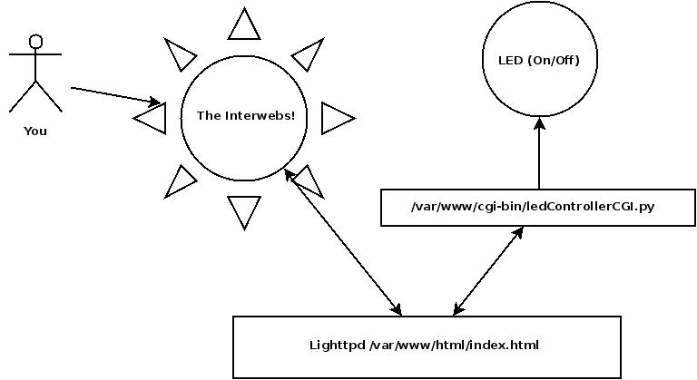
How the Raspi Blinky Works

Slide 19
First Try to ssh to your pi
. On Linux:
  ssh pi@yourname.dmraspi.lan
On windows:
  Open ssh client
  Type “pi@yourname.dmraspi.lan” into connect window
  Select “ssh” as connection method
It Won't Work

Slide 20
Enabling ssh on your pi
If you don't have a monitor hooked up to your Pi
  Mount raspberry pi “boot” sector on your computer (it's vfat, should mount on any system)
  Create empty “ssh” file in boot sector. ssh will be enabled on the next boot
If you do have a monitor hooked up
  Use raspi-config to enable ssh

Slide 21
You Must Change the Password!
Once you are talking to the raspberry pi, you must change the “pi” password!
passwd <enter>
Changing password for pi
(current) UNIX pasword: raspberry <enter>
Enter new UNIX password: <newpass> <enter>
Retype new UNIX password: <samepass> <enter>

Slide 22
Index.html
Cd /var/www/html
Nano index.html
<form>
<input>
<img>

Slide 23
ledControllerCGI.py
cd /var/www/cgi-bin
nano ledControllerCGI.py
#! explained
CGI (environment, command line) explained

Slide 24
Debugging Web Stuff
cd /var/www/html
nano index.html
Change:
<!-- form action="../cgi-bin/show_vars.sh" method="post"-->
To
<form action=”../cgi-bin/show_vars.sh” method=”post”>
And
<form action=”../cgi-bin/ledControllerCGI.py” method=”post”>
To
<!-- form action=”../cgi-bin/ledControllerCGI.py” method=”post”-->

Slide 25
Viewing HTML Form Variables
Reload the web page
Hit the <submit> button
You will see the variables from your HTML form, and the environment variables which your cgi-bin program is seeing.

Slide 26
Making the LED Actually Blink
http://yourname.dmraspi.lan/daemon_index.html
Use the web page to control the LED blink Frequency

Slide 27
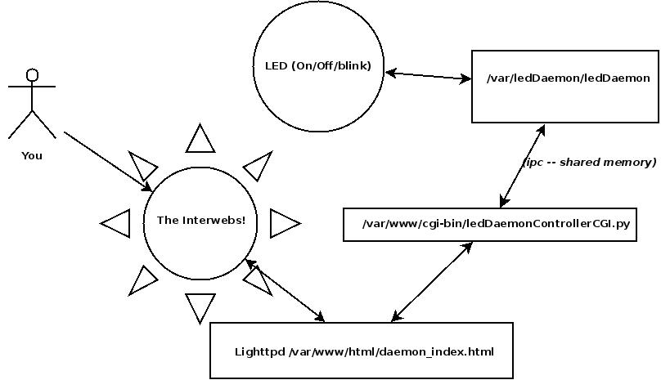
Using a Daemon to Blink the LED

Slide 28
daemon_index.html
The <select> input type
Using default values to limit execution paths

Slide 29
LedDaemonControllerCGI.py
cd /var/www/cgi-bin
nano ledDaemonControllerCGI.py
Using shared memory to communicate with a daemon (the joys of Unix IPC)

Slide 30
/var/ledDaemon/ledDaemon.py
cd /var/ledDaemon
nano ledDaemon.py
Writing a python daemon
cd /etc
nano rc.local
starting the daemon from a shell script

Slide 31
Using a Web Framework to blink the LED
Good Part:
  No httpd
  May be Easier to manage
  Better integration with some hardware
Bad Part:
  Tied to a specific language and framework
  May have to write More Code
    Code to generate HTML is harder to modify than a simple HTML page

Slide 32
Web Framework Setup
sudo /bin/bash
systemctl disable lighttpd.service
reboot
ps -aux -www | grep lighttpd
Root . . . grep lighttpd
cd /etc
nano rc.local
Add # before /var/ledDaemon . . . line
Remove # before /var/cherrypi_led . . . line
^x
Y
<enter>
reboot

Slide 33
Control the LED
http://<yourname>.dmraspi.lan
Use the web page to blink or turn the LED on or off. You now have more choices in the “frequency” list.

Slide 34
/var/cherrypy_led/cherrypyLedDaemon
cd /var/cherrypy_led
nano cherrypyLedDaemon
Using a script to control a daemon
nano cherrypy_led_daemon.py
cherrypy web framework madness...

Slide 35
Next Steps
Installing and Maintaining Software
  dpkg-query -l
  apt-cache show
  apt-get
Network Configuration
  ifconfig
  ping

Slide 36
Packages I Installed
lighttpd (web server)
python-sysv-ipc (access ipc from python)
spawn-fcgi (fast cgi access)
cherrypi (from source, since the repo is way out of date)

Slide 37
Some Fun Resources
Lighttpd ( https://www.lighttpd.net/ )
Cherrypy ( https://cherrypy.org/ )
Raspberry pi ( https://www.raspberrypi.org/ )
O'reilly media ( http://shop.oreilly.com )
Source Code Repository ( http://github.com/lemgandi/raspi_blinky )
Me ( charles.shapiro@tomshiro.org )

