Slide 1

Predicting Hospital Bed Utilization Using Social Determinants of Health
A County-Level Analysis (2020)
Team IOTA
May 2025

Slide 2

Table of Contents
Background
Methods
Findings
Conclusions

Slide 3
Background
1
Understanding the what and the why

Slide 4
Background & Motivation
Why Does This Matter to Public Health Agencies?(References 1 & 3)
Hospital bed capacity is a key health system indicator
Traditional forecasting overlooks social drivers of demand
Proactive identification of vulnerable communities enables targeted intervention
Shifting from reactive ➔ anticipatory planning

Slide 5

Research Question
Question:
Can social and geographic determinants of health (e.g., disability, poverty, healthcare access, advanced age, and transportation access) predict non-COVID hospital bed utilization at the county level in 2020?
Hypothesis & Prediction:
Counties with higher socioeconomic vulnerability will show higher utilization rates, independent of COVID factors (References 2 & 4)
image: https://www.freeimages.com/clipart/stickman-looking-through-magnifying-glass-1934931

Slide 6
Methods
2
Our data, preparation, and modeling approach

Slide 7
Data Sources
Source 1
AHRQ Social Determinants of Health Database (2020)
Source 2
HHS COVID-19 Hospitalization Dataset (2020)
Response Variable
Non-COVID Bed Utilization Ratio
Response Variable Formula:
(Inpatient Beds Used – COVID Beds Used) / Total Inpatient Beds
Final Dataset: 2,391 counties with 20 features
Caveats: County-level aggregation may mask neighborhood disparities

Slide 8
Data Preparation
Selected variables: economic status, housing burden, healthcare access
Removed redundant variables & addressed collinearity
Standardized features for model stability
1
3
5
2
4
6
Encoded region & urban/rural variables
Preserved county coverage while ensuring data quality
Final Dataset is ready to be used

Slide 9
Findings
3
Key results and insights from the analysis

Slide 10




Modeling Approach
Evaluated multiple regression algorithms: SVR, Random Forest, Gradient Boosting, XGBoost(best performance)
Optimized with grid search
Validated across geographic regions
Dimensionality reduction tested (not used; decreased performance)

Slide 11
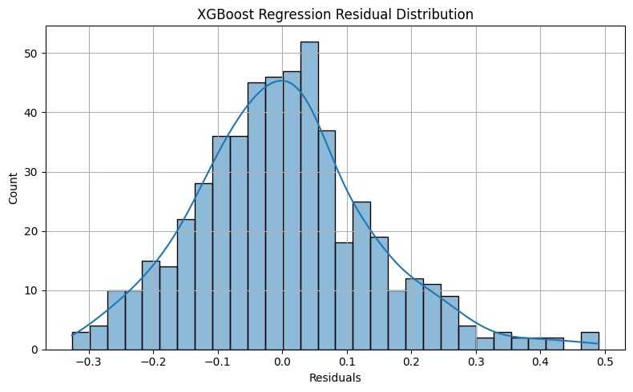
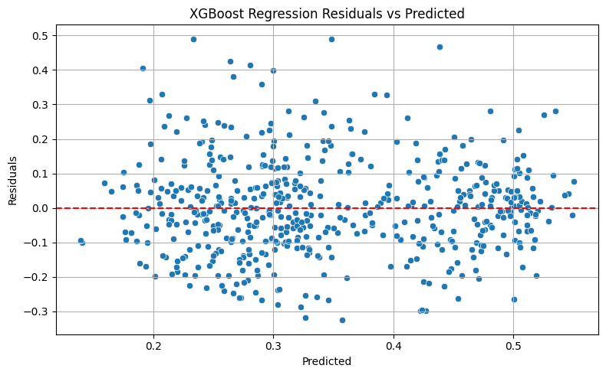
Model Performance
Selected Model
XGBoost Regressor
Performance
Test R²: 0.3617 (36.2% variance explained)
RMSE: 0.1378
Validation
Model tested across all U.S. regions with no major geographic bias

Slide 12
Model Comparison
Model Performance Metrics: Comparing Train/Test Results Across Approaches
Why XGBoost Works Best?
XGBoost 0.362 Best performance
Gradient Boosting 0.356 Strong but less robust
Random Forest 0.352 Good but less generalizable
SVR 0.154 Couldn't capture complexity
Tree-based models outperformed; PCA reduced performance (36.2% → 13.9%)
Model with No-PCA | Train R² | Test R² | Train RMSE | Test RMSE | Notes
SVR | 0.17 | 0.15 | 0.57 | 0.63 | Underfit
Random Forest | 0.48 | 0.35 | 0.12 | 0.14 | Competitive
Gradient Boosting | 0.50 | 0.36 | 0.12 | 0.14 | Strong
XGBoost | 0.50 | 0.36 | 0.12 | 0.14 | Best Performance
XGBoost w/PCA | 0.18 | 0.14 | 0.42 | 0.49 | Underfit/ Lower Performance

Slide 13
Feature Importance
Total Population in Poverty
F score: 114
Housing Costs
F score: 52
Single Parent Rates
F score: 50
Disability Rates
F score: 45
Distance to ICU
F score: 43

Slide 14
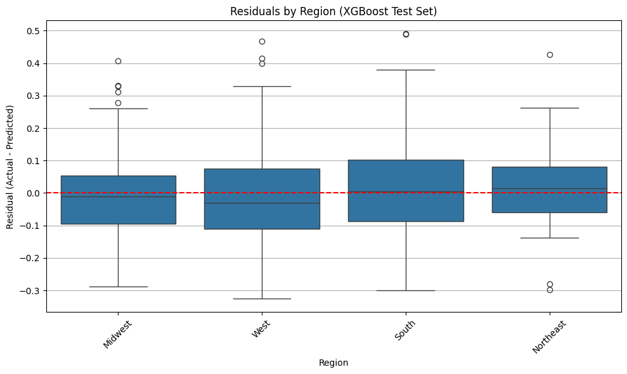
Regional Insights
Geographic Patterns in Utilization:
Consistent model performance across regions
Regional differences exist but smaller than socioeconomic effects
Socioeconomic vulnerability transcends geographic factors
Slight underprediction Southern counties

Slide 15
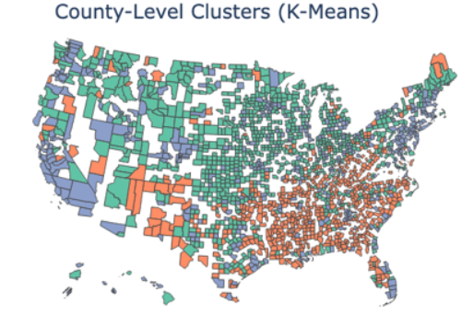
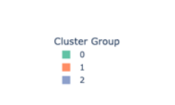
Country Typology Clusters- Understanding Different Vulnerability Patterns
Cluster 0
Cluster 1
Cluster 2
Higher homeownership, traditional households
Rural, mobile homes, disability, limited internet
Urban/suburban, higher incomes, better digital access
*Clusters align with residual patterns

Slide 16
Conclusions
4
Limitations, recommendations, and next steps

Slide 17
Key Findings
Economic vulnerability drives hospital strain
Prioritize interventions in low-income areas
Poverty is the top predictor
Improving economic well-being contributes to healthier communities
Healthcare access moderately influential
Investment in access can improve capacity
Regional variation is eclipsed by socioeconomic factors
Focus efforts on social risks before regionally targeted policies

Slide 18

Limitations & Cautions
Important Considerations:
Model explains ~36% of variance – not comprehensive
Shows correlation, not causation
County-level ➔ may miss neighborhood-level disparities
Not for individual hospital-level planning
2020 data may reflect pandemic impacts

Slide 19
Recommendations
Applying These Insights:
Integrate predictions into community health assessments
Target resources to high-vulnerability counties
Address underlying social factors:
Transportation assistance programs
Housing stability initiatives
Family support services
Use model to justify grants for underserved communities

Slide 20

Thank You & Next Steps
Moving Forward:
Develop interactive dashboard for regional planning
Validate with newer data (2021–2023)
Pilot interventions in high-risk counties
Expand to granular geographic analysis
Full technical report https://github.com/lemieuxjm-cap/Iota-Capstone/reports/Final_Report.pdf

Slide 21
References
(1)Artiga, S., & Hinton, E. (2018). Beyond Health Care: The Role of Social Determinants in Promoting Health and Health Equity.
(2)Garg, S., Kim, L., Whitaker, M., & et al. (2020). Hospitalization Rates and Characteristics of Patients Hospitalized with Laboratory-Confirmed Coronavirus Disease 2019 — COVID-NET
(3)Kreuter, M. W., Thompson, T., McQueen, A., & Garg, R. (2021). Addressing Social Needs in Health Care Settings: Evidence, Challenges, and Opportunities for Public Health
(4)Magnan, S. (2017, October 9). Social Determinants of Health 101 for Health Care: Five Plus Five

