Slide 1

MandiPass: Secure and Usable User Authentication via Earphone IMU
Jianwei Liu, Wenfan Song, Leming Shen, *Jinsong Han, Xian Xu, and Kui Ren
Zhejiang University, Hangzhou, China
ICDCS 2021, Online
July 2021
Notes:
Hello everyone, I am wenfan song from Zhejiang University, I’m glad to introduce our workMandiPass: Secure and Usable User Authentication via Earphone IMU.

Slide 2
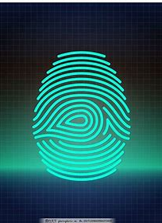
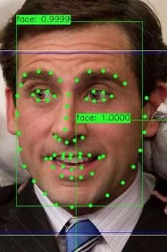
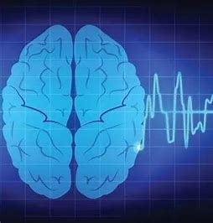
Background
Biometric plays an important role in user authentication
Fingerprint
Facial Feature
Brain Wave
Notes:
Nowadays, biometric plays an important role in user authentication. For example, fingerprint, facial feature, and brain wave
随着科技的进步身份认证技术变得尤为重要，在众多认证技术当中人脸识别技术是最promising的，人脸识别也非常受欢迎且准确率很高，常常被用于手机解锁，门禁系统和网络支付

Slide 3
Limitations of Existing Authentications
Intracorporal biometrics
1) Current biometrics are hard to collect them, e.g., brain wave and ear canal feature
2) Or they are not stable, e.g., electrocardiogram can be easily affected by motion and emotion
Non-intracorporal biometrics
1) Current biometrics are easy to stolen/forged, e.g., a fingerprint verification system could be spoofed by clay-made fingerprint
2) Or they are vulnerable to adversarial sample attacks, e.g., adversarial facial samples and adversarial voice samples
Notes:
Traditional biometrics lie into intracoporal ones and non-intracorporal ones. The former is secure but hard to collect. The latter is easy to collect but vulnerable to spoofing attacks

Slide 4
Motivation & Goal
With the popularity of earphones, many kinds of sensors including inertial measurement unit (IMU) have been integrated into them
Earphone will become the next-generation mobile computing platform
We want to explore a brand-new intracorporal biometric that can be captured by earphone IMU
We want to extract fine-grained biometric to achieve accurate user authentication
Notes:
Since earphone will be one of the next computing platforms, and IMU has been integrated into many types o earphones. in this work, we aim to leverage the IMU to collect a brand-new intracorporal biometric to achieve accurate user authentication

Slide 5
Challenge
It is difficult to find a brand-new intracorporal biometric, and theoretically prove that it can be captured by earphone IMU
Raw IMU signals contain much noise, and the sampling rate of IMU is low, which make the biometric hard to extract from noisy signals
Resisting replay attacks remains an open issue for biometric-based authentication
Notes:
However, achieve secure and user-friendly authentication is challenging. First, It is difficult to find a brand-new intracorporal biometric, and theoretically prove that it can be captured by earphone IMU. Econd, Raw IMU signals contain much noise, and the sampling rate of IMU is low, which make the biometric hard to extract from noisy signals. Third, Resisting replay attacks remains an open issue for biometric-based authentication

Slide 6
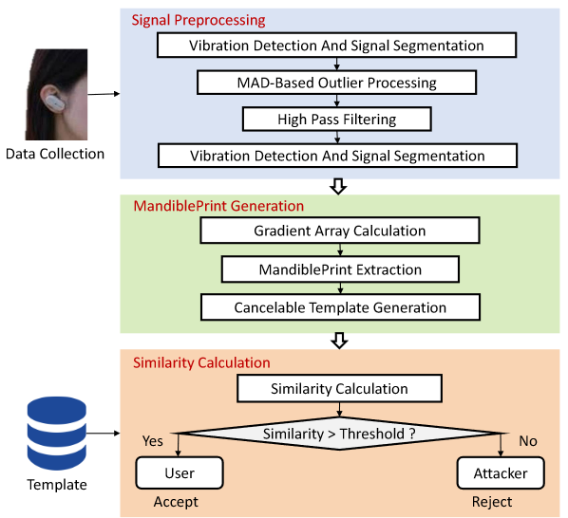
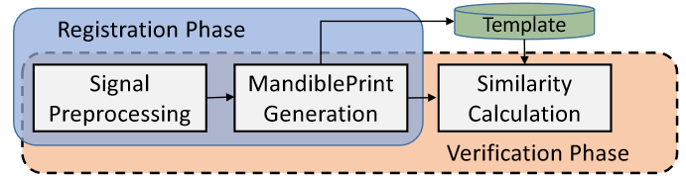
Proposed System: MandiPass
Use of MandiPass
Registration phase
Verification phase
Architecture of MandiPass
Data Preprocessing module
MandiblePrint Generation module
Similarity Calculation module
Notes:
In this work, we overcome the above challenges and propose a system named MandiPass. MandiPass achieves usable and secure authentication by extracting a brand-new biometric called MandiblePrint. MandiPass is composed of three modules, data preprocessing, mandibleprint generation, and similarity calculation. User only needs to produce a voice by his throat to generate vibration. MandiPass extract mandibleprint from the received vibration signa;

Slide 7

Challenge 1:
Feasibility study & Validation Experiment
Notes:
I first present the feasibility study and validation experiment

Slide 8
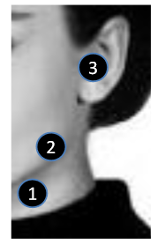
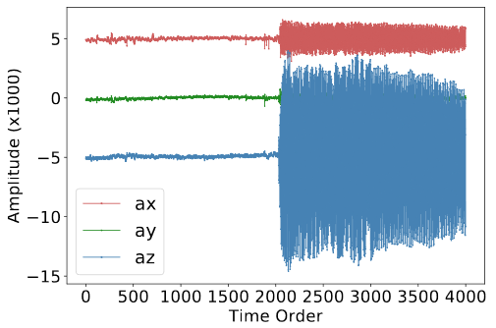
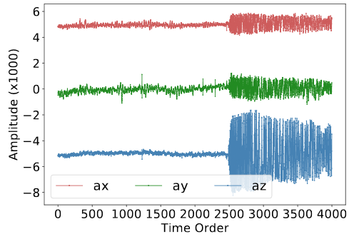
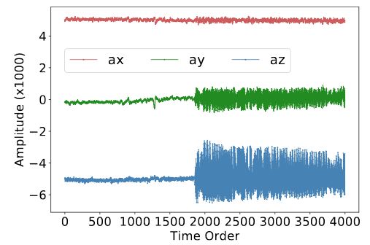

Signal Propagation Path
Propagation experiment
We attach the IMU to three different locations around the mandible: throat, mandible, and ear
The vibration strength becomes lower and lower along the path ”throat-mandible-ear”
The vibration introduced by the throat can propagate through the mandible, and finally reach ear
Notes:
To confirm that the vibration can propagate from throat to ear, we attached IMU to three different location to the face to observe the vibration strength. The result shows that the vibration is able to probagate along the mandible, and finally reach ear

Slide 9
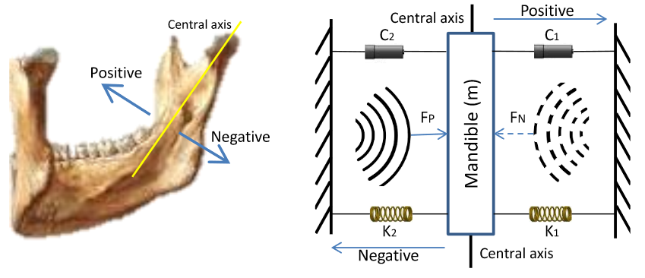
Vibration Model
One-degree-of-freedom model
m: mass of mandible
c1, c2: two dampers
k1, k2: two springs
FP, FN: two virtual forces
The vibration can be divided into two phases: positive-direction vibration and negative-direction vibration
Notes:
We then built a one degree-of-freedom theoretical model to prove that the received vibration signal contains mandible biometrics. In this model, the vibration can be divided into positive-direction one and negative-direction one

Slide 10

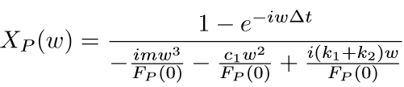

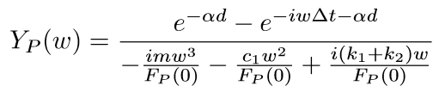
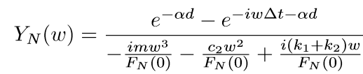
Theoretical Analysis
For the positive-direction vibration, we have:
After performing Fourier transform and term transposition, we have:
According to
, we have:
similarly
The received vibration signals contain person-specific mandible biometrics: m, c1, c2, k1, k2
Notes:
From the theoretical analysis we can found that position-direction vibration sisgnal and negative-direction vibration signal record different biometrics. Thus, it is feasible to extract mandibleprint from the vibration signals

Slide 11
Challenge 2:
Data Processing & MandiblePrint Generation
GeGenerationneration
Notes:
Now, I will present how to perform data processing and menbleprint generation

Slide 12
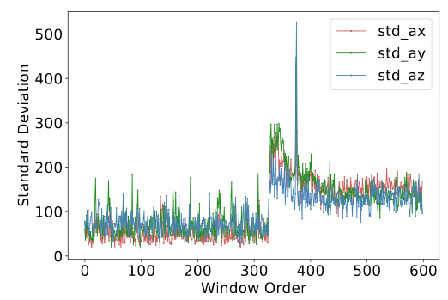
Authentication Detection & Data Segmentation
Authentication request detection
Achieving authentication detection by monitoring the vibration strength
Using a sliding window to detect the vibration strength of the accelerometer
Calculating standard deviation of each window, the threshold is 250
Selecting 60 signal values for each axis
Notes:
In the data preprocessing, MandiPass first detects the beginning of the vibration by utilizing a slide window to calculate the standard deviation

Slide 13
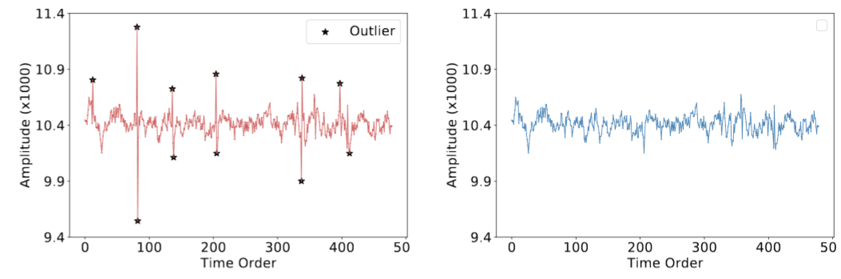
Outlier Processing
There are some outliers mixed in the normal values due to the hardware imperfection and human motion
Using MAD algorithm to find all outliers
Replacing each outlier by the mean of its two previous and two subsequent normal values
MAD-based outlier processing method can effectively eliminate the impacts of outliers
Notes:
Then, MandiPass leverages MAD algorithm to find all out;iers and replace the outliers by the mean of normal values

Slide 14
High-Pass Filtering
Human’s fundamental frequency of vocal vibration varies from 100Hz to 200Hz
Human motion may generate low-frequency components (LFCs), which are generally less than 20Hz
A high-pass filter can be used to preserve high-frequency components
Using a high-pass filter with a cutoff frequency of 20Hz to process each axis
The most impactful identity-irrelevant components have been removed through outlier processing and high-pass filtering
Notes:
Next, to eliminate the low-frequency component introduced by body motion, MandiPass filter the signals by a high-pass filter with a cutoff frequency of 20Hz

Slide 15
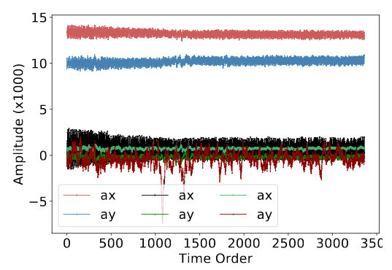

Normalization & Concatenation
Different axes have different initial signal values
Using min-max normalization method to normalize each axis
In this formula:
xn: normalized signal value
xo: original signal value
xmax: the maximum of the corresponding axis
xmin: the minimum of the corresponding axis
Finally, MandiPass concatenates all six axes and obtains a feature block with a dimension of (6, 60)
Notes:
Afterwards, MandiPass normalize the signal values and obtains a feature block with a dimension of (6, 60), where 6 means the six axes in the IMU and 60 means 60 signal values for each axis

Slide 16
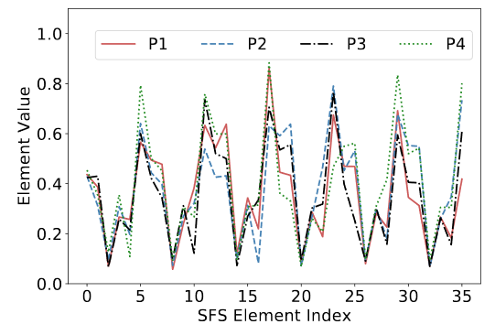
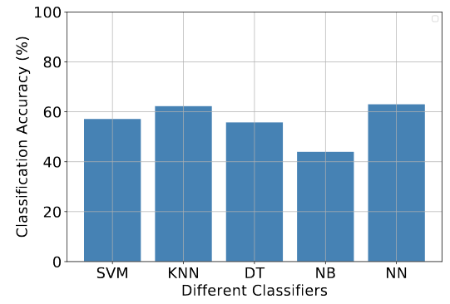
Identity Recognition-Statistical Feature
Intuitively, statistical features can be calculated as MandiblePrint, and we can use traditional classifiers to identify users
The statistical features of different persons are similar
The classification accuracy of five classifiers are less than 65%
Notes:
To identify users, an inituitive method is to calculate statistical features and use traditional classifiers to identify these features. Howvwer, the identification accuracy is not high enough

Slide 17
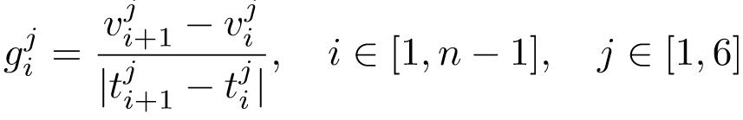
Gradient Features
The biometrics in positive-direction vibration are different from that in negative-direction vibration
MandiPass separates the positive-direction vibration and negative-direction one by calculating the gradients for each axis:
Performing interpolation on the gradients of each axis, so that each axis has two kinds of gradients and each of kind contains 30 gradient values
Finally, MandiPass obtains a dimension-consistent gradient array with a dimension of (6, 2, 30)
Notes:
As mentioned before, positive-direction vibration and negative-direction vibration contain different biometrics, we thus separate the positive-direction vibration signals and negative-direction ones by calculating the gradient features

Slide 18
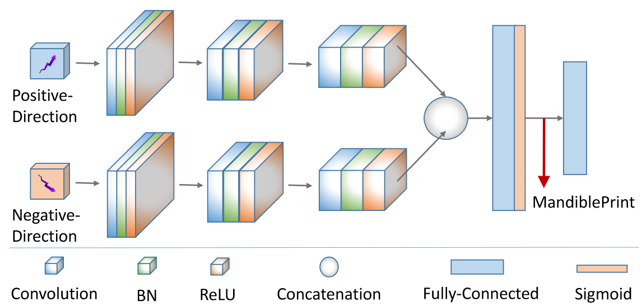
Two-Branch CNN
Convolutional neural network has powerful feature extraction ability
Two branches for positive- and negative-direction gradients
Each convolutional layer is followed by a batch normalization and a ReLU activation function
The output of the hidden layer is regarded as MandiblePrinrt
Users do not need to provide any data for the network training. The network is pre-trained by the verification service provider
Notes:
Since convolutional neural network has powerful feature extraction ability, we design a two-branch feature extractor to extract mandibleprint from vibration signals. The output of the first fully-connected layer is regarded as the mendibleprint vector

Slide 19
Challenge 3:
Security Enhancement
Notes:
Then, I will introduce the security enhancement part

Slide 20

Attack Model
Zero-effort attack: The attacker has no awareness of MandiPass’s principle. The attacker steals the victim’s earphone and attempts to use it to conduct authentication
Vibration-aware attack: The attacker knows the principle of MandiPass. The attacker attempts to produce a vibration signal to deceive MandiPass
Impersonation-aware attack: The attacker first observes the verification process of the victim. Then the attacker mimics the voicing manner of the victim to launch the impersonation attack
Replay attack: The replay attacker steals the MandiblePrint template stored in the secure enclave and exhibits it to MandiPass to launch the replay attack
Notes:
We first define four attack models towards four kindss of mainstream attacks.

Slide 21


Security Analysis
Zero-effort attack analysis: The attacker who is not aware of this principle cannot provide gradient array to MandiPass
Vibration-aware attack analysis: The attacker is unable to provide correct MandiblePrint, leading the attack to fail
Impersonation attack analysis: Even if the attacker is able to mimic the voicing manner of the victim, his MandiblePrint is still dissimilar to the victim’s one, resulting in the calculated similarity smaller than the threshold
Replay attack defense: Leveraging a Gaussian matrix to transform the MandiblePrint into cancelable MandiblePrint template
Notes:
From the analysis, we found that mandiPass can defend against the first three kinds of attacks naturally. To defend against replay attacks, mandipass leverages a Gaussian matrix to transform the mandibleprint template to a cancelable one. Once the cancelable template is changed, the replay attacker cannot pass the verification

Slide 22
Evaluation & Result
c
Notes:
Then, let’s move to the evaluation part

Slide 23
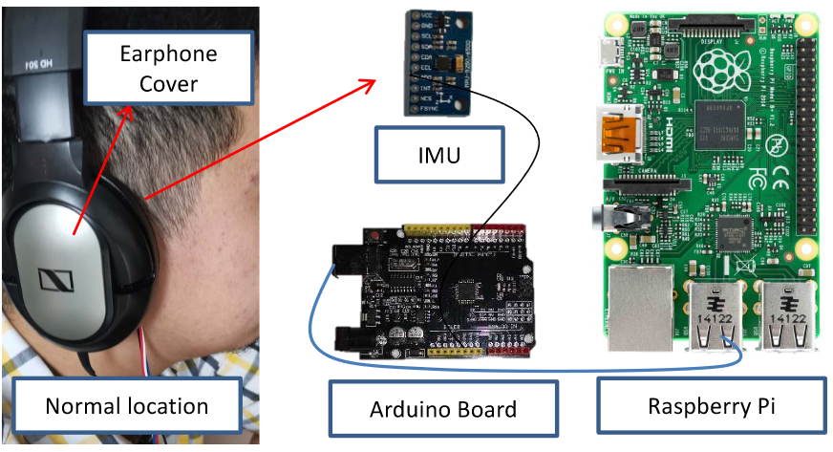
Experiment Setup and Metric
Experiment setup
# 34 volunteers were invited to collect signals
# Hardware:
Raspberry Pi
IMU: MPU-9250 & MPU-6050
# Software:
Pytorch framework
Metric
# False Reject Rate (FRR) # False Accept Rate (FAR)
# Verification Success Rate (VSR) # Equal Error rate (EER)
The lower the FRR, FAR, EER are, the higher the VSR is, the better MandiPass performs
Notes:
We implemented MandiPass on a Raspherry Pi to conduct real-world experiment. We invited 34 volunteers to collect vibration signals. To quanlify the authentication performance, we defined four metrics: FRR FAR VSR and EER

Slide 24
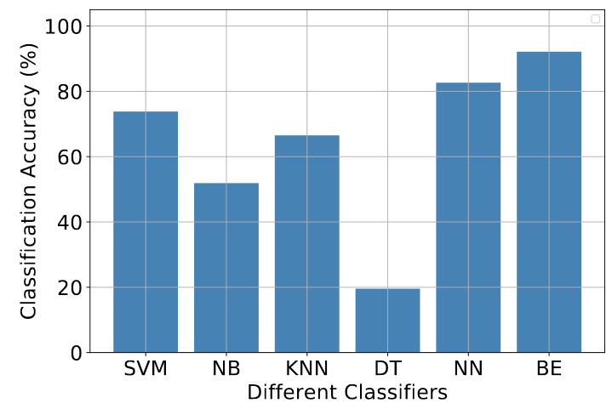
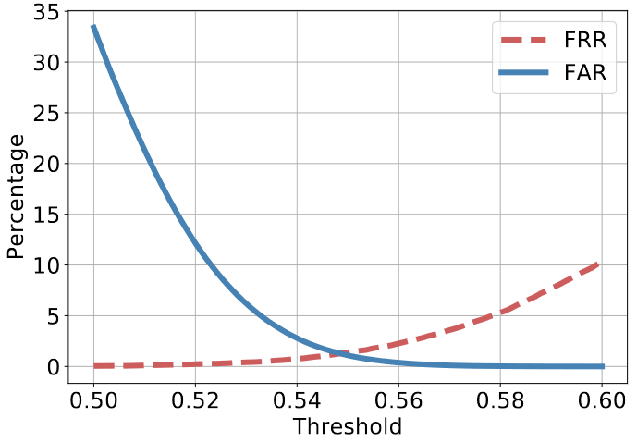
Overall Performance
The proposed two-branch convolutional neural network can achieve the highest accuracy (>90%)
The EER is only 1.28%, when the acceptance threshold is 0.5485
Notes:
In the first figure, the identification results show that our feature extractor outperforms other classifiers. The curves of the Far and the FRR show that the EER is only 1.28%

Slide 25
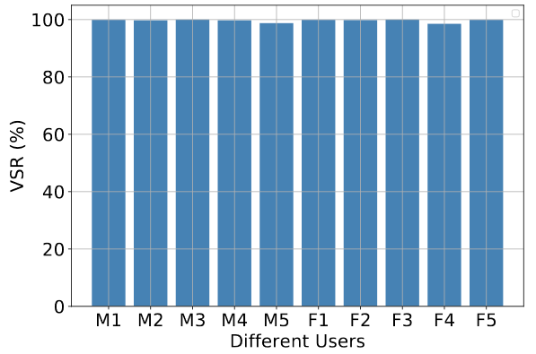
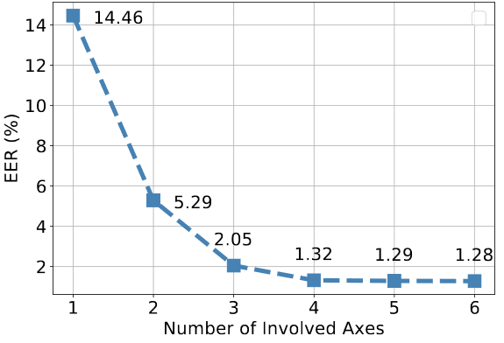
Impacts of Gender and Axes Number
The VSR is fair to different genders
The EER is as low as 1.32% when we only use the three axes of the accelerometer
Notes:
In the gender and axis experiments, the results show that MandiPass is fair to different genders. And using only three axes can achieve sufficiently low EER

Slide 26
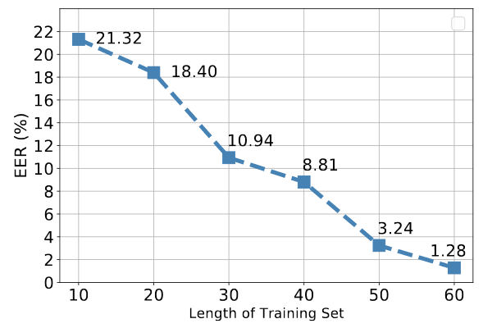
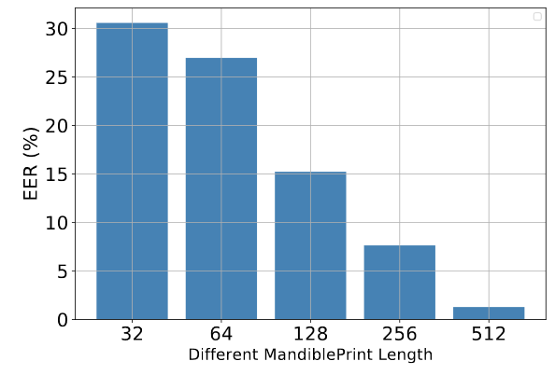
Impacts of System Settings
Collecting 60 gradient arrays is sufficient for the CNN training
When the number of the elements in the MandiblePrint vector is 512, the EER is as low as 1.28%
Notes:
In the experimets towards different system settings, the result demonstrate that collecting 60-second training data for the feature extractor is enough, Moreover, the number of the elements of the mandibleprint vector can be 512

Slide 27
Conclusion
We propose MandiPass, a usable and secure user authentication system
We theoretically prove that the vibration signals affected by the mandible contain MandiblePrint
We leverage a series of processing methods and a two-branch feature extractor to achieve precise user verification
We conducted comprehensive experiments with 34 volunteers, the result shows that the EER of MandiPass is only 1.28%

Slide 28

Thank you!

