Slide 1

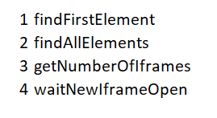




Content
1st
All

Slide 2
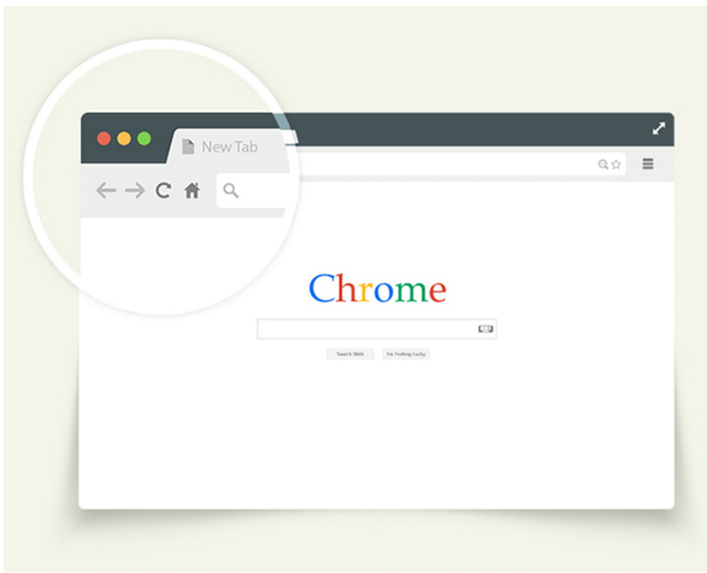
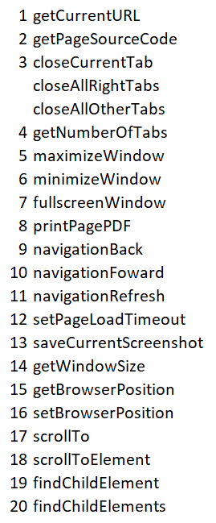










Browser
16
15
5
6
3
7
1
URL
4
9
10
11
2
8
18
17
13
14
12
20
19

Slide 3







keyMouse
debug

