Slide 1
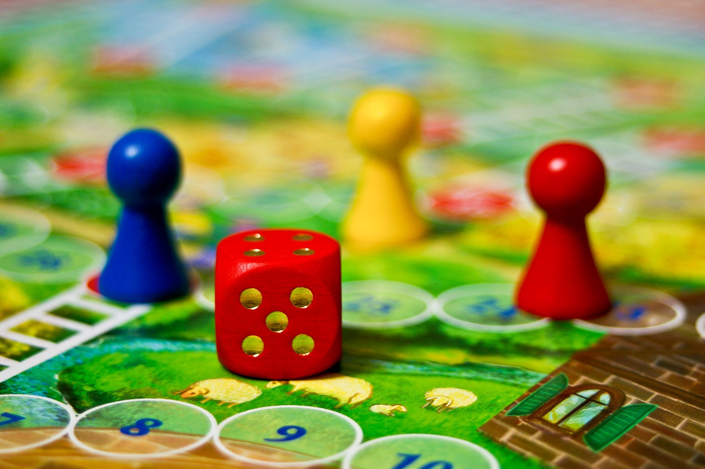
HTML + CSS: THE WORLD OF GAME
Presented By: Lê Minh Long
Teacher: Thầy Nguyễn Đức Huy
Date: September 30, 2025
Notes:
"Hello everyone!
Today, we're going to explore the world of web development through a website dedicated to games.
As the developer who built this site using just HTML and CSS, I'm excited to share how we brought this website to you.
We'll look at what the site does, the code that makes it, and some ideas for how it could evolve in the future.
Think of this as a practical look at how the web works, starting with the basics."

Slide 2
Welcome to My Gaming Portal!
What is this website? A dynamic showcase for trending and popular video games.
Our Goal: To provide a clean, accessible platform for gamers to discover new titles, explore categories, and get essential game info.
Key Focus: Highlighting hot new releases and frequently downloaded games.
Presentation Roadmap:
Website Functions
The Code Behind It (HTML & CSS)
Future Enhancements
Notes:
"So, what is this website all about? It's essentially a hub for gamers!
Our main mission was to create a space that’s easy to navigate and visually appealing, helping players discover exciting new games.
We're focusing on showcasing what's 'hot' right now and what games are getting a lot of attention.
Today, we'll walk through what you can do on the site, the core technologies – HTML and CSS – that make it work, and then brainstorm some cool ideas for how we can make it even better down the line."

Slide 3
Website Function: What Can You Do?
Discover Games: Get a quick overview of trending and top-downloaded games on the homepage.
Explore Categories: Navigate through different game genres:
RPG (Role-Playing Games)
Adventure
Puzzles
Access Key Information: Find links to:
News
Contact Page
Promotional Content: See featured game banners and key images.
Notes:
"Let's talk about what users can actually do on our gaming website.
The homepage immediately shows you what's trending and what games are popular.
If you're looking for a specific type of game, you can easily browse by categories like RPGs, Adventure games, or Puzzles, thanks to our navigation menu.
We also provide links to a dedicated News section to keep you updated, and a Contact page if you want to get in touch.
You'll also see eye-catching banners and images that highlight the featured games."

Slide 4
Featured Games & Content
Homepage Showcase: Features like "HOT TRENDING!" and "THE MOST DOWNLOADS!" highlight key titles.
Featured Games (Examples):
Hollow Knight: Silksong
Megabonk
The Talos Principle 2
Black Myth: Wukong
Game Previews: Each featured game includes:
Header image
Thumbnail images
Short description
Link to "See more" (often external, like Steam)
Navigation Menu: Clear links to Home, Categories, News, and Contact.
Notes:
Let's look at the actual content that makes this site exciting for gamers.
On the homepage, we've got these sections like 'Hot Trending!' and 'Most Downloads!' to immediately grab your attention.
We've featured some fantastic games here, such as Hollow Knight: Silksong, the action-packed Megabonk, the thoughtful puzzle game The Talos Principle 2, and the highly anticipated Black Myth: Wukong.
For each game, we provide a main header image, a few smaller screenshots, a brief description to pique your interest, and a link to find out more,
often directing you to places like Steam.
Our navigation menu is also very clear, guiding you to different game types, news, or contact information.

Slide 5
The Code: HTML
HTML Tags: We use modern tags for better organization and accessibility:
<header>, <nav>, <main>, <section>, <footer>
<h1> to <h6> for headings, <p> for paragraphs, <ul>/<ol> for lists (used for navigation and game categories).
Content Organization: HTML structures text, images (<img>), and links (<a>) into logical sections.
Navigation: Anchor tags (<a>) create links to different pages and categories, like [Home](index.html) or [RPG](categories/rpg.html).
Notes:
Now, let's dive into the code!
Every website you visit is built on HTML. These are tags like <header>, <nav>, <main>, <section>, and <footer> that clearly define what part of the page we're looking at.
We also use standard tags for headings (<h1> to <h6>), paragraphs (<p>), and lists (<ul> or <ol>), which are perfect for creating navigation menus and listing game categories.
HTML is also what allows us to embed images (<img>) and, crucially, create all the links (<a>) that let you jump between pages, like going from the homepage to the RPG category

Slide 6

The Code: CSS
CSS controls the presentation, look, and layout of the HTML elements.
Visual Styling:
Colors: Defining background colors, text colors, and link styles.
Typography: Setting fonts, sizes, and line heights for readability.
Spacing: Managing margins and padding to create visual breathing room.
Layout: Arranging elements on the page (e.g., side-by-side game previews, centering text).
Notes:
If HTML is the skeleton, CSS is the style, the clothing, and the makeup!
We use CSS to pick our color palette – notice the darker backgrounds with vibrant accents for the games? That’s CSS!
It also controls typography, making sure the text is easy to read. CSS manages all the spacing around elements, which is vital for a clean layout.
It's also responsible for how content is arranged on the page, like placing game images side-by-side.

Slide 7

Future Improvements: Taking it to the Next Level
Add Interactivity with JavaScript:
Dynamic Menus: Smooth dropdowns for categories.
Game Galleries: Image carousels or lightboxes for game screenshots.
Interactive Features: User ratings, comment sections, or simple game demos.
Search Functionality: Allow users to search for games by name or keyword.
Enhanced Design & UX:
Animations: Subtle hover effects, page transitions.
Backend Integration:
Contact Form: Allow users to send messages directly.
Content Management: A system to easily add new game reviews or news.
Notes:
While our current HTML/CSS site is functional, there's always potential for growth!
The biggest next step would be to introduce JavaScript. This would unlock a whole new level of interactivity.
We could add a search bar to help find specific titles instantly.
We could also enhance the design with more animations to make the site feel more alive.
Finally, to make it a true community platform, we could integrate a contact form or even a system to easily add new game news and reviews."

Slide 8

Question? & Thank you!

