Slide 1
Presentation
DEFI.ECO PROJECT
DESIGNING YOUR LIFE

Slide 2

BLOCKCHAIN
INTRODUCING
What is Blockchain technology?
Blockchain technology is most simply defined as a decentralized, distributed ledger that records the provenance of a digital asset.

Slide 3

ADVANTAGES OF BLOCKCHAIN
01
02
03
04
Efficiency
Transparency
Trust
Resilience
Using the “if-this-then-that” logic of smart contracts can reduce error reduction and increase speed
Get real-time insights into trades and transactions rather than just receiving reports in different formats at different times from different institutions
The majority of participants in a blockchain system need to approve the transactions and agree upon which data is written, altered or removed
The larger the number of blockchain participants the more robust the data is, as it can be seen as a massively replicated database

Slide 4
DECENTRALIZATION AND CENTRALIZATION
Basis of Comparison | Decentralization | Centralization
Definition | Decision-making capabilities delegated across multiple levels | Decision-making capability rests with the top management
Involves | Systematic dispersal of authority. | Systematic and consistent reservation of authority
Communication Flow | Open and Free | Vertical
Decision Making | Comparatively faster | Slow
Advantage | Proper coordination and Leadership | Sharing of burden and responsibility
Power of decision making | Lies with the top management. | Multiple persons have the power of decision making.
Implemented when | Inadequate control over the organization | Considerable control over the organization
Best suited for | Small sized organization | Large sized organization

Slide 5
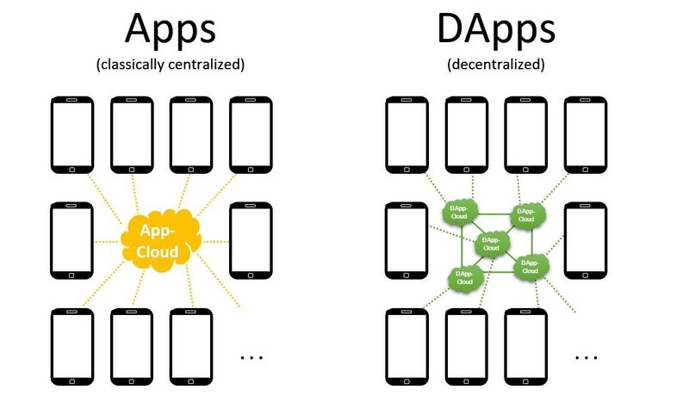
WHAT ARE
DAPPS?
Decentralized applications (dApps) are digital applications or programs that exist and run on a blockchain or P2P (peer-to-peer) network of computers instead of a single computer, and are outside the purview and control of a single authority.

Slide 6
KEY ATRRIBUTES OF DAPPS
01
02
OPEN SOURCE
DECENTRALIZED
Uses a blockchain-like
cryptographic technology
Source code of app is
available to all
03
04
INCENTIVE
PROTOCOL
App has crypto-tokens/digital assets for fueling itself
Generates tokens and has an inbuilt consensus mechanism

Slide 7
KEY ADVANTAGES OF DAPPS
Security
Speed
Being decentralized, these apps are tamperproof and the records inherent are unalterable. They are also highly secure and immutable from hacking, intrusions and any other potential sabotage.
It enables faster payment processing due to the absence of intermediate applications such as the integrated payment gateway for accepting funds.
Reliable Data Records
Anonymity
It provides reliable data records because users can access the public blockchain to verify transaction information.
It promotes greater anonymity as these applications do not require users to follow lengthy signup processes.

Slide 8
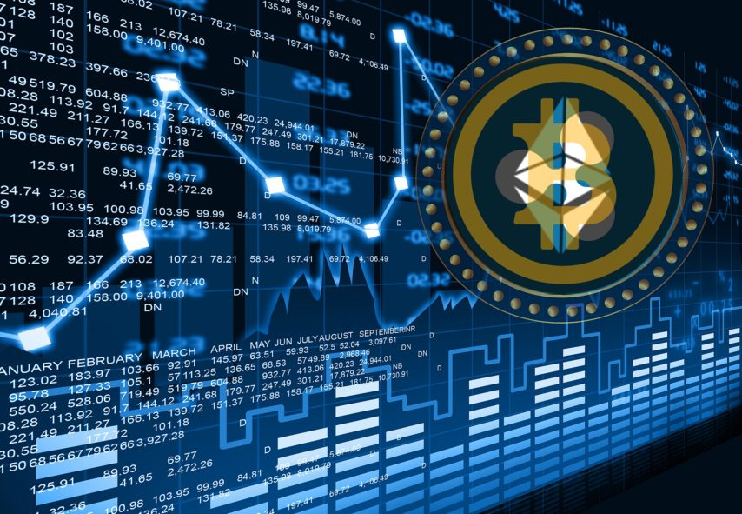
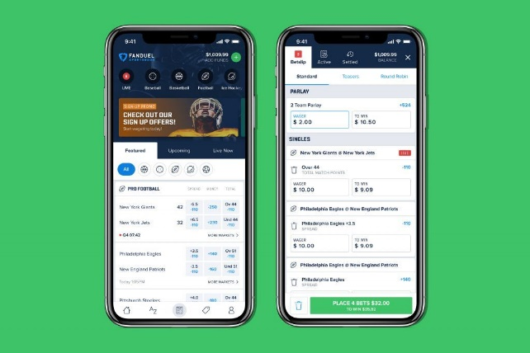
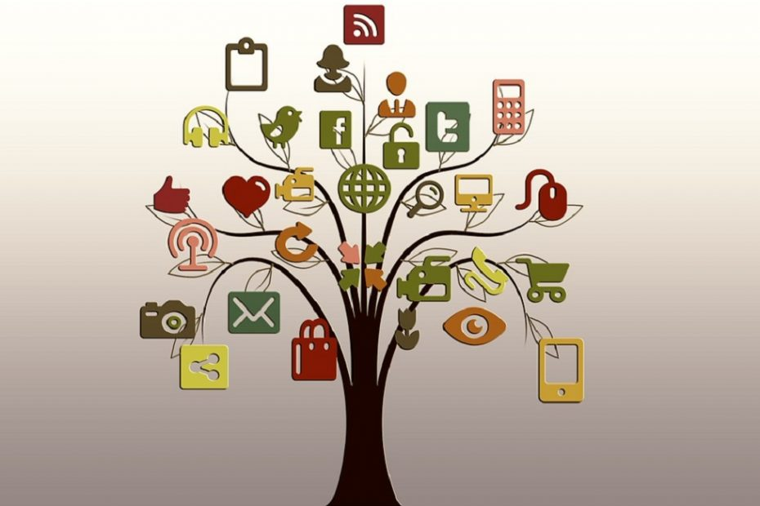
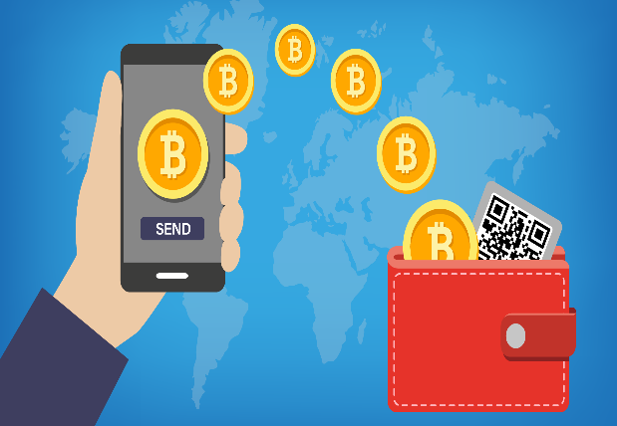
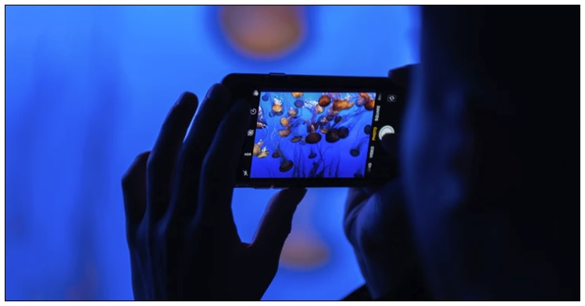
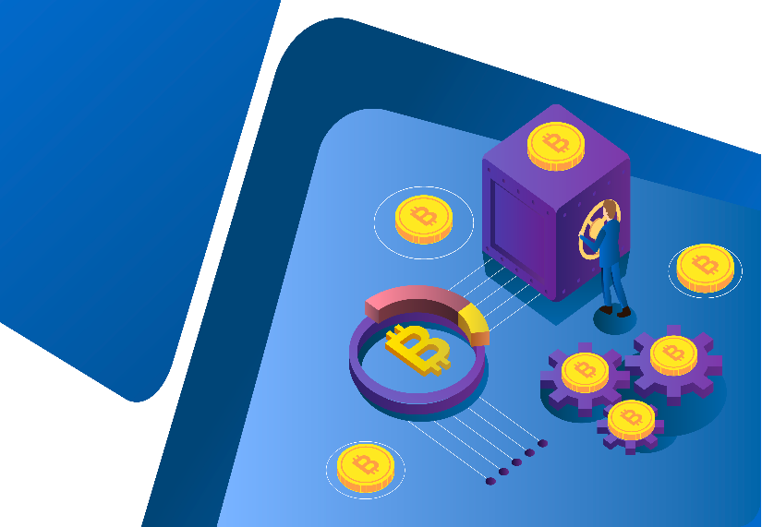
DAPPS CLASSIFICATION
Exchanges
Betting application
Social Network
Crypto wallet
Game
DeFi

Slide 9
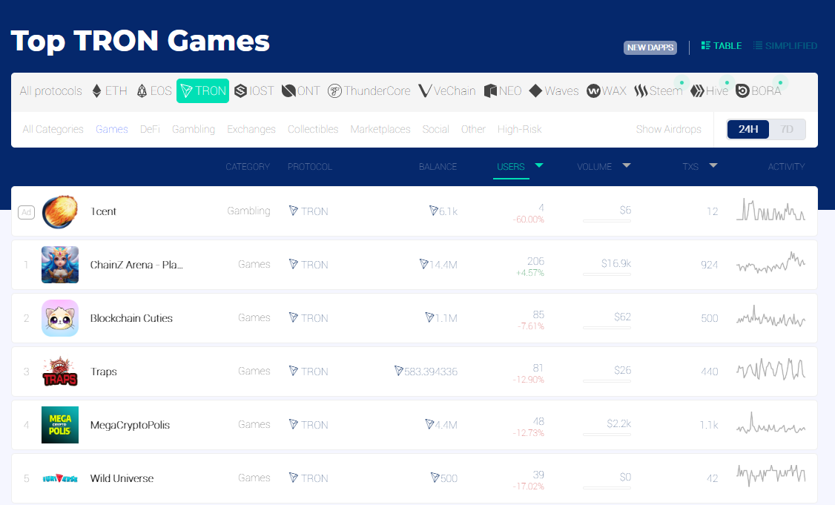
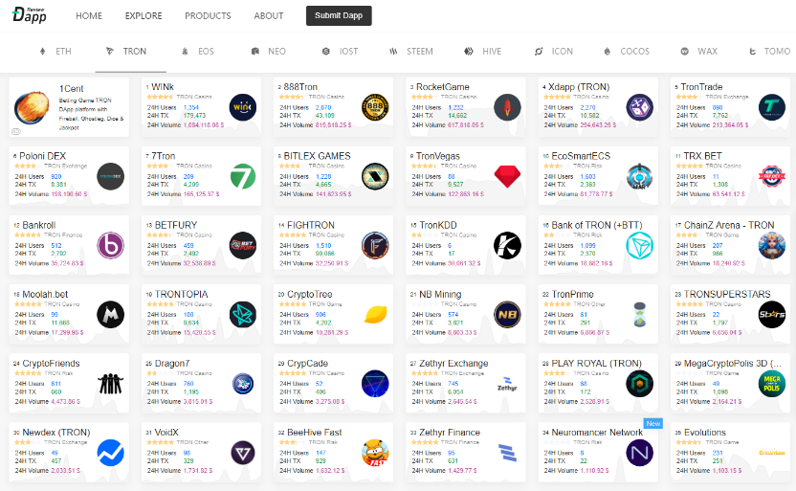
GAMING DAPPS
TRON and its dApp are slowly stealing the limelight in the decentralized world. While
there are some dApp’s on EOS and Ethereum that are still good enough but the way
TRON dApps are gaining limelight it’s not going to be long when these dApp will be
the most enviable one.
Yet, gaming dApps could be the reason why many people will approach the blockchain world. They are fun, they can be played on smartphones and they allow users to earn cryptocurrencies by playing.
There are hundreds of blockchain games, each more fun than the next, DappRadar keeps track of the statistics of over 500 games.

Slide 10

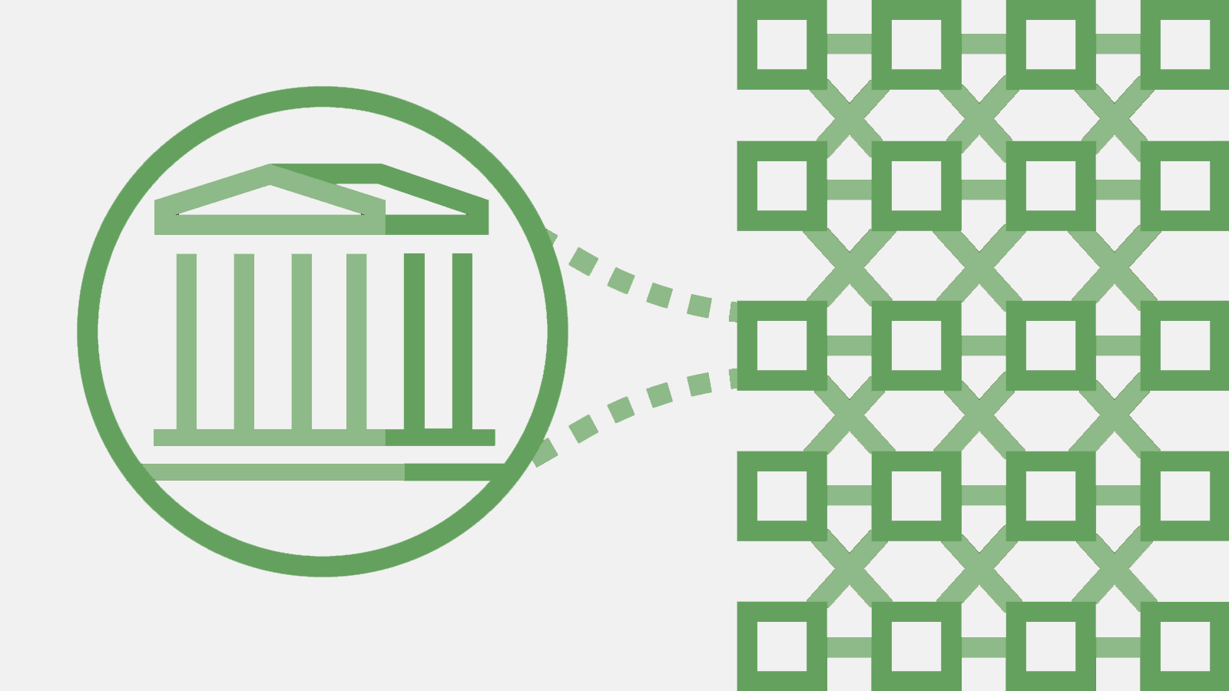
INTRODUCING DEFI
Decentralized finance - often called DeFi or open finance - refers to the economic paradigm shift enabled by decentralized technologies, particularly blockchain networks.
DeFi is as one of the most active sectors in the blockchain space, with a range of use cases for developers, individuals, and institutions.
DeFi consists of two major parts, DEX and Lending.

Slide 11
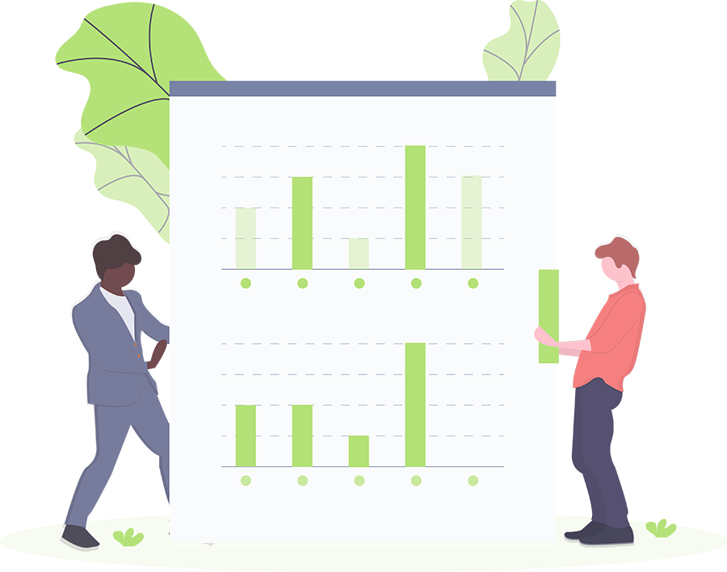
MAIN ADVANTAGES OF DEFI
DeFi proposes solutions to give economic power back to the people by creating a financial system that is accessible, efficient, and transparent.
✋
Trustless
Permissionless
Transparency
In DeFi, the system does not need to rely on trusted entities as the financial value is securely stored (or transferred peer-to-peer) using smart contracts, which cannot be modified after being created on the blockchain
It means that anyone, anywhere, at any time can access and use DeFi products and services without being decentralized or restricted.
Centralized institutions are built upon internal services where transactions are only viewable by their personnel. DeFi products run on public blockchains where data and transactions are typically easily viewable or traceable by anyone.

Slide 12


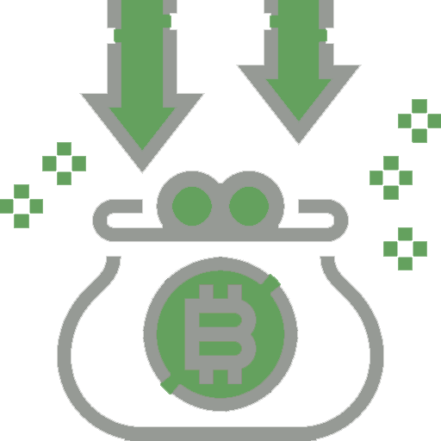
DEFI LENDING
DeFi Lending works similar to traditional p2p-services, the core difference being that loans are issued on decentralized platforms that lock up cryptocurrencies via smart-contracts deployed on public blockchains.
DeFi Lending aims to democratize this entire process and connect borrowers to a wide pool of lenders. Instead of having institutes acting as intermediaries, smart contracts directly connect the borrower and the lender with each other.

Slide 13
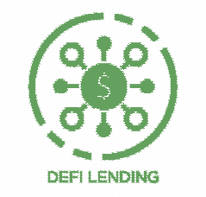
BENEFITS OF DEFI LENDING
Zero credit checks which make loans available to a wide variety of investors.
It’s a solid long-term HODL plan.
The opportunity to earn passive income via interests.
Gain access to different utilities.
Immediately short the asset they borrow in different exchanges to participate in margin trading.
Due to the transparency and lack of mediators, the lender earns higher returns and has a clearer understanding of the risks involved.
You can simply impress your audience and add a unique zing.

Slide 14
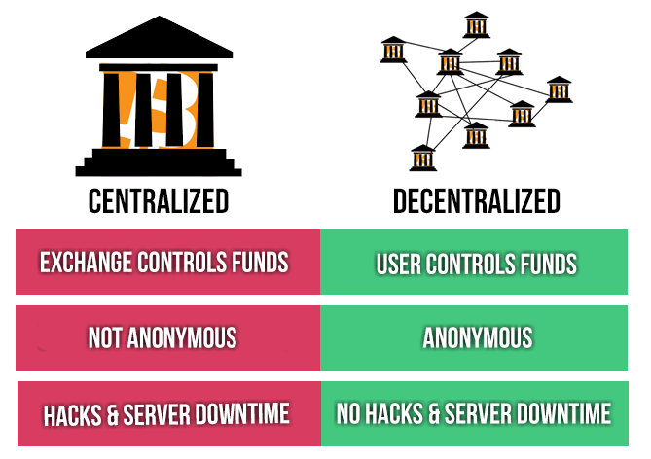
DECENTRALIZED EXCHANGE (DEX)
What is a Decentralized Exchange (DEX)?
A decentralized exchange (DEX) is a
cryptocurrency exchange which operates in a decentralized way, without a central authority.
Benefits of DEXs
- “Trustless” nature
- Privacy
- No risk of server downtime

Slide 15
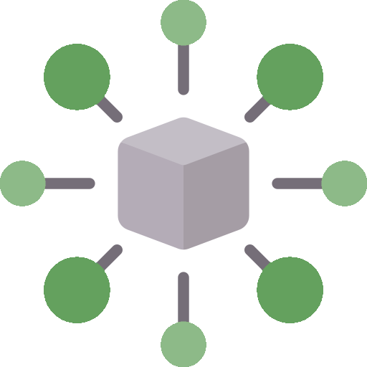
INTRODUCING DEFI.ECO
The various products, services involved in DeFi are also collectively referred to as open finance since it’s an ecosystem where blockchains, digital assets, open protocols are integrated with conventional financial structures.
DeFi.ECO (stand for Decentralized Finance Ecosystem) mentioned here is a project that has profit-sharing financial games.

Slide 16

MISSION AND VISION OF DEFI.ECO
We are here to build a comprehensive ecosystem for users
MISSION
Create a decentralized financial system - extensive cooperation - high profit sharing
Developing a wide ecosystem system with many applications: Game - Financial application
Generate passive income for ecosystem developers
Attract millions of people to join our ecosystem

Slide 17
MISSION AND VISION OF DEFI.ECO
We are here to build a comprehensive ecosystem for users
VISION
Develop a centralized business system that pays 100% to users and generates high income for participants
Develop a long-term ecosystem with a strict reward mechanism for sustainable development
Create millions of opportunities for profitable cooperation
Develop ecosystem with millions of regular service users

Slide 18
ROADMAP
ROUND 4
ROUND 3
Operating financial services
ROUND 2
Launching game
ROUND 1
Selling stock and e-sharing
Partnership and cooperation programs

Slide 19
MATRIX COMPENSATION PROGRAM
You
Level
This program is set up to have a pyramid structure with a fix number in the width and columns.
The following terms:
You get three
Then your three people get three
Then those people get three, etc
So if 2187 representatives of level 7 have 3 customers each,
that equals 6561 members.
3
1
9
2
27 Reps
3
81 Reps
4
243 Reps
This is the process that a person participating in the program must
go through 8 levels:
Immigrant => Visa Holder => Permanent Resident => Citizen
=> Ambassador => Senator => Vice President => President
This process represents the influence in this society. The sooner you join, the more influence and value you create
5
729 Reps
6
2187 Reps
7
6561 Reps
8

Slide 20
MATRIX COMPENSATION PROGRAM
Level
Name
Slots
Assistance
USDT
Potential Earning ($)
(3)
(9)
(27)
(81)
(243)
(729)
(2187)
(6561)
15
45
90
180
240
420
600
900
15 x 3 = 45
45 x 9 = 405
90 x 27 = 2,403
180/2 x 81 = 7,290 ⁽*⁾
240/2 x 243 = 29,160 ⁽*⁾
420/2 x 729 = 153,090 ⁽*⁾
600/2 x 2187 = 656,100 ⁽*⁾
900/2 x 6561 = 2,952,450 ⁽*⁾
Name | DFC
Immigrant | 0%
Visa Holder | 0%
Permanent Resident | 0%
Citizen | 9%
Ambassador | 12%
Senator | 15%
Vice President | 18%
President | 21%
1
Immigrant
Visa Holder
Permanent Resident
Citizen
Ambassador
Senator
Vice President
President
…
2
3
…
4
…
5
…
…
6
…
7
…
8
⁽*⁾ From Citizen onward, you receive ½ assistance USDT, ½ assistance USDT will give your three people (first three people on the first level or inferior to one level)
From Citizen onward, you receive ½ assistance USDT, ½ assistance USDT will give your three people (first three people on the first level or inferior to one level)

Slide 21
BUY DEFI CREDITS PROGRAM
Crypto stock is sold by Round (8 rounds). In every round, DeFi Credits (DFC) = Volume x Bonus
Example: Co-Founder: Buy 50 DFC => Have 50 x 128 = 640 DFC
Angel: Buy 50 DFC => Have 50 x 64 = 320 DFC
Bonus USDT
Level | %
1 | 10
2 | 8
3 | 6
4 | 4
5 | 2
6 | 1
7 | 1
8 | 1
SUM | 33
Co-Founder
Angle
Serie A
Serie B
Volume: 100,000
Bonus: 128
DFC
12,800,000
Volume: 200,000
Bonus: 64
DFC
12,800,000
Volume: 400,000
Bonus: 32
DFC
12,800,000
Volume: 800,000
Bonus: 16
DFC
12,800,000
Total _{Volume} = 25,500,000
Total _{DFC} = 128,000,000 (20% for Developers)
Volume: 1,600,000
Bonus: 8
DFC
12,800,000
Volume: 3,200,000
Bonus: 4
DFC
12,800,000
Volume: 6,400,000
Bonus: 2
DFC
12,800,000
Volume: 12,800,000
Bonus: 1
DFC
12,800,000
Serie C
Serie D
Pre – Listing
Listing

Slide 22
ECOSYSTEM DEVELOPMENT PROGRAM
When you meet both conditions of DFC and Volume, you will get daily income (% volume based on level)
Level | %
1 | 1,2
2 | 0,9
3 | 0,6
4 | 0,3
5 | 0,3
6 | 0,1
7 | 0,1
8 | 0,1
SUM | 3,6
Name | DFC | Volume | % | Daily income
Manager | 100,000 | 10,000 | 0,60% | 0,60% x 10,000 = 60
Senior Manager | 200,000 | 50,000 | 0,90% | 0,90% x 50,000 = 450
Director | 400,000 | 100,000 | 1,20% | 1,20% x 100,000 = 1,200
Senior Director | 800,000 | 200,000 | 1,50% | 1,50% x 200,000 = 3,000
Gold Director | 1,600,000 | 400,000 | 1,80% | 1,80% x 400,000 = 7,200
Ruby Director | 3,200,000 | 800,000 | 2,10% | 2,10% x 800,000 = 16,800
Diamond Director | 6,400,000 | 1,600,000 | 2,40% | 2,40% x 1,600,000 = 38,400
Black Diamond | 12,800,000 | 3,200,000 | 2,70% | 2,70% x 3,200,000 = 86,400
Bonus on direct volume
Get 10% of BD's income if you're at the same BD level

Slide 23


DOMAIN .ECO
What is .eco?
.eco is a new web address ending - known as a top-level domain - for those committed to positive change for the planet. .eco web addresses are available to any business, government, non-profit or individual working toward a sustainable future.
The .eco domain is backed by more than 50 organizations including Conservation International, WWF and United Nations Global Compact

Slide 24

DOMAIN .ECO
Who is .eco for?
Businesses can share their vision for a greener world while promoting their products or services with this extension and show customers that they care about a sustainable future.
Businesses
Non - profits
Join the community of environmental non-profits who are already using .eco, including Conservation International, WWF and Greenpeace.
People
Governmental organizations and individuals who want to make a difference can increase user education by providing valuable information via a .ECO website.

Slide 25
THANK YOU !!!

