Slide 1
Profit testing
Lemin Wu
School of Mathematics
University of Leicester

Slide 2
Contents in the presentation
Whole life annuity
Target customer: old age
Benefit: a predetermined lump sum on the death of the policy holder to his/her estate
Other kinds of annuities

Slide 3
Unit-linked insurance
Target customer: people who want to have their life insured, but the same time have the premium paid as an investment
Death Benefit: if the death of the police holder occurs in the insured term, his/her estate would receive the policy holder’s fund with an extra amont (eg. Additional 10% of the fund)

Slide 4
Investment : equity, bond or a portfolio will be available to purchase as units
Survival till the contract maturate date: the policy holder will receive greater of the value of the policy holder’s fund and the total of the premiums paid.

Slide 5
With profit insurance
Target customer: same as unit-linked insurance
Death Benefit: very similar to unit-linked contract, will be an guaranteed amount of money
Investment: instead of buy units of equity or bonds, it will investment on the insurance company itself, if the company making profit then each policy holder can share certain amount of it.

Slide 6
Survival till the maturate date: similar to unit-linked contract, but there is no guaranteed minimum maturity benefit (GMMB).

Slide 7
Assumption:
I modeled a company which only sells two kinds of contract, whole life annuity and unit-linked insurance.

Slide 8
Whole life annuity
For this contract, I started with determine its premium.

Slide 9
Assumptions:
1. Age group from 60 to 80
2. Gender: female and male
3. Smoking: generated randomly
4. Fixed sum of insured: S = £100,000
5. Premium paid monthly
6. 100 people in the group

Slide 10

The premium is calculated by equivalence principle
EPV of benefit + EPV of expenses
= EPV of gross premium income

Slide 11



Unknown variables:

Slide 12
Problem arise:
How to calculate fractional mortality rate?
Approach 1:
UDD assumptions (uniform distribution of death)

Slide 13
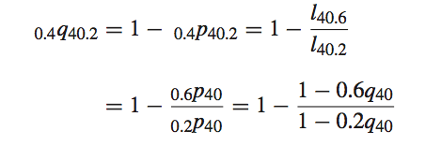
Eg.
Example 1:

Slide 14
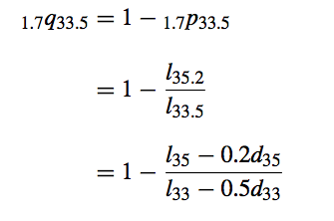
Second example:

Slide 15
Problem, linear regression will lose information if the time interval is large.
Approach2:
Select life table on continuous motality investigation report

Slide 16
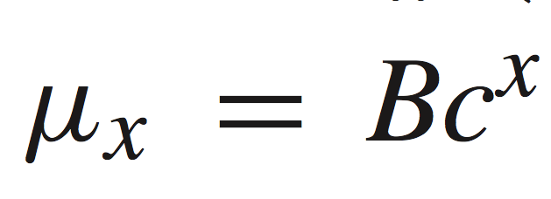
Approach 3:
Survival model: Gompertz’ law and Woolhouse formula
Where B= 0.0000027
c = 1.124

Slide 17
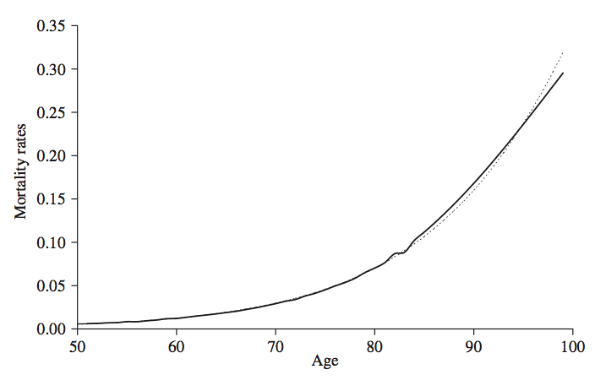

Slide 18


Select part of the model
Woolhouse formula

Slide 19
New model assumption:
Fudge factor:
{FN=0.98f,FY=0.95f}
{MN=0.97f, MY=0.93f}

Slide 20

Reserve = policy value

Slide 21
Unit-linked insurance
Age group: from 55-60
Group size: 1000
Premium use: £5200
Initial expense : 10%P
Renewal expense : 0.5%P
Interest (policy holder) : 8%
Interest (insure) : 6.5%
Management charge: 0.8%

Slide 22
Unallocated rate : 1st year 5%
2nd till the end 1%
GMMB = max( policy holder fund, sum of premium)
Death benefit in 10 years term = 110% fund in policy holder account
Force of mortalddity = constant,
mortality rate= 0.0005
2nd till the end 1%

Slide 23
10% surrender in 1st year
5% surrender in 2nd year

Slide 24
Deterministic pricing test
2 cash flow tables for policy holder account and insurer account
Fund
Profit
Net Present Value

Slide 25
Profitability
In the model, we use
Lower interest rate
Lower initial expense
Lower renewal expense
Higher force of mortality

Slide 26
Stochastic pricing test
Reason:
1. Uncertainty in investment, which is not diversifiable
2. EPV of future profit doesn’t contain information from investment return, more appropriate to model it as a random variable. (can be achieved by stochastic testing)

Slide 27

Monte Carlo simulation,
R represents the accumulation at time t of a unit amount invested in an equity fund at time t − 1

Slide 28
Zt follows N(0,1)

Slide 29

Data in the table:
Pi:
D
NPV

Slide 30
Statistic analyze
*NPV fifth percentile
*NPV negative value

Slide 31
Pricing
Quantile premium principle:
Lower fifth percentile > 0
NPV >= 65% acquisition cost

Slide 32
How to achieve?
Change rates in our assumption.
(B) Premium increase
(C ) increase management cost
(D) Increase mortality rate
(E) Reduce the level of maturity guarantee

Slide 33

Reserve (for non-diversifiable risk)
2 ways:
1. hedge in the financial market
2. reinsuring (passing the risk on by taking out insurance with another insurer)

Slide 34
Conclusion
For annuity:
Mortality rate is more important than other information, the more precise, the better our model is.
For unit-linked:
Investment return is non-diversifiable which we can’t model it linearly or constant value, a stochastic model is the important factor in this case.

