Slide 1

Smart software and
THEM Geophysics Inc.
Daniel Lemire, Ph.D.
http://www.ondelette.com
DSP consultant

Slide 2
Who am I? Why am I talking?
I have a Ph.D. in Engineering Mathematics and am a UofT graduate. I work as a freelance consultant and speaker.
I have worked for several years with THEM Geophysics on various projects ranging from numerical analysis (F.E.M.) to signal processing.

Slide 3
What I’ll do today...
History (where we come from)
I’ll try to stay brief!
Our software
Our algorithms (some math)
Our numerically modelling
Results! Examples of how our
work is improving!
The future!

Slide 4
A brief history
Early processing (1998 and before)
SIMn baseline correction,
Wavelet-based denoising...
New version of
THEM’s software
November 1999 revision (DLL)
Split
team
Late 1999/early 2000
numerical modelling
Soudan (2000)
Toronto 2001 meeting?

Slide 5
Problems that have been solved?
The new DSP library funded and developped for THEM, first released as a DLL in November 1999 has yet to be fully integrated in THEM’s systems. By using a DLL, we can easily upgrade the processing and fall back when needed.
Among a few things, this new version fixed many problems in the baseline correction (SIMn algorithm) reported by CGI.

Slide 6
How does our baseline works?
The SIMn model first assumes that we can reliably divide
the signal of each impulse in two zones.
Remaining energy
should be near 0
k₁
k_{max}

Slide 7
SIMn postulates
    1. The baseline should be continuous from one frame to the other;
    2. The total mass from 0 à k₁ should be zero;
    3. The remaining energy from k₁ to k_{max} should be as small as possible.

Slide 8
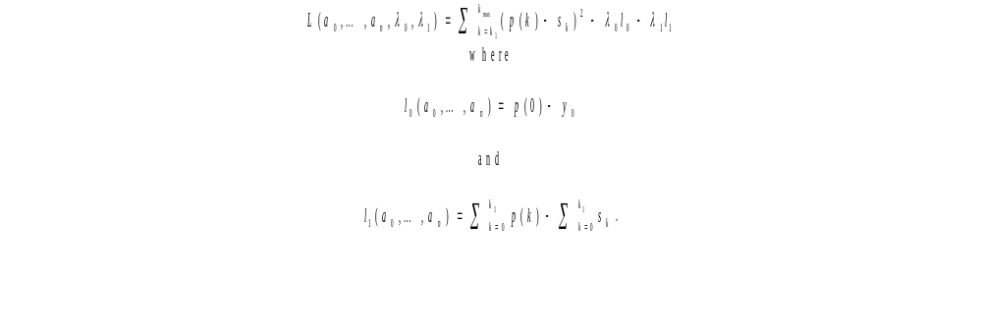
Lagrange equations...
Mathematically, we are solving for a polynomial of degree n (noted p) over each frame where y₀ is the value of the baseline at the end of the previous frame and where the actualsignal is noted s.

Slide 9
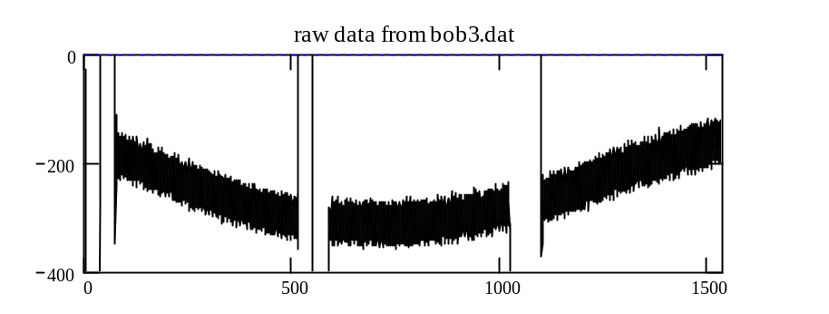
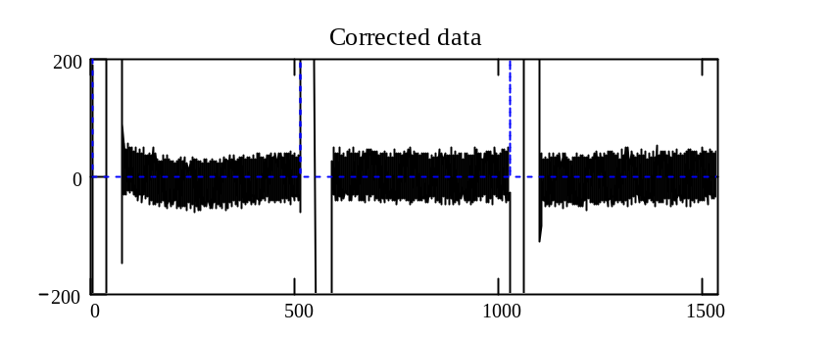
The new baseline in action!
It used to be
that the baseline
would require
several frames
to work properly.
The new processing (1999)
reduces these artefacts
dramatically.
Visible
artefact

Slide 10
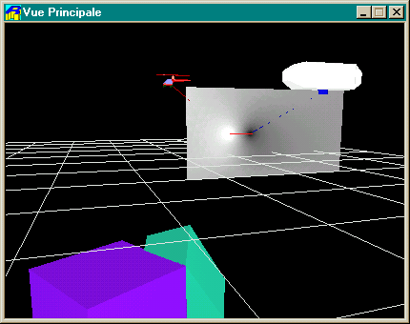
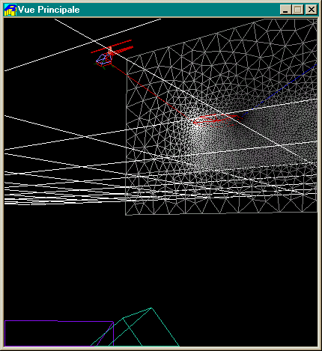
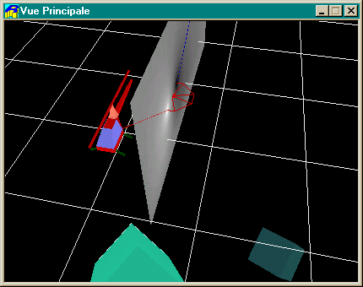

Slide 11
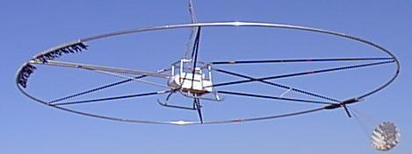
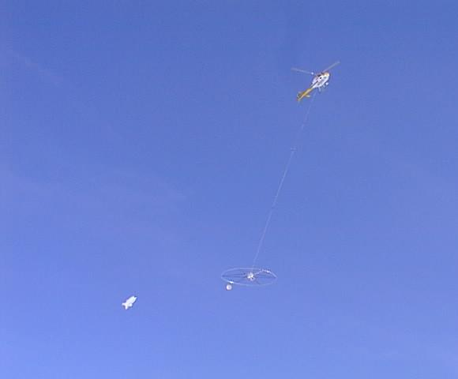
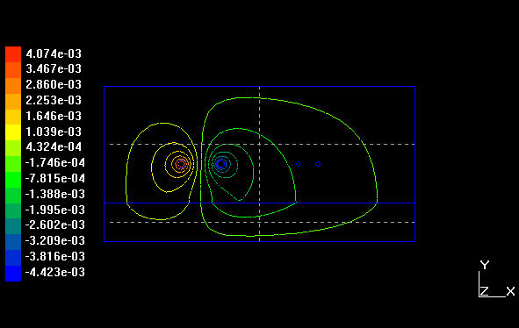
Inductor, air, soil and receptor (5132 elements)

Slide 12
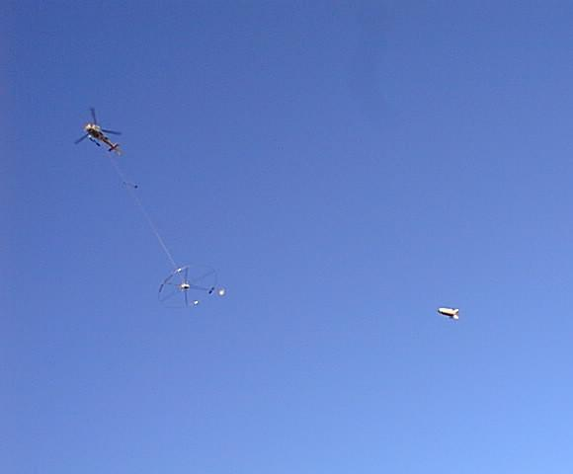
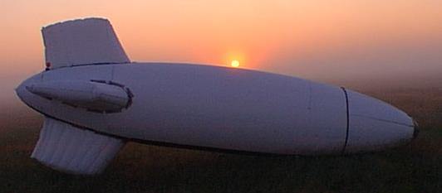
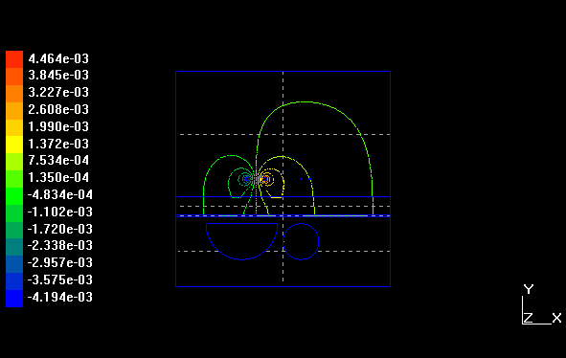
Inductor, soil, highly conductive sheet, 2 conductive anomalies, receptor (214056 elements)

Slide 13
Feature extraction through wavelets
Most current denoising scheme either rely on modelling or lowpass/highpass filtering. Filtering is nice because it provides you with smooth curves if you want to… However, doing so will also kill some features that you may want to keep.
To properly select the features that might be interesting we use a time-frequency analysis called Wavelet Shrinkage. In effet, we do no discrimate against any range of frequency in particular (so we might keep a lot of very localized components if needed) but focus on keeping the most significant features, no matter what they are.

Slide 14
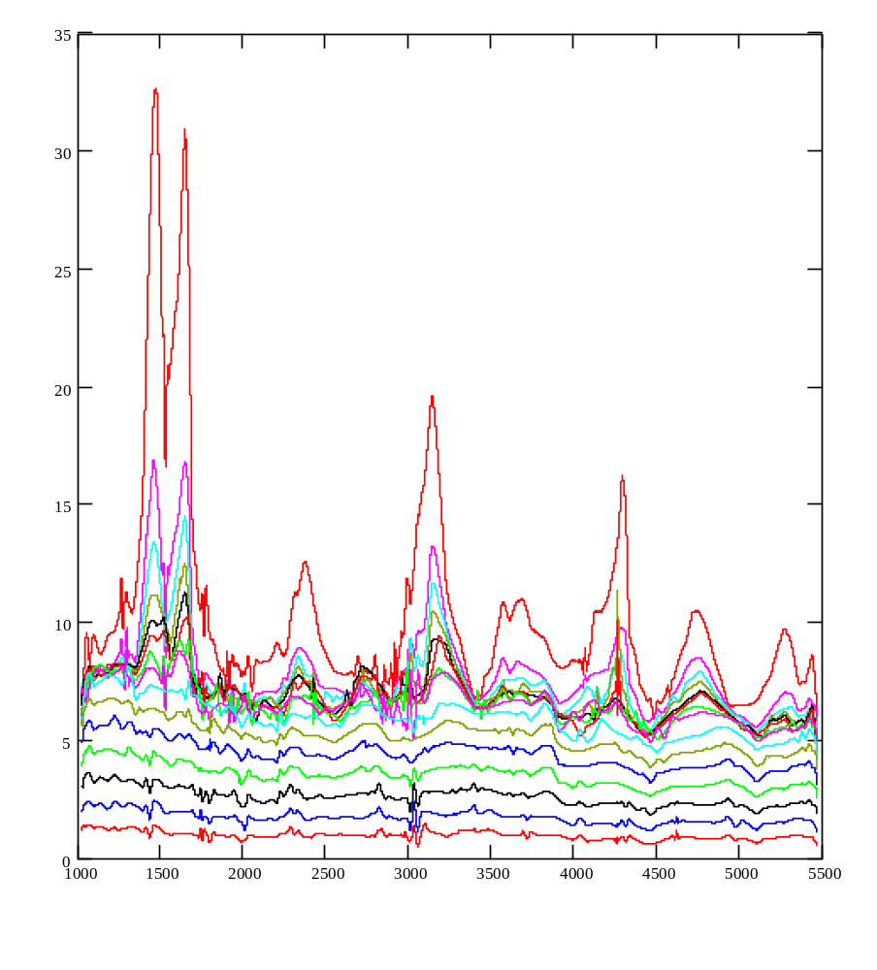
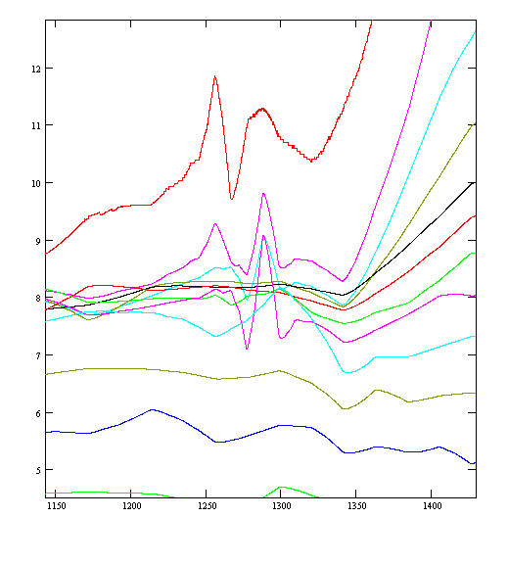
At lowsettings, it kills much of the apparent noise , while keeping
some striking features.

Slide 15
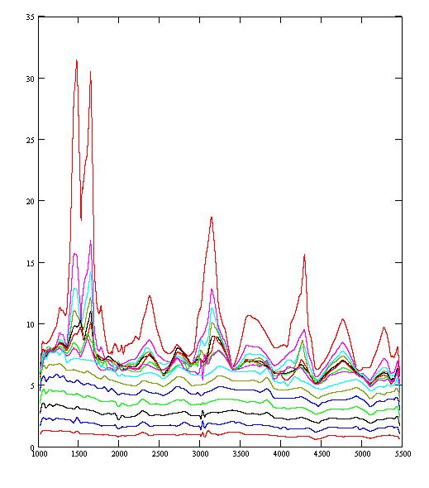
At higher settings
we have a very clean
signal but we keep
dominant features that
might have been lost
with most denoising
scheme.
To resume: we can
provide simple plots
but still keep as much
information as possible!

Slide 16
The future
Deconvolution (at least compensate for the morphology of the impulse)
Better wavelet processing (less aliasing)
Achieve scientific results with unicoil
B field estimation through spline modelling
MAG compensation
stereoscopic acquisition
better X-Z processing
Even more accurate baseline

Slide 17
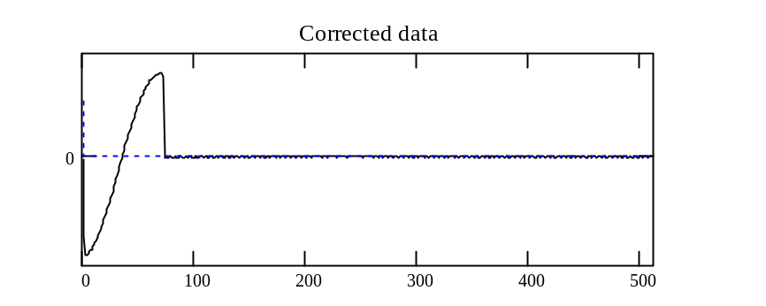
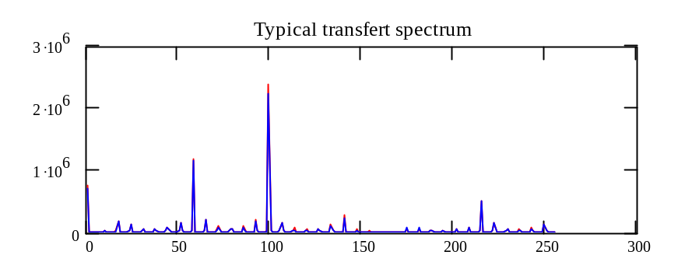
Simplification through convolution
While more research is needed, it is already a fact
that deconvolving the frames using a simple input
function (a cosine adapted to the impulse length),
reduce a great deal the entropy… (3 complex numbers
model more than 90% of the energy in the signal)

