Slide 1

T.H.E.M. Geophysics Inc. : Bernard Kremer
Digital Signal Processing: Daniel Lemire (Ph.D.)
Numerical analyst: Alain Béliveau (Ph.D.)
Numerical design : Ludovich Pénet (M. Sc.)
& Jean-François Remacle (Ph.D.) funded in part by the Canadian governement
Geophysics, Digital Signal Processing and Numerical Modelling

Slide 2
Table of Contents
A Brief History
Our Goals (DSP, Numerical Analysis)
Differential Forms
Fields Approximation and Form Integration
Programming Paradigm
Magnetic Field Examples
Conclusion

Slide 3
First Part
A Brief History

Slide 4
A story
A little more than a year ago, T.H.E.M. Geophysics began designing a new DSP software to gain a competitive edge. While much work remain, T.H.E.M.’s processing is now state-of-the-art and makes use of the finest processing methods : wavelets, spectral methods, spline modelling, Lagrangian systems, etc.

Slide 5
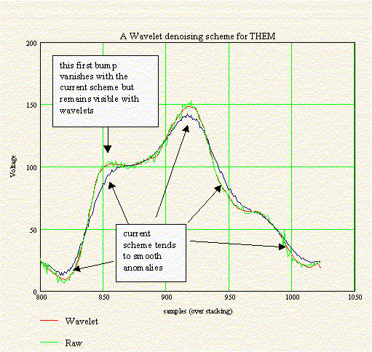
An example of good DSP

Slide 6
Current state
However, some fine processing tools are still mostly out of range because of the lack of good, cheap and easily accessible numerical models. Some common problems :
Current processing (multi-channel) is 1D, yet the data is 2D or even 3D, and to make matters worse, stereoscopic systems are being designed;
Much of the information in the on-time still eludes us and yet, it is where most of the information is;
Handling the next generation of EM systems like T.H.E.M.’s unicoil is challenging.

Slide 7
Second Part
Our Goals

Slide 8

What do we really want to do :
Take the signal, process it, and
solve an inverse problem...
Signal + GPS
GROUND
ORE
have the computer draw a 3D map of the ground components matching the combined signals and GPS;
Allow the geophysicist to play what if. Allow everybody to do customized numerical analysis through a user-friendly software.
That is, build a generic software tool to ease signal processing and geophysical data analysis in general and get T.H.E.M. DSP software ahead of the competition while allowing new designs : stereoscopic, unicoil, etc.

Slide 9
What we are not doing
It is not a research project aimed at publishing new papers but rather an industrial project aimed at designing new tools to help EM prospection. In short, it is a R&D project funded so far by T.H.E.M. and the Canadian government, and executed by a group of independent consultants together with T.H.E.M.

Slide 10
How do we need to do it :
O.O. design (C++), OpenGL, user-friendly interface;
Finest numerical methods available, Finest DSP;
Pentium III/IV/V computers (cheap yet powerful);
The combined efforts of numerical analysts, computer scientists, engineers, DSP experts and geophysicists;
A lot of research, work, time and money.

Slide 11
Finally...
To further improve DSP software, we need acurate signal response provided by a powerful and flexible numerical analysis;
Numerical analysis will help guide an experienced geophysicist to the solution of the inverse problem.

Slide 12
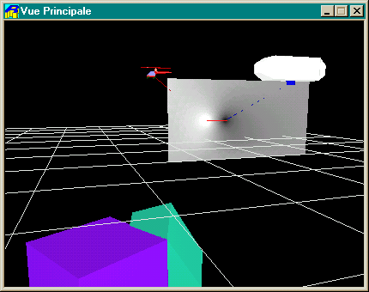
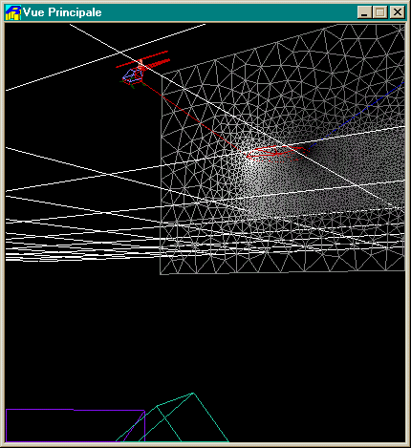
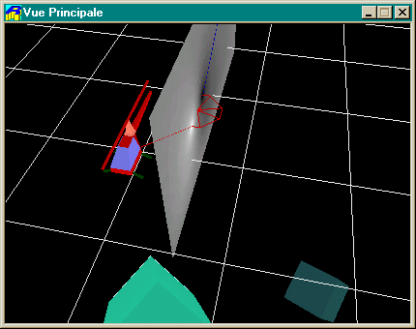

Slide 13
Third Part
Differential Forms

Slide 14
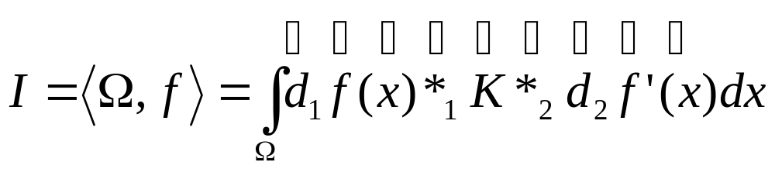
What is the FEM ?
An integrand
A geometrical domain
A coordinate system
First differential operator
Second “function”
Constitutive law
First “function”
Second differential operator
First “multiplication”
Second “multiplication”

Slide 15
Why Differential Form Paradigm in Numerical Code?
Differential forms are independent of the space dimension
Differential forms are independent of submanifold parametrisation
Differential forms have well defined operators (equivalent to well known operators : multiplication, derivative, integration,...)

Slide 16
3-D Differential Forms in EM
  0-forms :Temperature, pressure, electric potential
    scalar potential
  1-forms : magnetic field, electric field, vectorial potential
    contravariant vectors
  2-forms : magnetic induction, electric current density
    flux density
  3-forms : charge density
    density

Slide 17
Operator Nº1
The Exterior Derivative
A unique differential operator → d
d is the classical grad, rot and div of 3D vectorial analysis
d(ω^{p}) = ω^{p+1} where ω^{p} is a p-form
☺ d: numerical code global definition
  pure virtual class « p-form »
  4 derived classes with overloaded d function

Slide 18
Operator Nº2
Exterior Product
∧: product of different ?-forms
ω^{p}∧ω^{q} = ω^{p+q}
☺∧: numerical code global definition
  ∧ (operator*) overloaded function
  form₃ form₁::operator*( const form & form₂);

Slide 19
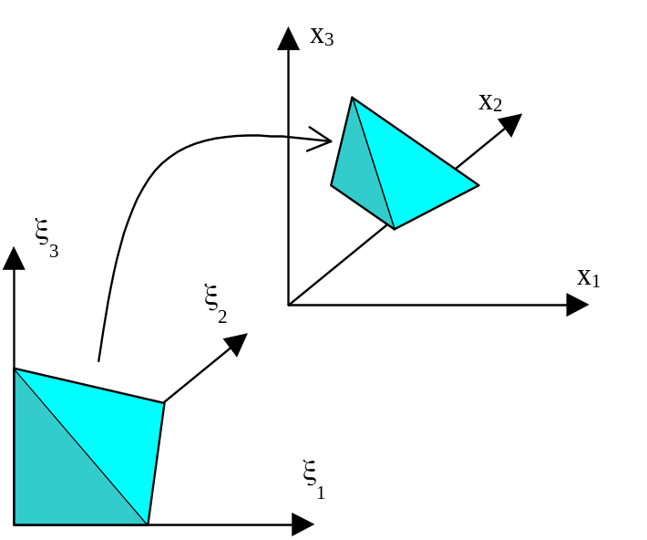
Operator Nº3
Coordinate Change
J_{ij} = ∂x_{j} /∂ξ_{j}
u(x) =? u(ξ)
grad_{x}u(x)=? grad_{ξ}u(ξ)
rot_{x}u(x) =? rot_{ξ}u(ξ)
div_{x}u(x) =? div_{ξ}u(ξ)
Differential Forms = Generalisation
☺ numerical code global definition
  virtual method form::ChangeOfCoord

Slide 20
Fourth Part
Field Approximation and Form Integration

Slide 21
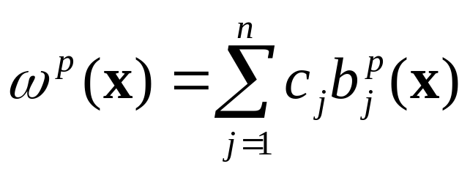
Approximation
Discret Functional Space B = [b₁,b₂,…,b_{n}] with n = dim(B )
The coefficient c_{j} will always be scalar (IR or C) and do not need to have any particular geometrical or physical meaning

Slide 22
Discrete Form Spaces
Whitney edge element
  b₁,b₂,…,b_{n} are 1-forms
  Discrete version of H(rot)
  Continuity of ω¹ t
Whitney face element
  b₁,b₂,…,b_{n} are 2-forms
  Discrete version of H(div)
  Continuity of ω² n
Intrinsic LBB Condition (A. Bossavit)

Slide 23
Operator Nº4
Integration of forms
Form/Chain Duality
  a p-form ω^{p} is “integrated” on a p-chain D
  <D ^{p},ω ^{p}> (code verfications)
  Generalised Stokes Theorem
    FEM → Variational formulations
    <D ^{p-1},dω ^{p}> = <∂D ^{p},ω ^{p-1}>
    Works with any classical operator Grad, Rot, Div (3D) in any dimension

Slide 24
Integration mechanism
Constitutive law
Geometrical domain
Pseudo-functional spaces B(n) and B’(m)
Integrator
Change of Coordonnates
Result : M(n×m)

Slide 25
Dof manager
Three keys define a dof
  Geometric entity (node, edge, face, element, group of nodes, zone,…)
  Physical type (p, T,…)
  Hierachical degree
Field Aproximation using basis B(n)
  n keys linking basis functions (local) to connectors (global)

Slide 26
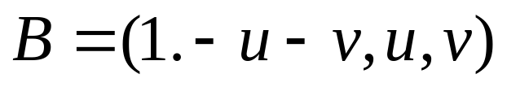
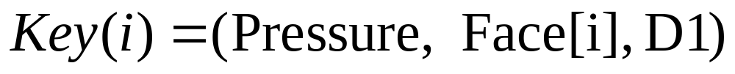
Dof manager
Basis
Example : continuous field on a triangle
Example : discontinuous field on a triangle
Example : non conformal field on a triangle

Slide 27
Flexibility
Modify the parametrisation
  Electromagnetism → infinite elements
  1-d, 2-d, 3-d geometrical domains
Modify basis functions
Define custom degrees of freedom
Modify integration quadrature
  Gauss
  Recursive (Romberg)

Slide 28
Fifth Part
Programming paradigm

Slide 29
Programming paradigm
Generic programming (STL style: Alexander Stepanov)
  Datas (Classes with <,=,+,* … defined)
  Algorithms (OOP style: C++)
Double dispatch (general coding work with mother classes then resolve type at function calls)

Slide 30
Why generic programming paradigm ?
Object oriented methods were created for information processing systems
Not created to build efficient algorithms
hence generic programming as an opposition to classic OOP

Slide 31
Generic programming in a glace
Foundation: separation of algorithms and datas
Algorithms “scroll” through the data structure by the use of iterators (pointer)
Algorithms “access” data through functions of dereferenced data structure iterator
Definition of interfaces rather than multiple inheritances
Example: A sorting method (MySort) is written generically then is applied to different data structures (DataType) using iterators (MySort<DataType> → template)

Slide 32
FEM Algorithms/Datas
Algorithms
  Shape_Functions
  Function_Spaces
  Functions
  Formulations
  Term
  Integrators
  Geometrical_Informer
  Elementary_Matrix_Assembler
Datas
  Mesh
  Geometrical_Elements
  Orientation
  Form
  Coefficient
  Integration
  Jacobian
  Materials
  Physic_Law

Slide 33
Sixth Part
Examples

Slide 34
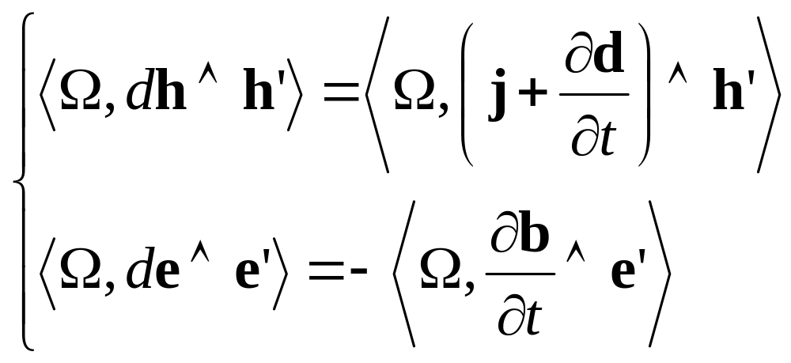
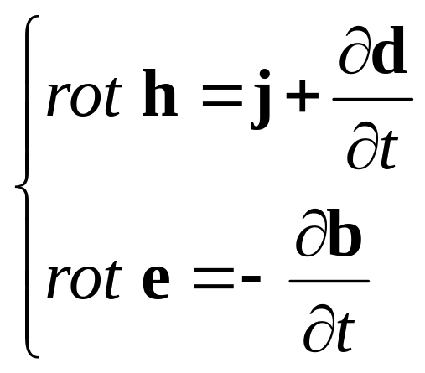
Examples
Electromagnetism

Slide 35
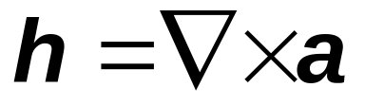


2D Formulation
Take and we get the vectorial potential formulation.
Supposing we can write

Slide 36
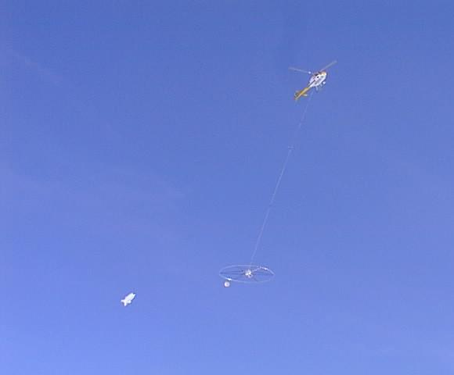
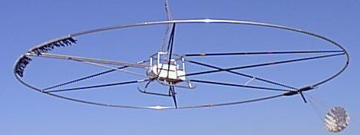
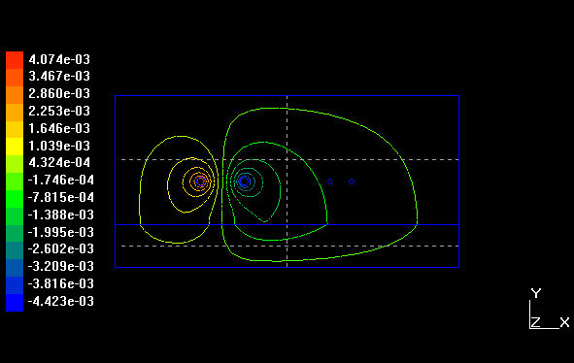
Results
Inductor, air, soil and receptor (5132 elements)

Slide 37
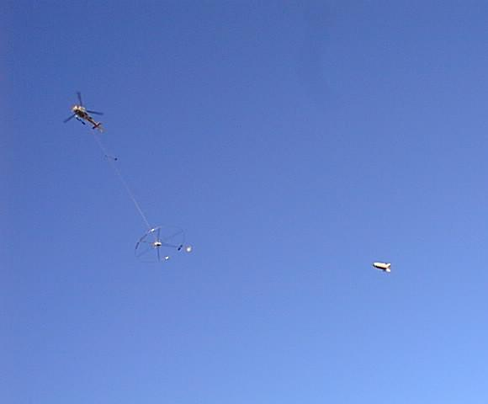

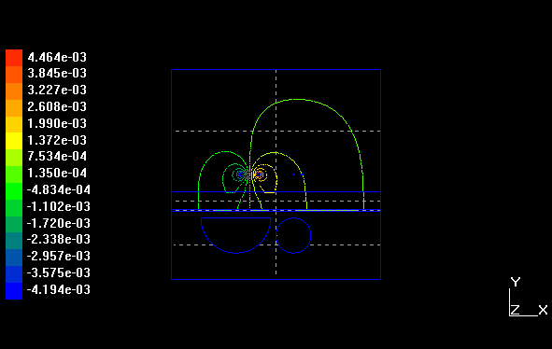
Results
Inductor, soil, highly conductive sheet, 2 conductive anomalies, receptor (214056 elements)

Slide 38
Seventh Part
Conclusion

Slide 39
Conclusion
Electromagnetism is a natural setting for differential forms
Discret differential forms is the finite element (p-chains) method + inclusion of the geometric structure of space
Discret version of complex spaces → Intrinsic LBB condition
Dof freedom (time scheme)

Slide 40
Conlusion
Any dimension
Coordinate free
Generic programming innovation in FEM code

