Slide 1
Live Data Analysis with using VPNService
Fabian Gruber, Béla Lemle
Mobile Security (SS 2023)
10. June 2023
Notes:
Good afternoon..
My name is B. L. and today I would like to give you a short presentation about my isw and Bachelor thesis topic, Hardening...
ISAP is a prem.-based auth. enc. scheme that provides protection against many attacks by default but not immune to p. p. a.
Interesting fact: TU Graz has connection to ISAP, as a group of cryptographers from TU was also involved in the design of ISAP.
‹#›

Slide 2
Agenda
VPNService
Framework and implementation
Analysis of apps
‹#›
Mobile Security – Graz Univerisity of Technology
Notes:
Transition to next slide:
To provide some background I would like to briefly describe the physical attacks and then narrow this down to p.p.a. against which isap is to be hardened.
‹#›

Slide 3
VPNService
Class for apps to build own VPN solutions
Virtual network interface, routing rules, addresses, file descriptor
Read from fd ➙ outgoing packet that was routed to the interface
Write to fd ➙ injected packets are as if they were received through the interface
Security measures:
user interaction needed to start the VPN service
only one service at a time
visible on the device if the service is running (system managed)
BUT no root access required to use it
‹#›
Mobile Security – Graz Univerisity of Technology
Notes:
Transition to next slide:
To provide some background I would like to briefly describe the physical attacks and then narrow this down to p.p.a. against which isap is to be hardened.
‹#›

Slide 4
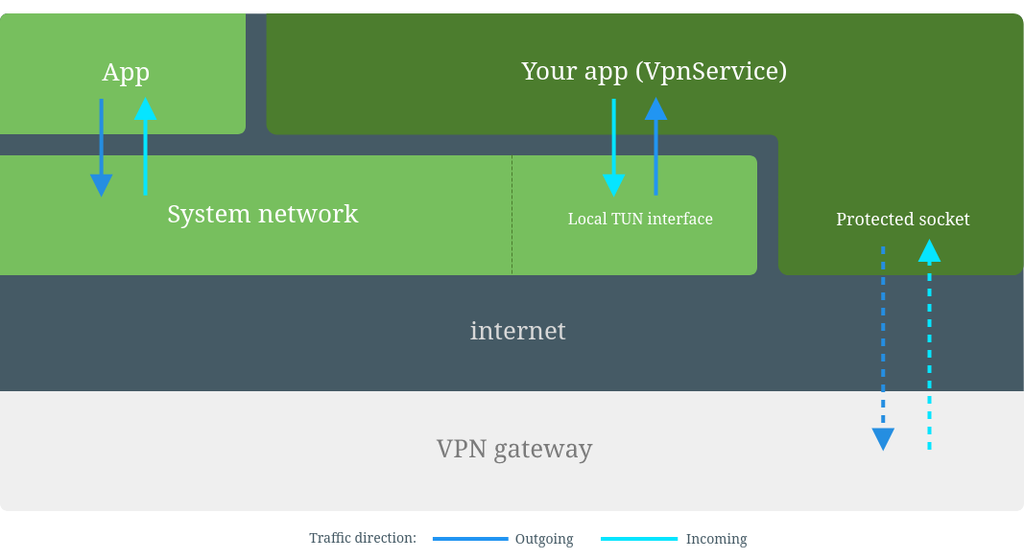
‹#›

Slide 5
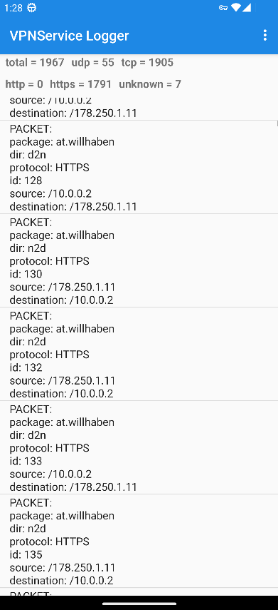
Implementation
UI for the live packet analysis
Differentiate between TCP, UDP, HTTP, HTTPS, DNS packets
Extract payload of DNS requests
Specify the app where the packet comes from
Display packet related data (e.g. source/destination addresses)
General packet type statistics
‹#›
Mobile Security – Graz Univerisity of Technology
Notes:
Transition to next slide:
To provide some background I would like to briefly describe the physical attacks and then narrow this down to p.p.a. against which isap is to be hardened.
‹#›

Slide 6
Packt and Application Mapping
Pre Android 10 ➙ /proc/net/tcp
Shows ports and corresponding UIDs
Post Android 10 ➙ ConnectivityManager
/proc/net/tcp no longer accessible
Use ConnectivityManager class to get UIDs of connections owners
Use PackageManager to get package names from UIDs
‹#›

Slide 7
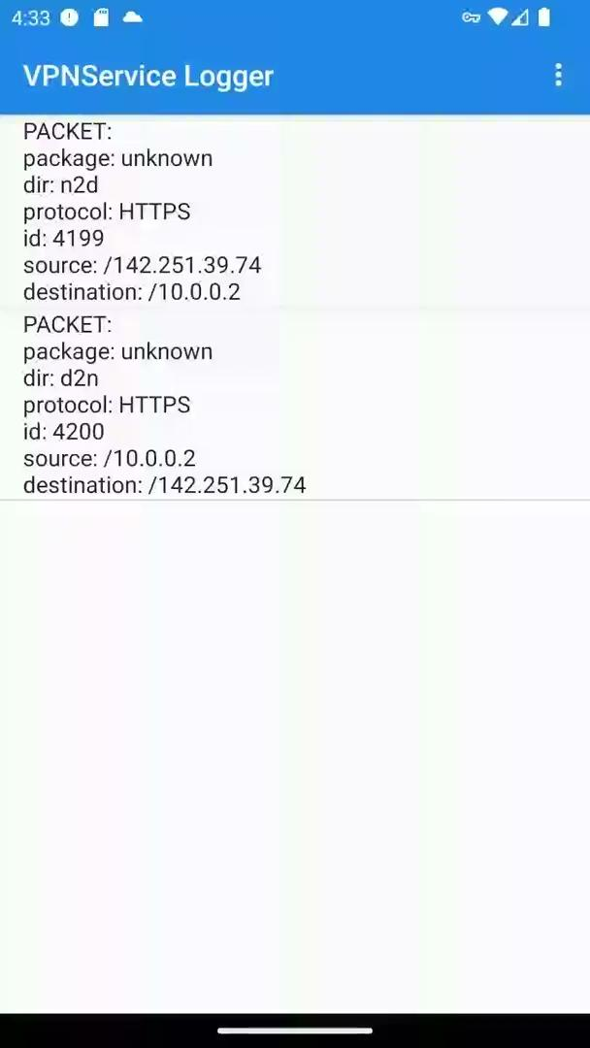
Live Analysis
‹#›
Mobile Security – Graz Univerisity of Technology
Notes:
Transition to next slide:
To provide some background I would like to briefly describe the physical attacks and then narrow this down to p.p.a. against which isap is to be hardened.
‹#›

Slide 8
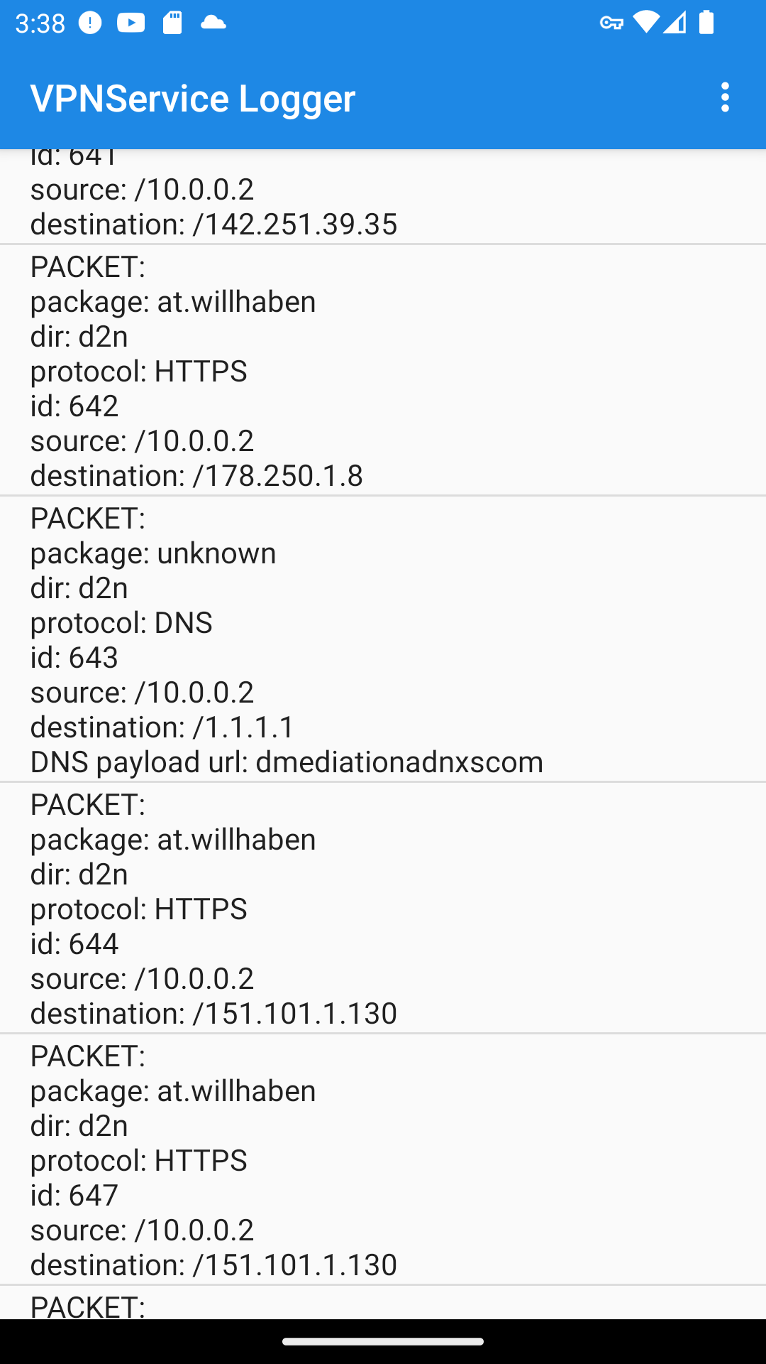
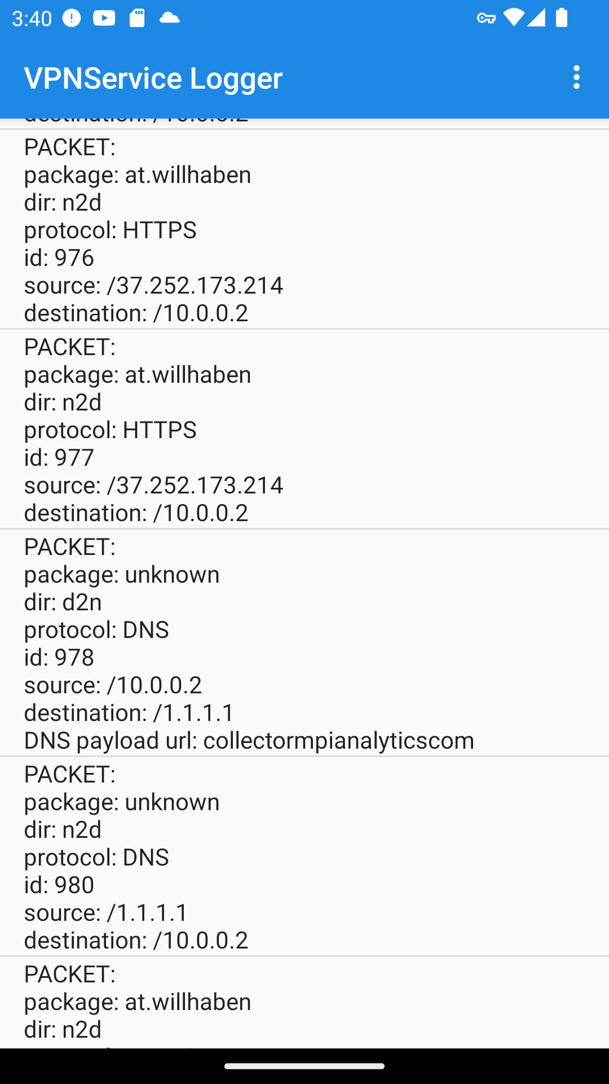
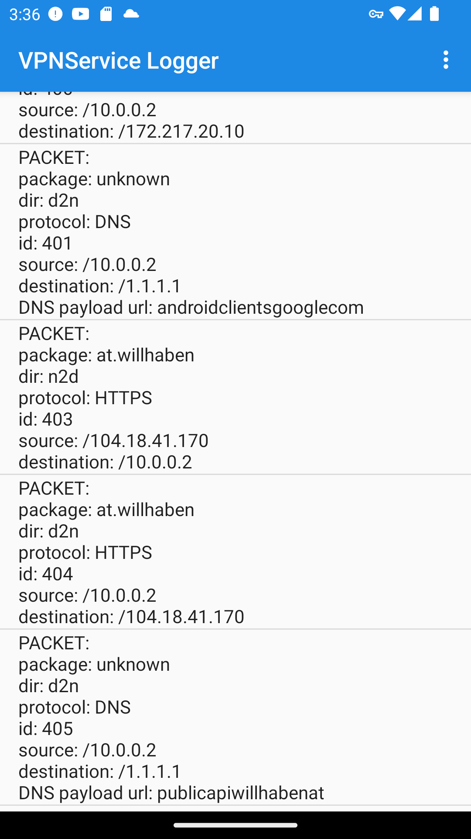
Packet Analysis
willhaben.at
‹#›
Mobile Security – Graz Univerisity of Technology
Notes:
Transition to next slide:
To provide some background I would like to briefly describe the physical attacks and then narrow this down to p.p.a. against which isap is to be hardened.
‹#›

Slide 9
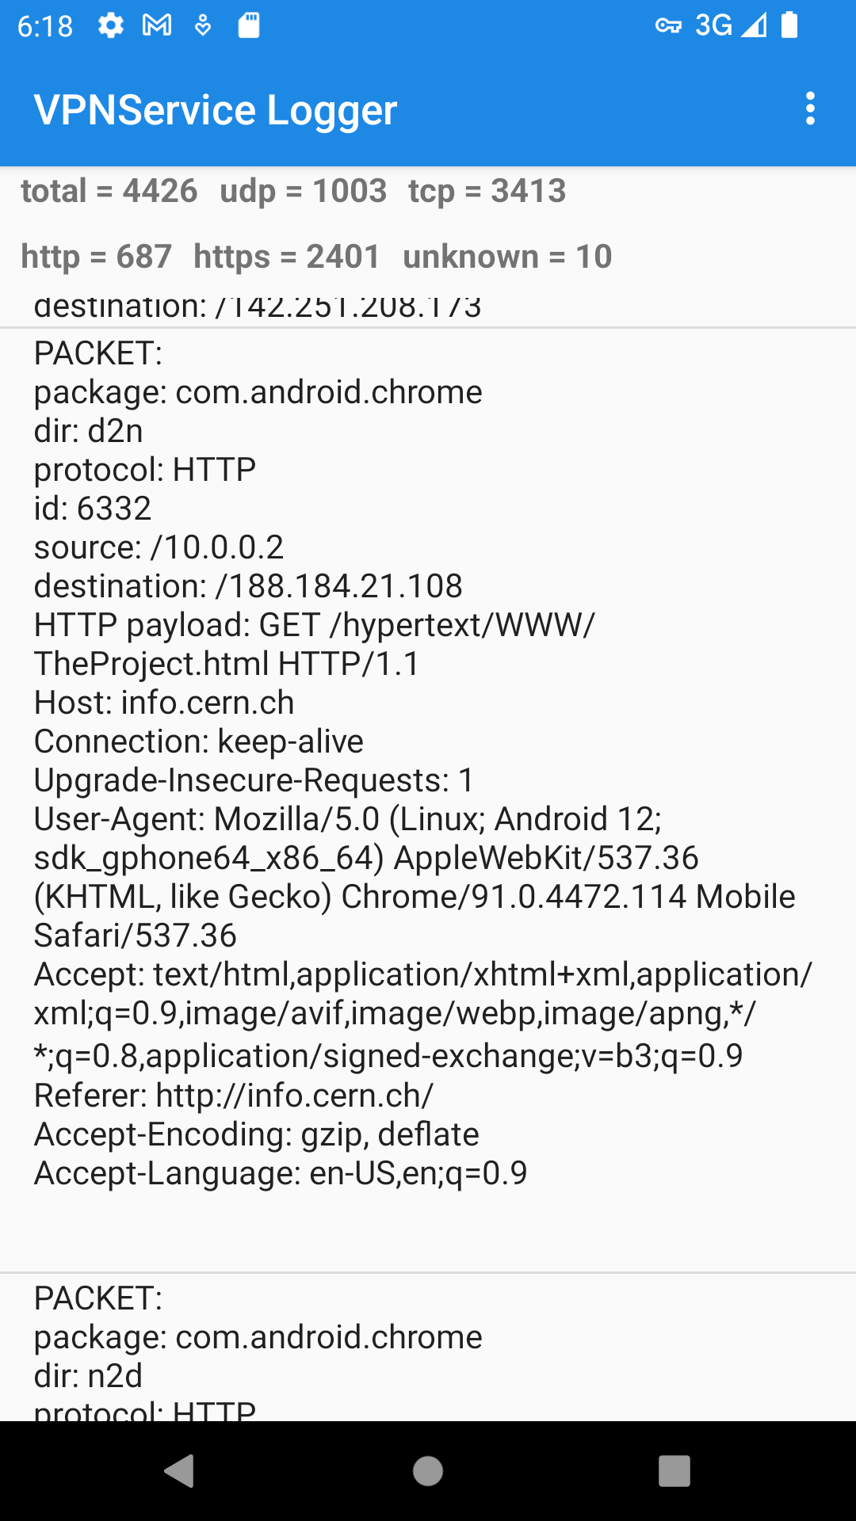
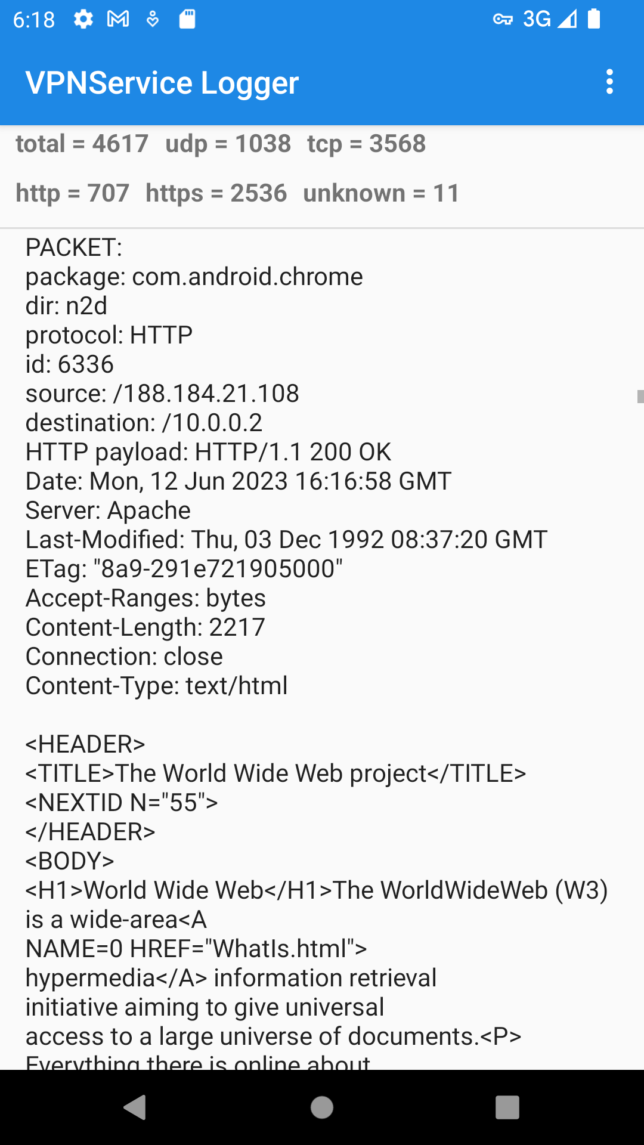
Packet Analysis
Chrome (http://info.cern.ch)
‹#›
Mobile Security – Graz Univerisity of Technology
Notes:
Transition to next slide:
To provide some background I would like to briefly describe the physical attacks and then narrow this down to p.p.a. against which isap is to be hardened.
‹#›

Slide 10
Resources
Based on https://github.com/mightofcode/android-vpnservice-example
VPNService https://developer.android.com/guide/topics/connectivity/vpn
ConnectifiyManager https://developer.android.com/reference/android/net/ConnectivityManager
‹#›

