Slide 1


Slide 2
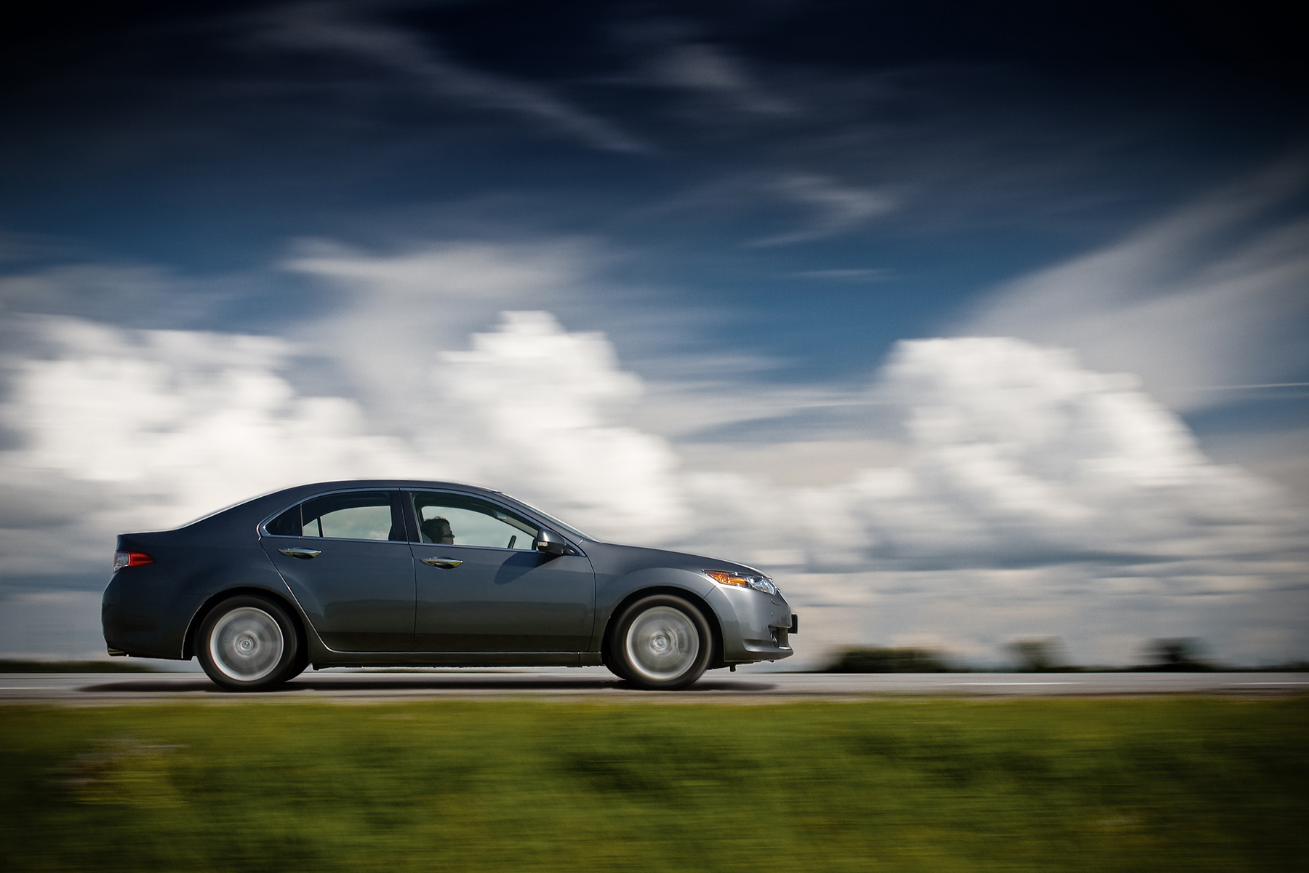
The Wild World of DEFENSIVE DRIVING
绝影之守护
Bus Driver In-Service
2012/2013

Slide 3





Our team
Musketeers:
Our goal:
Driving behavior analysis with machine learning
徐孝天
CSL ESSL
俞一鹏
CRL
才志
CSL HPC IST
彭毅
CSL ESSL

Slide 4
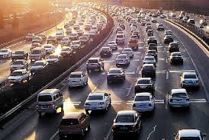
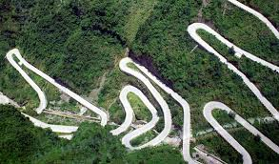
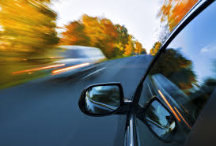
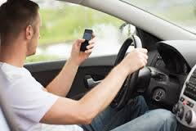
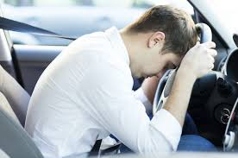
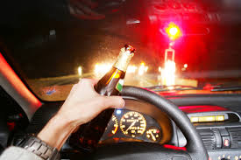
Starvation for Driving behavior analysis
Problems:
Traffic
Drivers

Slide 5
Solution topology
Bluemix + Spark
AdaBoost
Driving behavior recognition
Display
Classify
Data preprocess
ODBII interface
Engine RPM
Vehicle speed
Throttle position
Engine load
…

Slide 6
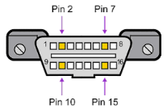
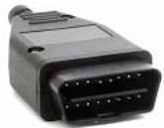
On-Board Diagnostics (OBD)
A standard component referring to a vehicle's self-diagnostic and reporting capability
Information
Real-time information from various kinds of sensors
Connect
Serial cable, Bluetooth…
[Ref.] S.H. Chen, J. Pan, and K. Lu, Driving Behavior Analysis Based on Vehicle OBD Information and AdaBoost Algorithms, IMECS2015 HongKong

Slide 7
AdaBoost Algorithm
Technical Description:
Weak classifier:
Perceptron
Relative ratios of Engine RPM, Vehicle Speed
Throttle Position, Engine Load

Slide 8
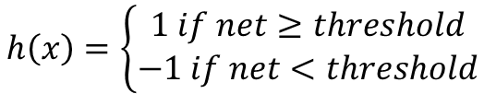
Perceptron— A weak classifier
First neural network learning model in the 1960’s
Simple and limited (single layer models)
Basic concepts are similar for multi-layer models so this is a good learning tool
$$h\left(x\right)=\left\{\begin{aligned}1 if net≥threshold \\ −1 if net<threshold\end{aligned}\right.$$
x₁
w₁
x₀₌₁
w₀
w₂
x₂
Σ
o
.
.
.
w_{n}
x_{n}

Slide 9
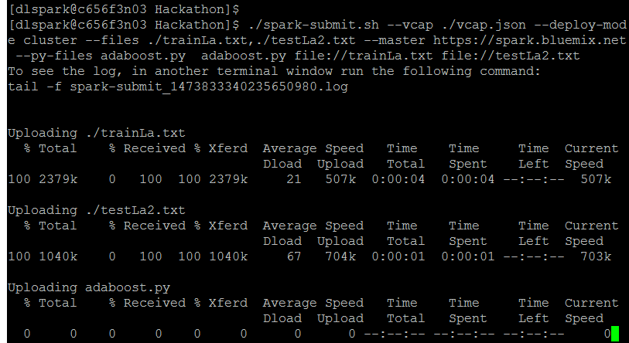
Analyze result
OBDII data (91490 lines items)
Using Bluemix + Spark
Time | Engine RPM | Vehicle speed | Throttle position | Engine load
17:24:29 | 1844 | 17 | 15.7 | 27.1
17:24:31 | 1459 | 19 | 15.3 | 30.2
17:24:32 | 1472 | 20 | 10.6 | 23.9

Slide 10
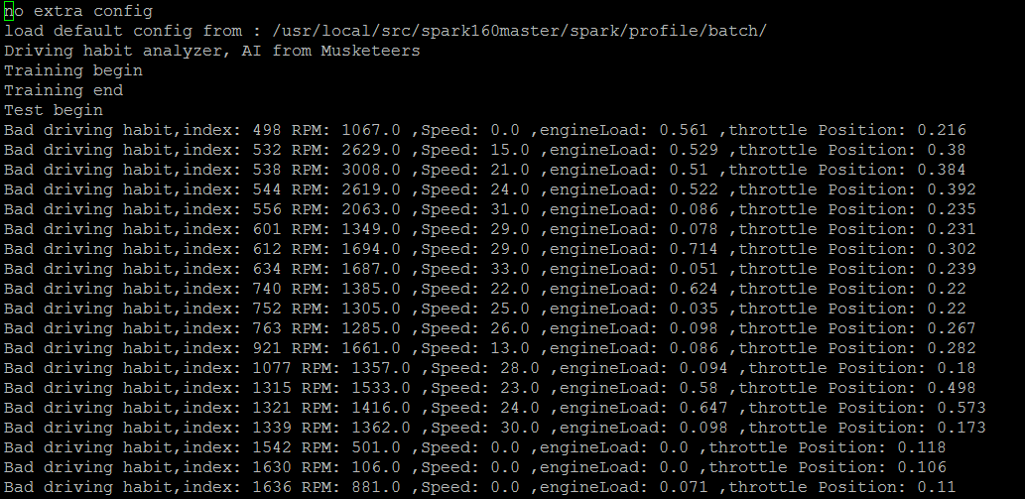
Analyze results
Test results
20317 lines test data
20059 good behaviors 258 bad behaviors
total classify error: 0.00147659595413

Slide 11
Potential business value
Avoid accident (real-time)
Improving traffic efficiency
Insurance evaluation
Cars design, auto-driving
Notes:
DEMONSTRATION!!!!

Slide 12
Happy Hackathon!
Thank you!

