Slide 1

PARALLEL PROGRAMMING...
Copyright 2023 Patrick Lemoine. All rights reserved.

Slide 2

Parallel Programming: Overview
SESSION 2/3
GOAL
Programming Interface for parallel computing
MPI (Message Passing Interface)
OpenMP (Open Multi-Processing)

Slide 3
Programming interface for parallel computing
병렬 컴퓨팅을 위한 프로그래밍 인터페이스

Slide 4

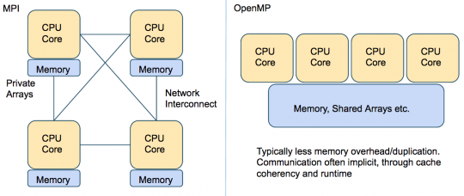
Programming interface…
Remember
.
.
MPI (Message Passing Interface) is a multi-process model whose mode of communication between the processes is explicit.
==> communication management is the responsibility of the user.
.
OpenMP (Open Multi-Processing) is a multitasking model whose mode of communication between tasks is implicit
==> communications is the responsibility of the compiler.

Slide 5

Hybrid OpenMP-MPI

Slide 6

Hybrid MPI and OpenMP
Hybrid application programs using MPI + OpenMP are now common place on large HPC systems.
There are basically two main motivations:
1. Reduced memory footprint, both in the application and in the MPI library (eg communication buffers).
2. Improved performance, especially at high core counts where pure MPI scalability runs out.

Slide 7
Hybrid MPI and OpenMP
Parallel programming models
Parallel execution is based on threads or processes (or both) which run at the same time on different CPU cores
Processes
- Interaction is based on exchanging messages between processes
- MPI (Message passing interface)
Threads
- Interaction is based on shared memory, i.e. each thread can access directly other threads data
- OpenMP

Slide 8
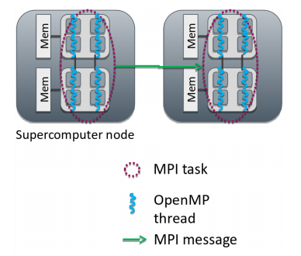
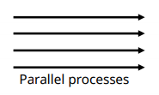
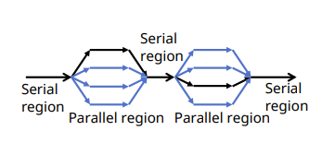
Hybrid MPI and OpenMP
1: MPI: Processes
- Independent execution units
- Have their own memory space
- MPI launches N processes at application startup
- Works over multiple nodes
2: OpenMP: Threads
- Threads share memory space
- Threads are created and destroyed (parallel regions)
- Limited to a single node
3: Hybrid programming: Launch threads (OpenMP) within processes (MPI)
- Shared memory programming inside a node, message passing between nodes
- Optimum MPI task per node ratio depends on the application and should always be experimented.

Slide 9
Hybrid Programming
In hybrid programming each process can have multiple threads executing simultaneously
All threads within a process share all MPI objects Communicators, requests, etc.
MPI defines 4 levels of thread safety:
MPI_THREAD_SINGLE : One thread exists in program
MPI_THREAD_FUNNELED : Multithreaded but only the master thread can make MPI calls Master is one that calls MPI_Init_thread()
MPI_THREAD_SERIALIZED: Multithreaded, but only one thread can make MPI calls at a time
MPI_THREAD_MULTIPLE: Multithreaded and any thread can make MPI calls at any time. Use MPI_Init_thread instead of MPI_Init if more than single thread

Slide 10


Hybrid Programming
Potential advantages of the hybrid approach
Fewer MPI processes for a given amount of cores
- Improved load balance
- All-to-all communication bottlenecks alleviated
Decreased memory consumption if an implementation uses replicated data
Additional parallelization levels may be available
Possibility for dedicating threads for different tasks
- e.g. dedicated communication thread or parallel I/O
Dynamic parallelization patterns often easier to implement with OpenMP
Disadvantages of hybridization
Increased overhead from thread creation/destruction
More complicated programming
- Code readability and maintainability issues
Thread support in MPI and other libraries needs to be considered

Slide 11
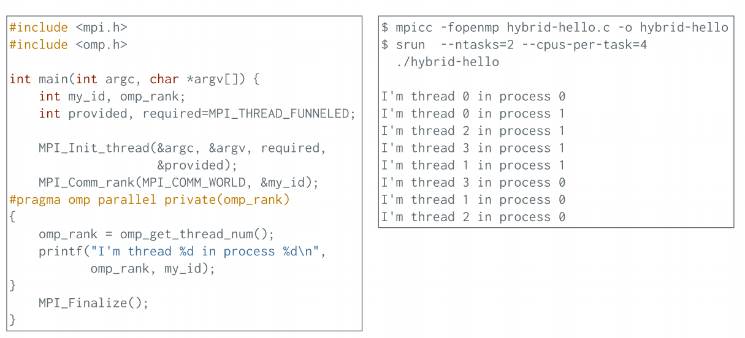
Hybrid Programming: Example

Slide 12
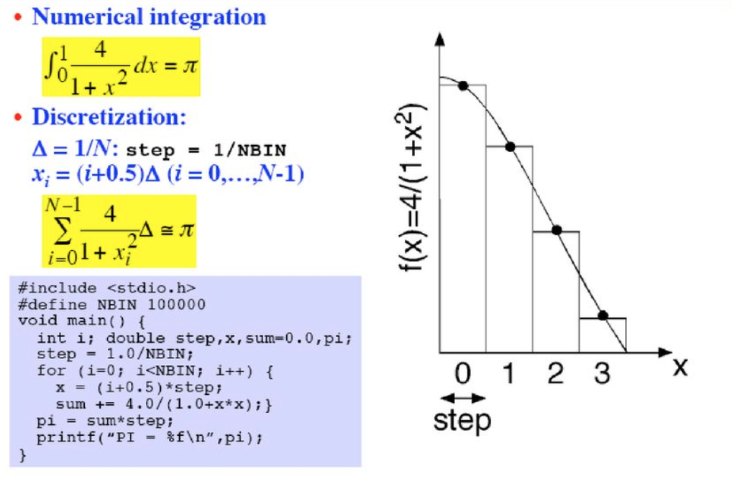
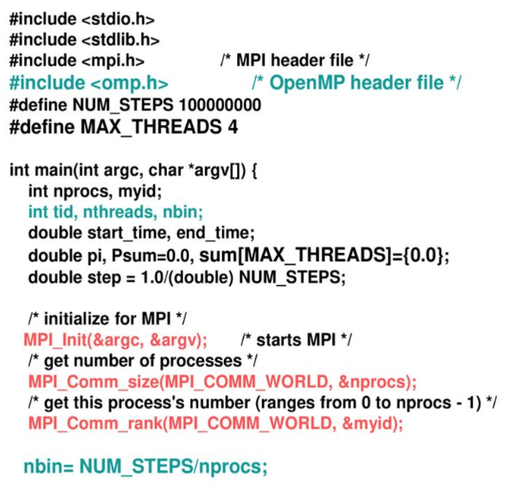
Hybrid Programming Example

Slide 13
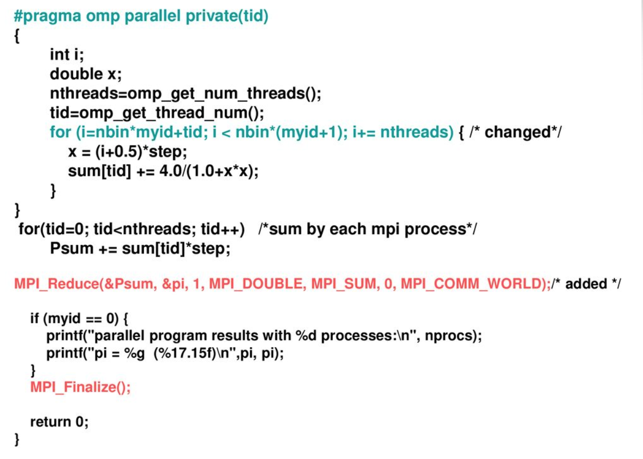
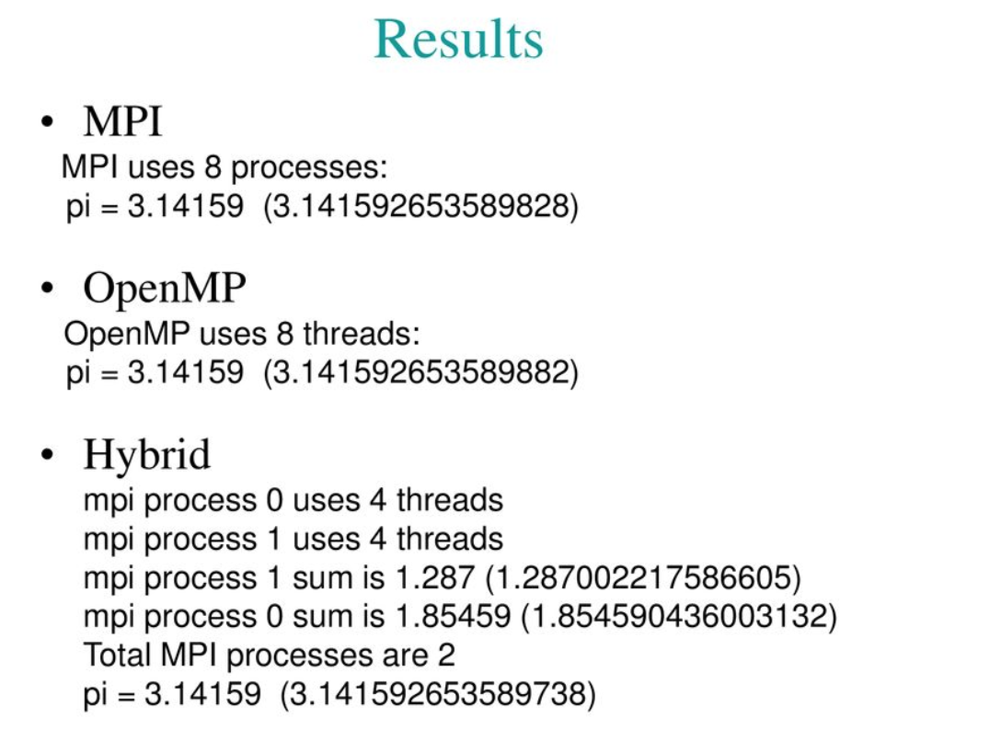
Hybrid Programming Example

Slide 14


Thank you for your attention !

