Slide 1

PARALLEL PROGRAMMING...
Copyright 2023 Patrick Lemoine. All rights reserved.

Slide 2

Parallel Programming: Overview
SESSION 6/6
SPECX
Why ?
GOAL

Slide 3

SPECX
양

Slide 4
SPECX
SPECX
Shares many similarities with StarPU.
Written in modern C++ (20).
Task-based execution system.
Able to also support speculative execution, which is the ability to execute tasks ahead of time if others are unsure about changing the data.
StarPU
StarPU is a task scheduling library for hybrid architectures.
Design systems in which applications are distributed across the machine, feeding all available resources into parallel tasks.
Optimized heterogeneous scheduling, cluster communication, data transfers and replication between main memory and discrete memories

Slide 5

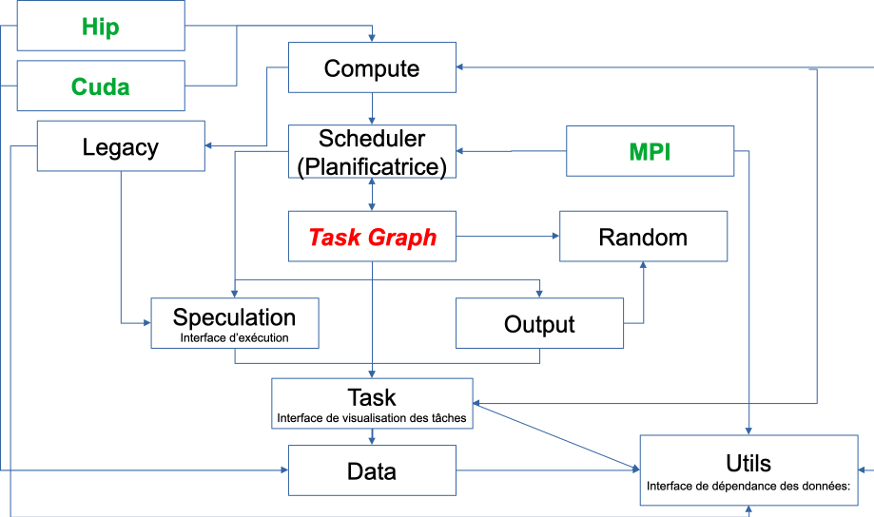
SPECX
Workflow
Execution interface: Provides functionality for creating tasks, task graphs and generating traces. Can be used to specify speculation model.
Data Dependency Interface: Forms a collection of objects that can be used to express data dependencies. Also provides wrapper objects that can be used to specify whether a given callable should be considered CPU or GPU code.
Task visualization interface: Specifies the ways to interact with the task object.

Slide 6

SPECX
Future developments
The main objective is to reduce the calculation times,
To manage the use of the different calculation resources, the different typical workloads, in particular in the case of multicore machines equipped with several acceleration machines.
Plan to separate thread management from execution. To change the prototype of the predicate, to be able to consider additional data or different to make the decision.
Develop decision graphs to optimize available hybrid resources (CPU, GPU, GPGPU, TPU,...) to increase computational speed for given problems.
To provide effective and high -performance tools to the user.

Slide 10

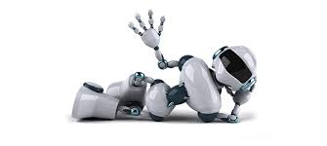
Thank you for your attention !

