Slide 1
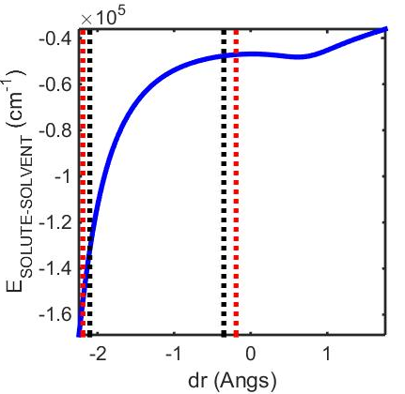
r_{eq Fe} COMb =
0.24 Å
r_{N(HIS)} COMb = 2.19 Å
r_{eq Fe} deoxyMb =
0.35 Å
r _{N(HIS)} deoxyMb = 2.1 Å

Slide 2
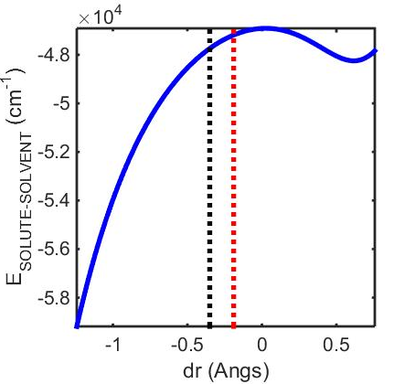
r_{eq Fe} COMb =
0.24 Å
r_{eq Fe} deoxyMb =
0.35 Å

Slide 3
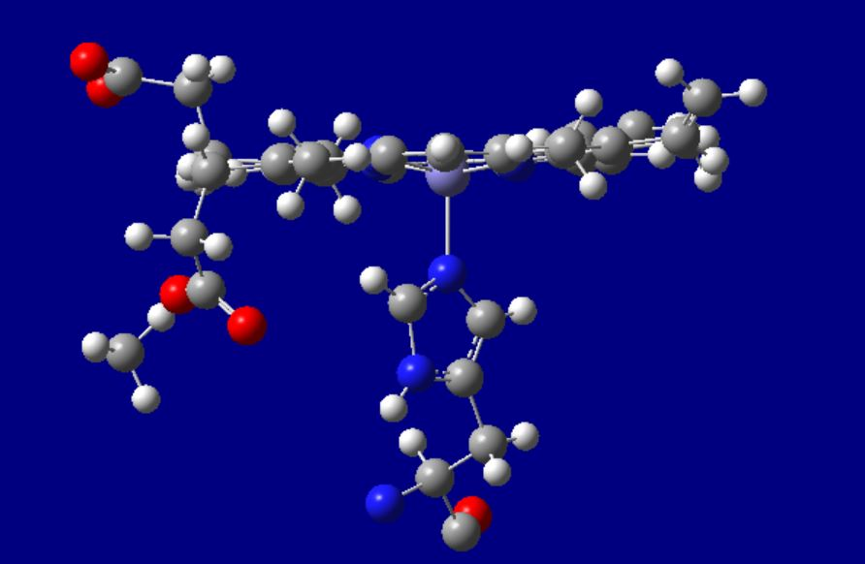

Slide 4
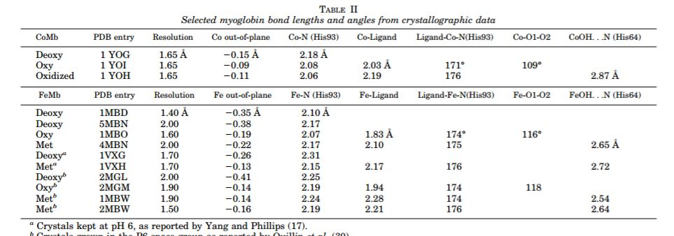
High Resolution Crystal Structures of the Deoxy, Oxy, and Aquomet Forms of Cobalt MyoglobinJ. Biol. Chem. 1996 271: 25419-. doi:10.1074/jbc.271.41.25419

