Slide 1
A multi-armed bandit incentive mechanism for task allocation in crowdsencing
Presented by: Yun Zhang
Notes:
同类工作比较，建立一个通用的模型，抽象不同问题的相似性，

Slide 2
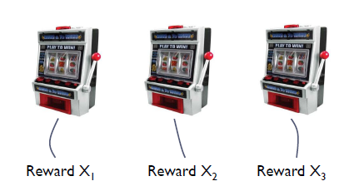
The multi-armed bandit problem
Maximize the reward obtained by successively playing the arm
Invented in early 1950s by Robbins to model decision making under uncertainty when the environment is unknown
The reward are unknown ahead of time
Notes:
A gambler faces with several bandits, each time, he pulls the lever, it will return some rewards, but it doesn’t fixed. It has a unknown distribution.

Slide 3
Exploration vs Exploitation
Explore/Learn
Try out different action to learn how they perform over time---this is a data collection task.
Exploit/Earn
Take advantage of what you have learned to get highest payoff---your current best guess.

Slide 4

Contextual Bandit --Clinical trials
Goal：evaluate K possible treatments for a disease
Which one is the most effective?
Pool of T subjects partitioned randomly into K groups
Resource to allocate: partition of the subjects
In later stages of the trial, a greater fraction of the subjects should be assigned to treatments which have performed well during the earlier stages of the trial
Reward: 0-1 if the treatment is successful or not
Notes:
对一种疾病尝试K中治疗方案，希望能够找到治疗效果最好的

Slide 5
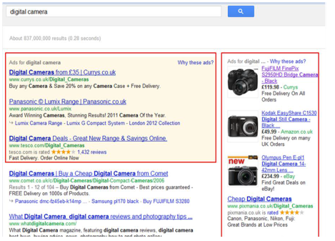
Internet advertising
Each time a user visits the site you must choose to display one of K possible advertisements
Reward is gained if a user click on it
No knowledge of the user, the ad content, the web page content required

Slide 6
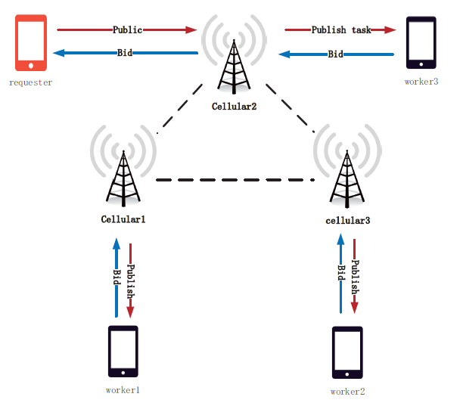
Task allocation
Notes:
假设有一个sensing任务，
两种说法：
1. 在某个时刻requester产生一个task，然后他给他的k个联系人发送消息，workers回复对任务的报价和当前完成任务的能力等信息返回给requester，
2. 我们可以将它划分为若干个小的任务，然后分配依次分配
Requester根据contextual信息，选择较好的worker执行task。

Slide 7

Formulate—Thompson Sampling
Reward with linear payoffs
Regret
Notes:
B表示的是上下文信息，mu是未知参数

Slide 8
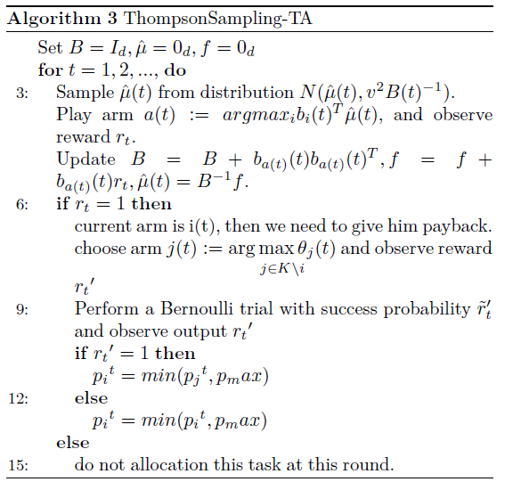
Thompson Sampling task allocation
Notes:
“observe reward” 指的是requester根据决策选了完成该任务的worker， 如果worker成功的完成了该task则reward为1，否则为0
随机生成的是直线，而对于采用本算法的是选择用户的reward越来越高，在趋于平衡的地方是tradeoff的位置

Slide 9
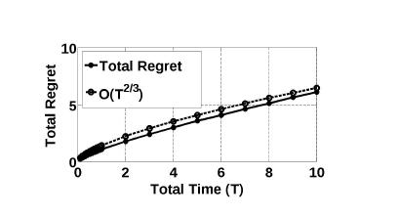
Experiments
Figure 1 : regret
Figure 2: the influence of package different generate rates
Figure 3: the amount of tasks

Slide 10
Contribution
Model task allocation to a MAB problem
Design an algorithm to solve this problem with incentive mechanism
Proof user truthful and the regret bound
The algorithm is distributed algorithm
Do some experiments to proof it
Notes:
算法是分布式式的，不同于传统的集中式的需要平台的支撑。每个任务发布者独立的处理者自己工作的分配

Slide 11
Simulations
100 nodes
Task generate rate:
One day, twelve hours, eight hours, four hours, two hours, one hours, half hours
Context:
Bid
Buffersize
The probability of accomplished the task (distance)
Centrality
Number of task(# of type1, # of type 2, # of type3)
Task value
Do 100 times for every kind of task generate rate
Notes:
Context中的第三个考虑的是worker当前的位置和一些其他的因素导致的

Slide 12
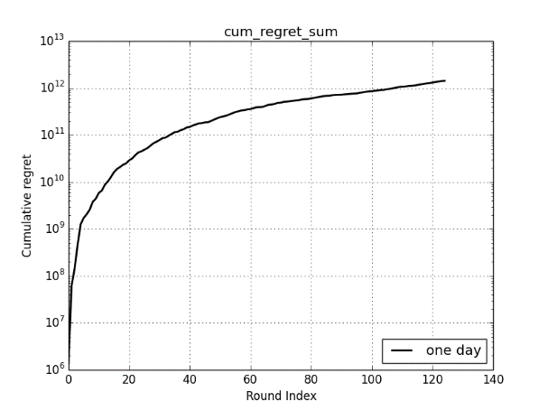
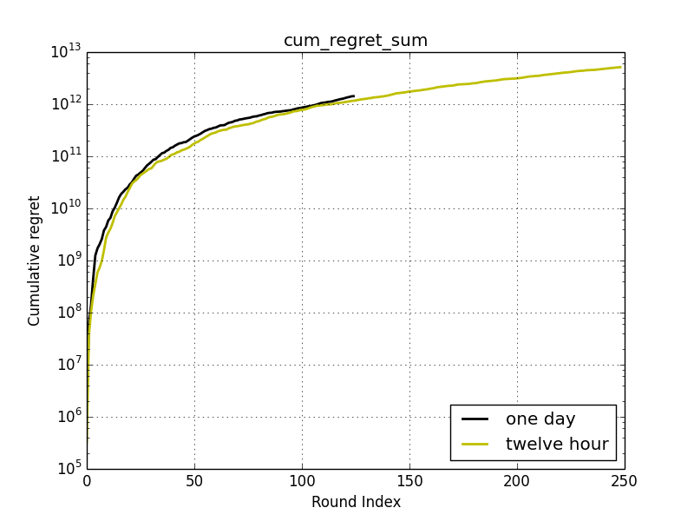
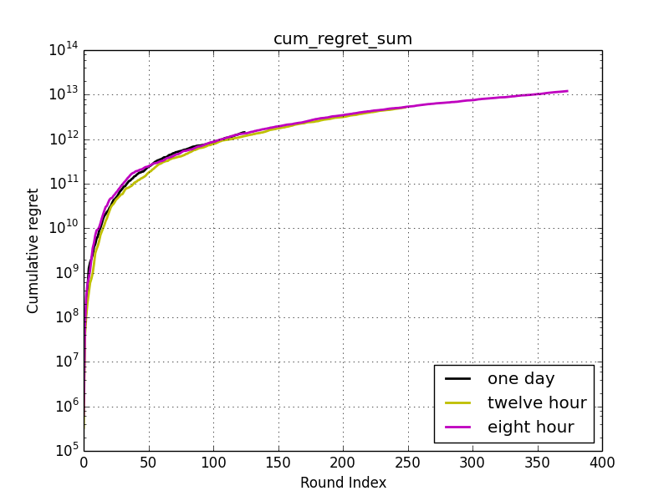
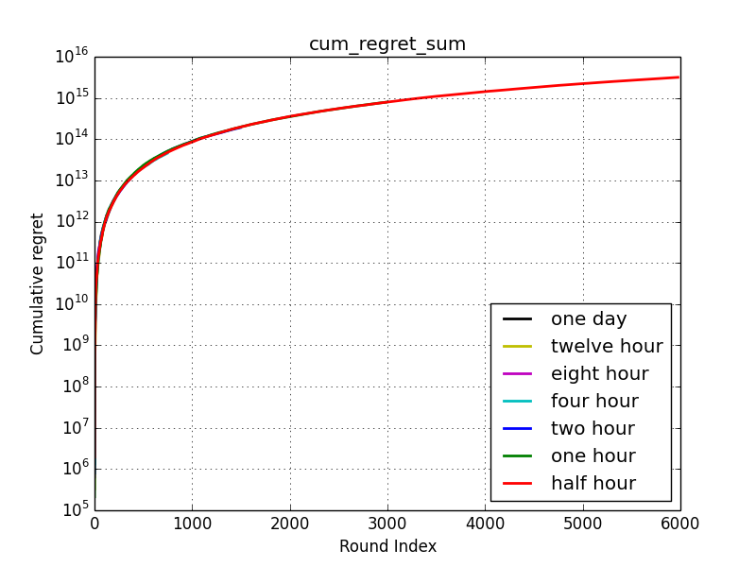
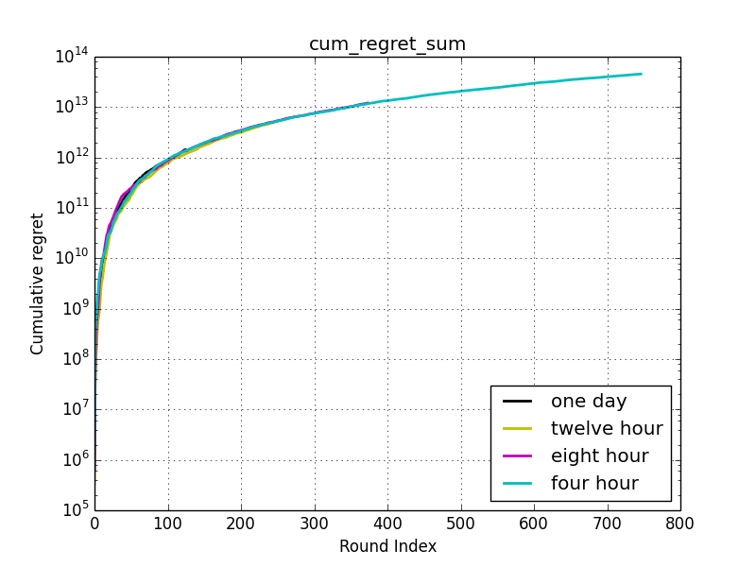
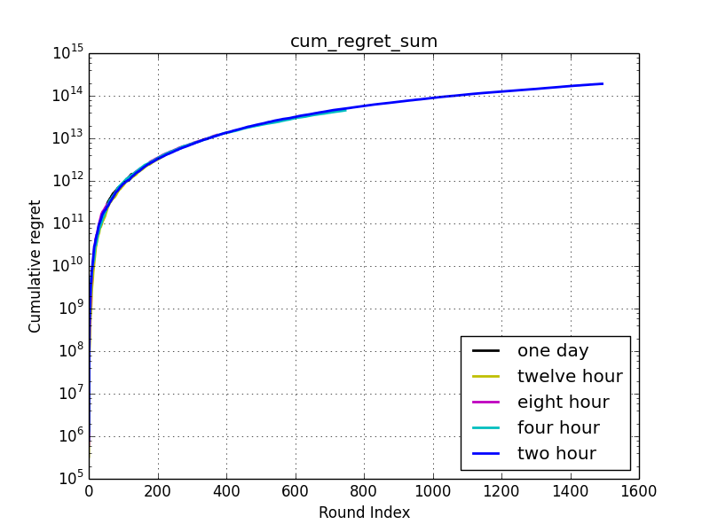
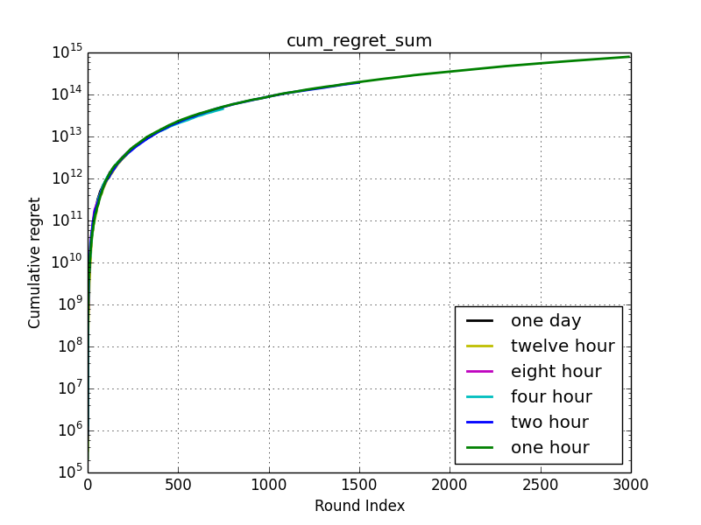
Experiments
Notes:
实验尝试的是不同的任务产生率的情况下，regret变化的情况，基本上在不同的产生率下，regret基本上很接近，
但是还是有些差别，仔细查看one hour 这种情况稍微比half hour偏低

Slide 13
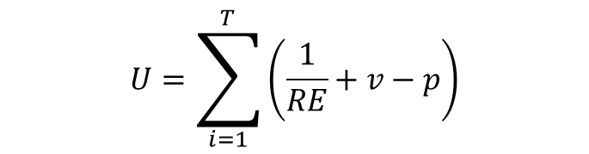
Further work
Simulation and real dataset
Redefine the aim function
$$U=\sum_{i=1}^{T}{\left(\frac{1}{RE}+v−p\right)}$$
Notes:
安全方面的，实验做个app，模型点击来得到实际的reward

