Slide 1
Task Allocation in Crowdsensing based on multi-armed bandit problem with incentive mechanism
Presented by: Yun Zhang

Slide 2
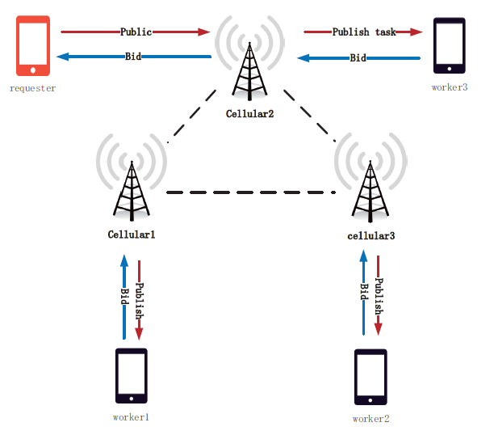
Task allocation
Notes:
假设有一个sensing任务，我们可以将它划分为若干个小的任务，然后分配

Slide 3
Multi-armed bandit problem

Slide 4

Clinical trials
Goal：evaluate K possible treatments for a disease
Which one is the most effective?
Pool of T subjects partitioned randomly into K groups
Resource to allocate: partition of the subjects
In later stages of the trial, a greater fraction of the subjects should be assigned to treatments which have performed well during the earlier stages of the trial
Reward: 0-1 if the treatment is successful or not

Slide 5
Contribution
Feature:

