Slide 1
Multi-armed bandits(MAB)
Yun Zhang

Slide 2
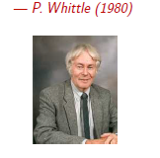
The Essential Conflict and Two Formulations
Conflict
“Bandit problems embody in essential form a conflict evident in all human action: choosing actions which yield immediate reward vs. choosing action(e.g. acquiring information or preparing the ground) whose benefit will come later.”

Slide 3

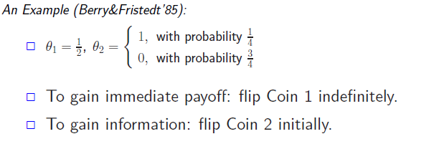
Information vs. Immediate Payoff
A Two-Armed Bandit:
Two coins with unknown bias
Head: reward = 1; Tail: reward = 0.
Objective: maximize total reward over T flips.
Notes:
扔两枚硬币可以看成两个带拉杆的老虎机问题，两个硬币扔出来的正面或者反面的概率分布中的参数为 theta1 和 theta2.
该问题的目标就是如何使T次扔硬币得到的 reward 最大。
从 example中我们可以看出如果为了获得即时reward最大，那么久扔硬币1，如果为了获得更多信息，使能够获得的reward更大，
就要尝试扔硬币2.

Slide 4
Two Formulations
Non-Bayesian Formulation:
are unknown deterministic parameters.
Policy : choose a coin based on the observation history.
: total reward over a horizon of length T.
Bayesian Formulation:
are random variables with prior distributions
Policy : choose a coin based on and the observation history.
The total discounted reward over an infinite horizon:

Slide 5
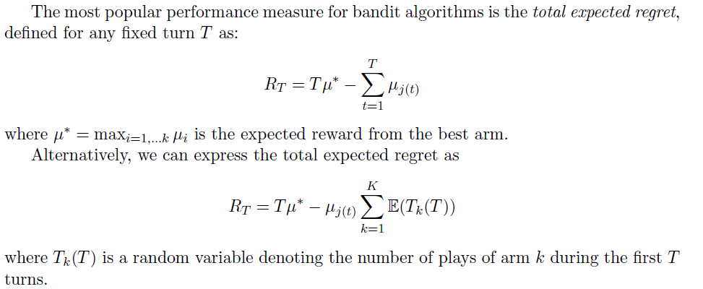
Another perspective
Notes:
另外一种视角

Slide 6
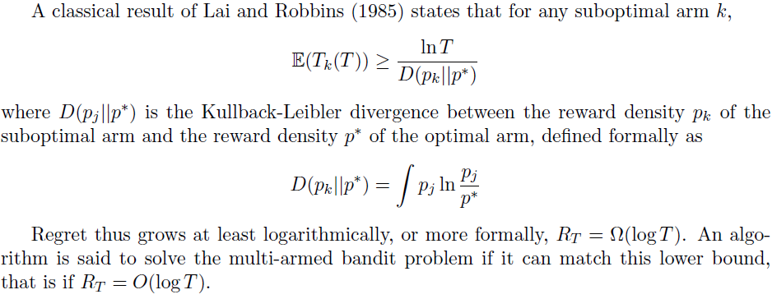

Slide 7
Bandit and MDP
Multi-Armed Bandit as A Class of MDP:
N independent arms with fully observable states
One arm is activated at each time
Active arm changes state(known Markov process); offers reward
Passive arms are frozen and generate no reward.
Notes:
Markov decision process

Slide 8
Why is sampling stochastic process with unknown distributions an MDP？
The state of each arm is the posterior distribution
For an active arm, is update from and the new observation.
For a passive arm,
Solving Multi-Armed Bandit using Dynamic Programming:
Exponential complexity with respect to N.
Notes:
利用马尔科夫决策过程来建模MAB问题，能够解决

Slide 9
Markov Decision Process(MDP)
Definition: (S, A, , , r)
S is a finite set of states.
A is a finite set actions.
is the probability that action a in state s at time t will lead to state s’ at time t+1.
is the immediate reward(or expected immediate reward) received after transition to s’ from state s,
is the discount factor, which represents the difference in importance between future reward and present reward
Notes:
马尔科夫决策过程由五元组组成：S表示的是有穷状态集，A表示的是有穷行为集，P表示的是在t时刻，当前状态为S，由行为a导致状态变换为S’的概率
R表示的是状态从S变为S’得到的回报，lambda是一个折扣因子，
马尔科夫决策中并没有说明S A是有穷的，但是算法中假定他们是有穷的
马尔科夫决策要做的是找到一个决策函数Pi,根据它可以知道从状态s选择何种action从而使累计reward最大，当决策函数Pi确定了，这个问题也就变成了马尔科夫过程

Slide 10
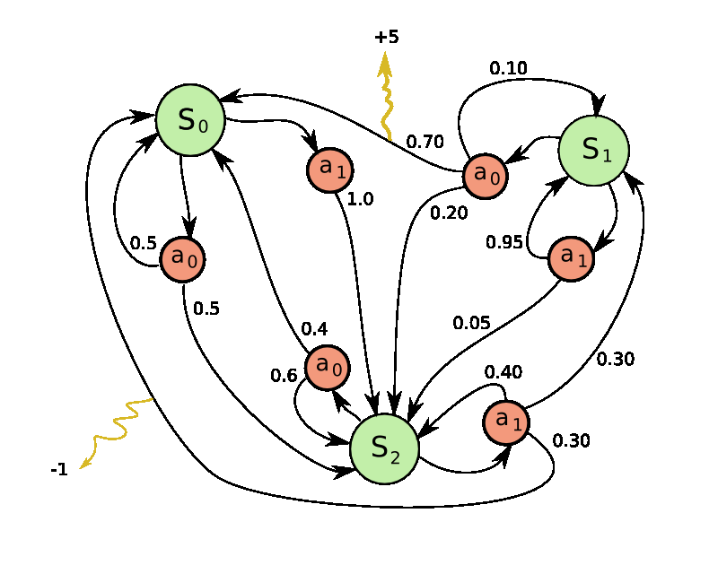

Slide 11
Further introduction
Algorithm
Application

Slide 12
Algorithm
Heuristics
ε-greedy
Boltzmann exploration
Pursuit
Reinforcement comparison
Mathematical idea
UCB1
UCB1-Tuned
Notes:
Boltzmann exploration is based on the principle that the f
UCB guarantee on the expected regret.it solve the bandit problem
Optimally up to a constant factor in a way that will be made precise below.
启发式的算法理论依据不够。(handling the explortaion/exploitation)
启发式：解决问题时采取一种根据经验规则进行发现的方法。其特点是在解决问题时，利用过去的经验选择行之有效的方法，而不是系统地、以确定的步骤寻找答案。

Slide 13

ε-greedy
At each round t = 1; 2; the algorithm selects
the arm with the highest empirical mean with probability 1 -ε , and selects a random arm
with ε probability . In other words, given initial empirical means u1(0),…
Notes:
对每个arm维护一个经验的reward均值，然后在执行的每一轮进行更新它。
当ε是一个常量时，只能实现regret为线性的下界。当 ε随着时间降低能够实现一个对数级的regret下界

Slide 14
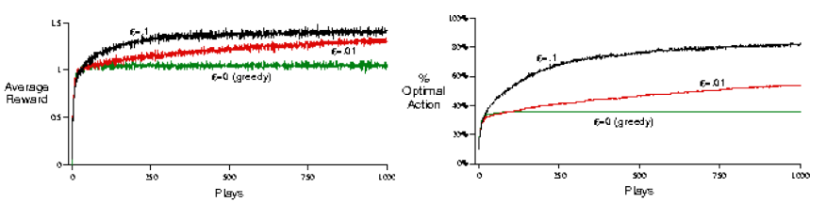
ε-greedy Result

Slide 15

Boltzmann Explortation
Pick each arm with a probability that is proportional to its average reward. Arms with greater empirical means are therefore picked with higher probability.
Notes:
挑选一个 arm 服从玻尔兹曼分布，当tao=0时，分布类似与纯粹的贪婪算法，
当tao趋于无穷大时，算法随机的服从均与分布的从arm中选择一个。

Slide 16

Pursuit Algorithm
It maintain an explicit policy over the arms, whose updates are informed by the empirical means, but are performed separately.
Notes:
初始情况，选择每个arm服从均匀分布，pi(0)=1/k.每轮对概率进行更新。
Beta是学习率

Slide 17
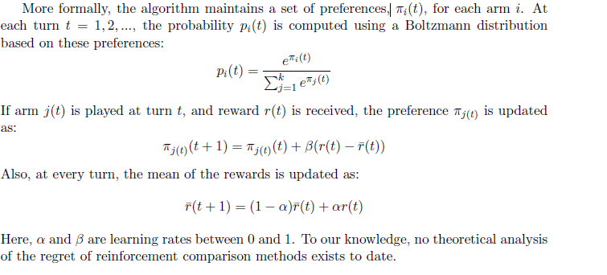
Reinforcement Comparison
Notes:
维护一个关于action的分布，不是直接从经验得到的。玻尔兹曼分布，
存储平均的expected reward r(t)
将得到的reward与平均的reward比较，如果得到的reward比经验的均值大，
他的概率就会增加，否则降低

Slide 18


Upper Confidence Bounds(UCB)
UCB1:initially，each arm is played once, Afterwards, at round t, the algorithm greedily picks the arm j(t) as follows:
At turn t, the expected regret of UCB1 is bound by
Notes:
保存每个arm被选择的次数和经验的均值。
在1989年被证明了上式。上式能够确保regret是log级别，可以解决了mab问题
j(t)前面是根据历史数据，后面的是尝试新的arm的reward

Slide 19
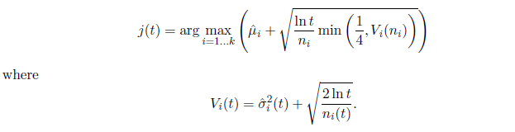
UCB1-Tuned
At turn t=1,2,… the algorithm picks an arm j(t) as
Notes:
实践效果更好，没有理论依据。这个的不同点在与考虑了方差，而不仅仅只是均值
方差通过经验值可以计算出来

Slide 20
Applications
Clinical Trial
Adaptive routing in networks
Advertising: what ad to put on a web-page?
Economy: auctions
Computation of Nash equilibria
Notes:
治疗某种疾病的时候，是选择已知疗效情况的某些药物，还是尝试新的药物，期望能有更好的疗效。

Slide 21

Clinical trials
Goal：evaluate K possible treatments for a disease
Which one is the most effective?
Pool of T subjects partitioned randomly into K groups
Resource to allocate: partition of the subjects
In later stages of the trial, a greater fraction of the subjects should be assigned to treatments which have performed well during the earlier stages of the trial
Reward: 0-1 if the treatment is successful or not

Slide 22
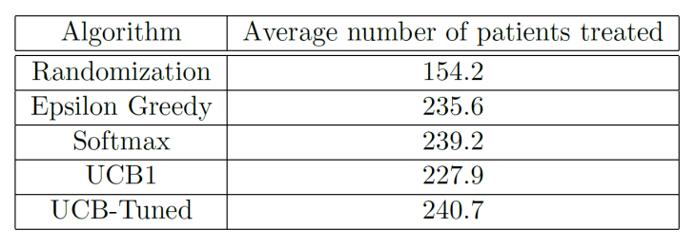
Result for clinical trials

Slide 23
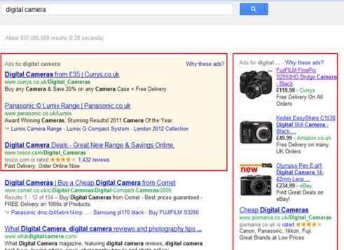
Internet Advertising
Each time a user visits the site you must choose to display one of K possible advertisements
Reward is gained if a user click on it
No knowledge of the user, the ad content, the web page content required..
Notes:
显示的内容应该与用户查看的相关，解决方法是提出了contextual bandits
结合监督学习和强化学习

Slide 24
Conclusion
Bandit problem：starting point for many application and context-specific tasks
Widely studied in the literature, both from the methodologic and the applicative perspective
Still lots of open problems:
Exploration/exploitation dilemma
Theoretical proofs for many algorithms
Optimization in finite-time domain

Slide 25
Reward Maximize for task allocation in Opportunistic crowdsensing network
研究的问题
Task有k个目的节点如何挑选中继是reward最大化
研究的方法
MDP
UCB
Contributions
定义reward来建模问题，提出对应解决问题的算法
融合MAB模型
Notes:
对于任务的分配类似于MAB问题模型中的拉杆问题：我们如何选择中间节点(选择最佳的arm), 从而是我们的任务更好的传递到目的节点，或者说如何选择中间任务承包商，是我们他们工作的满意度更好。
在某一个时刻如何从相遇的若干个节点中选择Reward最大的节点进行任务分配，类似与如何选择Reward最大化的arm

Slide 26
Model
One player k armed bandit
Dilemma: history reward mean ui(t), meet new node
Reward have a unknown distribution(uniform distribution)
Exponential distribution(node meet each other)
Notes:
根据历史一段时间内的数据可以确定用户完成任务的reward的均值，然后
Reward可以自己定义

Slide 27
1
历史数据
i
2
3
exploitation
exploration
Max reward

Slide 28
Thanks for listening!

Slide 29
CrowdSensing
Introduction

Slide 30
Boltzmann exploration: the frequency of an arm should be proportional to its average reward.
Pursuit :maintain an explicit probability distribution over the arms, and to search directly in the space of probability distributions.
Notes:
算法是把各种可能性都一一尝试，最终能找到问题的答案，但是它是在很大 的问题空间内，花费大量的时间和精力才能求的答案。

Slide 31
Reward Maximize for task allocation in Opportunistic crowdsensing network
对于任务的分配类似于MAB问题模型中的拉杆问题：我们如何选择中间节点(选择最佳的arm), 从而是我们的任务更好的传递到目的节点，或者说如何选择中间任务承包商，是我们他们工作的满意度更好。
在某一个时刻如何从相遇的若干个节点中选择Reward最大的节点进行任务分配，类似与如何选择Reward最大化的arm
尝试MDP，UCB策略

