Slide 1
Task Allocation in Crowdsensing based on multi-armed bandit problem with incentive mechanism
Presented by: Yun Zhang

Slide 2
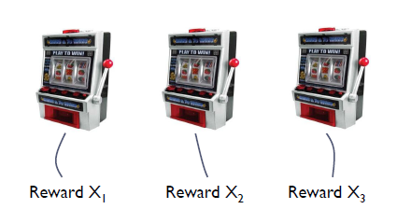
The multi-armed bandit problem
Maximize the reward obtained by successively playing the arm
Invented in early 1950s by Robbins to model decision making under uncertainty when the environment is unknown
The reward are unknown ahead of time
Notes:
A gambler faces with several bandits, each time, he pulls the lever, it will return some rewards, but it doesn’t fixed. It has a unknown distribution.

Slide 3
Exploration vs Exploitation
Explore/Learn
Try out different action to learn how they perform over time---this is a data collection task.
Exploit/Earn
Take advantage of what you have learned to get highest payoff---your current best guess.

Slide 4

Contextual Bandit --Clinical trials
Goal：evaluate K possible treatments for a disease
Which one is the most effective?
Pool of T subjects partitioned randomly into K groups
Resource to allocate: partition of the subjects
In later stages of the trial, a greater fraction of the subjects should be assigned to treatments which have performed well during the earlier stages of the trial
Reward: 0-1 if the treatment is successful or not
Notes:
对一种疾病尝试K中治疗方案，希望能够找到治疗效果最好的

Slide 5
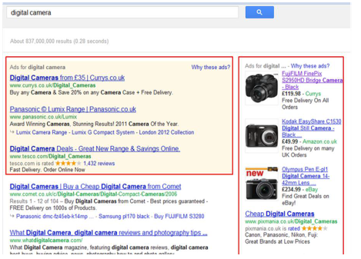
Internet advertising
Each time a user visits the site you must choose to display one of K possible advertisements
Reward is gained if a user click on it
No knowledge of the user, the ad content, the web page content required

Slide 6
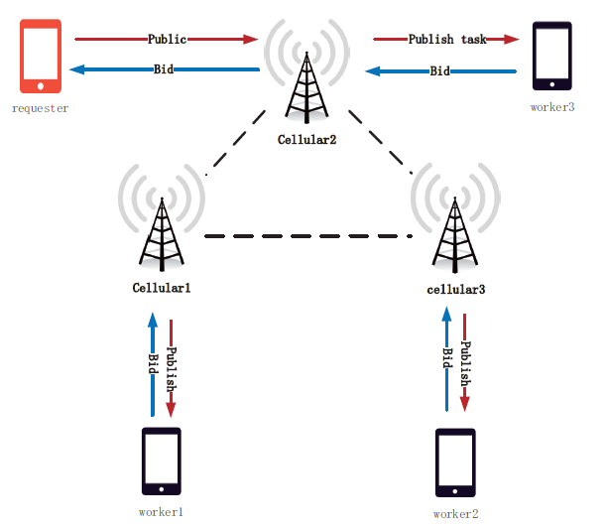
Task allocation
Notes:
假设有一个sensing任务，
两种说法：
1. 在某个时刻requester产生一个task，然后他给他的k个联系人发送消息，workers回复对任务的报价和当前完成任务的能力等信息返回给requester，
2. 我们可以将它划分为若干个小的任务，然后分配依次分配
Requester根据contextual信息，选择较好的worker执行task。

Slide 7

Formulate—Thompson Sampling
Reward with linear payoffs
Regret
Notes:
B表示的是上下文信息，mu是未知参数

Slide 8
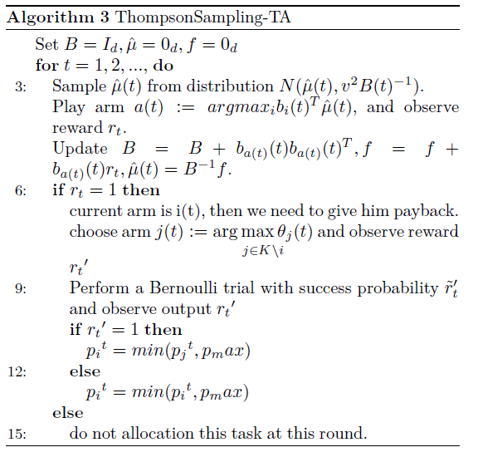
Thompson Sampling task allocation

Slide 9
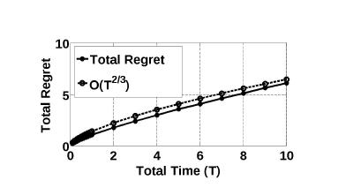
Experiments
Figure 1 : regret
Figure 2: the influence of package different generate rates
Figure 3: the amount of tasks

Slide 10
Contribution
Model task allocation to a MAB problem
Design an algorithm to solve this problem with incentive mechanism
Proof user truthful and the regret bound
Do some experiments to proof it

