Slide 1

✦ META AI ACADEMY KENYA · PITCHATHON 2026 ✦
AI-powered, gamified financial literacy & numeracy for early learners — engineered on Meta Llama for edge & offline play.
META LLAMA 3.3 & 3.2 CORE
KENYA CBC CURRICULUM ALIGNED (GRADES 1–4)
100% OFFLINE EDGE CAPABLE
Martin Mwai · Solo Technical Founder · Nairobi, Kenya | martinmwai.vercel.app

Slide 2
THE PROBLEM · GROUNDED REALITY
SMARTDUKA · META AI
Kids Fall Behind Before They Even Start
Foundational literacy and applied numeracy gaps compound quietly into permanent economic exclusion.
A TRUE GROUNDED STORY
“On my brother’s first day at a new school, the teacher asked where our parents were. He answered in Kamba instead of Swahili.
In Kenya, language and conceptual gaps don't announce themselves — they become normal.”
— Martin Mwai, Founder & Lead Architect
Abstract Western EdTech drills ignore this reality. Children fail not from lack of intelligence, but because existing tools assume high-bandwidth connectivity and foreign idioms.
1 in 3
Primary learners in East Africa achieve basic arithmetic by Grade 3
Over 90% of children in Sub-Saharan Africa cannot read or perform basic arithmetic by age 10.
84%
Of Kenya's workforce operates within the informal economy
Applied mental math, trade negotiation, and trust are fundamental daily survival skills.
78.3% Offline
With only 21.7% rural internet penetration, cloud EdTech fails
Mainstream solutions require high-speed continuous data, locking out millions of rural students.
02 / 08

Slide 3
CORE PRODUCT MECHANIC
SMARTDUKA · META AI
The Duka Loop: Turning Everyday Commerce into a CBC Learning Engine
A duka (corner shop) is East Africa's most familiar economic hub. SmartDuka turns it into an adaptive, gamified learning loop.
01
INTERACT & CONVERSE
02
CALCULATE & TRANSACT
03
MANAGE THE LEDGER
Real-Time NPC Dialogue
Applied Mental Arithmetic
Daftari ya Deni (Credit Ledger)
• Autonomous customer NPCs speak Sheng, Swahili, and English.
• Dynamic stock negotiation: Customers adapt when goods run low.
• Reinforces CBC Strand 3.0 (Language Comprehension & Vocabulary).
• Kenyan Shilling (KES) currency calculations with coins & notes.
• Fast mental math under natural shop pressure without timed panic.
• Safe-fail pedagogy: Milo mentor gives Socratic hints on repeat error.
• Evaluate customer trust, verify repayment dates, and issue credit.
• Balances profit, loss, and community accountability.
• Introduces financial literacy years before a formal bank account.
➔
➔
↻ CONTINUOUS CYCLIC LOOP: Every transaction reinforces CBC Numbers (Strand 1.0) + Financial Trade (Strand 2.0) + Language (Strand 3.0)
03 / 08

Slide 4
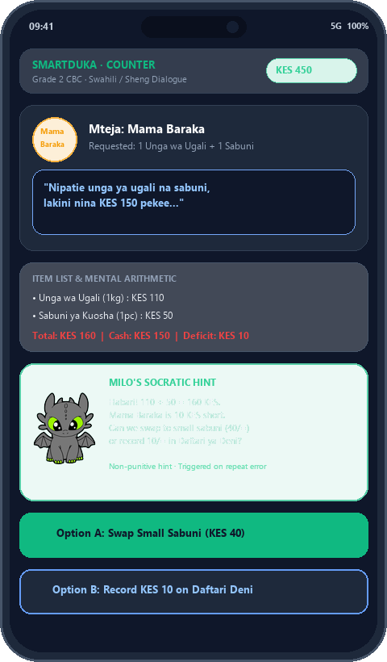
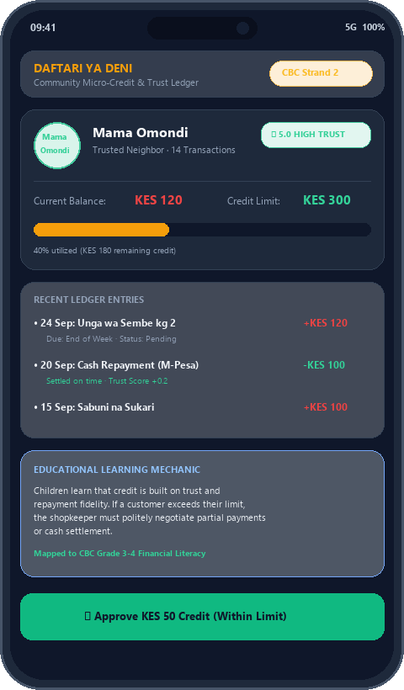
PRODUCT & AGENTS IN ACTION
SMARTDUKA · META AI
Dual-Engine Architecture: Conversational NPCs & Financial Logic
Live gameplay UI showing multi-lingual conversational AI dialogue and the real-world Daftari ya Deni credit ledger.
MOCKUP A · CONVERSATIONAL AGENT
Dynamic Negotiation & Local Dialect
• Customer NPC: 'Nipatie unga ya ugali na sabuni, lakini nina 150 pekee...'
• Calculates total (KES 160) vs cash tendered (KES 150) under real-world trade pressure.
• Local dialect adaptation: Seamless switching across Sheng, Swahili, and English.
MOCKUP B · DAFTARI YA DENI
Community Micro-Credit & Trust Ledger
• Visual credit book: Tracks customer balances, credit limits, and repayment fidelity.
• Children evaluate credit risk: Approving credit within safe limits while rejecting defaults.
• Directly addresses Kenya's 84% informal economy commerce dynamics.
SAFE-FAIL PEDAGOGICAL ENGINE
Milo Mascot Socratic Tutoring
• Milo watches quietly and triggers only when an arithmetic error is repeated.
• Delivers gentle, non-punitive guidance without breaking the child's flow state.
⚡ Real-Time Inventory Substitution: Customers propose swaps when items run low.
04 / 08

Slide 5
HYBRID AI ARCHITECTURE · META LLAMA CORE
SMARTDUKA · META AI
Hybrid AI Pipeline: Cloud Reasoning to Zero-Cost On-Device Edge
Engineered natively on the Meta Llama model family to guarantee sub-second latency and 100% offline rural accessibility.
TIER 1 · PRIMARY CLOUD REASONING
• High-reasoning multi-turn conversational roleplay.
• Nuanced Sheng, Swahili, and English colloquial speech comprehension.
• Dynamic inventory negotiation and adaptive pedagogical difficulty.
• Structured JSON function calling for game state mutation.
Meta Llama 3.3 70B
OpenRouter / Regional Cloud API
TIER 2 · ULTRA-FAST LATENCY FAILOVER
• Sub-second (<1s) conversational response times during mobile network jitter.
• Prevents game freeze or dialogue stutter for high engagement.
• Guarantees seamless flow state for early primary learners.
• Automated fallback trigger on API latency > 2.5 seconds.
Groq LPUs + Llama 3.3 70B
Hardware-Accelerated Inference
TIER 3 · ZERO-DATA ON-DEVICE EDGE
• 100% offline gameplay for rural schools with zero internet connection.
• Zero cellular data charges incurred for the learner or school.
• Runs on low-cost entry-level Android tablets (2GB–4GB RAM).
• IndexedDB local persistence syncing progress when connectivity resumes.
Quantized Meta Llama 3.2 (1B / 3B)
Ollama / WebLLM Edge Runtime
✦ PURE META OPEN-SOURCE SHOWCASE: Engineered exclusively around Meta Llama models with zero proprietary lock-in ✦
05 / 08

Slide 6
INSTITUTIONAL LEGITIMACY · CBC FRAMEWORK
SMARTDUKA · META AI
Direct Competency-Based Curriculum (CBC) Integration
Designed specifically for Kenya's Ministry of Education CBC standards for Grades 1 through 4.
STRAND 1.0
STRAND 2.0
STRAND 3.0
STRAND 4.0
NUMBERS & ARITHMETIC
Grades 1–3 Alignment
FINANCIAL LITERACY & TRADE
Grades 2–4 Alignment
LANGUAGE & COMMUNICATION
Grades 1–4 Alignment
HYGIENE & OPERATIONS
Grades 1–3 Alignment
• Mental addition & subtraction under shop pressure.
• Bundle multiplication (e.g. egg trays, matchbox packets).
• Fair division of bulk inventory items.
• Verifying tendered cash and exact KES change.
• Kenyan Shilling (KES) currency & coin recognition.
• Percentage discounts and promotional pricing.
• Daftari ya Deni: Credit risk & repayment tracking.
• Balancing daily cash profit, loss, and debt.
• Trilingual fluency: Sheng, Swahili, and English.
• Contextual reading comprehension for shopping lists.
• Word-to-item visual vocabulary matching.
• Polite customer service dialogue and negotiation.
• Safe food handling, hygiene, and store cleanliness.
• Perishable dairy inspection (maziwa mala, fresh milk).
• Cold storage refrigeration rules.
• Inspecting expiration dates before selling goods.
✓ Structured for seamless accreditation with the Kenya Institute of Curriculum Development (KICD)
06 / 08

Slide 7
EXECUTION VELOCITY & ROADMAP
SMARTDUKA · META AI
Rapid Full-Stack Execution & Initial Validation
From zero to a fully functional, curriculum-aligned PWA powered by Meta Llama in weeks.
PROOF OF EXECUTION · WHAT'S REAL TODAY
FOUNDER & LEAD ARCHITECT
✓ Fully Working PWA Prototype
Next.js 16 + FastAPI engine with interactive shelves, counter, basket, and Sauti audio TTS.
✓ Multi-Tier Llama Orchestration
Live integration of Llama 3.3 70B & local Llama 3.2 with automated failovers.
✓ OpenAI Build Week 2026
Demonstrated live to global builders, validating architecture and pedagogical novelty.
✓ In-Field Teacher Feedback
1-week structured evaluation with active Kenyan primary educators validating curriculum fit.
✓ Automated Quality Assurance
Robust test suite verifying mathematical accuracy, ledger math, and AI failovers.
Martin Mwai
Solo Technical Founder · Nairobi, Kenya
Computer Science Graduate, Kisii University
Sole architect and engineer behind SmartDuka. Designed the end-to-end full-stack platform, multi-agent AI orchestrator, and CBC curriculum engine.
━━━━━━━━━━━━━━━━━━━━━━━━━━━━━━━━━━━━
NEXT GO-TO-MARKET MILESTONE
➔ 500-Student Formal Pilot across 5 partner primary schools in Nairobi & peri-urban Kenya.
➔ Quantitative impact data collection: Measuring arithmetic fluency and financial numeracy gains.
➔ Team Expansion: Bringing in a school pedagogical liaison to deepen educator partnerships.
07 / 08

Slide 8
META AI ACADEMY KENYA · CAPITAL ALLOCATION
SMARTDUKA · META AI
Deploying $5,000 to Reach 500 Rural Learners
Every dollar is directly allocated to accelerating Meta Llama edge deployment and classroom impact.
$2,000
40% of fund allocation
$1,500
30% of fund allocation
$1,500
30% of fund allocation
Llama Fine-Tuning & Swahili/Sheng Dataset
Edge & PWA Infrastructure
Classroom Pilot Hardware
Fine-tune Meta Llama 3.2 on primary-level East African retail and educational dialogues for higher cultural nuance and localized dialect accuracy.
Deploy regional cloud caching, automated sync pipelines, and optimized edge-serving for low-bandwidth rural school environments.
Procure and deploy 5 low-cost shared Android test tablets across partner schools for offline testing and quantitative learning impact data.
“SmartDuka turns the corner shop into Africa's most scalable classroom. Built on Meta Llama.”
Empowering the next generation of East African problem solvers from the foundation up.
08 / 08

