Slide 1

AI-Powered, gamified numeracy & financial literacy for early learners
Meta AI Academy Kenya · Pitchathon 2026
Martin Mwai – Solo Founder

Slide 2
THE CRISIS
Kids fall behind before they even start.
Foundational literacy and applied numeracy gaps compound quietly into permanent economic exclusion.
1 in 3
Primary learners in East Africa achieve basic arithmetic by Grade 3
Over 90% of children in Sub-Saharan Africa cannot read or perform basic arithmetic by age 10.
Based on a TRUE STORY
“On my brother’s first day at a new school, the teacher asked where our parents were. He answered in Kamba instead of Swahili.
In Kenya, language and conceptual gaps don't announce themselves — they become normal.”
— Martin Mwai, Founder & Lead Architect
Abstract Western EdTech drills ignore this reality. Children fail not from lack of intelligence, but because existing tools assume high-bandwidth connectivity and foreign idioms.
84%
Of Kenya's workforce operates within the informal economy
Applied mental math, trade negotiation, and trust are fundamental daily survival skills.
78.3% Offline
With only 21.7% rural internet penetration, cloud EdTech fails
Mainstream solutions require high-speed continuous data, locking out millions of rural students.
02

Slide 3
THE CORE PRODUCT MECHANIC
Every child already knows what a duka is.
A Duka (corner shop) is the most familiar commercial space in East Africa. SmartDuka turns it into an adaptive, gamified learning loop.
1
Serve Customers
2
Give Change
3
Track the Ledger
Real-Time NPC Dialogue
Applied Mental Arithmetic
Daftari ya Deni (Credit Ledger)
AI-generated Kenyan customers with real shopping lists, in Swahili and English
Dynamic stock negotiation: Customers adapt when goods run low.
Real KES transactions build numeracy the child never sees as a lesson
Fast mental math under natural shop pressure without timed panic
Evaluate customer trust, verify repayment dates and issue credit
Balances profit, loss, and community accountability
Live conversation adapts as items run low, negotiating substitutes in real time.
Coins and notes, mental arithmetic under natural time pressure.
Children evaluate trust, record debts, and balance repayments.
03

Slide 4
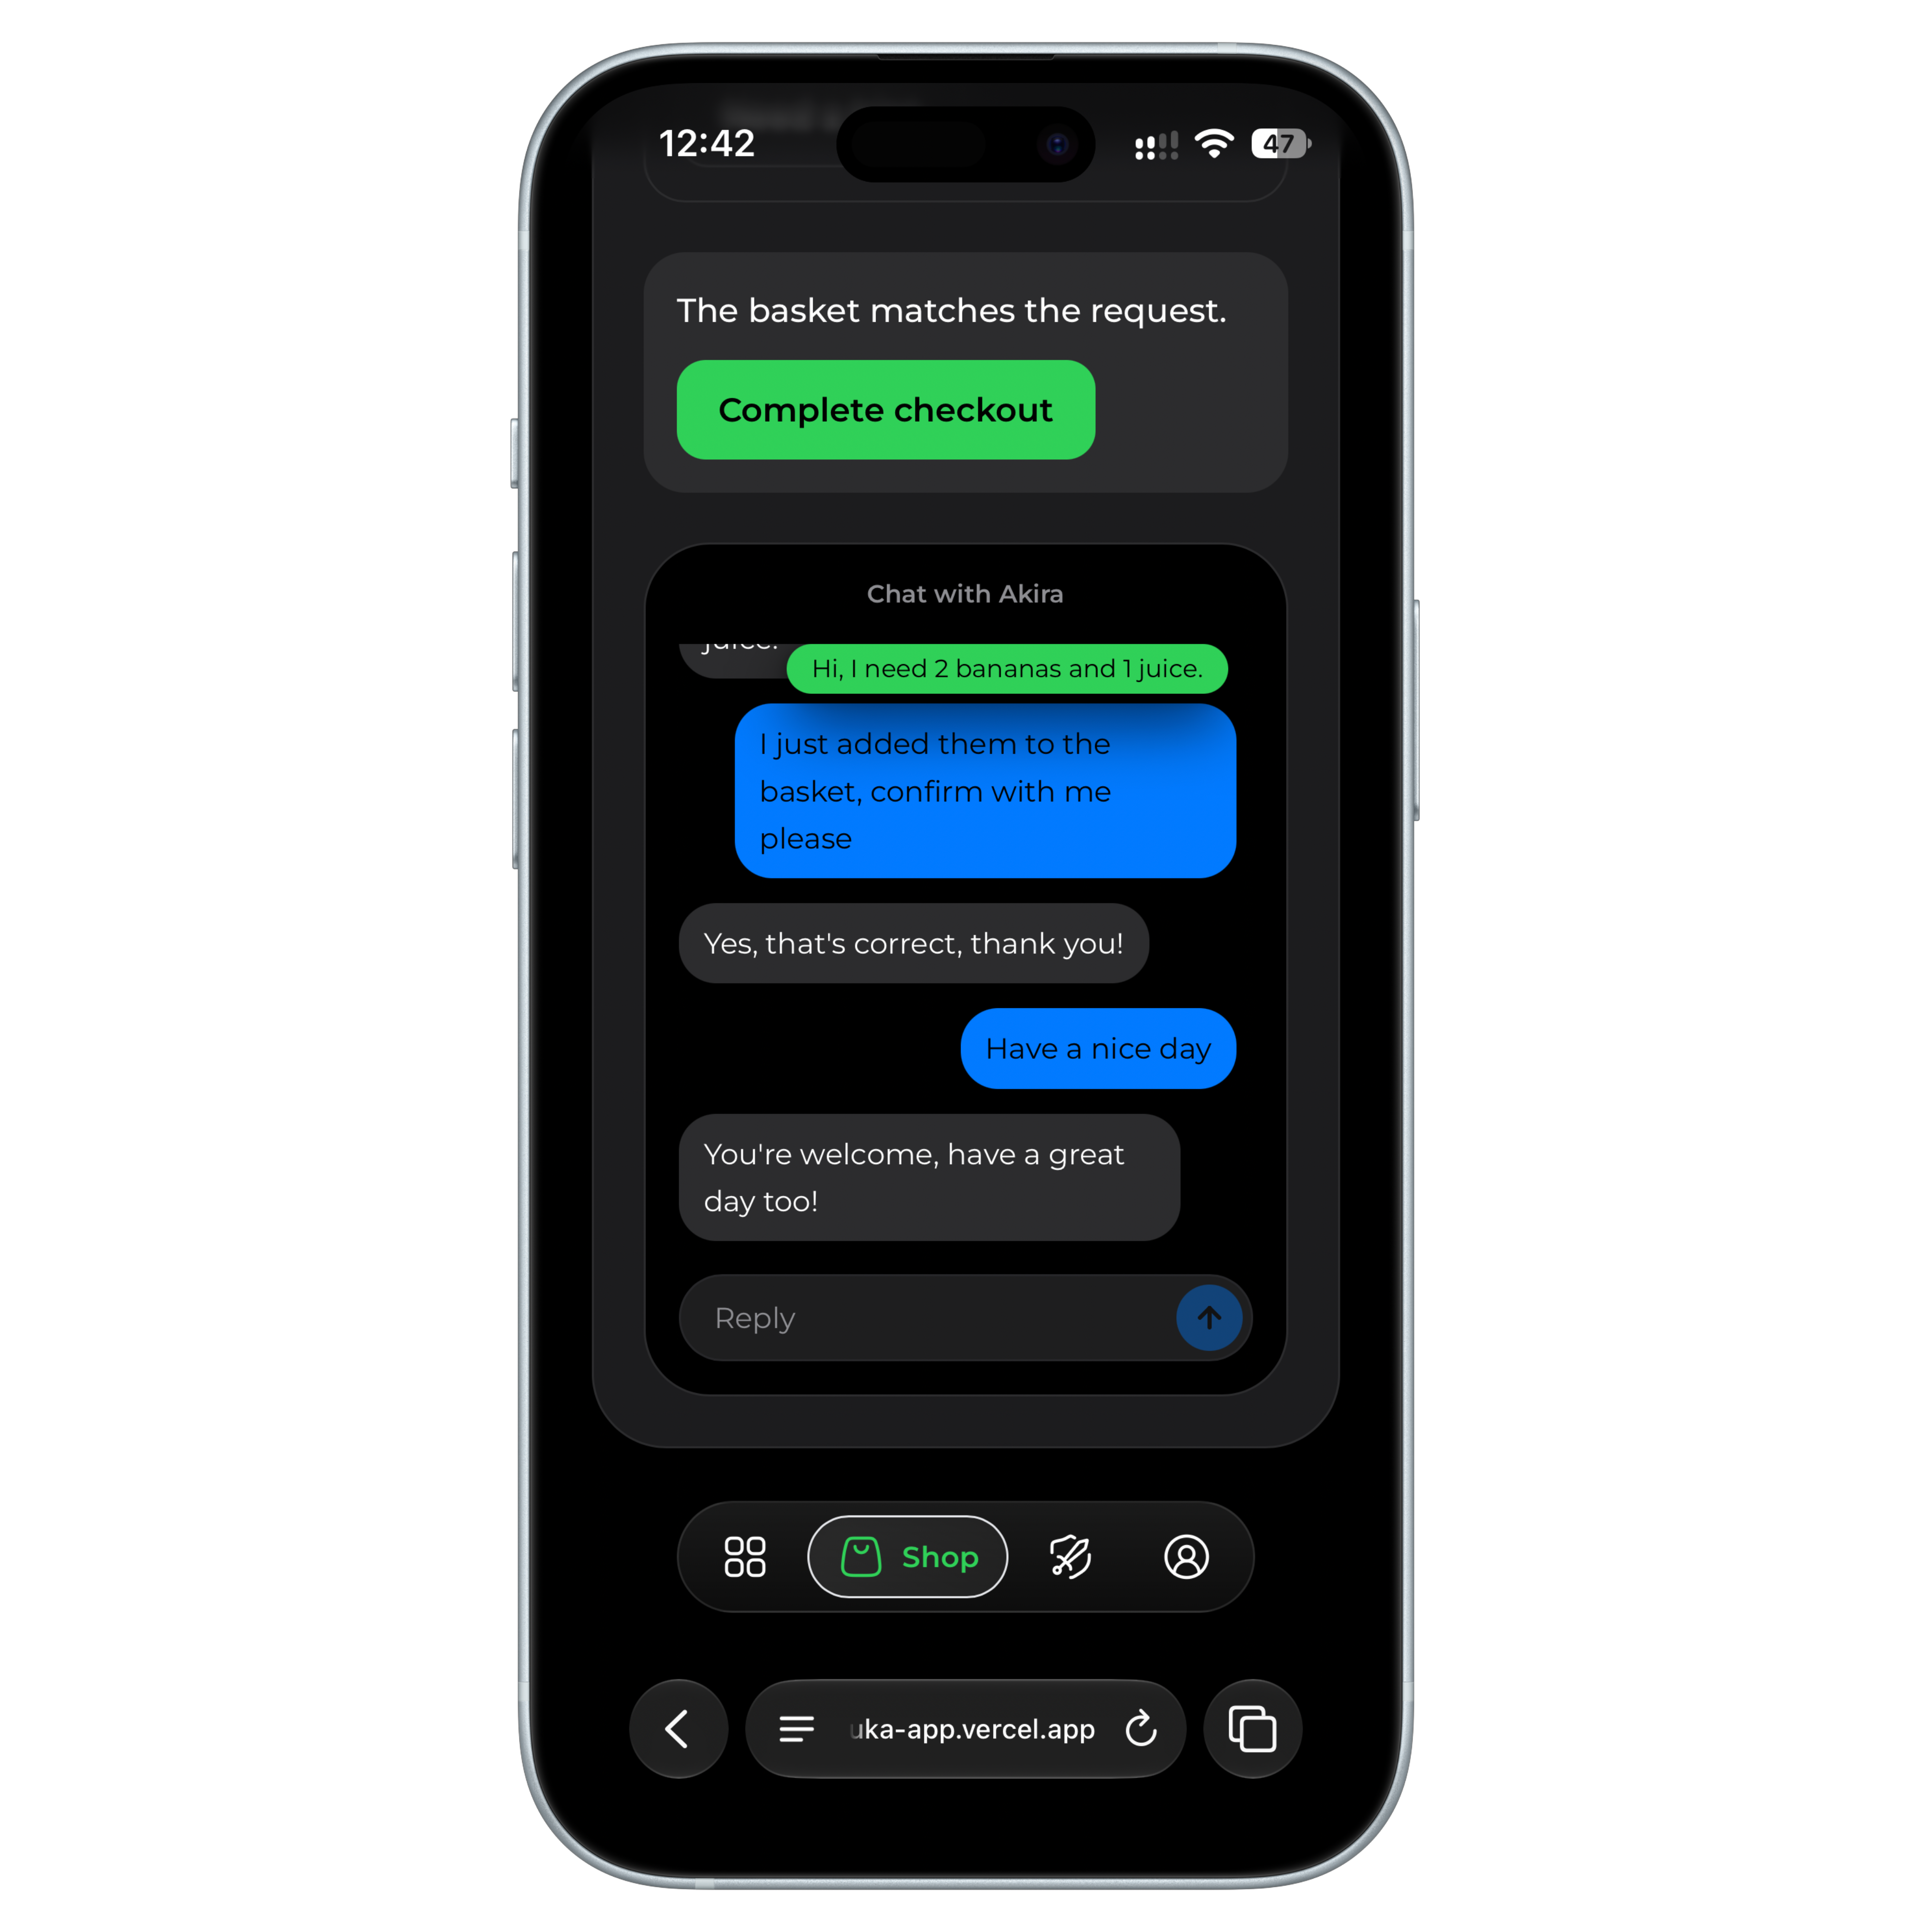
PRODUCT & AGENTS IN ACTION
Dual-Engine Architecture
A) Conversational NPCs
Live gameplay UI showing multi-lingual conversational AI dialogue.
AI Customer Conversation
Customers speak Swahili and English, negotiating substitutions live for instant; "agreeing to swap juice for milk" while the basket updates in real time.
Milo, the tutor mascot, watches quietly and steps in only when a child repeats the same mistake.
04

Slide 5
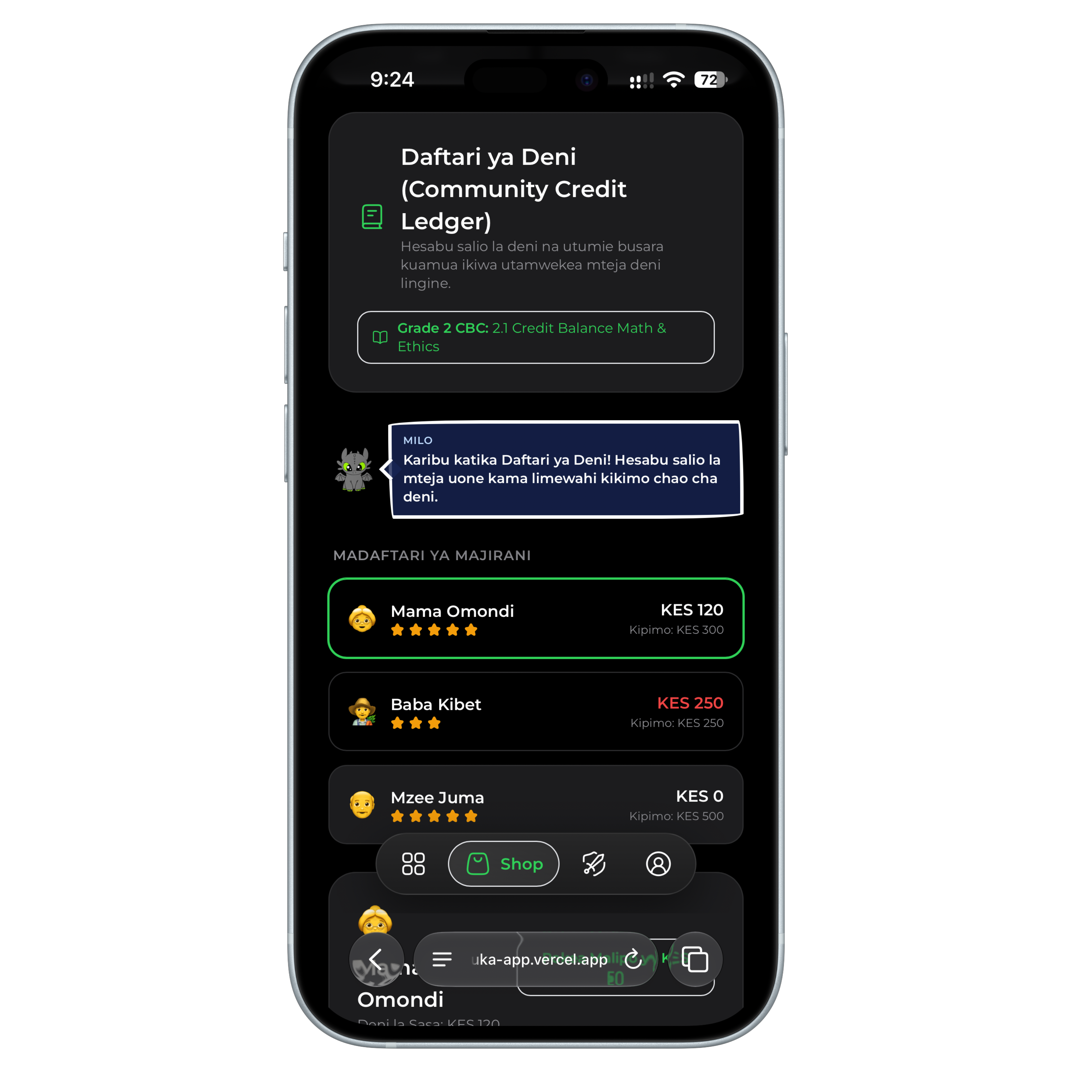
PRODUCT & AGENTS IN ACTION
b) Financial Logic
The real-world Daftari ya Deni credit ledger.
Daftari ya Deni
The credit ledger system. Children evaluate a trusted customer's creditworthiness, record debits, and balance repayments — real micro-commerce, taught through play.
Introduces credit, trust, and repayment years before a bank account ever will.

Slide 6

OFFLINE PWA & META LLAMA
Hybrid AI Pipeline: Cloud Reasoning to Zero-Cost On-Device Edge.
Engineered natively on the Meta Llama model family to guarantee sub-second latency and 100% offline rural accessibility.
01
OpenRouter Cloud
Meta Llama 3.3 70B Instruct
Primary — Rich Swahili/Sheng dialogue, adaptive customer personalities & CBC shopping lists.
02
Ollama
Meta Llama 3.2 (3B)
On-device — fully offline, zero token cost for schools & edge devices.
03
Failover & Safety Net
Gemini Flash + Local Rules Engine
Resilience- high-speed cloud failover buffer and deterministic customer queue preventing zero-drop sessions.
05

Slide 7
CBC CURRICULUM ALIGNMENT
Four strands. One shopkeeper loop.
Designed specifically for Kenya's Ministry of Education CBC standards for Grades 1 through 4.
1.0
2.0
3.0
4.0
Numbers & Arithmetic
Financial Literacy & Trade
Language & Communication
Hygiene & Operations
Counting, addition, subtraction, bundle multiplication, fair division
Verifying tendered cash and exact KES change.
KES change calculation, percentage discounts, Daftari ya Deni credit tracking
Balancing daily cash profit, loss, and debt.
Bilingual shopping lists, vocabulary matching, reading comprehension
Word-to-item visual vocabulary matching.
Polite customer service dialogue and negotiation.
Safe storekeeping, cold storage rules, shelf inspection for expiry dates before selling goods
Perishable dairy inspection
06

Slide 8
TRACTION, PILOT & TEAM
Full-Stack Execution & Initial Validation
WHAT'S REAL
MARTIN MWAI
Solo Technical Founder
Fully working PWA prototype
Multi-Tier Llama Orchestration
CBC-aligned curriculum engine, Grades 1–4
In-Field Teacher Feedback
Automated quality Assurance
Sole architect and engineer behind SmartDuka. Designed the end-to-end full-stack platform, multi-agent AI orchestrator, and CBC curriculum engine
NEXT MILESTONE
Student Formal pilot across primary schools in urban and peri-urban Kenya.
Quantitative impact data collection: Measuring arithmetic fluency and financial gains.
A technical collaborator, and someone closer to schools who can deepen teacher relationships beyond the one I have today.
07

Slide 9
THE ASK
US $5,000: Deploying to reach real learners.
1
Llama Fine-Tuning ; Swahili/Sheng Datasets
Fine-tune Meta Llama 3.2 on primary-level East African retail and educational dialogues for higher cultural nuance and localized dialect accuracy.
2
Edge & PWD Infrastructure
Deploy regional cloud caching automated sync pipelines and optimized edge-serving for low-bandwidth rural school environments
GET IN TOUCH
Martin Mwai
martinmwai.vercel.app
GitHub: lemonhead-ai
Nairobi, Kenya
Classroom, Pilot Hardware & Connectivity
3
Get SmartDuka in front of a real classroom for the first time, procure tablets across partner schools for offline testing and quantitative learning impact data
https://martinmwai.vercel.app · Martin Mwai
Let's make Africa a land of great minds.

