Slide 1
Jorit Studer & Michelle Koch
Reproducibility Study:
Have vehicle registration restrictions improved urban air quality in Japan?
Shuhei Nishitateno, Paul J. Burke
Natural Experiments Using R
Notes:
Welcome to our Reproducibility Study about the question if vehicle registrations improved urbain air quality in japan.
THe original study was conducted by Nidhitateno and Burke 2020.

Slide 2
Table of Content
1
2
3
4
5
6
Motivation Data Sources Method Descriptive Statistics Results Conclusion
Natural Experiments Using R
Notes:
Michelle:
In this presentation, we will be discussing the motivation behind the study of vehicular air pollution in Japan, the data sources used, the method applied, the descriptive statistics, the results obtained, and the conclusion drawn.

Slide 3
Motivation
Relevance of the Topic
What happened: Residents from Japan sued 1978 the national government, expressway companies, and automakers for the health damage brought on by vehicular air pollution.
Answer: The introduction of vehicle registration restrictions (the Automobile NOx Control Law, 1992 in Japan) resulted in the removal of 2.6 million polluting vehicles from metropolitan areas between June 1992 and December 2015.
The introduction led to a 3%–6% reduction in the monthly mean ambient concentration of nitrogen dioxide (NO2) in the treated areas.
Due to this law the mortality from asthma was reduced, which saved about US$104 million
Natural Experiments Using R
Notes:
Michelle:
Concerns about the harmful effects of vehicular air pollution have been raised by residents of metropolitan areas in japan for many years. In 1978, a group of residents took legal action against the national government, expressway companies, and automakers, pointing out the health damage caused by vehicular air pollution.
The result of this action was the introduction of the Automobile NOx Control Law in Japan in 1992. This law imposed restrictions on vehicle registration and resulted in the removal of 2.6 million polluting vehicles from metropolitan areas between June 1992 and December 2015. The implementation of the law resulted in a 3%-6% reduction in the monthly mean ambient concentration of nitrogen dioxide (NO2) in treated areas.
This reduction in air pollution brought significant health benefits, including a decrease in mortality rates from asthma. The implementation of the law resulted in an estimated saving of US$104 million in health costs associated with asthma. The success of this law can be seen as a motivating example of how collective action can lead to positive changes in public health and the environment.

Slide 4
Data Sources
About the Data
Monthly panel dataset at the pollution monitor level from Japan for
January 1981–December 2015.
Control Group: 109 municipalities that were subject to the ANCL 1992
Treatment Group: 5 urban municipalities that were subject to the ANCL 1992
Main Data Source: Environmental GIS compiled by the National Institute for Environmental Studies (NIES)
Meteorological data: Japan Meteorological Agency (JMA). (Meteorological data )
Annual data on demographic and socioeconomic factors: System of Social and Demographic Statistics compiled by the Ministry of Internal Affairs and Communications (MIAC).
Natural Experiments Using R
Notes:
Michelle:
For this study, a monthly panel dataset was used, covering the period from January 1981 to December 2015, for 109 boroughs without and five urban boroughs that were subject to the ANCL. The main data source was the Environmental GIS compiled by the National Institute for Environmental Studies (NIES), while meteorological data was obtained from the Japan Meteorological Agency (JMA). Annual data on demographic and socioeconomic factors was obtained from the System of Social and Demographic Statistics compiled by the Ministry of Internal Affairs and Communications (MIAC).

Slide 5
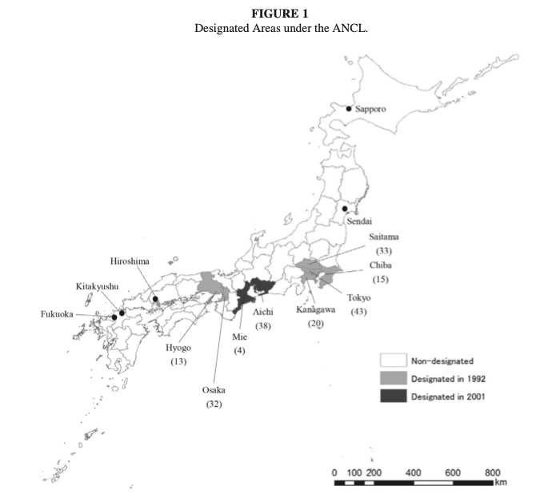
Data Sources
Key Variables
Variable | Descritpion | Source
lnaverage_ndd | Monitor-level NO2 concentration measured by the monthly mean. Unit: ppb. | NIES
lnhmax_ndd | Monitor-level NO2 concentration measured by the hourly maximum. Unit: ppb. | NIES
dabove_nd | Days exceeding national standard: Days exceeding 60 ppb in terms of the daily average per month.
treatment_effects | Monthly mean temperature measured every 10 minutes at a meteorological station nearest to the pollution monitor (same as below), degree Celsius. | JMA
temp | Monthly mean temperature measured every 10 minutes at a meteorological station nearest to the pollution monitor (same as below), degree Celsius. | JMA
precip | Total precipitation per month, millimeters. | JMA
wind | Monthly mean wind velocity measured every 10 minutes, meters per second. | JMA
daylight | Total daylight duration per month, hours. | JMA
snow | Total snowfall per month, centimeters. | JMA
cloud | Degree of cloud cover per month, 0–10. | JMA
treatment1992 | Time-varying dummy variable equal to one if a monitor is located in a municipality subject to the ANCL and zero otherwise. | Ministry of the Environment.
y_month | Absolute number of Months
m_code | Regions in Japan
Missing: | Monitor-level NO2 concentration measured by the daily maximum, Population, Income per capity and Unemployment rate.
Natural Experiments Using R
Notes:
Michelle: The study used several variables.
In our dataset, we have monitor-level NO2 concentration measured by the monthly mean and hourly maximum, as well as days exceeding national standards. We also have monthly mean temperature, total precipitation, wind velocity, daylight duration, snowfall, and cloud cover. There is a time-varying dummy variable for treatment effects and the absolute number of months.
The mcode shos the region in japans and how they were divided into the two groups. Can also be seen in the picutre.
. However, we are missing monitor-level NO2 concentration measured by the daily maximum, population, income per capita, and the unemployment rate.

Slide 6
Method
Difference-in-Differences - Setup
2 Groups
Control Group
Treatment Group
2 Time periods
t=0 no Treatment
t=1 treatment of Treatment group
Control Group without ANCL* (109)
Treatment Group wit ANCL* (5)
*Automobile NOx Control Law
t=0 01.1981 – 05.1992
t=1 06.1992 – 12.2015
Comparison of the average temporal changes in pollution levels before and after the intervention in municipalities subject to the ANCL with those that were not.
Natural Experiments Using R
Notes:
Michelle:
In econometrics, the Difference-in-Differences (DID) method is a widely used technique to estimate the causal effect of an intervention on an outcome of interest. The key requirements for the DID method are two groups (a control group and a treatment group) and two time periods (a pre-intervention period and a post-intervention period). The idea behind the method is to compare the changes in the outcome variable over time in the treatment group to those in the control group, and to see if the difference between the two groups changes after the intervention.
In this particular study, the goal is to compare the average temporal changes in pollution levels before and after the intervention in boroughs subject to the Automobile NOx Control Law (ANCL) with those that were not subject to the law. The study includes a control group of 109 borough without ANCL and a treatment group of 5 boroughs with ANCL. The time periods for the study are from January 1981 to May 1992 (t=0) and from June 1992 to December 2015 (t=1).
(By using the DID method, this study aims to identify the causal effect of the ANCL on pollution levels in the treatment group, taking into account the changes in pollution levels that would have occurred even without the ANCL.)

Slide 7
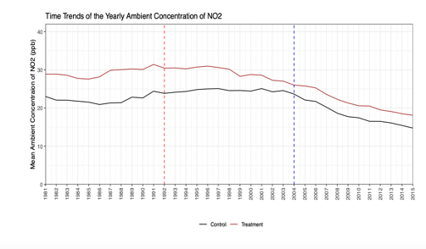
Method
Difference-in-Differences - Identification
Requirement: Parallel trend
Natural Experiments Using R
Notes:
Michelle:
To ensure the validity of the DID method, it is essential to establish a parallel trend assumption, which can be seen in the plot on the right side from 1981 to 1992. The parallel trend assumption implies that the control group and treatment group would have followed the same trend in the absence of the intervention.

Slide 8
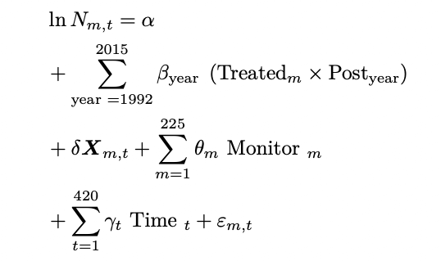
Method
Difference-in-Differences - Estimators
Variables | Description
N_{m,t} | represents the log of the monthly mean ambient concentration of NO₂
β_{year} | change in NO₂ concentrations pre-intervention vs post-intervention period in comparison to the control group
m | Pollution monitor
t | month
X | vector of weather conditions (temperature, precipitation, sunlight duration, snowfall, wind, and cloud cover) as well as monitor-specific time trends
θ | monitor fixed effects (c_code) that account for time-invariant factors relevant to pollution level (e.g., location)
γ | extracted month-of-year fixed effect to control for any national-level monthly changes
ε | error term
Natural Experiments Using R
Notes:
Michelle oder Jorit:
The method equation on this slide is a regression equation that estimates the relationship between the log of the monthly mean ambient concentration of NO2 (Nm,t) and the various explanatory variables. The equation includes the change in NO2 concentrations pre-intervention vs post-intervention period in comparison to the control group (βyear), the vector of weather conditions (X), monitor fixed effects (θm) that account for time-invariant factors relevant to pollution levels, and month-of-year fixed effects (γt) to control for any national-level monthly changes.
The variable "Treatedm" is a dummy variable that takes on the value of 1 if the monitor is located in a borough subject to the ANCL and 0 otherwise. The variable "Postyear" is another dummy variable that takes on the value of 1 if the observation is made after the intervention period (June 1992) and 0 otherwise. The variable "Monitorm" represents the pollution monitor, and the variable "Timet" represents the month.
The error term (εm,t) in the equation captures all the omitted variables and measurement errors that may affect the relationship between the independent and dependent variables. The estimated coefficients of the equation (α, βyear, δ, θm, and γt) provide the estimates of the effects of the various variables on the log of the monthly mean ambient concentration of NO2.

Slide 9
Descriptive Statistics
Pre-Processing
Convert the absolute number of months into a date format
Get the actual values for the the provided log of the monthly and hourly ambient concentration of NO2
Extract the month and year of the dates for a later fixed-effects feature
df <- read.csv("data/nishitateno_burke_2020.csv", sep = ";")
first_date <- as.Date("1981-01-01")
last_date <- as.Date("2015-12-01")
dates <- data.frame(
y_date = seq(first_date, last_date, by = "month"),
y_month = seq(252, 671, by = 1)
)
df <- merge(dates, df, by = "y_month", all.x = TRUE) # get the actual value from the log of lnaverage_ndd df$average_ndd <- exp(df$lnaverage_ndd) %>% round(2) # get the actual value from the log of lnhmax_ndd df$max_ndd <- exp(df$lnhmax_ndd) %>% round(2)
# add month and year column variables for fixed effects
df$month <- month(df$y_date)
df$year <- year(df$y_date)
Natural Experiments Using R
Notes:
Jorit:

Slide 10
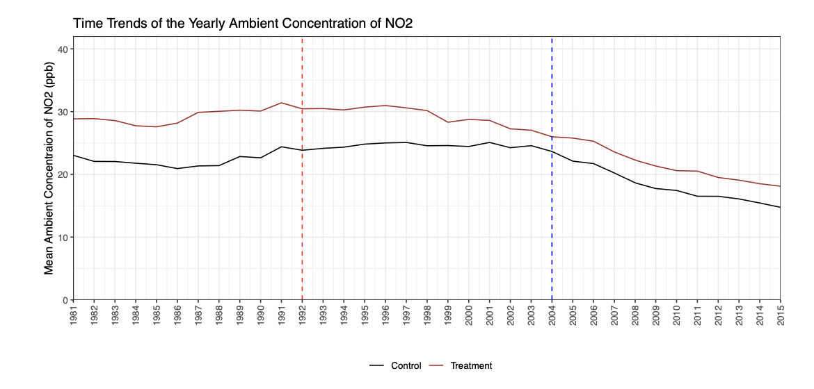
Descriptive Statistics
Looking at the time trends
4. Descriptive statistics
Natural Experiments Using R
Notes:
Jorit:

Slide 11
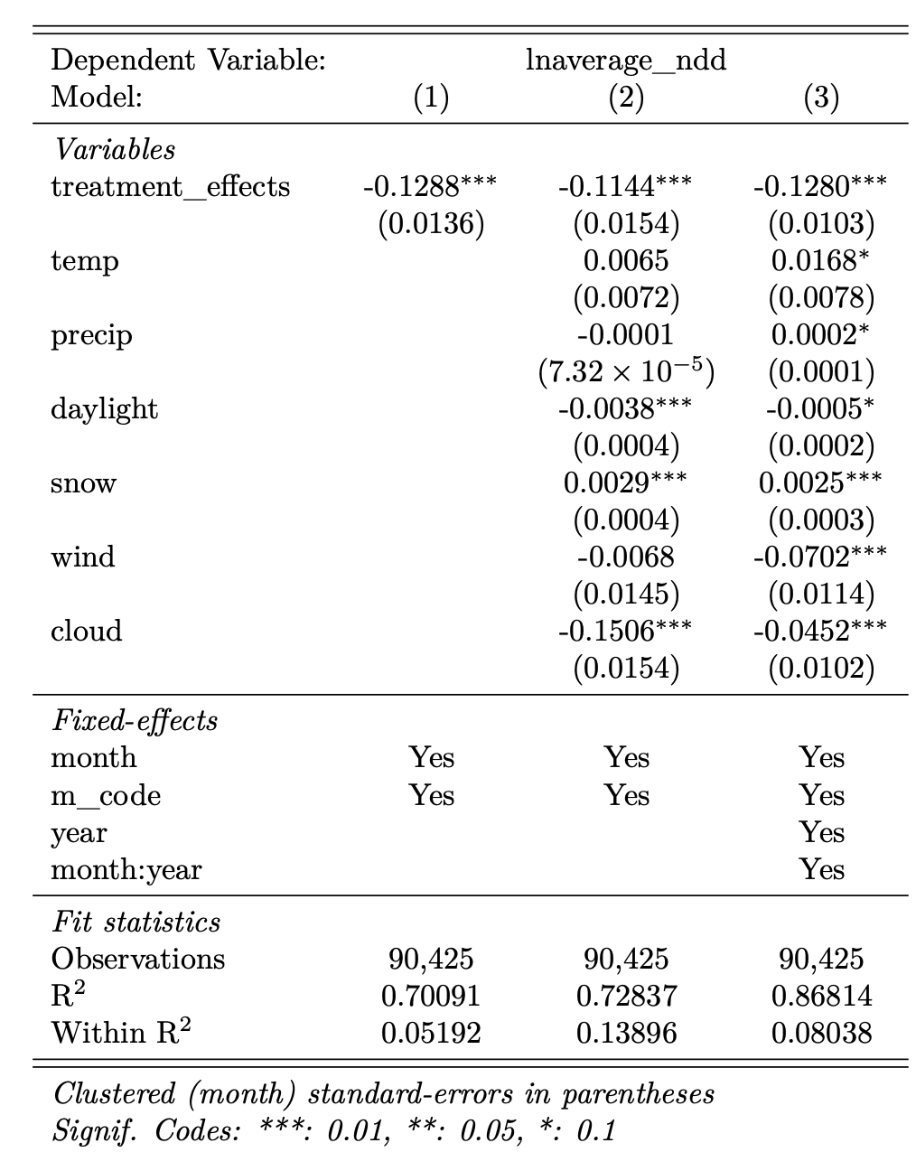
Descriptive Statistics
Replication Modeling Results
Results:
Natural Experiments Using R
Notes:
Jorit:

Slide 12
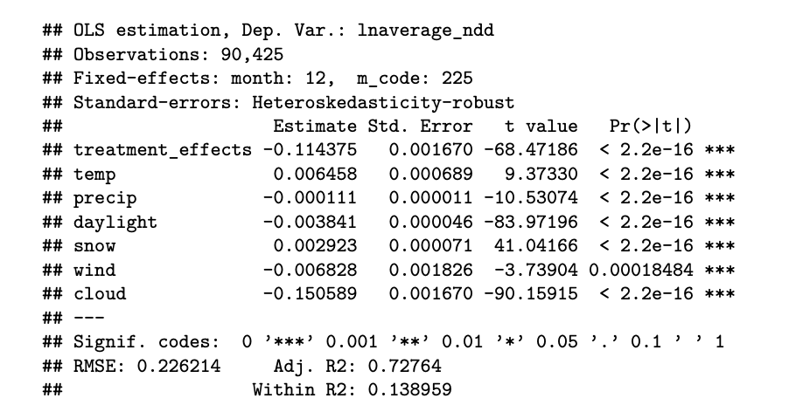
Descriptive Statistics
Robustness Check
Natural Experiments Using R
Notes:
Jorit:

Slide 13
Descriptive Statistics
Replication Modeling Interpreation
Our result suggests that designation under the ANCL reduced the monthly mean ambient concentration of NO2 by 10–16% on average over June 1992–December 2015 for monitors in treated areas.
Treatment Effect = -0.1288 ± t.critical (df, alpha/2) * 0.0136
95% Confidence Interval = (-0.1552, -0.1023)
Natural Experiments Using R
Notes:
Jorit:

Slide 14
Results
5. Results: Are these results plausible? How robust are the results to changing the sample?
Challenges and Limitations
The estimation challenge is to disentangle the effects of the intervention under the ANCL from the effects of unobserved factors.
Estimates could still be biased upward given that it is impossible to fully control for all omitted variables.
Estimates should be seen as an upper bound of the benefits of the intervention.
Nishitateno and Burke (2020, p.449)
Including more variables does not change the … (Exercises 5.8)
Including more variables does not change the … (Exercises 5.8)
Natural Experiments Using R
Notes:
Jorit:

Slide 15
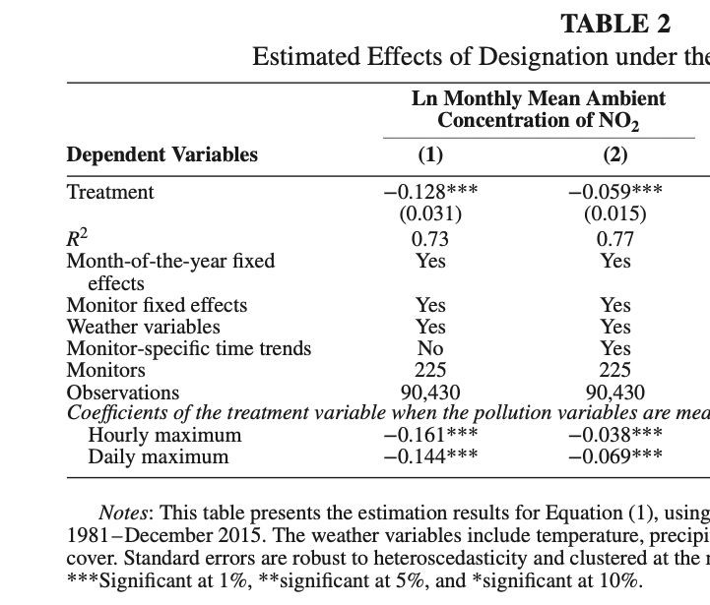
^
Conclusion
Comparison Results
…
Nishitateno and Burke (2020, p.455)
Replication of the Paper
Natural Experiments Using R
Notes:
Jorit:
Unklar wie Wetterdaten modelliert worden sind.
Hourly Maximum vergleichen
Weniger Daten (5 observations less)

Slide 16
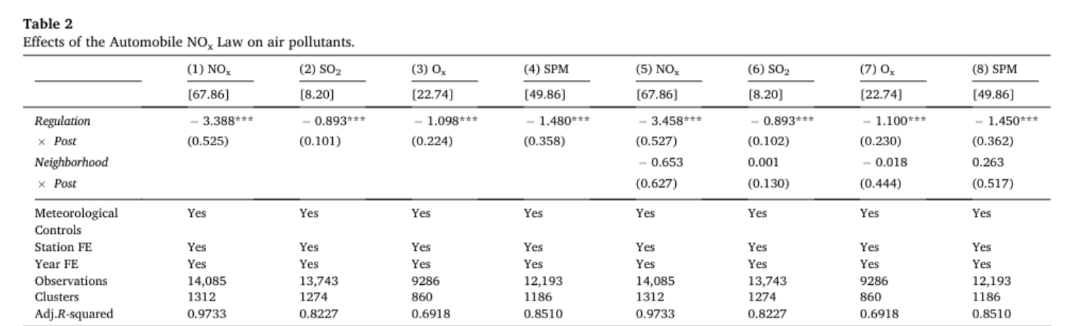

^
Conclusion
Particulate air pollution, birth outcomes, and infant mortality: Evidence from Japan’s automobile emission control law of 1992 Inoue, Nunokawa, Kurisu, and Ogasawara (2020)
Investigates the impacts of the Automobile NOx Law of 1992 on ambient air pollutants and fetal and infant health outcomes in Japan.
NOx and SO2 levels reduced by 5% and 11%
Fixed effects model in the spirit of the DID approach
196 municipalities as treatment group; remaining 194 municipalities in the non-regulated area are
used as the control group
Natural Experiments Using R
Notes:
Jorit:
___
The paper "Particulate air pollution, birth outcomes, and infant mortality: Evidence from Japan’s automobile emission control law of 1992" by Inoue, Nunokawa, Kurisu, and Ogasawara (2020) examines the impact of the Automobile NOx Law of 1992 on air pollutants and fetal and infant health outcomes in Japan. The study finds using a fixed effects model and a DiD approach that the regulation led to a 5% reduction in NOx levels and an 11% reduction in SO2 levels. The treatment group consists of 196 boroughs and 194 boroughs in non-regulated areas belong to the control group. Therefore the findings of Inoue, Nunokawa, Kurisu, and Ogasawara (2020) are consistent with the results of the study by Nishitateno and Burke (2020), as well as our own findings. All studies employed the difference-in-differences (DiD) method to analyze the impacts of vehicle regulations on air quality in Japan. A big difference between the studies is that the number of observations varies, with Inoue et al. having 14,085 monitoring stations, Nishitano et al. having 90,430, and our study having 90,425.

