Slide 1
Jorit Studer & Michelle Koch
Reproducibility Study:
Have vehicle registration restrictions improved urban air quality in Japan?
Shuhei Nishitateno, Paul J. Burke
Natural Experiments Using R

Slide 2
Table of Content
1
2
3
4
5
6
Motivation Data Sources Method Descriptive Statistics Results Conclusion
Natural Experiments Using R

Slide 3
Motivation
Motivation: Why is this research question relevant? What are the main hypotheses?
Relevance of the Topic
What happened: Residents sued 1978 the national government, expressway companies, and automakers for the health damage brought on by vehicular air pollution.
Answer: The introduction of vehicle registration restrictions (the Automobile NOx Control Law, 1992 in Japan) resulted in the removal of 2.6 million polluting vehicles from metropolitan areas between June 1992 and December 2015.
The introduction led to a 3%–6% reduction in the monthly mean ambient concentration of nitrogen dioxide (NO2) in the treated areas.
Due to this law the mortality from asthma was reduced, which saved about US$104 million
Natural Experiments Using R

Slide 4
Data Sources
Data sources: Where does the data come from (country, time period, source)? What are the key variables? How are these measured?
About the Data
Monthly panel dataset at the pollution monitor level
from Japan for
January 1981–December 2015.
Treatment Group: 109 municipalities designated in 1992
The control group comprises five urban municipalities that were not subject to the ANCL.
Main Data Source: Environmental GIS compiled by the National Institute for Environmental Studies (NIES)
Meteorological data: Japan Meteorological Agency (JMA). (Meteorological data )
Annual data on demographic and socioeconomic factors: System of Social and Demographic Statistics compiled by the Ministry of Internal Affairs and Communications (MIAC).
Natural Experiments Using R

Slide 5
Data Sources
Data sources: Where does the data come from (country, time period, source)? What are the key variables? How are these measured?
Key Variables
Variable | Descritpion | Source
lnaverage_ndd | Monitor-level NO2 concentration measured by the monthly mean. Unit: ppb. | NIES
lnhmax_ndd | Monitor-level NO2 concentration measured by the hourly maximum. Unit: ppb. | NIES
dabove_nd | Days exceeding national standard: Days exceeding 60 ppb in terms of the daily average per month.
treatment_effects | Monthly mean temperature measured every 10 minutes at a meteorological station nearest to the pollution monitor (same as below), degree Celsius. | JMA
temp | Monthly mean temperature measured every 10 minutes at a meteorological station nearest to the pollution monitor (same as below), degree Celsius. | JMA
precip | Total precipitation per month, millimeters. | JMA
wind | Monthly mean wind velocity measured every 10 minutes, meters per second. | JMA
daylight | Total daylight duration per month, hours. | JMA
snow | Total snowfall per month, centimeters. | JMA
cloud | Degree of cloud cover per month, 0–10. | JMA
treatment1992 | Time-varying dummy variable equal to one if a monitor is located in a municipality subject to the ANCL and zero otherwise. | Ministry of the Environment.
y_month
m_code
Missing: | Monitor-level NO2 concentration measured by the daily maximum, Population, Income per capity and Unemployment rate.
Natural Experiments Using R
Notes:
Created Variables
Average_ndd
max_ndd
month
year

Slide 6
Method
3. Method: What are the assumptions of the method? Are these assumptions plausible in this example? Maybe: regression equation.
Difference-in-Differences - Setup
2 Groups
Control Group
Treatment Group
2 Time periods
t=0 no Treatment
t=1 treatment of Treatment group
Control Group without ANCL* (109)
Treatment Group wit ANCL* (5)
*Automobile NOx Control Law
t=0 01.1981 – 05.1992
t=1 06.1992 – 12.2015
Comparison of the average temporal changes in pollution levels before and after the intervention in municipalities subject to the ANCL with those that were not.
Natural Experiments Using R
Notes:
We never observe the Outcome for the treated group without treatment.
The treatment group consists of 109 munic- ipalities designated in 1992, whereas the con- trol group comprises five urban municipalities that were not subject to the ANCL. Like the key municipalitiesinthetreatmentgroup,theselected control municipalities were categorized as major cities under Japan’s Local Autonomy Law. We find no differential pretrends for NO2 concen- tration in the treatment and control groups. The choice of the control group is also motivated by the fact that the five selected municipalities are geographically distant from the treated areas, reducing concerns that spatial leakages exist from the treatment to control groups.
The choice of the control group was based on two criteria: comparability and geographical location. First, we sought nondesignated munic- ipalities that are as urbanized as the treatment group using the list of major cities under Japan’s Local Autonomy Law. As of 2015, 20 municipal- ities were classified as major cities under this law, including nine designated municipalities under the ANCL and 11 nondesignated municipal- ities: Sapporo, Sendai, Nigata, Hiroshima, Okayama, Hamamatsu, Shizuoka, Kyoto, Kitakyusyu, Fukuoka, and Kumamoto. Major cities must meet several standards such as having more than 500,000 residents, less than 10% of employment in the primary industry, and adequate urban infrastructure. We excluded Okayama, Hamamatsu, Shizuoka, and Kyoto from the control group,
as they are geographically close to the des- ignated municipalities in Tokyo, Kanagawa, Chiba, Saitama, Osaka, and Hyogo prefec- tures. This was important for minimizing the potential for geographical spillovers, because new compliant vehicles could be driven outside designated areas.

Slide 7
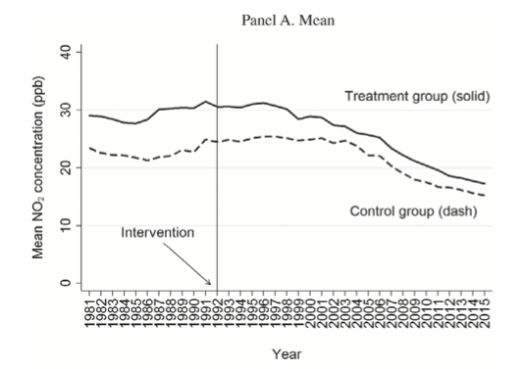
Method
Difference-in-Differences - Identification
Paralleltrend
text
Nishitateno and Burke (2020, p.453)
Natural Experiments Using R

Slide 8
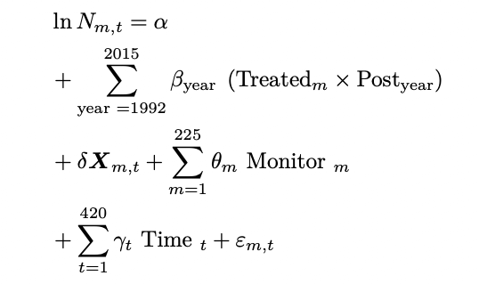
Method
Difference-in-Differences - Estimators
Variables | Description
N_{m,t} | represents the log of the monthly mean ambient concentration of NO₂
β_{year} | change in NO₂ concentrations pre-intervention vs post-intervention period in comparison to the control group
m | Pollution monitor
t | month
X | vector of weather conditions (temperature, precipitation, sunlight duration, snowfall, wind, and cloud cover) as well as monitor-specific time trends
θ | monitor fixed effects (c_code) that account for time-invariant factors relevant to pollution level (e.g., location)
γ | extracted month-of-year fixed effect to control for any national-level monthly changes
ε | error term
Natural Experiments Using R

Slide 9
Descriptive Statistics
Pre-Processing
Convert the absolute number of months into a date format
Get the actual values for the the provided log of the monthly and hourly ambient concentration of NO2
Extract the month and year of the dates for a later fixed-effects feature
df <- read.csv("data/nishitateno_burke_2020.csv", sep = ";")
first_date <- as.Date("1981-01-01")
last_date <- as.Date("2015-12-01")
dates <- data.frame(
y_date = seq(first_date, last_date, by = "month"),
y_month = seq(252, 671, by = 1)
)
df <- merge(dates, df, by = "y_month", all.x = TRUE) # get the actual value from the log of lnaverage_ndd df$average_ndd <- exp(df$lnaverage_ndd) %>% round(2) # get the actual value from the log of lnhmax_ndd df$max_ndd <- exp(df$lnhmax_ndd) %>% round(2)
# add month and year column variables for fixed effects
df$month <- month(df$y_date)
df$year <- year(df$y_date)
Natural Experiments Using R

Slide 10
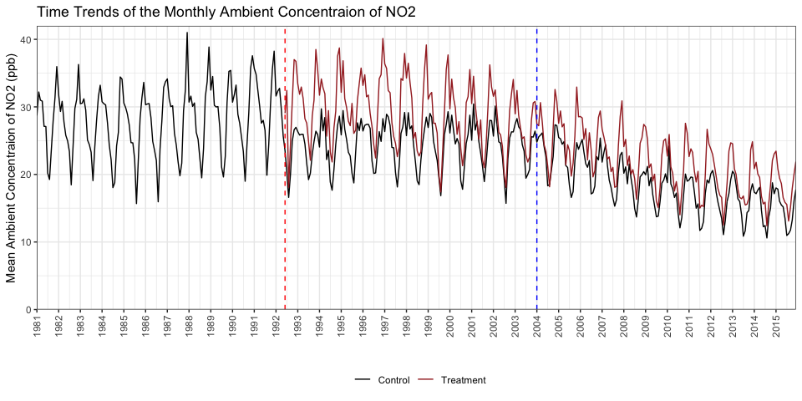

Descriptive Statistics
Looking at the time trends
4. Descriptive statistics
Needs do be changed maybe
Natural Experiments Using R

Slide 11
Descriptive Statistics
Replication Modeling
4. Descriptive statistics
Natural Experiments Using R

Slide 12
Results
5. Results: Are these results plausible? How robust are the results to changing the sample?
Challenges and Limitations
The estimation challenge is to disentangle the effects of the intervention under the ANCL from the effects of unobserved factors.
Estimates could still be biased upward given that it is impossible to fully control for all omitted variables.
Estimates should be seen as an upper bound of the benefits of the intervention.
Nishitateno and Burke (2020, p.449)
Natural Experiments Using R

Slide 13
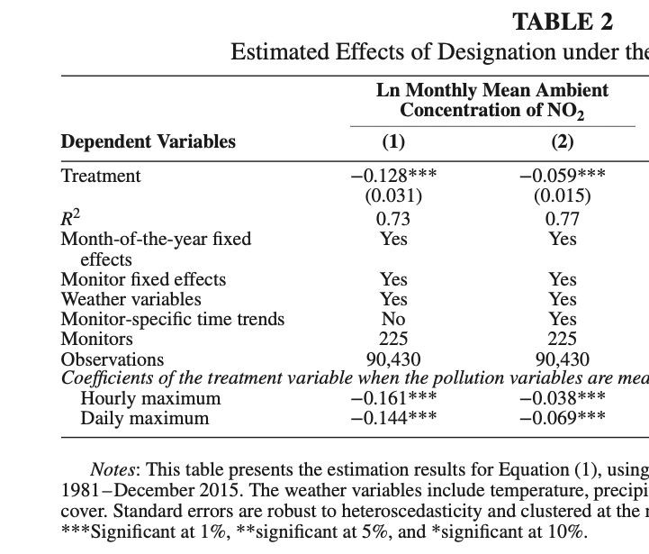
^
Conclusion
6. Conclusion • Replication of a research paper: How do results compare to results of research paper? • Analysis of new data: Are ther
Comparison Results
…
Table
Nishitateno and Burke (2020, p.455)
Natural Experiments Using R

Slide 14
^
Conclusion
6. Conclusion • Replication of a research paper: How do results compare to results of research paper? • Analysis of new data: Are ther
…
Natural Experiments Using R

