Slide 1
U.S. Consumer Complaints about Bank Account or Service
Yeon Kyung(Joanne), Chung

Slide 2
Data Background and Purpose
Purpose
Analyze consumer complaints about bank account or service over the last 5 years and then find ways to reduce complaints or improve banking service in US.
Data Source
Consumer Financial Protection Bureau(CFPB) website
https://data.consumerfinance.gov/dataset/Consumer-Complaints/s6ew-h6mp
Period: between 2012 and 2016
Location: United State
United State Census Bureau website
https://www.census.gov/data/datasets/2016/demo/popest/state-total.html
Population by State
nst-est2016-popchg2010_2016.csv

Slide 3
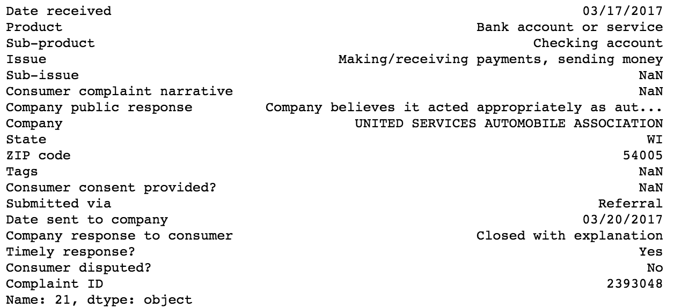
Data Understanding Overview
The Number of Data
Total number: about 900,000
Related “Bank Account or Service”: about 87,000
Check Data Quality
Completeness – Date, U.S state, product, company and complaint issue
Uniqueness – Compliant ID
Validity – Missing value, unformatted value
Accuracy – Product and Company
Consistency – U.S states ex: California, CA
One Sample

Slide 4
Data Analysis
The “Bank Account or Service” consumer complaints
Find top 7 states
Collect between 2012 and 2016
Compare the number of complaints by year.
Compare the data with U.S states’ population.
Check the complaint issues by states and find the patterns.
Find top 5 number of complaints companies in CA, check the pattern and do forecast.
Check the trends of “submitted via” and predict.

Slide 5
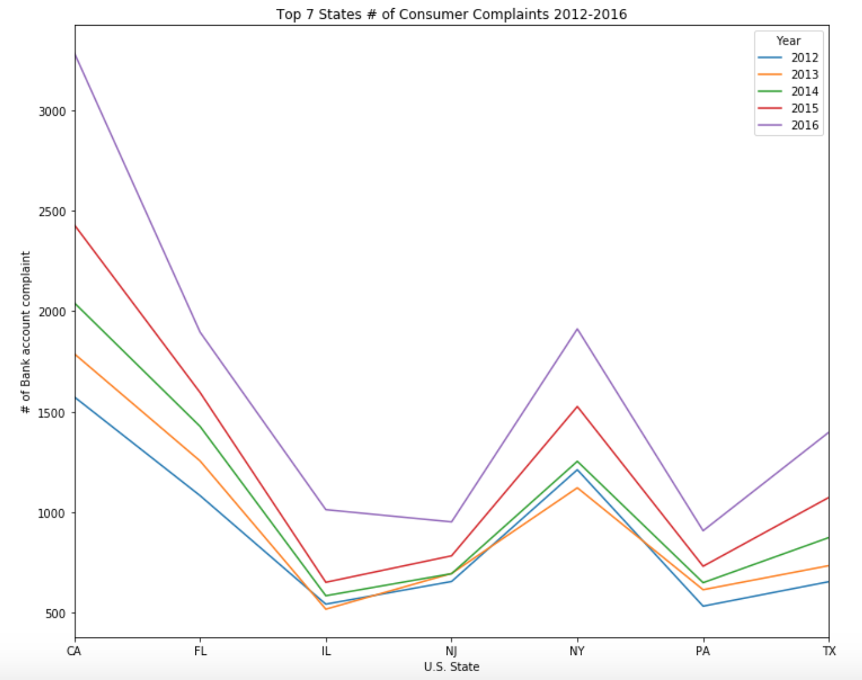
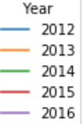
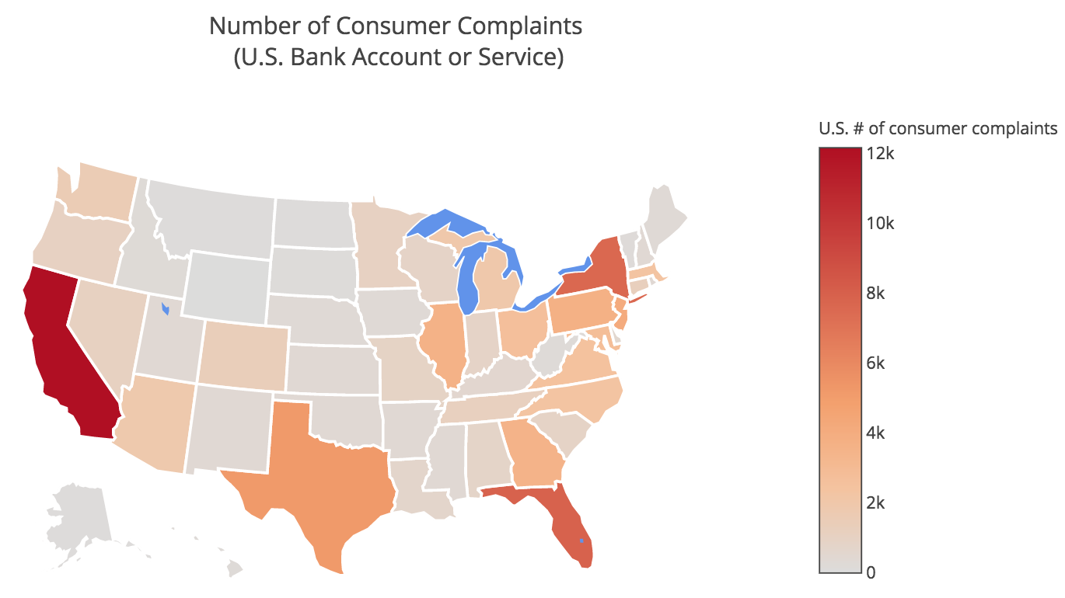
The Number of Complaints by Year
Check the data quality and extract year
Find the top 7 States
Collect between 2012 and 2016

Slide 6
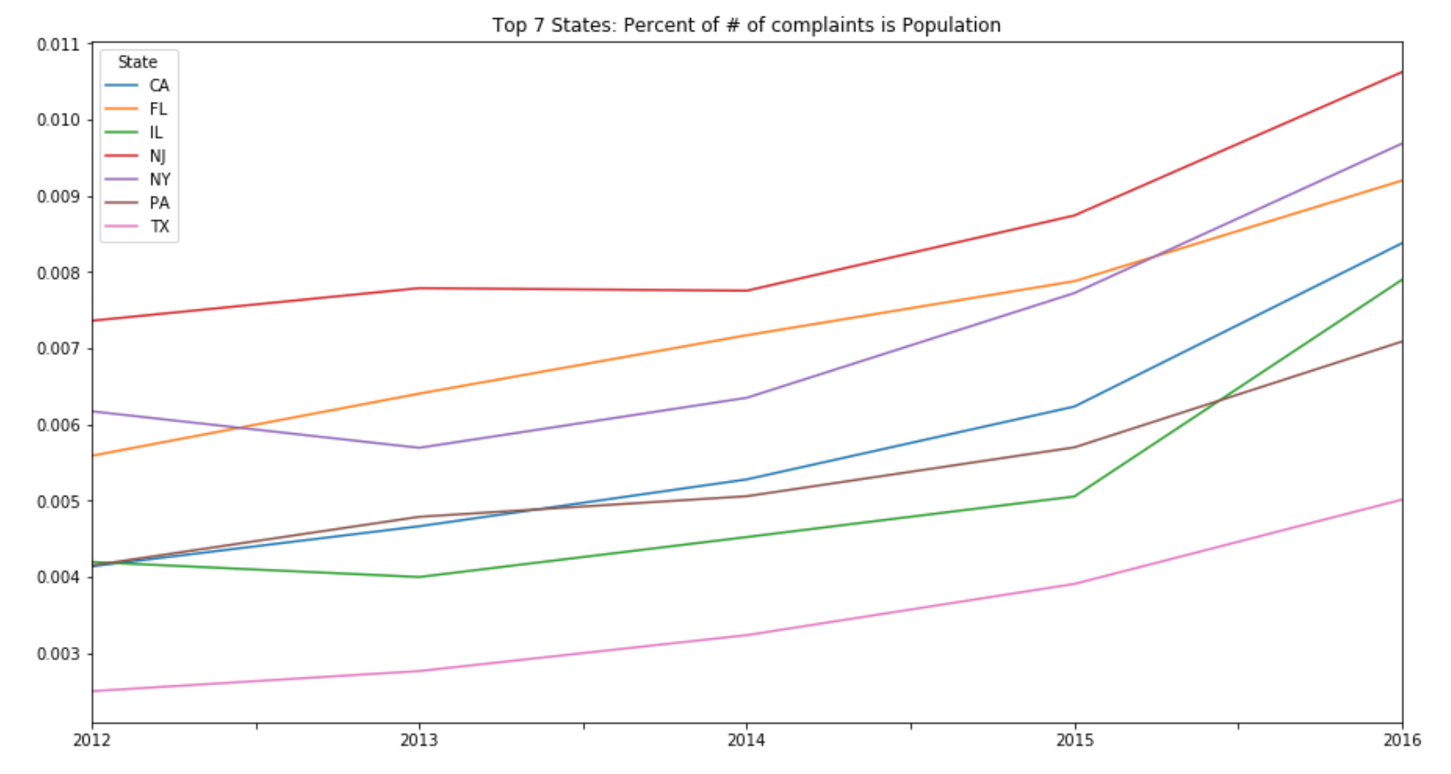

The Complaint Data with U.S. States’ Population
Calculate the percent
Number of complaints
Number of population
By Year
NJ is the highest percent and TX is the lowest percent.

Slide 7
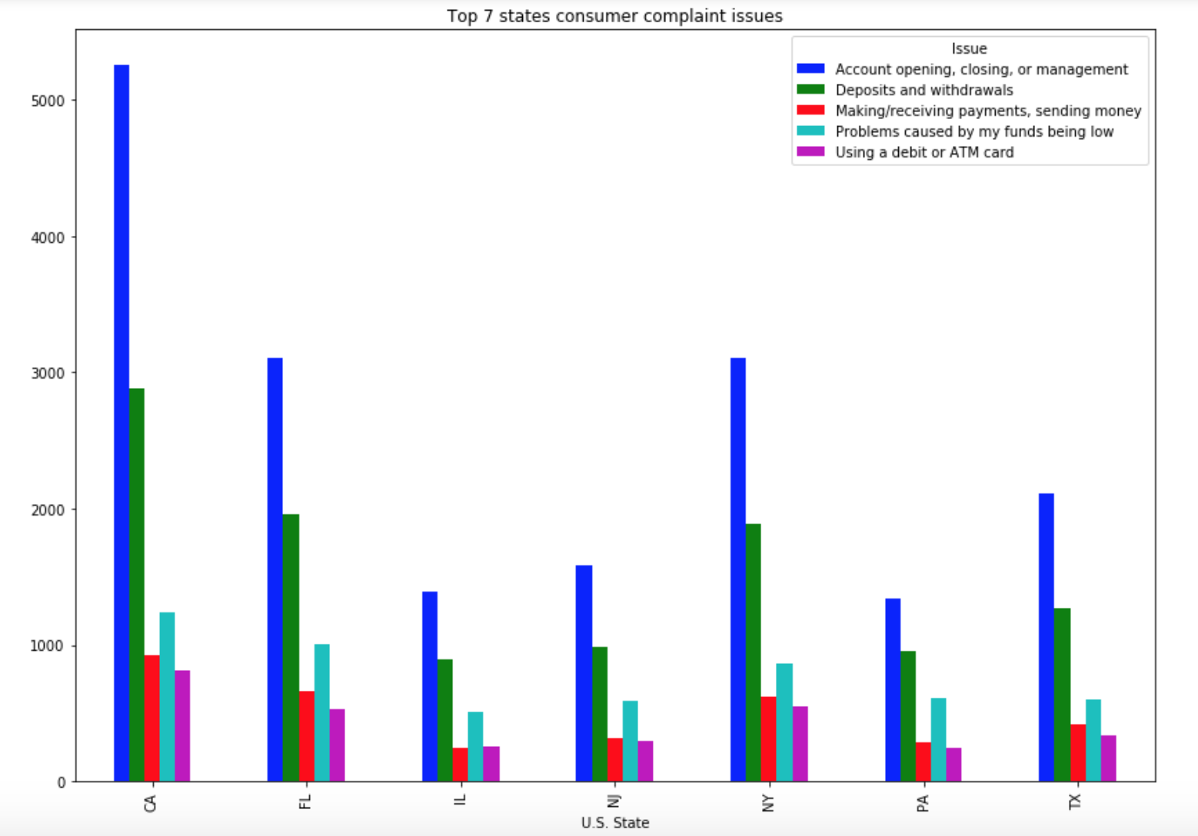
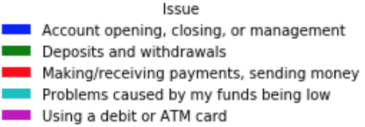
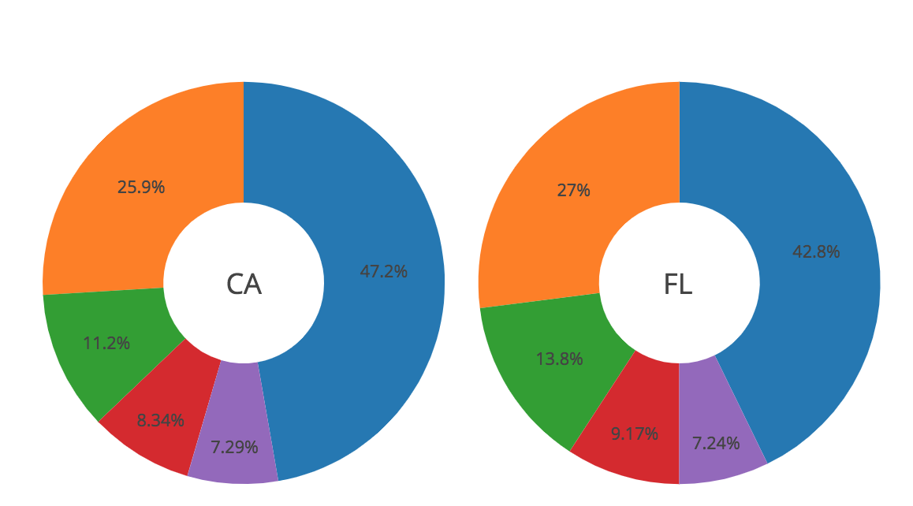
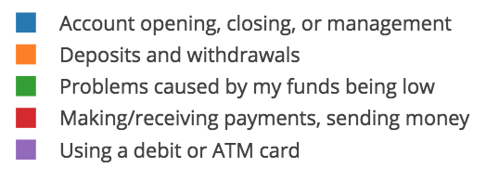
The Complaint Issues by State
“Account Opening, Closing and Management” is the biggest issue in all top 7 states.

Slide 8
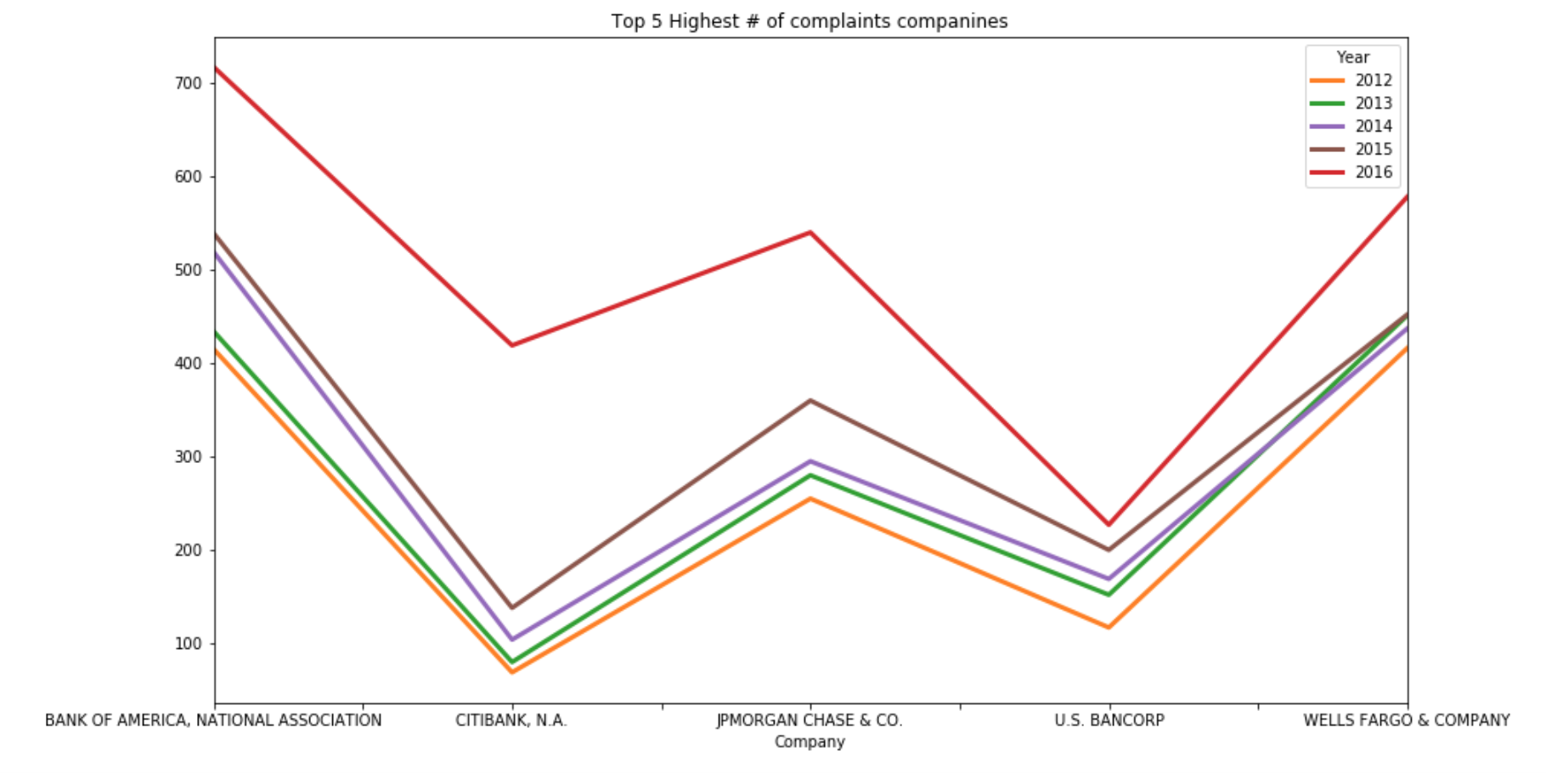
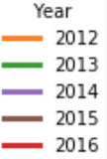
Top 5 number of complaints companies in CA
Bank of America had the highest number of complaints.
Citi bank had the highest increasing rate of the number of complaints between 2015 and 2016. Need to research more information about it.

Slide 9
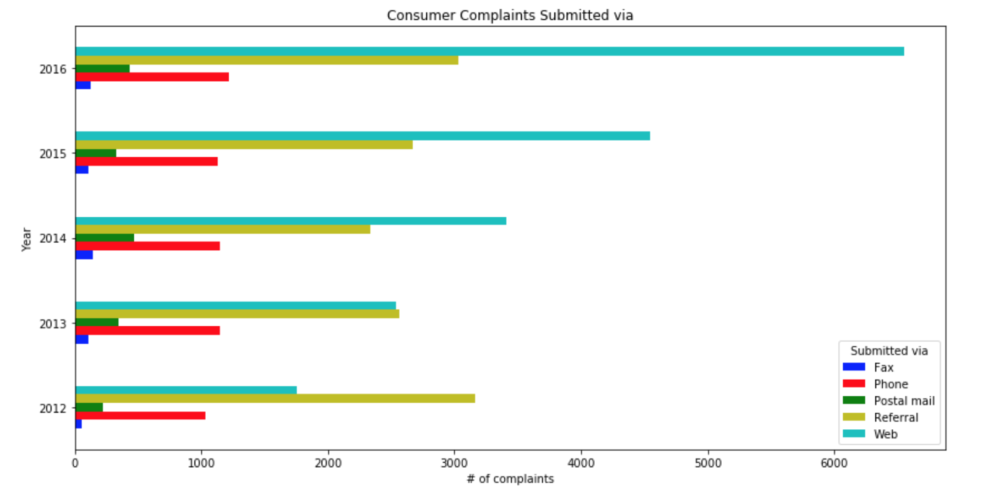
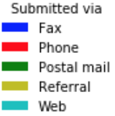
The Trend of “submitted via”
Submitted methods are important to collect data in the future.
Submitted via Web is the fastest growing method after 2014. More maintenance is needed.

Slide 10
Patterns, Predictions and Conclusion
Number of consumer complaints by states
CA was the highest complaints over the last 5 years.
Top 7 states: 'CA', 'FL', 'NY', 'TX', 'NJ', 'PA', 'IL’
Compare by year
In 2016, ‘CA’ and ‘IL’ were high increased # of complaints and ‘NJ’ was the lowest.
Need to study why CA has fast growing and not NJ.
Consumer Complaint Issues
“Account opening, closing, or management” was the biggest issue in all top 7 states.
Need to review the bank account opening / closing procedure.
Top 5 highest number of complaints companies in CA
Citibank was highly increased # of complaint over the year and U.S Bancorp was the lowest.
Citi bank will continue to have a high number of consumer complaints and should investigate the reasons.
Submitted via
Submitted via web has grown fast over the last 3 years. More growth is expected.

