Slide 1

Mass Shootings Data Analysis
Group 907 :
Yeon kyung Chung
Tianyi Wang
Xiaoqian Sun
Yon ho Cheong

Slide 2
Background of the Dataset
Mass Shootings in the United States of America during 1966 to 2017.
It has included 398 mass shootings in last 50 years in the United States.
Estimate the extent from different variables: year, total victims, locations, federal firearms licensees, number of internet users, GDP, drugs arrested, regions and U.S. population.
How to minimize the total victims for mass shootings in United States?
Notes:
Jessica

Slide 3
EDA PROCESS
The first round
The second round
The third round
EDA
Right data?
More data?
Meaningful?
What is the pattern of Mass Shooting
&
Which is the safety area in the United States?
Which national trends contributes the most to number of mass shooting in the United States ?
How to minimize the number of total victims in mass shooting?
QUESTION
Smart Question
Hard to predict
Hard to Prediction
Just output from the model
PROBLEM
Notes:
Matthew

Slide 4
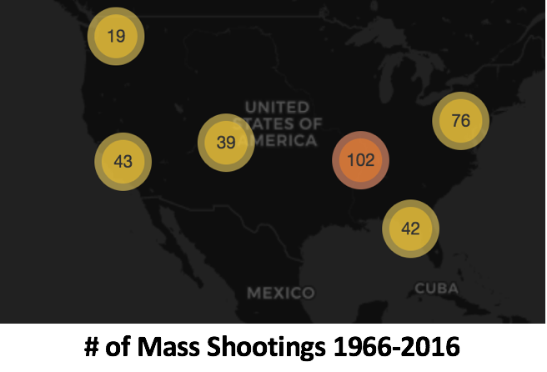
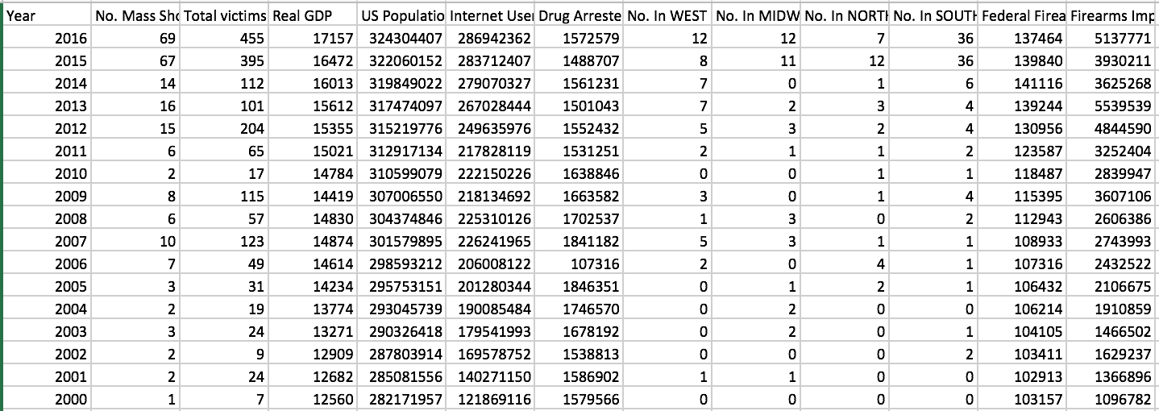
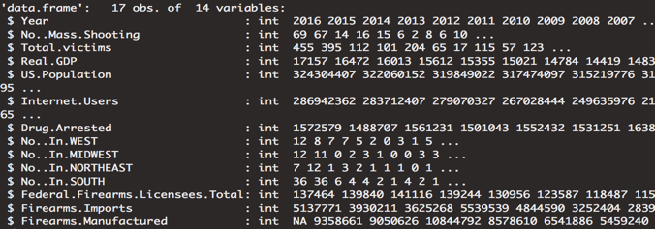
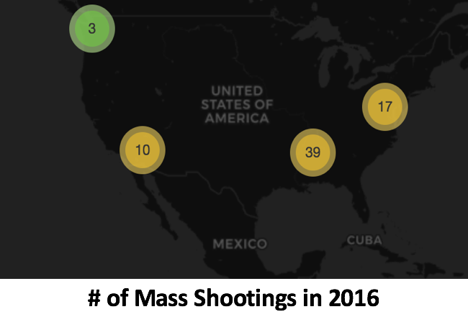
Data Analysis and Geo Map
The majority of our dataset happened after the year of 2000, so we focus on our data from the year of 2000 to 2016.
Notes:
Matthew

Slide 5
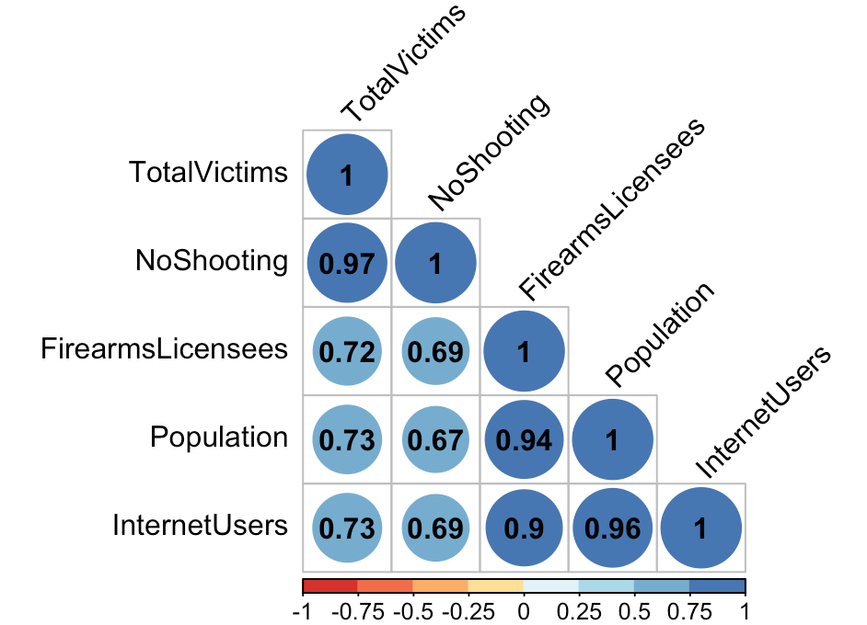
Correlation with variables
Linear regression appears to be good model
because the total victim does have highly correlation with these different independent variables.
Notes:
Matthew

Slide 6
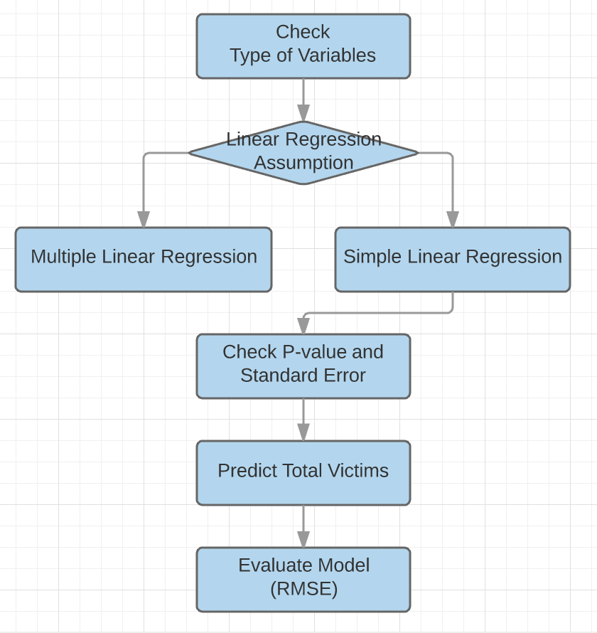
Find a fitting Model
• Type of Variables
• All Continuous Variables
Dependent Variable
Total victims
Independent Variables
U.S. population
Number of mass shootings
Number of internet users
Total federal firearms licensees
Notes:
Yeon Kyung

Slide 7
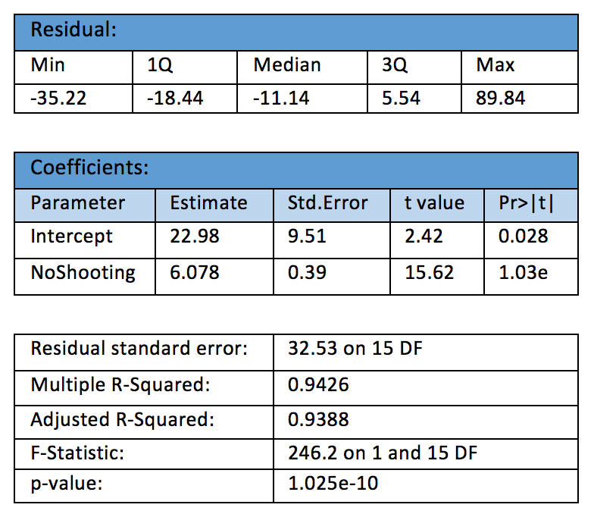
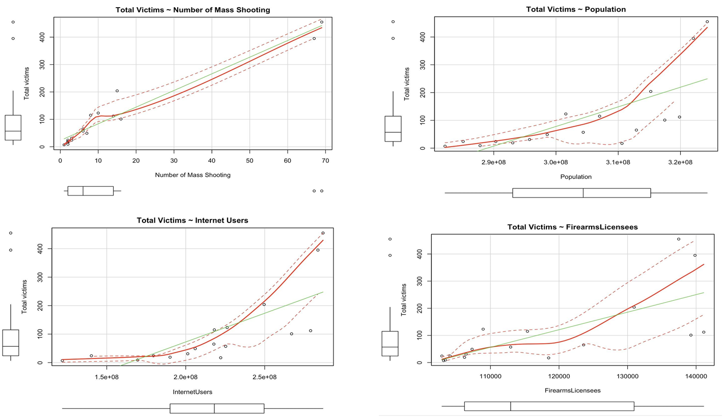
Linear Regression Model Graphs
Federal firearms licensees, number of internet users, U.S. population and number of shootings are significant.
Notes:
Yeon Kyung
hi

Slide 8
Predict and Evaluate the Model
Result of the prediction
There is the lowest error value in 2011 that means our prediction for total victims is more accurate.
RMSE is useful for evaluating a model. Our RMSE divided by the degrees of freedom is around 2.
The number of shootings with total victims is significant
prediction total victims error
2016 441.17603 455 13.823974
2015 420.19616 395 -25.196162
2014 128.65602 112 -16.656016
2013 133.40580 101 -32.405801
2012 124.19365 204 79.806348
2011 70.86011 65 -5.860114
Notes:
Yeon Kyung

Slide 9
Conclusion
How to minimize the total victims for mass shootings in United States?
Federal firearms licensees, number of internet users, U.S. population and number of shootings are significant. Reducing the number of firearms licensees are helping to minimize the total victims for mass shootings.
Notes:
Jessica

Slide 10
Limitations and Suggestions
Suggestions:
Gun control: Is it too easy for people to get a gun?
prevent the Media Contagion Effect: many profiles of mass shooters is desire for fame
Educate the public: get help if you have mental illness
Limitations of dataset:
Data Quality: uncertainty values
Hard to predict and track the data: “Copycat Crimes”
http://rpubs.com/yeonjoannechung/341416
Notes:
Jessica

