Slide 1
FFT practice summary
Minseok Kwon
July 17, 2024

Slide 2
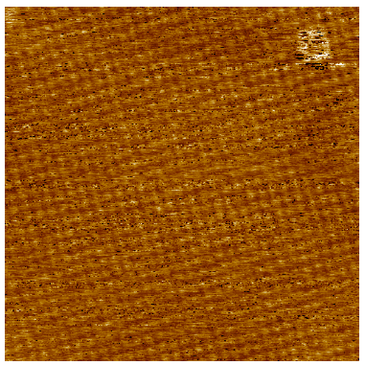
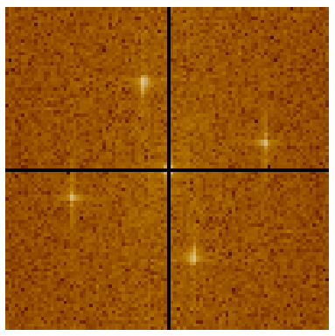

Cu100_W_LN2_1686.sxm
FFT, log
Subtract linear fit xy

Slide 3
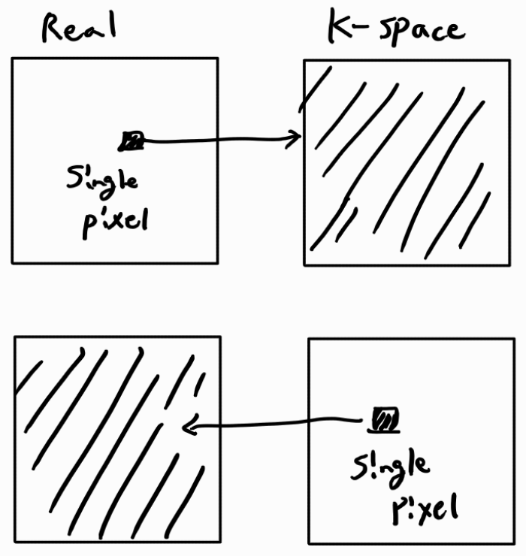
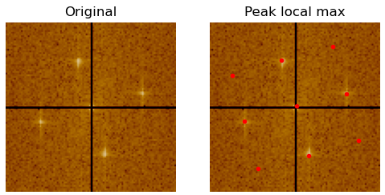
(14,72)
reciprocal
(22,42)
(31,13)
b
(42,80)
(51,49)
a
(58,20)
(69,87)
reciprocal
(78,58)
(86,28)
Scan pixels: 512 * 512 px
Scan range: 8 * 8 nm
Pixel range in real space: 1/64 nm
Range of k-space: 64 nm^-1
Pixel range in k-space: 1/8 nm^-1
Magnitude of a : 3.729 nm^-1
In real space, 1/3.729 = 0.268 nm
Magnitude of b : 3.729 nm^-1
In real space, 1/3.729 = 0.268 nm

Slide 4
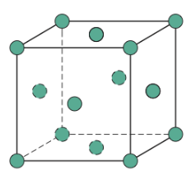
(100)
lattice constant : a
n.n. distance of fcc : 1/√2 a
Magnitude of a,b = 0.268 nm = n.n. distance
Calculated lattice constant: 0.379 nm
Theoretical value: 0.361 nm (5% error)
Single step size: ½ a
n.n. distance
a
a
a

Slide 5
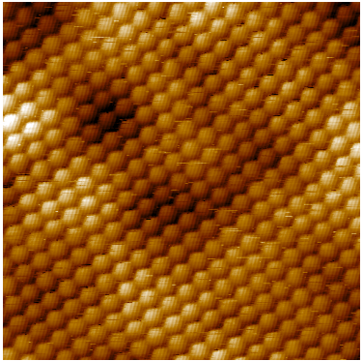
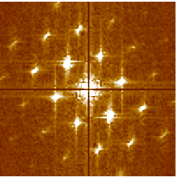

Au111_W_LN2_0689.sxm
FFT, sqrt
Subtract linear fit xy

Slide 6
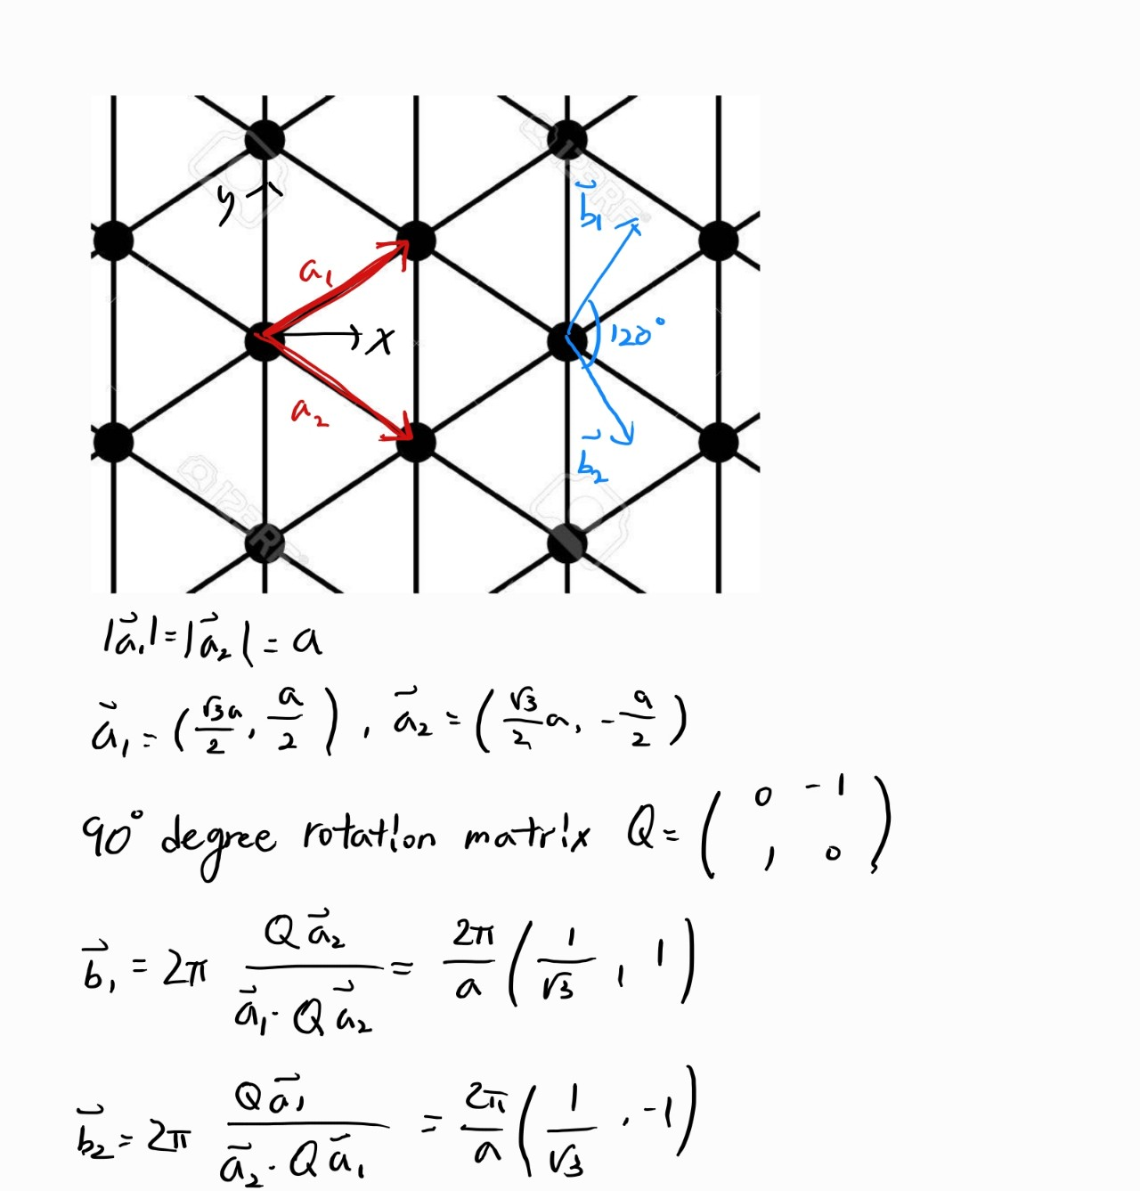
Unit cell
Magnitude of vector = √3/2 * (n.n. distance)

Slide 7
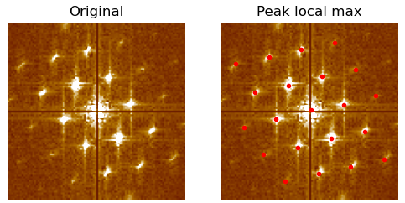
b
(26,76)
(30,57)
c
(35,38)
a
(49,51)
(54,31)
Scan pixels: 512 * 512 px
Scan range: 5 * 5 nm
Pixel range in real space: 5/512 nm
Range of k-space: 512/5 nm^-1
Pixel range in k-space: 1/5 nm^-1
Magnitude of a : 4.123 nm^-1
In real space, 1/4.123 = 0.243 nm
Magnitude of b : 3.985 nm^-1
In real space, 1/3.985 = 0.251 nm
Magnitude of c : 3.821 nm^-1
In real space, 1/3.821 = 0.262 nm

Slide 8
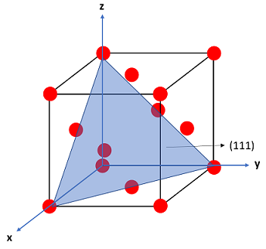
Average magn​itube of a, b, c : 0.252nm
Calculated n.n. distance = 2/√3 * 0.252 = 0.291nm
Calculated lattice constant = √2*0.291 = 0.412nm
Theoretical value: 0.408 nm (<1% error)

Slide 9
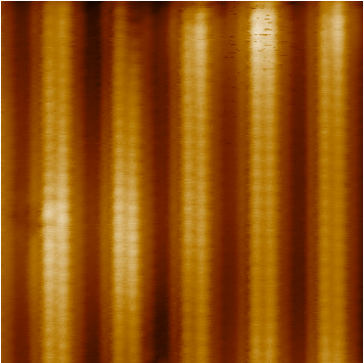
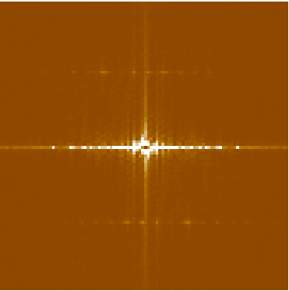

TNS_STM6_#117_2938.sxm
FFT, lin
Subtract plane fit
1 atom
5 atoms

Slide 10
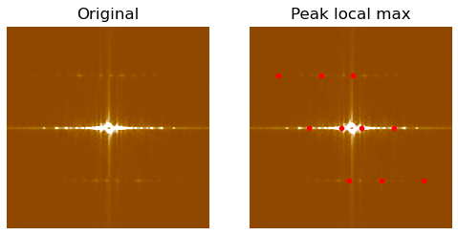
(24,14)
(24,35)
(24,51)
(50,29)
(50,45)
(50,55)
(50,71)
(76,49)
(76,65)
(76,86)
Scan pixels: 512 * 512 px
Scan range: 8 * 8 nm
Range of k-space: 512/8 = 64 nm^-1
Pixel range in k-space: 1/8 nm^-1
Magnitude of a : 0.625nm^-1
In real space, 1/0.625 = 1.6 nm
Magnitude of b : 3.252 nm^-1
In real space, 1/3.729 = 0.308 nm
|a| : |b| = 5.19 : 1 (Real space)

Slide 11
(24,14)
(24,35)
(24,51)
(50,29)
(50,45)
(50,55)
(50,71)
(76,49)
(76,65)
(76,86)

