Slide 1
NBDB RESEARCH SEMINAR
Toward Verifiable Agents
for Structural Biology
Scientific semantics, bounded repair,
and falsifiable evaluation
How can an agent recognize the limits of its own structural analysis?
Research & Engineering / 29 October 2026
Notes:
Open with the motivating scientific question, not a tool inventory. This presentation proposes an architecture and a research program; no new system performance is claimed. Literature results are attributed to the cited papers. Design examples are synthetic and labeled throughout. The objective is a publishable, falsifiable contribution with a real platform implementation behind it.
Research question: How can an agent execute a structural analysis and recognize when the evidence does not support its conclusion?
Mechanism and implementation detail:
- Frame the platform as a scientific execution and inference system.
- Use one interface-comparison task throughout to connect historical methods to concrete implementation choices.
Central claim: The research target is a system that preserves scientific meaning across planning, computation, recovery, and interpretation.
Boundary: A general platform can host many analyses; evidence for an agent method must be established on a bounded task distribution.
Sources:

Slide 2
PROBLEM
ILLUSTRATIVE EXAMPLE
Tool success does not establish scientific validity
$ compare_interfaces ref.cif query.cif
exit_code = 0
contacts.csv written
report.html written
Object semantics
Did both selections refer to the
intended assembly and residues?
Measurement
Did missing coordinates enter the
calculation as missing?
REPORTED: “The contact was lost.”
Inference
VIOLATION: the query residue has no coordinates.
Does a geometric change warrant the
biological claim?
A valid file is only one predicate in a scientifically valid answer.
wwPDB validation guidance
02
Notes:
Use a simple progression: the executor can be correct about a command; the agent can still be wrong about what was measured; and the report can still overstate what that measurement means. These failure classes require different interventions. More model reasoning is not a substitute for a missing scientific precondition.
Research question: What goes wrong after a tool returns successfully?
Mechanism and implementation detail:
- A zero exit code only addresses part of the first test.
- A well-formatted RMSD can be wrong for the research question if mapping or atom selection is wrong.
- A true geometric difference still does not establish an affinity or causal effect.
Central claim: Execution success and scientific validity are different events, and both need explicit tests.
Boundary: Validation is task-specific; this three-part decomposition is our design taxonomy, not an established universal standard.
Sources:
https://www.wwpdb.org/validation/validation-reports

Slide 3
PROBLEM
ILLUSTRATIVE EXAMPLE
Interface comparison exposes the scientific contract
“Which interactions changed between these two complexes?”
Decision | What must become explicit
Identity | Assembly, molecular entity, chain correspondence
Observability | Missing residues, atom coverage, conformer policy
Measurement | Contact definition, comparable region, units
Interpretation | Supported geometry versus unresolved biology
wwPDB PDBx/mmCIF; DockQ v2
03
Notes:
This running example is useful because the arithmetic is easy but the scientific bookkeeping is not. Show that parsing files and calling distance functions is the easy part. The agent must decide whether it has enough information to answer. Hold the scientific question fixed when comparing architectures.
Research question: “Compare these two complexes: which interactions changed?”
Mechanism and implementation detail:
- Resolve assembly and molecule identity before contact calculation.
- Build explicit correspondence between coordinate numbering and biological sequence.
- Calculate contacts within each structure; use alignment for spatial comparison, not to make intra-structure distances possible.
- Report comparable changes separately from unobservable regions.
Central claim: A seemingly simple request contains unresolved decisions about identity, observability, comparison, and interpretation.
Boundary: Contact geometry is descriptive. Neither a new contact nor its absence alone proves a binding-affinity change.
Sources:
https://mmcif.wwpdb.org/docs/user-guide/guide.html
https://academic.oup.com/bioinformatics/article/40/10/btae586/7796530

Slide 4
PROBLEM
ILLUSTRATIVE EXAMPLE
Correspondence must survive identifier changes
Same biological residue. Different coordinate identifiers.
Field | Reference | Query
Entity / chain IDs | entity 1; label A; author H | entity 1; label C; author B
Sequence position | label_seq_id = 42 | label_seq_id = 42
Author residue ID | 57 + insertion code A | 104, no insertion code
Mapping status | Sequence-supported correspondence | Assembly and coverage still checked
Synthetic mapping. Chain labels and author numbering do not define cross-file identity.
wwPDB PDBx/mmCIF
04
Notes:
Explain the identifiers rather than assuming the audience knows mmCIF. label identifiers are standardized within the file, author identifiers reflect deposited naming, and neither is a cross-file biological accession. The same residue can carry different author numbering in different constructs. A conversion table must survive every downstream tool. For symmetric homomers, a single apparently confident mapping can hide a permutation choice.
Research question: Can we compare chain A in file 1 with chain A in file 2?
Mechanism and implementation detail:
- The rows are an illustrative synthetic mapping, not real PDB measurements.
- An internal residue key includes structure hash, model, chain namespace, residue identifiers, insertion code, and atom/conformer policy.
- Sequence alignment proposes correspondence; assembly membership, coverage, and equivalent-chain ambiguity remain explicit constraints.
- Equivalent chains can produce several admissible mappings; preserve that ambiguity or apply a task-defined selection rule.
Central claim: A scientifically valid mapping must connect entities and residues, not merely match visible labels.
Boundary: This example illustrates data representation only. The platform still needs tested parsers and molecule-specific mapping policies.
Sources:
https://mmcif.wwpdb.org/docs/user-guide/guide.html
https://academic.oup.com/bioinformatics/article/40/10/btae586/7796530

Slide 5
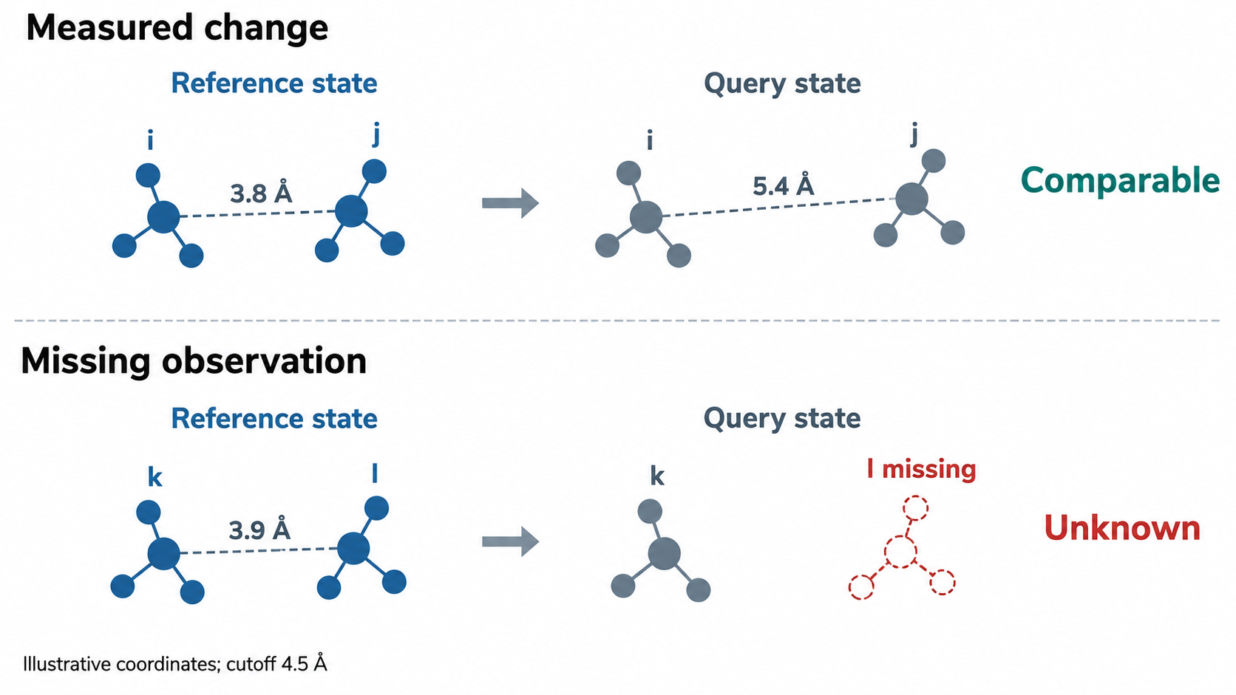
PROBLEM
ILLUSTRATIVE EXAMPLE
Missing observations change the answerable scope
Measured pair
3.8 Å becomes 5.4 Å
under the declared rule.
Missing residue
Absent coordinates
make the pair
incomparable.
Evidence state
Keep present, absent
and unknown distinct.
Synthetic illustration. Distances and cutoff explain the logic; they are not measured results.
Illustrative example; see mmCIF coordinate semantics
05
Notes:
The first row establishes a geometric classification under a chosen rule. The second row establishes only a coverage limitation. Replacing unknown with absent creates false biological claims while every distance calculation can remain numerically correct. This is the central reason to represent evidence state explicitly. Be careful: partial side-chain coordinates can make an absent-contact inference unsafe even when a residue has some atoms.
Research question: What if one of the residues is missing from the second coordinate file?
Mechanism and implementation detail:
- All numbers and the 4.5 Å threshold are synthetic examples, not a recommended universal contact definition.
- Define required atom coverage, alternate-location choice, and residue-level aggregation before scoring.
- Separate contact-set change among comparable pairs from changes in coordinate coverage.
- Perform a prespecified threshold sensitivity analysis when the scientific conclusion depends on marginal distances.
Central claim: Contact comparison requires a three-valued result: present, absent under an observation policy, or not comparable.
Boundary: A contact threshold is an analysis choice. Experimental uncertainty and model heterogeneity are not fully captured by a binary distance rule.
Conceptual schematic generated from the proposed design for exposition. It is not a measured experimental result.
Sources:
https://mmcif.wwpdb.org/docs/user-guide/guide.html

Slide 6
PROBLEM
PROPOSED DESIGN
The output is an answer plus its evidence boundary
analysis/
objects.json
residue_map.csv
contact_distances.csv
comparability_mask.csv
validation.json
claim_ledger.json
Inputs remain identifiable
Hashes, assembly, model, chain
namespace and coordinate policy.
Calculations remain reproducible
Versioned scripts, parameters and
immutable artifacts.
Claims remain bounded
Every statement links to evidence and
excluded scope.
The report is the readable view of a versioned scientific record.
Sources and experimental conditions in speaker notes
06
Notes:
These are acceptance criteria for both development and evaluation. The interface-comparison output should allow a researcher to reconstruct which residues were compared and why a conclusion was or was not made. Provenance establishes traceability, not truth: a fully traceable wrong method is still wrong. Independent validation is therefore a separate layer.
Research question: What should the platform return beyond a paragraph?
Mechanism and implementation detail:
- A report sentence must point to a derived table or validated measurement.
- A derived measurement must point to its input identities and operation version.
- A limitation must identify the excluded scope, not merely say “results may vary.”
Central claim: A successful task returns linked scientific objects, numerical evidence, and an explicit interpretation boundary.
Boundary: The claim ledger is a proposed interface; it requires empirical testing for usefulness and overhead.
Sources:
https://www.wwpdb.org/validation/validation-reports

Slide 7
EMPIRICAL MOTIVATION
PREPRINT EVIDENCE
A geometry gap appears in three of four tested models
Observed pattern
Numeric reward is lower
in 3 of 4 models. Gemini
reverses this ordering.
Comparison limit
Different task families do
not isolate a causal
effect.
130 shared tasks. Mean weighted
reward, not accuracy. Metadata n =
36; numeric n = 28.
Turk et al., ProteinGeoBench, Table 4, arXiv v1 (19 Oct 2026). Preprint.
Sources and experimental conditions in speaker notes
07
Notes:
Turk et al., ProteinGeoBench, arXiv:2610.26829v1, 19 Oct 2026. Native redraw of Table 4. Mean weighted reward on 130 tasks shared across four models, with different task counts across families. Numeric geometry is weaker than metadata for three of four models; Gemini is an exception. This is not binary accuracy or a causal comparison between task families. Models and environment are a historical benchmark snapshot. The full suite contains 131 tasks, one infrastructure-related cell excluded in this comparison.
Sources:
https://arxiv.org/abs/2610.26829

Slide 8
HISTORICAL REASONING
LITERATURE SYNTHESIS
Agent methods repair different control failures
Control bottleneck | Mechanism introduced | Representative work
No external observations | Interleave reasoning, actions and observations | ReAct, 2022 / ICLR 2023
Repeated serial decisions | Expose variables and dependency graphs | ReWOO, 2023; LLMCompiler, ICML 2024
Unproductive failed attempts | Retain feedback or search alternative trajectories | Reflexion, NeurIPS 2023; LATS, ICML 2024
Manual program design | Optimize a program against development examples | DSPy, ICLR 2024
Fixed action policy | Train on actual tool interactions and rewards | Search-R1, 2025; ReTool, 2025
These research lines overlap. Scientific validity still needs an application-specific definition.
Yao et al. 2023; Xu et al. 2023; Kim et al. 2024; Zhou et al. 2024
08
Notes:
Spend time on the causal connection: external observations motivate an action loop; expensive repeated loops motivate plans and dependency graphs; repeated errors motivate memory and search; reusable policy improvements motivate program or model optimization. The unresolved scientific issue stays visible beneath the timeline. This is an intellectual development map, not a claim of historical exclusivity.
Research question: Why did prompting grow into planning, memory, search, and training?
Mechanism and implementation detail:
- Present these as intersecting research lines, not a clean sequence where one method replaces another.
- The useful historical question is what state or decision a paper makes explicit.
Central claim: Each line of work changes a specific control variable; none automatically supplies domain validity.
Boundary: Results across papers use different tasks, budgets, and models; their headline scores are not directly comparable.
Conceptual schematic generated from the proposed design for exposition. It is not a measured experimental result.
Sources:
https://arxiv.org/abs/2210.03629
https://arxiv.org/abs/2305.18323
https://proceedings.mlr.press/v235/kim24y.html
https://proceedings.neurips.cc/paper_files/paper/2023/hash/1b44b878bb782e6954cd888628510e90-Abstract-Conference.html
https://proceedings.mlr.press/v235/zhou24r.html

Slide 9
HISTORICAL REASONING
LITERATURE MECHANISM + DESIGN INFERENCE
ReAct conditions the next action on an observation
1 parse_structures(ref, query)
observation: chain mapping ambiguous
2 inspect_sequences(candidate_maps)
observation: two admissible maps
3 ask_or_restrict_scope()
observation: interpretation bounded
New capability
Choose the next action after
reading a real observation.
Remaining assumption
The observation is correctly
interpreted and attached to the
right scientific object.
Structural adaptation
Resolve mapping ambiguity
before interpreting distances.
Observation-conditioned action is a control mechanism, not a scientific validator.
Yao et al., ReAct, ICLR 2023
09
Notes:
ReAct originally studies interleaved reasoning and acting in question answering and interactive environments. The transferable mechanism is observation-conditioned action choice, not its particular prompting format. In our case, an ambiguous mapping should produce a branch rather than an invented correspondence. If the tool silently returns the wrong chain selection, a ReAct loop can amplify the error. That motivates typed observations and independent checks.
Research question: How does feedback change an agent compared with a static answer?
Mechanism and implementation detail:
- Separate the tool output from the agent’s belief about that output.
- Expose structured failure and ambiguity codes so the next action is conditioned on actual evidence.
- Retain the exact tool configuration and input object identity for each observation.
Central claim: ReAct provides a minimal feedback control loop, which is a necessary baseline for adaptive scientific tasks.
Boundary: ReAct alone does not define durable job state, scientific contracts, or an independent validator.
Sources:
https://arxiv.org/abs/2210.03629

Slide 10
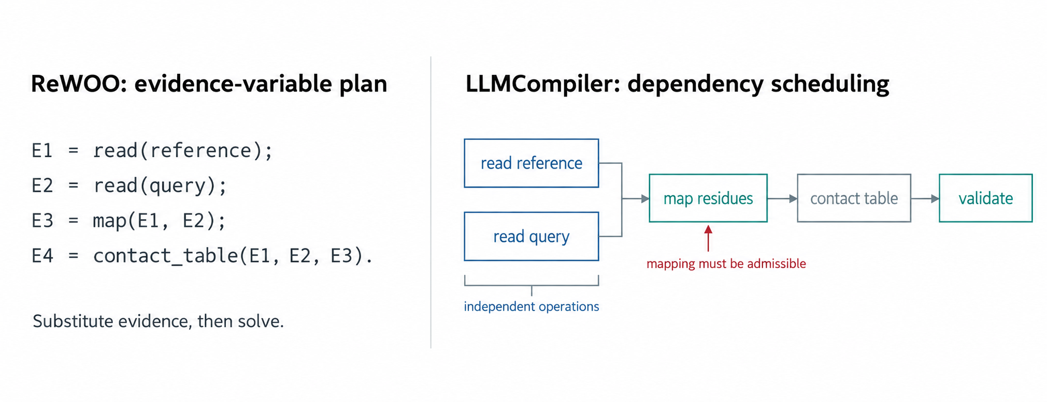
HISTORICAL REASONING
LITERATURE MECHANISM + DESIGN INFERENCE
Planning exposes dependencies before execution
Mechanism reconstruction for one structural task. Mapping is a prerequisite, not a string argument.
Xu et al., ReWOO, 2023 preprint; Kim et al., ICML 2024
10
Notes:
A simple graph is parse(reference) and parse(query) in parallel, then establish mapping, then compute comparable contacts. Independent quality checks may run alongside mapping. ReWOO primarily reduces repeated reasoning by decoupling planning from observations. LLMCompiler makes ready-task scheduling explicit. Neither establishes the scientific meaning of a dependency edge. The executor must enforce scientific preconditions in addition to readiness.
Research question: When should the agent stop deciding one tool call at a time?
Mechanism and implementation detail:
- Distinguish data dependencies from semantic preconditions: two files existing is not enough to make them comparable.
- Compile safe independent substeps into a DAG.
- Create explicit replan exits for missing coverage, ambiguous entities, or invalid assumptions.
Central claim: Represent stable dependencies explicitly, and reserve replanning for observations that change the scientific route.
Boundary: Parallel speedup is bounded by the dependency graph, resource limits, and tool concurrency; do not generalize benchmark maxima to HPC.
Conceptual schematic generated from the proposed design for exposition. It is not a measured experimental result.
Sources:
https://arxiv.org/abs/2305.18323
https://proceedings.mlr.press/v235/kim24y.html

Slide 11
HISTORICAL REASONING
LITERATURE MECHANISM + DESIGN INFERENCE
Feedback must diagnose the failure
Attempt | Feedback | Admissible next move
Initial map | Residue coverage fails | Inspect correspondence and assembly
Alternative map | Ambiguity remains | Ask or retain alternatives
Restricted scope | Independent distances agree | Accept a bounded partial answer
Reflexion
LATS
Feedback-derived experience guides another
attempt.
Branch into trajectories, evaluate them, then
expand promising alternatives.
Shinn et al., NeurIPS 2023; Zhou et al., ICML 2024
11
Notes:
Reflexion does not mean the model has learned through gradient updates; it uses text memory to condition future trials. LATS trades more calls and environment interactions for exploring alternatives. Scientific agents cannot assume all actions are cheap, reversible, or safely repeatable. Evaluation must charge every failed branch and distinguish optimizer-facing feedback from the final independent scoring system.
Research question: Why do reflection and search sometimes improve a task and sometimes compound the error?
Mechanism and implementation detail:
- Differentiate a factual diagnostic (“mapping coverage 41%”) from an unsupported explanation (“the protein unfolds”).
- A repair proposal must name the failed predicate and expected change.
- Keep the previous valid artifact and stop after a bounded number of attempts.
Central claim: The value of additional attempts depends on feedback quality, action reversibility, and a declared budget.
Boundary: Self-generated feedback can be wrong; using the same weak criterion for repair and final evaluation hides reward hacking.
Sources:
https://proceedings.neurips.cc/paper_files/paper/2023/hash/1b44b878bb782e6954cd888628510e90-Abstract-Conference.html
https://proceedings.mlr.press/v235/zhou24r.html

Slide 12
HISTORICAL REASONING
LITERATURE SYNTHESIS
Adaptation changes context, programs or policy
What changes? | Concrete mechanism | Evaluation obligation
Context / memory | MemGPT: move records into and out of model context | Applicability, freshness, retrieval error
Skill library | Voyager: save executable skills for later retrieval | Rebind inputs and test new cases
LLM program | DSPy: optimize program components on development data | Hold out cases and environment changes
Model policy | Toolformer / tool-use RL: update model weights | Unseen tools and reward alignment
Each adaptation changes a distinct object and needs a matching validation test.
Packer et al. 2023; Wang et al. 2023/2024; Khattab et al. 2024
12
Notes:
Use the table to prevent a common conceptual confusion. A larger context window, an experience database, a reusable function, a searched workflow, and a fine-tuned policy are not interchangeable. MemGPT contributes memory-management ideas, Voyager executable skill reuse, DSPy program-level optimization, and Toolformer learned tool calling. Their mechanisms can be combined, but each introduces a different validation obligation.
Research question: What exactly improves when an agent “learns”?
Mechanism and implementation detail:
- Cache factual artifacts by content and version; store strategy recommendations as conditional claims.
- Invalidate experiences when software, object semantics, or evaluation rules change.
- Optimize against development data, then lock the system before test evaluation.
Central claim: Specify whether adaptation changes retrieved context, executable skills, workflow structure, or model parameters.
Boundary: Memory can preserve incorrect conclusions; workflow optimization can overfit the metric; training can learn environment-specific shortcuts.
Sources:
https://arxiv.org/abs/2310.08560
https://arxiv.org/abs/2305.16291
https://arxiv.org/abs/2310.03714
https://arxiv.org/abs/2302.04761

Slide 13
HISTORICAL REASONING
PROPOSED DESIGN
Tool-use training depends on the meaning of reward
πθ(aₜ | task, observations, scientific state)
Work | Interaction during training | Transfer limit
Search-R1 | Issue a search, consume retrieved evidence, continue reasoning | Answer reward can miss evidence faithfulness.
ReTool | Generate code, observe execution, continue reasoning | Executable code can use the wrong scientific object.
A structural reward needs identity, measurement and inference checks beyond command success.
Search-R1, 2025; ReTool, 2025/2026
13
Notes:
The frontier is relevant because it shifts tool use from prompting to policy learning. However, evidence from mathematical reasoning or retrieval tasks does not show that the policy respects residue identity, experimental support, or physical validity. For this platform, an environment and evaluator contribution may be more defensible initially than expensive RL. Policy optimization becomes justified after the reward reflects the scientific objective and the execution environment is reproducible.
Research question: Would reinforcement learning solve structural-biology reliability?
Mechanism and implementation detail:
- Start with a stable environment, independently tested operations, and held-out task semantics.
- Construct reward components for valid objects, justified measurements, and calibrated abstention.
- Keep final evaluation distinct from the reward implementation; test reward exploitation.
Central claim: Training can optimize tool-use behavior, but only the implemented reward defines what behavior is reinforced.
Boundary: This slide proposes a training prerequisite, not a claim that RL is ineffective or unnecessary.
Sources:
https://arxiv.org/abs/2503.09516
https://arxiv.org/abs/2504.11536

Slide 14
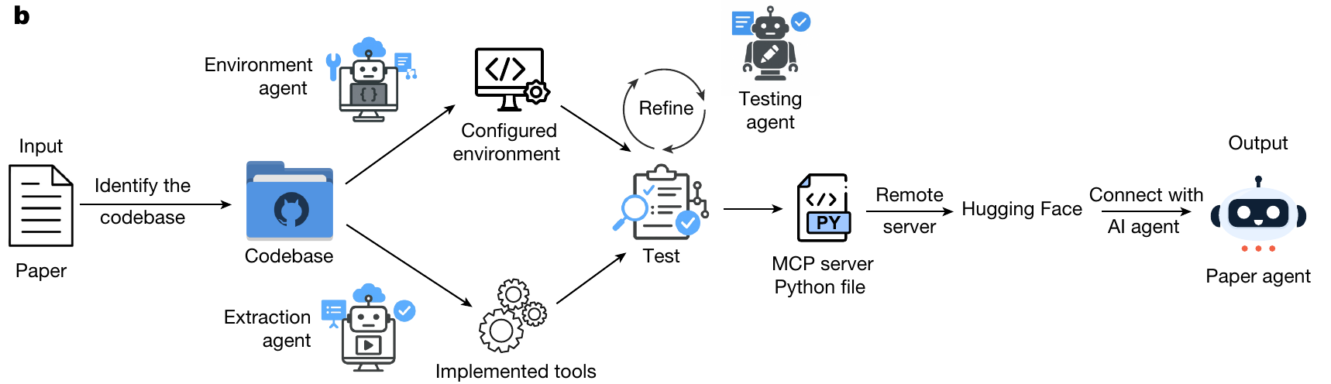
RELATED WORK
RELATED-WORK SYNTHESIS
A method becomes reusable when its environment
and tests run
Admission evidence
Transfer obligation
Tests connect a method to code, environment and
reference outputs.
New biological inputs still require scientific
preconditions and validation.
Miao et al., Paper2Agent, Nature 2026, Fig. 1b
14
Notes:
Do not compare headline accuracy across these systems because datasets and environments differ. Biomni represents broad biomedical environment composition; SciToolAgent structures tool relationships; Paper2Agent converts paper-associated code into tested interfaces with provenance. Their lessons motivate an operation registry with scientific types and validation evidence. None by itself proves validity for arbitrary structural inputs.
Research question: How do existing systems make scientific software usable?
Mechanism and implementation detail:
- Borrow the integration mechanism that addresses a demonstrated bottleneck.
- Add structure-specific identities, coordinate coverage, and interpretation rules rather than assuming broad biomedical support covers them.
Central claim: Environment breadth, tool relations, and method packaging solve distinct parts of the integration problem.
Boundary: Published cases establish performance within their evaluated scopes. Tool access and example reproduction are not universal scientific guarantees.
Sources:
https://www.science.org/doi/10.1126/science.adz4351
https://github.com/snap-stanford/Biomni
https://www.nature.com/articles/s43588-025-00849-y
https://www.nature.com/articles/s41586-026-11044-y

Slide 15
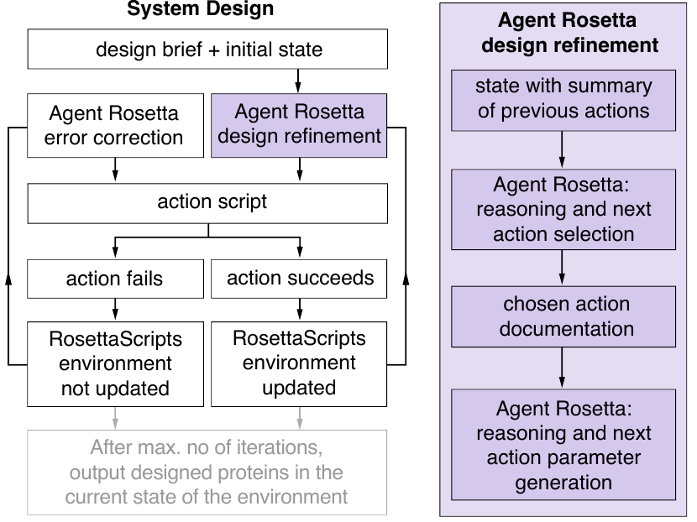
RELATED WORK
RELATED-WORK SYNTHESIS
Scientific environments make actions explicit
Stateful action space
Select a scientific operation and its
parameters from documented actions.
Feedback and persistence
Observe execution, retain candidates
and recover from failed actions.
Residual scientific burden
A valid Rosetta script may still produce
an unsuitable design.
Teneggi et al., Agent Rosetta, ICML 2026, Fig. 1
15
Notes:
Agent Rosetta’s paper explicitly identifies environment design as important relative to prompt-only action generation. Its evaluation uses defined design tasks and computational objectives; do not describe that as wet-lab confirmation. StructAgent and the recent refinement supervision work are preprints, with limited case-based evidence. They motivate the architecture, not a claim that general structural autonomy is solved.
Research question: What do structural-biology agents contribute beyond generic tool calling?
Mechanism and implementation detail:
- Treat scientific software state and candidate artifacts as first-class objects.
- Distinguish computed design scores, expert-reviewed cases, and experimental validation.
- Retain local adverse effects and failed attempts; do not summarize only the improved metric.
Central claim: Domain-specific action spaces and multi-metric feedback make specialization useful, but case evidence must be separated from general reliability.
Boundary: Preprint status and incomplete baselines limit conclusions. Scientific judgments about ions, ligands, or map ambiguity may require expert input.
Figure attribution: Teneggi et al., Agent Rosetta, ICML 2026 (local arXiv v2). Figure 1. https://proceedings.mlr.press/v306/teneggi26a.html
Figure limit: Action success is distinct from structural validity. A valid Rosetta script can still produce a poor candidate.
Sources:
https://proceedings.mlr.press/v306/teneggi26a.html
https://www.biorxiv.org/content/10.64898/2026.05.18.725842v1
https://www.biorxiv.org/content/10.64898/2026.10.05.756902v1.full

Slide 16
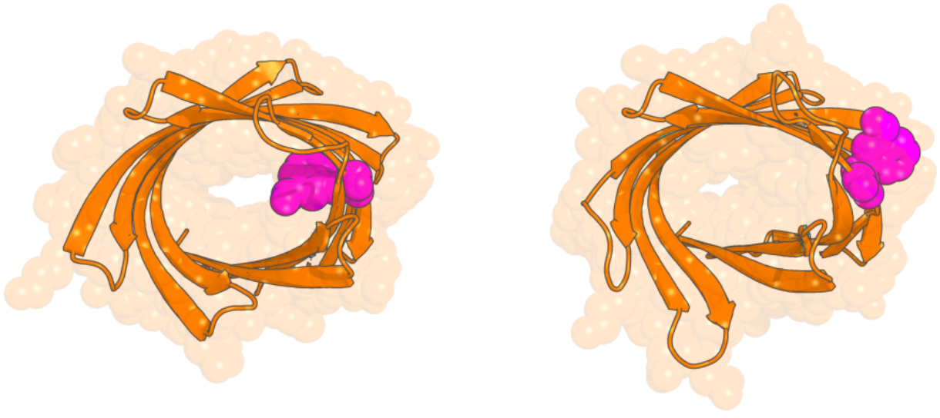
DOMAIN EVIDENCE
PUBLISHED EVIDENCE
Successful actions can miss the design objective
Core-facing TRF
Solvent-exposed TRF
Objective
Place TRF toward the
protein core.
Constraint
Retain a plausible fold.
Evidence boundary
One selected backbone.
Computational
candidates.
Agent Rosetta, Fig. 6. Original computational candidates.
Sources and experimental conditions in speaker notes
16
Notes:
Teneggi et al., Agent Rosetta, ICML 2026, Figure 6 in local arXiv v2, PDF page 11. Original figure excerpt. TRF residue can point into the beta-barrel core or solvent. This is an illustrative pair of computational candidates from one backbone, not an experimental stability result. Design validity requires an objective-specific assessment beyond script execution.
Figure attribution: Teneggi et al., Agent Rosetta, ICML 2026 (local arXiv v2). Figure 6. https://proceedings.mlr.press/v306/teneggi26a.html
Figure limit: Illustrative favorable/unfavorable candidates from one beta-barrel. This is computational evidence; it is not experimental validation of stability.
Sources:
https://proceedings.mlr.press/v306/teneggi26a.html

Slide 17
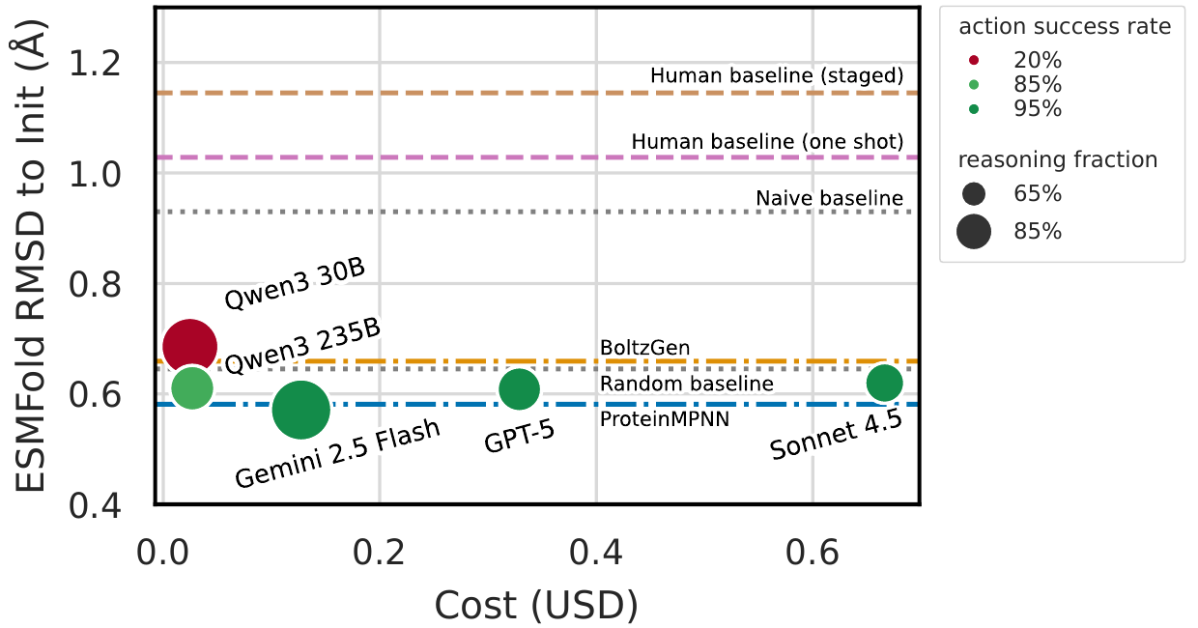
DOMAIN EVIDENCE
PUBLISHED EVIDENCE
Cost depends on the sampling protocol
Proxy metric
Lower ESMFold RMSD
for the chosen objective.
Selection
Best-of-eight and
best-step selection.
Cost boundary
Query cost per 30-query
trajectory.
Agent Rosetta, Fig. 5. Eight backbone targets; conditions in notes.
Sources and experimental conditions in speaker notes
17
Notes:
Teneggi et al., Agent Rosetta, ICML 2026, Figure 5, PDF page 9 in local arXiv v2. Eight backbone targets and 16 independent trials per method. Authors simulate best-of-eight with 1,000 bootstrap draws and select best steps. ESMFold RMSD is a proxy, with later AF3/MD checks. The x axis is mean agent-query cost per 30-query trajectory, not full experimental or platform cost. Specialized baselines remain competitive. Do not extrapolate these dollar amounts to a deployment.
Figure attribution: Teneggi et al., Agent Rosetta, ICML 2026 (local arXiv v2). Figure 5. https://proceedings.mlr.press/v306/teneggi26a.html
Figure limit: Eight backbone targets; 16 independent trials; authors simulate best-of-8 with 1,000 bootstrap draws and select best steps. ESMFold RMSD is a proxy; x-axis is mean cost per 30-query trajectory, not full end-to-end experimental cost.
Sources:
https://proceedings.mlr.press/v306/teneggi26a.html

Slide 18
DOMAIN EVIDENCE
PUBLISHED + PREPRINT SYSTEMS
Biomedical agents expose two integration problems
System / bottleneck | Mechanism | Evidence boundary
Biomni: compose methods | Retrieve relevant tools, datasets and protocols before executing code | Broad biomedical environment. Structural validity remains task-specific.
StructAgent: structural work | Reasoning and execution agents share job records and structural-software skills | Preprint system and cases. Expert judgment and setup remain.
The platform needs both a prepared scientific environment and explicit validity
checks.
Biomni, Science 2026 and primary repo; StructAgent, 2026 preprint / release
18
Notes:
Biomni is useful here because it treats the scientific environment as part of the system rather than assuming that language-model capability alone is enough. Its public repository documents retrieval-augmented planning and code execution, and a substantial environment setup. StructAgent addresses a different problem: scientific reasoning and literature work are separated from local execution, state tracking, and structural-software skills. The public release describes two operating modes: the complete two-agent system and skills-only reuse. Its skills list is a release inventory, not independent proof that every operation is validated on arbitrary inputs. The release excludes raw session logs and example structural datasets; reviewer evidence bundles are separate. This is a preprint, so present it as a useful design case with bounded evidence rather than established general structural autonomy. The synthesis is our inference: a broad environment and a controlled executor are both useful, but their scientific outputs still need task-specific checks.
Research question: What can broad biomedical agents contribute, and what remains specific to structures?
Mechanism and implementation detail:
- Biomni combines retrieval-augmented planning with code-based execution in a prepared biomedical software/data environment.
- StructAgent separates scientific reasoning from execution control and releases both a two-agent architecture and reusable skills.
- The platform should represent action readiness and scientific admissibility separately.
Central claim: Environment breadth and execution control are complementary design choices; neither removes the need for scientific validity checks.
Boundary: Do not compare system accuracy across different task sets or imply that repository skill count measures scientific competence. Avoid carrying current repository model defaults into claims about paper experiments.
Sources:
https://www.science.org/doi/10.1126/science.adz4351
https://github.com/snap-stanford/Biomni
https://www.biorxiv.org/content/10.64898/2026.05.18.725842v1
https://github.com/bhgtiger/StructAgent

Slide 19
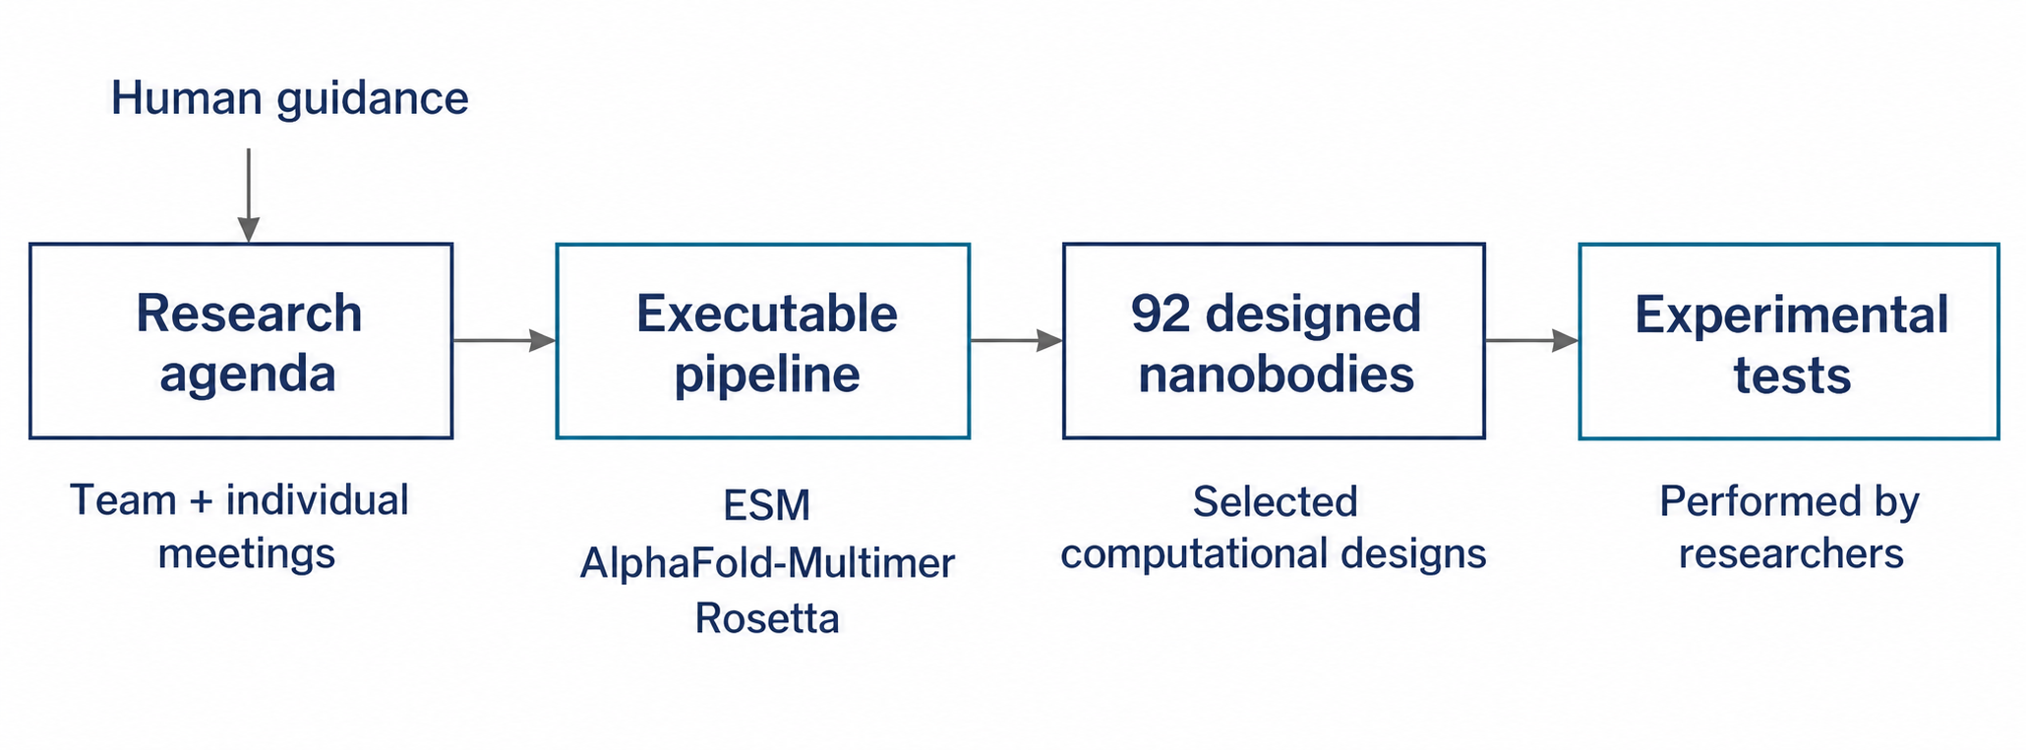
DOMAIN EVIDENCE
PUBLISHED EVIDENCE + DESIGN INFERENCE
Virtual Lab connects computation and experiments
Experimental evidence
Human execution and causal limits
Two highlighted mutants showed promising
binding beyond Wuhan RBD in ELISA.
Researchers ran scripts and assays. Role
benefits still need matched controls.
Swanson et al., Virtual Lab, Nature 2025; primary repository
19
Notes:
The primary Virtual Lab repository describes an AI–human collaboration: a researcher sets agendas and interacts with agents through team and individual meetings. In its nanobody application, the system built a computational pipeline using ESM, AlphaFold-Multimer and Rosetta, and designed 92 nanobodies that were experimentally evaluated. Say “92 designed and experimentally evaluated candidates,” not “92 successful binders.” Do not imply that the agents performed the wet-lab experiments or that the entire scientific process was fully autonomous. The paper is a Nature 2025 publication with a 2024 preprint origin; it is not a new 2026 method. The useful lesson is how computational decisions connect to external validation. The remaining causal question is whether role specialization or meeting structure improved the outcome at a matched budget, as distinct from the value of the underlying sequence, prediction, and energy tools. This distinction supports the deck’s own ablation design. In the formal paper results (Nature printed p721), all computational scripts were run by the human researcher, who also wrote some infrastructure/data-wrangling/scheduling scripts. Two candidates had highlighted promising binding profiles beyond ancestral Wuhan RBD. This is not a 2/92 overall hit rate. Nb21 mutant I77V/L59E/Q87A/R37Q showed JN.1 RBD ELISA EC50 2.0 ng/mL versus Wuhan RBD 0.2 ng/mL; binding does not establish neutralization. The schematic reconstructs the workflow rather than reproducing a paper figure.
Research question: What does a multi-agent biological project demonstrate beyond a discussion transcript?
Mechanism and implementation detail:
- Team meetings organize a scientific agenda; individual meetings carry out focused tasks.
- The project produced a concrete computational design pipeline rather than only candidate descriptions.
- Human-performed experiments provided evidence outside the language-model conversation.
- To test the architecture itself, compare role organization against matched single-agent and fixed-workflow baselines.
Central claim: A convincing scientific workflow links agent-generated decisions to a runnable pipeline and external experimental evidence.
Boundary: This is one application with human guidance and experiments. Binding evidence is not clinical efficacy, and one project does not establish domain-general scientific autonomy.
Sources:
https://www.nature.com/articles/s41586-025-09442-9
https://github.com/zou-group/virtual-lab

Slide 20
RESEARCH GAP
PROPOSED DESIGN
Scientific state gives tool calls a biological meaning
file + chain + cutoff
is a syntactic interface
identity + mapping + coverage + evidence
defines the scientific scope of an operation
The missing layer connects what a program accepts to what its result can mean.
Sources and experimental conditions in speaker notes
20
Notes:
This is the transition from literature survey to a proposed contribution. Existing protocols are useful transport and discovery layers. They do not encode all domain constraints automatically. Our hypothesis is that scientific state and operation semantics can reduce invalid but executable analyses and improve safe recovery. This hypothesis must be tested against strong tool-calling baselines using the same software.
Research question: Why is a tool protocol insufficient?
Mechanism and implementation detail:
- A string named “chain” must carry its namespace and input structure identity.
- A result must declare excluded objects and missing evidence.
- The planner should reason over validated object states rather than a flat list of filenames.
Central claim: A callable interface specifies how to exchange arguments; a scientific operation must also specify what the arguments mean and when the result is interpretable.
Boundary: A typed schema can prevent a class of errors but cannot prove that the underlying scientific method is appropriate.
Sources:
https://modelcontextprotocol.io/specification/2025-06-18/server/tools
https://mmcif.wwpdb.org/docs/user-guide/guide.html

Slide 21
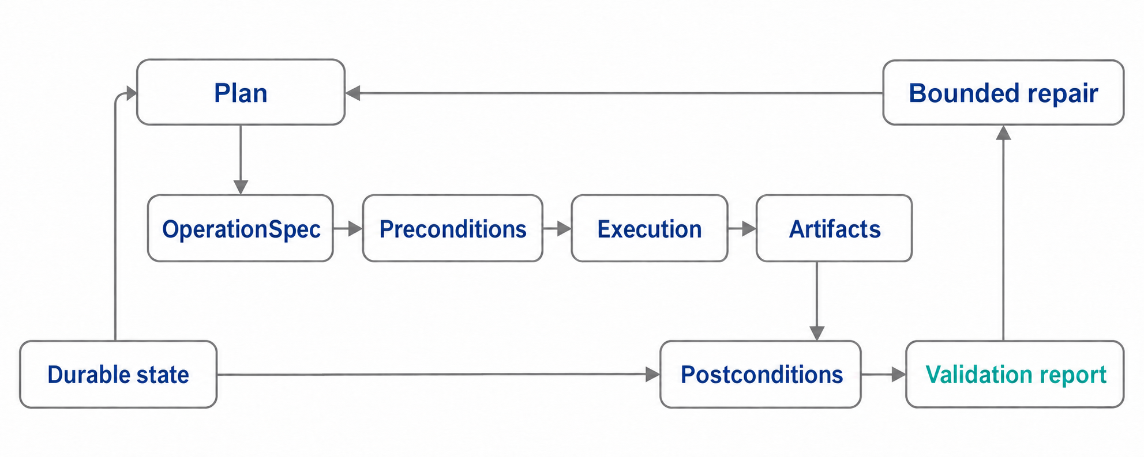
PROPOSED METHOD
PROPOSED DESIGN
Control, execution and verification have separate roles
Sources and experimental conditions in speaker notes
21
Notes:
This is not a fully deterministic pipeline and not an unrestricted agent shell. It is a hybrid where routine mechanics are explicit and adaptive choices are visible. The system should be executable through an agent, a form workflow, or a notebook using the same operations. That separation enables fair baselines: improvements should be attributable to decision logic rather than privileged tool access.
Research question: Which decisions should be deterministic and which should remain agentic?
Mechanism and implementation detail:
- The model can propose a mapping strategy or request another analysis.
- The execution layer checks object identity, permissions, resource budgets, and operation preconditions.
- The verifier can accept, reject, request bounded repair, or return insufficient evidence.
- The report generator reads a claim ledger built from validated results.
Central claim: Use deterministic execution and validation for stable mechanics; use the model for bounded decisions under incomplete information.
Boundary: Architecture is proposed, not implemented performance. Its additional complexity and latency are part of the evaluation.
Conceptual schematic generated from the proposed design for exposition. It is not a measured experimental result.
Sources:
https://proceedings.mlr.press/v306/teneggi26a.html
https://proceedings.mlr.press/v235/kim24y.html

Slide 22
PROPOSED METHOD
PROPOSED DESIGN
Identity is a versioned object, not a chain-name string
Structure(h1, model=1, assembly=2)
Selection(entity, chain_namespace, residues)
CoordinatePolicy(atoms, altloc, occupancy)
Mapping(h1, h2, method, version)
correspondences
comparable_atom_mask
unresolved_alternatives
Artifact(parent_hashes, operation_spec, output_hash)
Why version it?
A changed selection
invalidates dependent
mappings,
measurements and
claims.
Why preserve
ambiguity?
Symmetric or equivalent
chains can admit several
scientifically valid
mappings.
Sources and experimental conditions in speaker notes
22
Notes:
The main implementation challenge is not a giant universal ontology. Begin with the minimal structural object model required by the primary benchmark. Use immutable content references for evidence, and keep human-readable names as labels. A transformation can legitimately change identity fields, but then it must emit a mapping or a declared discontinuity.
Research question: What must remain invariant when one program writes a new structure?
Mechanism and implementation detail:
- Normalize tool-specific identifiers at the adapter boundary.
- Store an explicit crosswalk when a tool renumbers residues or rewrites chain IDs.
- Reject an artifact if its required correspondence cannot be reconstructed.
- Invalidate downstream claims when their input or mapping changes.
Central claim: Scientific identity and transformation lineage must be preserved independently of filenames and temporary tool labels.
Boundary: Hashes establish exact content identity, not molecular equivalence. Equivalence still needs scientific criteria.
Sources:
https://mmcif.wwpdb.org/docs/user-guide/guide.html

Slide 23
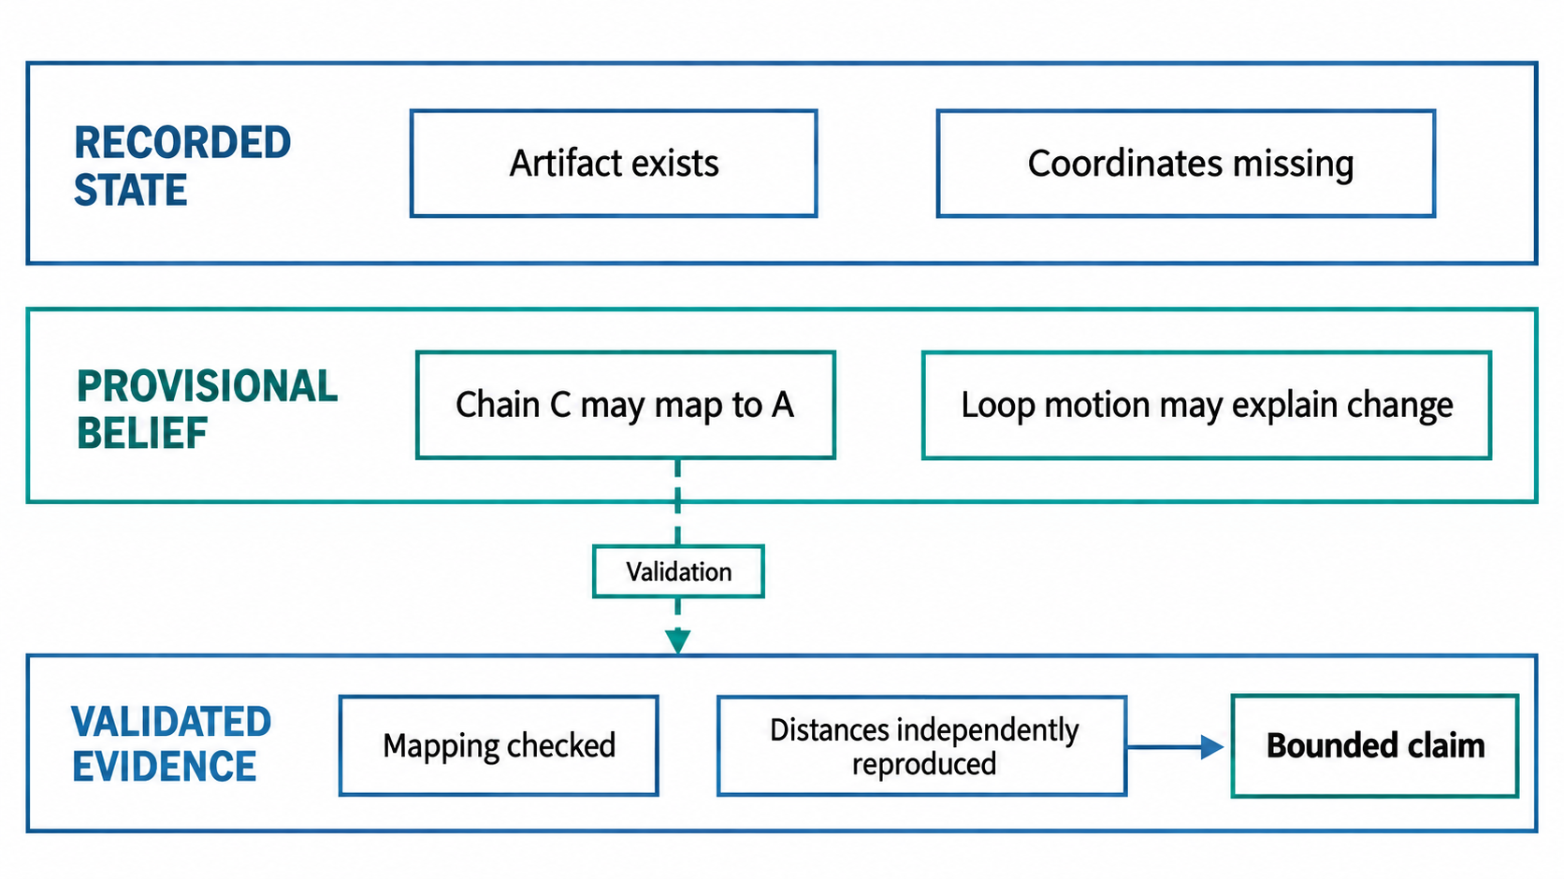
PROPOSED METHOD
PROPOSED DESIGN
State, belief, and evidence need different update rules
Facts: append/version. Beliefs: revise. Evidence: validate and retain provenance.
Proposed analysis / design; no new performance claimed
23
Notes:
State means recorded observable system/object facts, not omniscient ground truth. Belief means the agent’s current interpretation or hypothesis. Evidence means an observation that has passed a stated validation procedure and supports a bounded claim. These definitions are design choices and should be tested for practical value. They prevent a model-generated explanation from becoming an asserted fact merely through repetition in memory.
Research question: What should the system remember after an observation?
Mechanism and implementation detail:
- The planner can act on a belief while marking it provisional.
- A belief becomes reportable only when its required evidence conditions are met.
- A completed job may produce an invalid artifact; a valid artifact may still fail to answer the scientific question.
Central claim: Operational facts, hypotheses, and validated evidence must not be stored as interchangeable text.
Boundary: This is a proposed representational discipline, not a proof system for all biological knowledge.
Conceptual schematic generated from the proposed design for exposition. It is not a measured experimental result.
Sources:

Slide 24
PROPOSED METHOD
PROPOSED DESIGN
Scientific contracts specify checks and failures
pre(x)
entity_match ∧ mapping_admissible
∧ required_atom_coverage
post(y)
distances_recomputable
∧ comparability_mask_complete
Failure is typed
MAPPING_AMBIGUOUS
MISSING_COORDINATES
NUMERIC_MISMATCH
Allowed repair is scoped
Inspect mapping, restrict
scope or independently
recalculate.
Protected invariants include input identity, declared cutoff and validator version.
Sources and experimental conditions in speaker notes
24
Notes:
The key is semantic compression: the model receives a useful diagnostic without needing to infer validity from raw logs. A partial result can be scientifically valuable if its boundary is explicit. For example, “interface region 1 is comparable; loop region 2 is not observable” is more useful than a blanket failure. The contract also provides an executable basis for testing and benchmarking.
Research question: What does a trustworthy “compare interfaces” operation expose?
Mechanism and implementation detail:
- Keep domain-invalid results separate from runtime failure.
- Never encode missing measurements as zero distance or zero change.
- Return a machine-readable diagnostic and allowed repair class.
- Include operation and validator versions in the result.
Central claim: The adapter must report unmet scientific preconditions as structured outcomes, not plausible-looking numeric defaults.
Boundary: Contracts must be validated against independent reference implementations and expert review; a self-consistent contract can still encode a wrong rule.
Sources:
https://mmcif.wwpdb.org/docs/user-guide/guide.html
https://www.wwpdb.org/validation/validation-reports

Slide 25
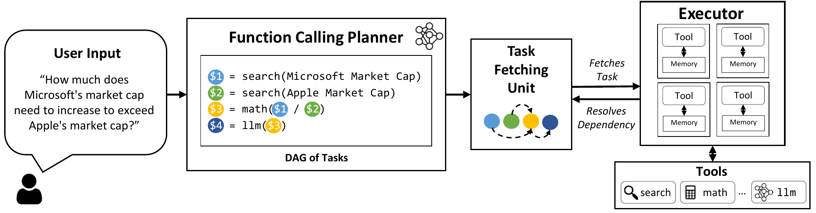
PROPOSED METHOD
PROPOSED DESIGN
Stable computation and adaptive decisions need
different control
Compile stable work
Replan at evidence boundaries
Known dependencies support concurrency and
reproducible execution.
Ambiguous mapping or invalid data can change
the admissible route.
Kim et al., LLMCompiler, ICML 2024, Fig. 2
25
Notes:
This graph borrows the scheduling logic of dependency-based agents but adds semantic readiness. An operation can have all files ready while its scientific precondition remains false. Adaptive replanning should respond to an identified missing fact, not generate a larger plan whenever the result is inconvenient. Expose graph revisions in the execution trace for evaluation.
Research question: How does the agent avoid both brittle pipelines and unconstrained wandering?
Mechanism and implementation detail:
- Define gate predicates independently of the language model.
- Permit only specific graph edits: replace a mapping strategy, narrow a selection, request an external annotation, or stop.
- Require a new scientific justification for expensive operations unrelated to the original question.
Central claim: A dependency graph with explicit scientific gates supports efficient execution and targeted adaptation.
Boundary: Restricting actions can reduce flexibility; test whether the allowed repair set covers real cases and measure failure modes caused by overconstraint.
Figure attribution: Kim et al., LLMCompiler, ICML 2024. Figure 2. https://proceedings.mlr.press/v235/kim24y.html
Figure limit: Paper evaluates short function calls. Long scientific jobs still require durable state, scheduler reconciliation and resource accounting.
Sources:
https://proceedings.mlr.press/v235/kim24y.html
https://arxiv.org/abs/2305.18323

Slide 26
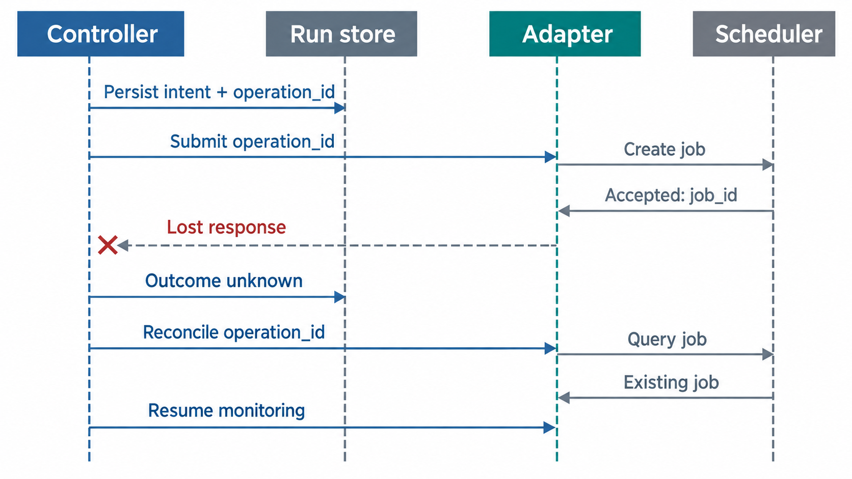
PROPOSED METHOD
PROPOSED DESIGN
A timeout creates an unknown outcome
Checkpointing does not itself guarantee exactly-once external execution.
Temporal idempotency; Slurm state documentation
26
Notes:
Show the exact race: the scheduler accepts a GPU job, the network response disappears, and a naïve agent retries because it saw no receipt. A persisted intent plus reconciliation can reduce duplicate submissions, but the guarantee depends on scheduler identifiers and adapter design. Do not claim exactly-once execution simply because the workflow engine can resume. This engineering issue affects compute cost and scientific provenance.
Research question: What happens if an HPC submission succeeds but its response is lost?
Mechanism and implementation detail:
- Distinguish pending, submitted, running, completed, failed, and outcome-unknown states.
- Idempotency requires cooperation at the external side-effect boundary, not just an agent memory.
- A cancellation request is not a confirmed cancellation.
- Restore execution from the durable journal; reconstruct context from that journal.
Central claim: Checkpointing the conversation does not by itself prevent duplicated external jobs.
Boundary: Full exactly-once guarantees are generally unavailable without support at the side-effect boundary; document the operational assumptions.
Conceptual schematic generated from the proposed design for exposition. It is not a measured experimental result.
Sources:
https://slurm.schedmd.com/rest.html
https://slurm.schedmd.com/job_state_codes.html
https://temporal.io/blog/idempotency-and-durable-execution

Slide 27
PROPOSED METHOD
PROPOSED DESIGN
Validation asks a sequence of independent questions
01 Identity
Did the operation address the intended molecules, selections and units?
02 Execution
Did the program actually produce the required complete artifacts?
03 Measurement
Can an independent implementation reproduce accepted quantities?
04 Inference
Does the stated claim stay within the validated scope?
Sources and experimental conditions in speaker notes
27
Notes:
Different validators need not all run on every task. Choose checks based on failure risk and cost, but state the coverage. Validation does not mean using a second LLM to agree with the first. A second model may help audit prose, while numerical and structural claims should be checked with appropriate scientific procedures. Keep final evaluation independent of any internal repair score.
Research question: What evidence is sufficient to accept an analysis?
Mechanism and implementation detail:
- Use deterministic checks where the predicate is objective.
- Use expert-calibrated rubrics for open-ended interpretation.
- Reserve independent tools, alternative implementations, or manual checks for high-impact results.
- Expose residual uncertainty even when every available validator passes.
Central claim: Acceptance requires different validators for execution, object semantics, measurements, and interpretation.
Boundary: Passing a finite validator suite cannot guarantee correctness outside its tested scope.
Sources:
https://www.wwpdb.org/validation/validation-reports
https://www.ebi.ac.uk/training/online/courses/alphafold/inputs-and-outputs/evaluating-alphafolds-predicted-structures-using-confidence-scores/

Slide 28
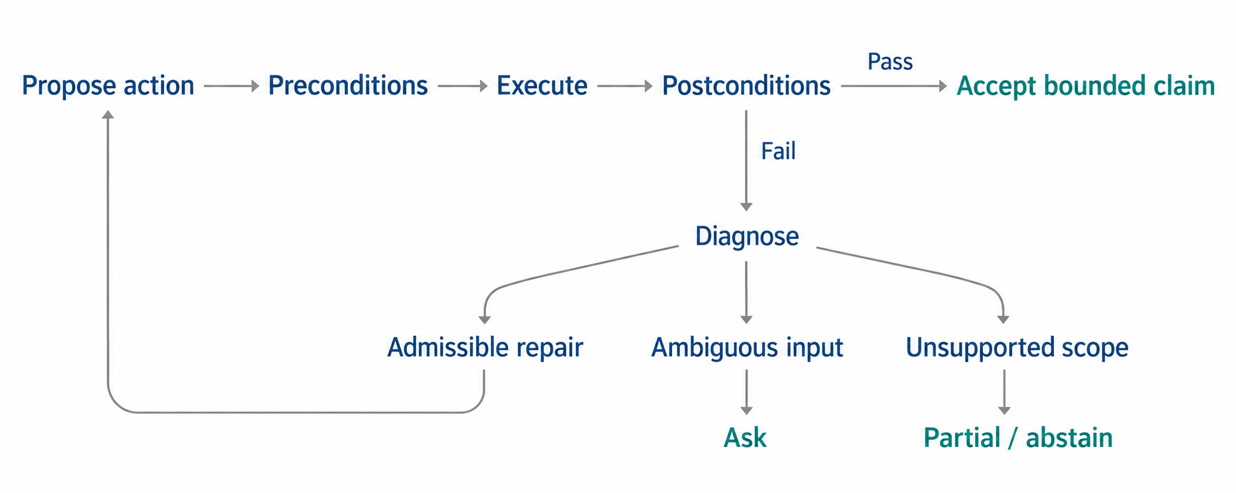
PROPOSED METHOD
PROPOSED DESIGN
Repair is admissible only within protected constraints
Scientific postcondition failure. Preserve identity and cutoff; never change them to obtain a pass.
Proposed controller, informed by Reflexion and LATS
28
Notes:
This is the method’s central control mechanism. It is inspired by feedback-based agents, but its scientific content is the mapping from a failed predicate to allowed actions and the preservation of invariants. The model proposes repairs; the runtime enforces budgets and protected state. A good outcome may be an honest partial answer rather than a completed but invalid result. A useful algorithmic representation is x_t for recorded objects and execution state, b_t for provisional interpretations, and V(x_t) for failed predicates, evidence masks, and uncertainty. The controller may choose only repairs that address a diagnosed predicate and preserve protected invariants. The LLM ranks or proposes admissible actions; it does not redefine the validators to make a candidate pass. This is a finite operational discipline, not a formal proof of biological truth.
Research question: How should the agent recover without optimizing the validator away?
Mechanism and implementation detail:
- Maintain a finite repair action set by failure class.
- Prevent changing the contact cutoff merely to obtain a desired conclusion unless a prespecified sensitivity analysis calls for it.
- Use a maximum number of repairs and a compute budget.
- Freeze protected validators and log every attempted repair, including failed ones.
Central claim: A repair is admissible only if it names the failure, preserves protected invariants, and stays within a predefined action budget.
Boundary: The repair policy may abstain too often or overfit a validator. These outcomes must be measured, not treated as automatic success.
Conceptual schematic generated from the proposed design for exposition. It is not a measured experimental result.
Sources:
https://proceedings.neurips.cc/paper_files/paper/2023/hash/1b44b878bb782e6954cd888628510e90-Abstract-Conference.html
https://proceedings.mlr.press/v235/zhou24r.html

Slide 29
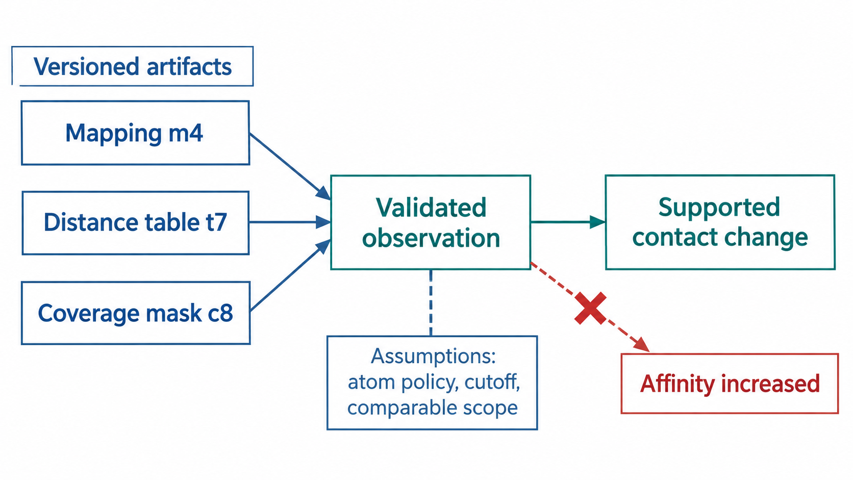
PROPOSED METHOD
PROPOSED DESIGN
Claims are generated from a versioned evidence graph
A claim ledger retains supporting artifacts, assumptions, alternatives and excluded conclusions.
Proposed claim–evidence representation
29
Notes:
The graph is a practical accountability device. It is not a formal theorem prover. Its value is that a reviewer can click a statement and inspect the exact underlying data, and the system can invalidate dependent claims when inputs change. Evaluate both factual correctness and citation coverage; coverage alone is not evidence that the linked source supports the claim.
Research question: How can the reader verify what a conclusion rests on?
Mechanism and implementation detail:
- Store graph edges from claim to measurement to input artifacts.
- Differentiate observation, interpretation, and hypothesis in report language.
- Do not turn a plausible biological explanation into a supported causal statement.
- Preserve uncertainty and contradictory evidence instead of compressing them away.
Central claim: Every substantive scientific claim should reference a measurement and the assumptions that permit its interpretation.
Boundary: Provenance completeness, evidence correctness, and inferential validity must be scored separately.
Conceptual schematic generated from the proposed design for exposition. It is not a measured experimental result.
Sources:

Slide 30
WORKED EXAMPLE
ILLUSTRATIVE EXAMPLE
The same ambiguous input can end in a bounded
answer
Event | Recorded / provisional information | Consequence
Observation | Two admissible maps; query loop absent | No unique full-scope comparison
Decision | Inspect task-defined correspondence | Preserve alternatives if tied
Computation | Distances only on comparable atom pairs | Missing region remains unknown
Validation | Independent distances agree | Accept supported measurements
Report | Changes plus excluded scope | Partial answer with explicit limits
Illustrative trace, not a demonstrated platform result.
Sources and experimental conditions in speaker notes
30
Notes:
Walk the audience through the example rather than listing system components again. The meaningful comparison is how a generic agent and the proposed controller respond to the same ambiguous input. A successful synthetic trace is an explanation of the design; it is not evidence of efficacy. The next section converts the design claims into experiments.
Research question: What exactly happens when the initial comparison is ambiguous?
Mechanism and implementation detail:
- Label this as a synthetic trace, not a demonstrated platform run.
- Show each event’s state fact, provisional belief, and evidential status.
- Include one injected runtime uncertainty and its reconciliation in speaker discussion, not every diagram.
Central claim: The system should resolve, narrow, or abstain at the first unsupported step rather than inventing an answer downstream.
Boundary: Real examples may involve more complex chemistry and ambiguous assemblies; the initial study should declare exclusions.
Sources:
https://mmcif.wwpdb.org/docs/user-guide/guide.html
https://academic.oup.com/bioinformatics/article/40/10/btae586/7796530

Slide 31
SCOPE
PROPOSED DESIGN
Generality requires shared semantics and
task-specific checks
Shared semantics | Comparison | Refinement / simulation
Input identity | Chains, residues, assembly | Map/model or topology/trajectory pairing
Uncertainty | Coverage and mapping alternatives | Density support or sampling uncertainty
Validation | Independent geometry and scope | Local data fit, physical assumptions
Evidence | Mapping and measurement artifacts | Candidates, trajectories and provenance
A shared platform can host many tasks; each validity claim needs a bounded study.
Task-specific validators; see appendix
31
Notes:
This slide reconnects the framework to the user’s broad platform goal. Support can expand tool by tool and workflow by workflow. Scientific generality should be evaluated as transfer across task families and perturbations, not by counting installed software. The initial paper should make a narrower claim than the long-term product vision.
Research question: How can the platform support many structural analyses without pretending that their validators are identical?
Mechanism and implementation detail:
- The same run/job/artifact ledger can support all families.
- Operation types, assumptions, and validators must be developed and tested by domain.
- A common interface does not justify pooling incompatible success metrics.
Central claim: Reuse the execution substrate while keeping scientific operations and acceptance criteria specific to each analysis family.
Boundary: The table is an architectural decomposition, not a statement that every listed workflow has been implemented or benchmarked.
Sources:
https://www.wwpdb.org/validation/validation-reports
https://www.ebi.ac.uk/training/online/courses/alphafold/inputs-and-outputs/evaluating-alphafolds-predicted-structures-using-confidence-scores/
https://academic.oup.com/bioinformatics/article/40/10/btae586/7796530

Slide 32
IMPLEMENTATION PATH
PROPOSED DESIGN
A structural-comparison workflow comes first
Layer | First implementation | Acceptance artifact
Scientific operations | Gemmi, explicit sequence mapping, US-align, contact calculation | Selections, coverage masks, independent checks
Shared execution | Versioned run / job / artifact records, containers and queues | Replay, restart and lost-response tests
Agent controller | Plan admissible operations, classify failures, bound repair | Traces and matched baselines
Expansion gate | One costly branch, e.g. map–model refinement | Paired inputs, local validation, resource budget
Agent, form workflow and notebook call the same operations and share evidence objects.
Implementation proposal. Gemmi, US-align and wwPDB documentation in notes
32
Notes:
This slide turns the architecture into a practical implementation sequence without giving a fictitious schedule. First establish a complete CPU-friendly path: parse coordinates, inspect molecular identity, propose and validate mappings, compute comparable geometry and contacts, and generate an evidence-linked report. Gemmi and US-align are examples of executable components, not claims that they are already deployed in NBDB. Contact calculations can be implemented using a tested spatial-neighbor routine, but the atom policy and missing-coordinate semantics must be explicit. FreeSASA can later add surface analysis; DockQ is appropriate for reference-based complex-interface quality assessment, not a universal metric for arbitrary contact changes. The runtime layer then makes the path replayable and recoverable. The controller should be tested against fixed and generic-agent baselines using the same operations. Only after this slice is reliable should the platform add a GPU/HPC branch such as refinement, with map–model pairing, data-agreement and local-geometry checks. Readiness is demonstrated by artifacts and tests, not by software being listed in a registry. The US-align primary page explicitly exposes choices for sequence-independent alignment, residue-index correspondence, atom representation, monomer versus oligomer mode, and multi-model reading. Its default monomer path uses only the first chain. This is a concrete example of why the adapter must specify the scientific selection and mode rather than invoke a default command.
Research question: What should be implemented first, and how do we know each layer is ready?
Mechanism and implementation detail:
- Implement a minimal set of operations: inspect_structure, map_entities, compare_coordinates, compare_interfaces, validate_result, render_evidence. These names are illustrative API proposals.
- Use Gemmi for structure parsing and identifier access; use an explicit mapping operation rather than trusting tool-local chain strings.
- US-align provides a comparison operation, but correspondence and scientific scope remain explicit inputs and outputs.
- Use an independent implementation for benchmark numerical checks; avoid validating code against itself.
- Keep full tool inventory and future installation scope outside the primary method claim.
Central claim: Build a complete, testable structural-comparison path before expanding to expensive scientific workflows.
Boundary: This is a proposed implementation path, not an audit of the current NBDB codebase or a promise of universal tool support. Software availability, resource limits, and licenses must be checked at deployment.
Sources:
https://gemmi.readthedocs.io/en/latest/mol.html
https://zhanggroup.org/US-align/
https://www.wwpdb.org/validation/validation-reports
https://academic.oup.com/bioinformatics/article/40/10/btae586/7796530

Slide 33
RESEARCH DESIGN
PROPOSED DESIGN
The architecture yields three falsifiable hypotheses
Hypothesis | Intervention | Falsifying observation
H1: scientific semantics | Typed identity, coverage and unknown states | No reduction in invalid conclusions
H2: bounded repair | Diagnose, repair and revalidate | Extra cost without valid completion gain
H3: durable state | Reconcile external outcomes | Duplicate work or unchanged fault recovery
Model, tool access, initial data and hard budgets remain matched.
Proposed analysis / design; no new performance claimed
33
Notes:
The three confirmatory hypotheses distinguish scientific semantics, adaptive repair, and execution reliability. H1 tests typed identities, coordinate coverage, and explicit unknown states against the same model and scientific tools without the proposed contract layer. Risk–coverage and unsupported claims are secondary outcomes within H1. H2 tests diagnostic-guided bounded repair, with the separate diagnostic-by-repair experiment distinguishing feedback information from policy use. H3 is an engineering hypothesis: recorded submission intent and external-state reconciliation should reduce duplicated or orphaned work after lost receipts and worker restarts. Final scoring is independent for all systems. Match model, initial data, operation access, and hard resource ceilings; charge every attempt. These are proposed hypotheses, not completed results.
Research question: What would the experiments actually establish?
Mechanism and implementation detail:
- H1 compares the same model and tool implementations with versus without domain contracts.
- H2 compares feedback with and without the proposed repair controller, under matched budgets.
- H3 reports risk–coverage tradeoffs rather than counting every abstention as success.
- Declare the test population and failure criteria before collecting the final runs.
Central claim: The study should test separable claims about semantic correctness, recoverability, and useful coverage.
Boundary: These are proposed hypotheses and contain no reported experimental results.
Sources:

Slide 34
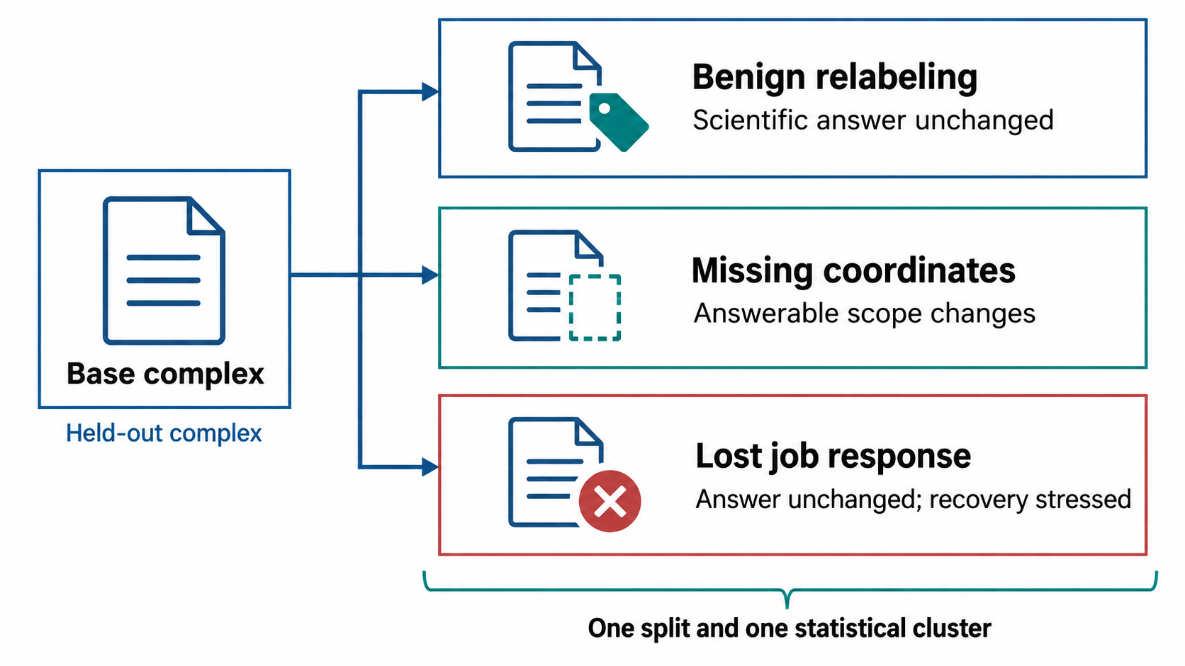
RESEARCH DESIGN
PROPOSED DESIGN
Matched variants isolate semantic and runtime failure
Planning proposal: pilot on development cases, then freeze held-out complexes and variants.
Proposed study; sizes require a pilot
34
Notes:
Matched variants enable sharper causal analysis than unrelated easy and hard tasks. A chain-renaming variant should preserve the answer; a missing-coordinate variant should change what is supportable; a runtime fault should preserve the scientific answer while stressing recovery. Keep these categories separate. The expensive extension demonstrates feasibility and exposes new failure modes, but does not inflate the primary statistical claim.
Research question: What task set is broad enough to test the method but small enough to validate rigorously?
Mechanism and implementation detail:
- Treat the numbers as a planning proposal subject to a cost/annotation pilot.
- Group related complexes and variants in the same split; avoid homolog or template leakage appropriate to the scientific claim.
- Create task records with intended objects, gold measurements where possible, allowed ambiguity, and unacceptable claims.
- Have two qualified reviewers calibrate the rubric on development data and adjudicate disagreements.
Central claim: Use a CPU-friendly primary study with expert-curated semantics, then add expensive workflows as a separate transfer test.
Boundary: This is not a universal structural-biology benchmark. Sampling bias, annotation uncertainty, and limited transfer must be reported.
Conceptual schematic generated from the proposed design for exposition. It is not a measured experimental result.
Sources:
https://mmcif.wwpdb.org/docs/user-guide/guide.html
https://www.wwpdb.org/validation/validation-reports

Slide 35
RESEARCH DESIGN
PROPOSED DESIGN
Strong baselines make the intervention identifiable
Condition | Scientific contract | Independent validation | Bounded repair
Expert fixed pipeline | Explicit | Yes | Fixed rules
Strong generic tool agent | Tool schema | Final scoring only | Generic retry
Agent + contracts | Yes | Final scoring only | Generic retry
Agent + verification | Yes | Runtime diagnostics | Generic retry
Full controller | Yes | Runtime diagnostics | Enabled
Matched model, tools, inputs and hard budgets. One independent final scorer for all conditions.
Sources and experimental conditions in speaker notes
35
Notes:
A weak ReAct baseline is not enough for a paper. The strongest generic baseline should get clear tool documentation and the same computational resources. Distinguish an interface improvement from an algorithmic controller improvement. If the proposed system gets exclusive validators or curated mappings, that advantage must be explicit and ablated. All learned-agent conditions use the same model, tools, inputs, attempt ceiling and hard budgets. The generic policy can retry self-directed actions. Structured diagnostics add information. The full controller additionally limits repairs to actions admissible under protected scientific invariants. A separate factorial analysis crosses feedback availability and repair enablement. All conditions receive the same independent final scorer.
Research question: What must be held equal to attribute a gain?
Mechanism and implementation detail:
- Use identical base model versions and comparable prompts where applicable.
- The fixed pipeline is allowed to fail on unsupported inputs, not receive hidden manual correction.
- Run unconstrained generic-code access as a separate setting if it changes capabilities.
- Include an expert-assisted reference only with measured intervention and time, not as an informal ceiling.
Central claim: All agent baselines should share tools, inputs, execution access, and prespecified resource limits.
Boundary: Some conditions differ in interface information by design; describe exactly what each condition can observe.
Sources:
https://arxiv.org/abs/2210.03629

Slide 36
RESEARCH DESIGN
PROPOSED DESIGN
A factorial test separates information from repair
 | Repair disabled | Repair enabled
Raw tool observations | One pass, raw observations | Same retry policy, raw observations
Structured diagnostics | One pass, structured feedback | Same retry policy, structured feedback
Information effect
Control effect
Does the diagnostic signal itself prevent invalid
claims?
Does enabling repair improve valid completion at
a matched budget ceiling?
Test bounded versus generic repair separately under identical feedback and attempt ceilings.
Proposed analysis / design; no new performance claimed
36
Notes:
This slide is important because a repair method can look strong simply because it receives a better error message or more attempts. The proposed experiment distinguishes diagnostic information from decision policy. Test the unknown-state representation on missing-data cases, not on easy complete structures where it cannot matter. Test reconciliation on lost-response cases, not only on ordinary timeouts. In the 2-by-2 experiment, hold the scientific contract, model, operations and repair-policy family fixed. Cross structured-feedback availability with whether further attempts are allowed. The repair-enabled cells use the same retry policy with raw versus structured observations. This estimates feedback and retry availability, including their interaction. Separately compare generic retries against the bounded repair policy under identical structured feedback and attempt ceilings, as shown in the baseline table. The factorial must not silently replace the generic policy with a different bounded controller in one cell. Charge actual attempts and report budget use.
Research question: Is a gain caused by better feedback or by a better response to the same feedback?
Mechanism and implementation detail:
- If R requires V, use a clear three-way design and do not claim a fully independent factorial effect.
- A useful four-cell design gives all conditions the same raw tool outputs; V adds structured diagnostics, R controls permitted retries.
- Match candidate count or report full cost–success curves.
- Keep benchmark perturbations paired and aggregate uncertainty at the base-complex level.
Central claim: A factorial analysis is needed because validation signals and repair policy can be confounded.
Boundary: Ablations identify effects within the benchmark and implementation; they do not prove every mechanism is universally necessary.
Sources:

Slide 37
RESEARCH DESIGN
PROPOSED DESIGN
Validity, coverage and cost define performance
Valid completion
Coverage
artifacts ∧ correct semantics
∧ accepted measurement
∧ bounded interpretation
Fraction of answerable scope with valid
output. Track correct and unnecessary
abstention.
Unsupported claims
Audit substantive claims and report the
explicit denominator.
Cost per valid completion = total cost of all runs / valid completed runs
No valid completions: report zero successes and total cost; the ratio is undefined.
Proposed metric definitions
37
Notes:
A system can improve apparent accuracy by refusing everything, or improve completion by making unsupported claims. Risk–coverage curves expose that tradeoff. An individual run is not an independent new complex. Repeated seeds estimate stochastic stability, while the unit for generalization is the sampled task or complex group. Cost per successful task should include failed tasks and attempts in the denominator accounting.
Research question: Which metrics cannot be gamed by producing more files or more cautious prose?
Mechanism and implementation detail:
- Report pass@1 for the deployed budget and repeated-run stability separately.
- Use paired effect sizes and confidence intervals; bootstrap at the base-complex level when variants are correlated.
- Report per-family and per-perturbation results before a pooled score.
- Predeclare multiplicity handling or distinguish confirmatory from exploratory comparisons.
Central claim: Report valid completion, unsupported claims, and coverage together, with denominators defined at the task and run levels.
Boundary: Rubric-based scientific validity includes expert judgment; report agreement, adjudication, and uncertainty rather than treating labels as infallible.
Sources:

Slide 38
RESEARCH DESIGN
PROPOSED DESIGN
Failure analysis locates the first invalid transition
First invalid transition | Observable failure | Targeted intervention
Selection / mapping | Wrong scientific object | Identity predicates
Coverage / representation | Unknown treated as absent | Evidence masks
Execution / recovery | Duplicate or wrong external state | Intent ledger and reconciliation
Measurement / inference | Wrong number or unsupported claim | Independent checks and claim ledger
Cluster paired estimates by base complex. Report task-family results separately.
Proposed analysis / design; no new performance claimed
38
Notes:
The mechanism claim is stronger if contracts eliminate identity errors, explicit unknown states reduce coverage-related false claims, and reconciliation prevents duplicate jobs. A final-score improvement without the predicted failure changes weakens the explanation. Negative cases can guide the next iteration and strengthen the paper by delimiting where the approach fails.
Research question: What would convince a reviewer that the mechanism actually works?
Mechanism and implementation detail:
- Annotate a stratified sample of successes and failures from each condition.
- Compare error transitions before and after each intervention.
- Audit repair-created failures and cases where the full system performs worse than the baseline.
- Release failure traces with sanitized inputs and replayable artifacts where licensing permits.
Central claim: Analyze where the first verifiable error occurs, not only the quality of the final narrative.
Boundary: Trace annotation can be expensive and subjective; use predefined categories and independent review on a sample.
Sources:

Slide 39
RESEARCH DESIGN
PROPOSED DESIGN
Three contributions define the proposed study
Representation
Controller
Evaluation
Scientific identities and
explicit evidence state
Admissible repair with
protected predicates and
budgets
Paired perturbations,
strong baselines and
independent scoring
Target claim: more scientifically valid execution
on the studied task distribution.
Biological discovery and unrestricted generality require additional evidence.
Proposed analysis / design; no new performance claimed
39
Notes:
Close by reconnecting product ambition and research discipline. The platform can become broad over time, but the first paper should be narrow enough to prove something. A useful publication does not need to claim autonomous discovery. It can establish a reliable and measurable method for scientific execution, with a benchmark that other systems can use. Venue and acceptance depend on actual novelty and results; this plan does not guarantee publication.
Research question: What is the strongest defensible contribution for the first paper?
Mechanism and implementation detail:
- Implement one complete vertical slice before expanding tool coverage.
- Validate adapters and scorers independently; lock the study protocol after the pilot.
- Run strong baselines and targeted ablations; disclose cost and human assistance.
- Expand to refinement, prediction, or simulation only when new operations and validators are ready.
Central claim: A focused method paper can connect a scientific state representation, a bounded repair controller, and a paired benchmark.
Boundary: Whether the proposed mechanism is novel and effective must be established through implementation, a wider related-work review, and empirical results.
Sources:

Slide 40
TECHNICAL APPENDIX
PROPOSED DESIGN
An operation exposes its scientific scope
INPUTS AND POLICY
RESULT AND PROVENANCE
operation: interface.compare.v1
inputs:
reference: sha256:h1
query: sha256:h2
mapping: artifact:m4
policy:
assembly: explicit
atoms: declared
contacts: prespecified
missing: unknown
result:
measurements: artifact:t7
comparable: artifact:c8
validity: partial
diagnostics:
MISSING_COORDINATES
provenance:
software: pinned
validator: v1
run: r12
Sources and experimental conditions in speaker notes
40
Notes:
The schema should be extended only as actual task families demand. Validation rules need executable tests. Avoid a universal schema that grows too complex for adapters or agents to use.
Research question: What would the contract look like in code?
Mechanism and implementation detail:
- Schema is illustrative and not an existing NBDB API.
- Store large data as artifacts; return compact summaries and exact references to the model.
Central claim: The schema separates input identity, analysis policy, execution state, and validity outcomes.
Boundary: JSON validity does not establish scientific validity.
Sources:
https://mmcif.wwpdb.org/docs/user-guide/guide.html

Slide 41
TECHNICAL APPENDIX
PROPOSED DESIGN
Fault injection tests external reconciliation
Injected condition | Correct observable response
Lost submission response | Reconcile existing job; avoid duplicate compute.
Worker restarts after artifact write | Attach existing immutable artifact; do not silently recompute.
Tool returns incomplete output | Reject or mark partial; preserve diagnostics.
User changes object selection mid-run | Version task state; invalidate dependent results.
Cancellation races with completion | Reconcile terminal state and record what actually ran.
Sources and experimental conditions in speaker notes
41
Notes:
Some failures require an executor test harness rather than a language-model benchmark. Report both system reliability and agent decision quality so that a durable queue implementation is not incorrectly attributed to better model reasoning.
Research question: Which runtime failures should be injected?
Mechanism and implementation detail:
- Inject at controlled boundaries with recorded timestamps.
- Score duplicate effects, orphaned artifacts, recovery latency, and scientific consistency.
- Keep fault-free performance as a separate reference.
Central claim: Each injected fault needs a known side-effect state and a measurable correct recovery.
Boundary: Fault model coverage is finite and should not be described as production reliability certification.
Sources:
https://slurm.schedmd.com/rest.html
https://slurm.schedmd.com/job_state_codes.html
https://temporal.io/blog/idempotency-and-durable-execution

Slide 42
TECHNICAL APPENDIX
PROPOSED DESIGN
A rubric for interface comparison
Hard failure
Wrong assembly / mapping, or missing data reported as measured contact loss.
Numerical acceptance
Independent distance computation under declared atom policy and tolerance.
Interpretation acceptance
Claims reflect comparable scope and unresolved mapping alternatives.
Out-of-scope claim
Affinity, kinetics and causality require evidence beyond this task.
Sources and experimental conditions in speaker notes
42
Notes:
A single weighted average can hide catastrophic identity errors. Use gate-based valid completion plus granular diagnostic scores. The rubric must not reward verbosity or a disclaimer that contradicts the main conclusion.
Research question: How would experts score one answer?
Mechanism and implementation detail:
- Define critical failures before evaluation.
- Allow correct partial answers when required by the gold task’s observability.
- Blind reviewers to system condition when feasible.
- Record disagreement categories and adjudication outcomes.
Central claim: Use objective artifact checks and separately scored interpretation criteria.
Boundary: Experts can disagree on acceptable inference; preserve that uncertainty and publish the rubric.
Sources:
https://www.wwpdb.org/validation/validation-reports

Slide 43
TECHNICAL APPENDIX
PROPOSED DESIGN
Different workflows require different validators
Task | Representative software | Scientific obligation
Structure search / comparison | Foldseek; US-align; Gemmi | Mapping and coverage policies; reference selection.
Interface / candidate assessment | DockQ; FreeSASA; PLIP | Suitable reference and contact definitions; no affinity overclaim.
Model/data refinement | Phenix; Coot; MolProbity | Data fit and local geometry; independent evidence where available.
Simulation | OpenMM; GROMACS; MDAnalysis | Parameters, system preparation, sampling, uncertainty.
Sources and experimental conditions in speaker notes
43
Notes:
The comprehensive HTML tool report remains the full catalog. In a research deck, examples should serve the method argument. Avoid implying that an agent can automatically use every installed program correctly.
Research question: Which compute packages belong to which scientific question?
Mechanism and implementation detail:
- This is an illustrative portfolio, not a verified deployment inventory.
- Admit each operation only after adapter tests and scientific validation.
Central claim: Choose software by operation semantics and validation needs rather than by a single tool leaderboard.
Boundary: Tool availability, licensing, and environment readiness must be checked at implementation time.
Sources:
https://www.wwpdb.org/validation/validation-reports
https://academic.oup.com/bioinformatics/article/40/10/btae586/7796530

Slide 44
TECHNICAL APPENDIX
PROPOSED DESIGN
Evidence strength across domain-agent studies
Reference reproduction
Consistency with tested inputs and expected outputs.
Held-out computation
Generalization within a specified environment and task set.
Expert-reviewed cases
Feasibility and scientific failure analysis.
Wet-lab validation
Support for a specific biological hypothesis under experimental conditions.
Paper2Agent; Biomni; Agent Rosetta; StructAgent; Virtual Lab
44
Notes:
This evidence ladder prevents inflated claims. Wet-lab evidence is stronger for a particular biological outcome, but it does not automatically establish that every agent component contributed or that the system is autonomous across domains. Controlled ablations and independent replication remain relevant.
Research question: What does each kind of result establish?
Mechanism and implementation detail:
- Paper2Agent: code-backed tool packaging and reference validation.
- Agent Rosetta: specialized environment plus defined computational design comparisons.
- StructAgent / refinement supervision: preprint case evidence with expert/context constraints.
- Virtual Lab: experimental candidate testing in a specific nanobody design project.
Central claim: Scientific evidence ranges from tool execution to experimental validation, and these claims should remain separate.
Boundary: No cross-paper aggregate score is meaningful without common tasks and evaluation.
Sources:
https://www.nature.com/articles/s41586-026-11044-y
https://proceedings.mlr.press/v306/teneggi26a.html
https://www.biorxiv.org/content/10.64898/2026.05.18.725842v1
https://www.biorxiv.org/content/10.64898/2026.10.05.756902v1.full
https://www.nature.com/articles/s41586-025-09442-9

Slide 45
TECHNICAL APPENDIX
PROPOSED DESIGN
Framework choice follows the failure model
Layer | What to require | What remains application-specific
Agent SDK | Tools, model loop, structured output | Scientific objects and preconditions
Workflow runtime | Persistence, branches, human input | External side effects and reconciliation
Execution substrate | Containers, queues, artifacts | HPC resources, data and software policy
Scientific layer | Contracts, validators, claim evidence | Scope, uncertainty and expert acceptance
Framework selection follows the failure model and existing platform constraints.
LangGraph and execution-runtime documentation
45
Notes:
A framework can make parts of the implementation easier but will not supply the entire scientific layer. LangGraph is an example of graph-based stateful orchestration. No framework choice should be presented as a benchmark result without a comparable prototype. Keep SDK and hosted runtime responsibilities explicit.
Research question: Which implementation framework should NBDB use?
Mechanism and implementation detail:
- Prototype the same vertical slice in at most two plausible stacks.
- Inject a lost response, worker restart, ambiguous mapping, and partial output.
- Measure implementation complexity, traceability, recovery correctness, and operational cost.
- Pin versions and record what is owned by the application versus the framework.
Central claim: Evaluate frameworks against the required state, execution, and observability semantics before selecting by popularity.
Boundary: Current product features can change; this slide gives selection criteria rather than a permanent winner.
Sources:
https://docs.langchain.com/oss/python/langgraph/overview
https://slurm.schedmd.com/rest.html

Slide 46
TECHNICAL APPENDIX
PROPOSED DESIGN
The literature defines mechanisms and assumptions
Reading focus | Representative work | Extract for implementation
Action loop | ReAct | Observation, action and failure traces
Dependencies | ReWOO / LLMCompiler | Variables, graph and replanning
Feedback / search | Reflexion / LATS | Evaluator, search rule and attempt cost
Adaptation | MemGPT / Voyager / DSPy | Changed object and held-out reuse
Scientific tools | Biomni / Paper2Agent / Agent Rosetta | Admission tests, state and feedback
Structural validity | wwPDB / mmCIF / DockQ v2 | Identity, coverage and reference
For each result: task distribution, intervention, baseline, evaluator, budget and failure scope.
Sources and experimental conditions in speaker notes
46
Notes:
This is a guided reading map tied to implementation decisions, not a list of every related paper. A researcher should ask what each source actually measured and what the present study still needs to establish.
Research question: Which papers should a developer read, and what should they extract?
Mechanism and implementation detail:
- For each paper, record task distribution, intervention, baseline, evaluator, budget, and failure scope.
- Keep first-publication and formal-publication dates separate.
- Use appendices and source notes for detail rather than crowding the main argument.
Central claim: Read representative papers for control mechanisms, then read domain systems for environmental and scientific constraints.
Boundary: A complete novelty review still needs a systematic search close to manuscript submission.
Sources:
https://arxiv.org/abs/2210.03629
https://proceedings.mlr.press/v235/kim24y.html
https://proceedings.neurips.cc/paper_files/paper/2023/hash/1b44b878bb782e6954cd888628510e90-Abstract-Conference.html
https://proceedings.mlr.press/v235/zhou24r.html
https://arxiv.org/abs/2310.08560
https://arxiv.org/abs/2305.16291
https://arxiv.org/abs/2310.03714
https://www.science.org/doi/10.1126/science.adz4351
https://www.nature.com/articles/s41586-026-11044-y
https://proceedings.mlr.press/v306/teneggi26a.html
https://www.wwpdb.org/validation/validation-reports
https://mmcif.wwpdb.org/docs/user-guide/guide.html
https://academic.oup.com/bioinformatics/article/40/10/btae586/7796530

Slide 47
TECHNICAL APPENDIX
PROPOSED DESIGN
A minimal verification-guided controller
initialize(task, immutable_inputs, budget)
while budget remains:
x = read_recorded_state()
D, E, U = verify(x)
if required_predicates_hold(D, E):
return claims_from_evidence(E)
A = admissible_repairs(D, protected_invariants, budget)
if A is empty:
return partial_or_ask_or_abstain(U)
execute_and_record(select(A))
revalidate_affected_artifacts()
return bounded_incomplete_report()
Proposed analysis / design; no new performance claimed
47
Notes:
Implement the controller with a small set of structural operations before expanding the tool catalog. The proposed method has three separable components: scientific object/operation semantics; informative validation feedback; and a bounded policy for reacting to that feedback. The ablation design should identify their independent and interacting effects. If the full system is only a prompt plus hidden heuristics, the paper will be hard to reproduce and its mechanism hard to evaluate.
Research question: What algorithm should be implemented and ablated?
Mechanism and implementation detail:
- Pseudocode must name the inputs and outputs of the verifier.
- A repair must target a failed predicate and preserve protected invariants.
- Separate invalid domain input from infrastructure uncertainty.
- The same recorded trace supports replay, independent scoring, and causal failure analysis.
Central claim: The contribution can be specified as a state-transition controller rather than a collection of prompts.
Boundary: No proof of global correctness is claimed. The behavior is only as complete as the operation contracts, validators, and failure classes.
Sources:

