Slide 1

STRUCTURAL BIOLOGY / AGENT RESEARCH
Structural Biology
Computational Agent
Research, Methods and Architecture
Organizing, executing and validating scientific tasks
Author: Yi Zhou
PDB 1CLL · structural illustration
30-slide research presentation November 2026
Notes:
Methods and representative biological agents motivate the proposed architecture. Capability maps describe target scope, separate from implementation and experimental findings. Cover: RCSB PDB 1CLL.
https://www.rcsb.org/structure/1CLL

Slide 2
Roadmap
Research Roadmap
Establish the field and research question before introducing architecture and experiments
01
Agents and Scientific Applications
03–12: methods, nine systems, research gaps and hypotheses
02
Task Space and Core Architecture
13–16: capability maps, system design and control loop
03
Implementation and Scientific Examples
17–26: specifications, planning, tools, state, validation and deployment
04
Evaluation and Delivery
27–30: controls, ablations, safety and development gates
Goal: an extensible scientific execution system, with tools and validators as units of capability.
02
Notes:
Establish the field and research question before introducing architecture and experiments
01：Agents and Scientific Applications：03–12: methods, nine systems, research gaps and hypotheses
02：Task Space and Core Architecture：13–16: capability maps, system design and control loop
03：Implementation and Scientific Examples：17–26: specifications, planning, tools, state, validation and deployment
04：Evaluation and Delivery：27–30: controls, ablations, safety and development gates
Goal: an extensible scientific execution system, with tools and validators as units of capability.
Public methods and proposed project design. Capability availability requires implementation and reference-task acceptance. No unperformed performance results are reported.
Sources and supporting material:
http://172.16.4.5:3188/prd/
http://172.16.4.5:3188/architecture/

Slide 3
01 Research Context
Structural Research Connects Multiple Modalities
Sequences, experiments and models contribute different forms of scientific evidence
Sequence and composition
FASTA, components, stoichiometry
Prediction, search, candidate expansion
Experimental data
Density, diffraction, spectra, restraints
Building, fitting, refinement, validation
Models and ensembles
Coordinates, trajectories, assemblies
Comparison, interfaces, mechanisms, design
Shared requirement: preserve object identity, parameters, artifacts and interpretation across tools.
03
Notes:
Sequences, experiments and models contribute different forms of scientific evidence
Sequence and composition：FASTA, components, stoichiometry：Prediction, search, candidate expansion
Experimental data：Density, diffraction, spectra, restraints：Building, fitting, refinement, validation
Models and ensembles：Coordinates, trajectories, assemblies：Comparison, interfaces, mechanisms, design
Shared requirement: preserve object identity, parameters, artifacts and interpretation across tools.
Prediction, experimentally restrained modeling, search and mechanistic analysis support different claims. A predicted model does not by itself establish experimental support, object identity or causality. This page organizes inputs and task roles without ranking methods across unrelated benchmarks.
Sources and supporting material:
https://www.nature.com/articles/s41586-024-07487-w
https://www.ebi.ac.uk/emdb/va/help/
http://172.16.4.5:3188/prd/
http://172.16.4.5:3188/architecture/

Slide 4
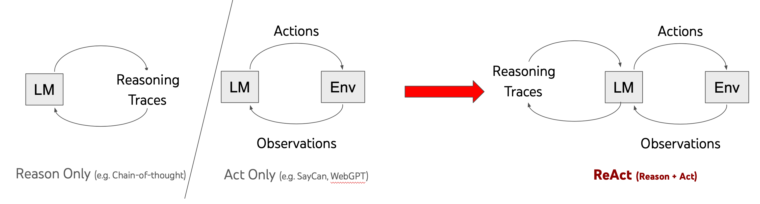
01 Agent Methods
Agent Foundations: Reasoning, Action, Observation
A model proposes decisions, tools return observations, and a runtime constrains permitted actions
Original ReAct author diagram: reason-only, act-only and combined reasoning/action
Reasoning
External actions
Constrained feedback
Form candidate plans and decision summaries
Execute tools and observe actual results
Update actions under permission, budget and stopping rules
Feedback informs decisions. Gains on question-answering or interactive tasks require scientific validation.
04
Notes:
A model proposes decisions, tools return observations, and a runtime constrains permitted actions
Reasoning：Form candidate plans and decision summaries
External actions：Execute tools and observe actual results
Constrained feedback：Update actions under permission, budget and stopping rules
Feedback informs decisions. Gains on question-answering or interactive tasks require scientific validation.
Original ReAct author diagram: reason-only, act-only and combined reasoning/action. This is a methods illustration, not a structural-biology experiment from this project. Audit actions, observations and decision summaries without requiring disclosure of private model reasoning.
Sources and supporting material:
https://arxiv.org/abs/2210.03629
https://react-lm.github.io/
http://172.16.4.5:3188/prd/
http://172.16.4.5:3188/architecture/

Slide 5
01 Agent Methods
Agent Methods Change Different System Components
Compare mechanisms and assumptions rather than treating papers as a single performance ranking
Method | Component affected | Mechanism and boundary
ReAct | Action-level feedback | Observe after acting. Incorrect observations can still mislead.
LLMCompiler | Planning and scheduling | Dependency DAG and ready calls. Parallelism obeys real constraints.
Reflexion | Memory across attempts | Reuse verbal feedback without necessarily updating weights. Verify it.
LATS | Search over trajectories | Tree search and evaluation need reliable feedback and extra budget.
DSPy | Offline program optimization | Optimize LM programs on development data. Freeze final tests.
AutoGen | Roles and communication | Coordinate models, people and tools. Consensus is not ground truth.
Combine mechanisms according to task feedback, action cost and evaluation reliability.
05
Notes:
Compare mechanisms and assumptions rather than treating papers as a single performance ranking
Method：Component affected：Mechanism and boundary
ReAct：Action-level feedback：Observe after acting. Incorrect observations can still mislead.
LLMCompiler：Planning and scheduling：Dependency DAG and ready calls. Parallelism obeys real constraints.
Reflexion：Memory across attempts：Reuse verbal feedback without necessarily updating weights. Verify it.
LATS：Search over trajectories：Tree search and evaluation need reliable feedback and extra budget.
DSPy：Offline program optimization：Optimize LM programs on development data. Freeze final tests.
AutoGen：Roles and communication：Coordinate models, people and tools. Consensus is not ground truth.
Combine mechanisms according to task feedback, action cost and evaluation reliability.
Original evaluations cover QA, code, web and interactive environments. They do not establish performance on this project’s scientific tasks. DSPy is an offline optimization method, not a mandatory online tool-loop stage. Reflexion can reuse verbal experience without updating model weights. Distinguish the AutoGen paper’s mechanism from later SDK versions.
Sources and supporting material:
https://arxiv.org/abs/2210.03629
https://arxiv.org/abs/2312.04511
https://arxiv.org/abs/2303.11366
https://arxiv.org/abs/2310.04406
https://arxiv.org/abs/2310.03714
https://arxiv.org/abs/2308.08155
http://172.16.4.5:3188/prd/
http://172.16.4.5:3188/architecture/

Slide 6
01 Architecture Choices
Workflow, Single Agent or Multiple Agents?
Fixed computation can use explicit paths. Dynamic selection and collaboration need measurable benefits
Fixed workflow
Single controller
Multiple agents
Agent
State / goal
Planner
Reviewer
Input
Tool A
Tool B
Check
Tool A
Tool B
Tools / executor
Known inputs and dependencies
Observations can change the next step
A testable division of responsibilities
Reproducible paths and low control cost. Define branches in advance.
One state and budget. Define tool semantics and stopping rules.
Explicit roles add communication, duplicate work and coordination risk.
Implementation options: LangChain / LangGraph, Google ADK and AutoGen. Evaluate state and recovery needs.
06
Notes:
Fixed computation can use explicit paths. Dynamic selection and collaboration need measurable benefits
Fixed workflow：Known inputs and dependencies：Reproducible paths and low control cost. Define branches in advance.
Single controller：Observations can change the next step：One state and budget. Define tool semantics and stopping rules.
Multiple agents：A testable division of responsibilities：Explicit roles add communication, duplicate work and coordination risk.
Implementation options: LangChain / LangGraph, Google ADK and AutoGen. Evaluate state and recovery needs.
Conceptual patterns, not a quantitative ranking. Report success, cost, latency, errors and human intervention under matched tools and budgets. Frameworks do not map one-to-one to patterns. LangChain organizes models, tools and middleware. LangGraph supports stateful workflows and agents. ADK provides agent and workflow components. Framework features do not ensure scientific correctness. Start this project with one controller and a persistent state graph; test collaboration as an additional mechanism.
Sources and supporting material:
https://docs.langchain.com/oss/python/langgraph/workflows-agents
https://arxiv.org/abs/2308.08155
https://docs.langchain.com/oss/python/langchain/overview
https://adk.dev/agents/
http://172.16.4.5:3188/prd/
http://172.16.4.5:3188/architecture/

Slide 7
01 Biological and Structural Agents
A Research-Role Map of Biological Agents
Nine examples occupy different research roles: frameworks, research systems and software entry points
I
II
III
IV
Knowledge / research
Analysis / experiment choice
Structure determination
Protein engineering
BioChatter
CellAgent
Phenix AI Agent
ProtAgents
Biomni
BioDiscoveryAgent
CryoNet.Agent
Sparks
StructAgent
Compare knowledge access, tool execution, feedback and the evidence supporting each conclusion.
07
Notes:
Nine examples occupy different research roles: frameworks, research systems and software entry points
Knowledge / research：BioChatter：Biomni
Analysis / experiment choice：CellAgent：BioDiscoveryAgent
Structure determination：Phenix AI Agent：CryoNet.Agent：StructAgent
Protein engineering：ProtAgents：Sparks
Compare knowledge access, tool execution, feedback and the evidence supporting each conclusion.
A representative, overlapping classification rather than an exhaustive map or common autonomy ranking. BioChatter is an application framework. Biomni and CellAgent are research systems. Phenix and CryoNet entries use official implementation or capability documentation, which is not comparable to a shared benchmark protocol.
https://www.nature.com/articles/s41587-024-02534-3
https://github.com/snap-stanford/Biomni
https://arxiv.org/html/2407.09811v1
https://arxiv.org/abs/2405.17631
https://www.phenix-online.org/documentation/reference/ai_agent.html
https://cryonet.ai/agent/
https://github.com/bhgtiger/StructAgent
https://pubs.rsc.org/en/content/articlehtml/2024/dd/d4dd00013g
https://arxiv.org/html/2504.19017v1

Slide 8
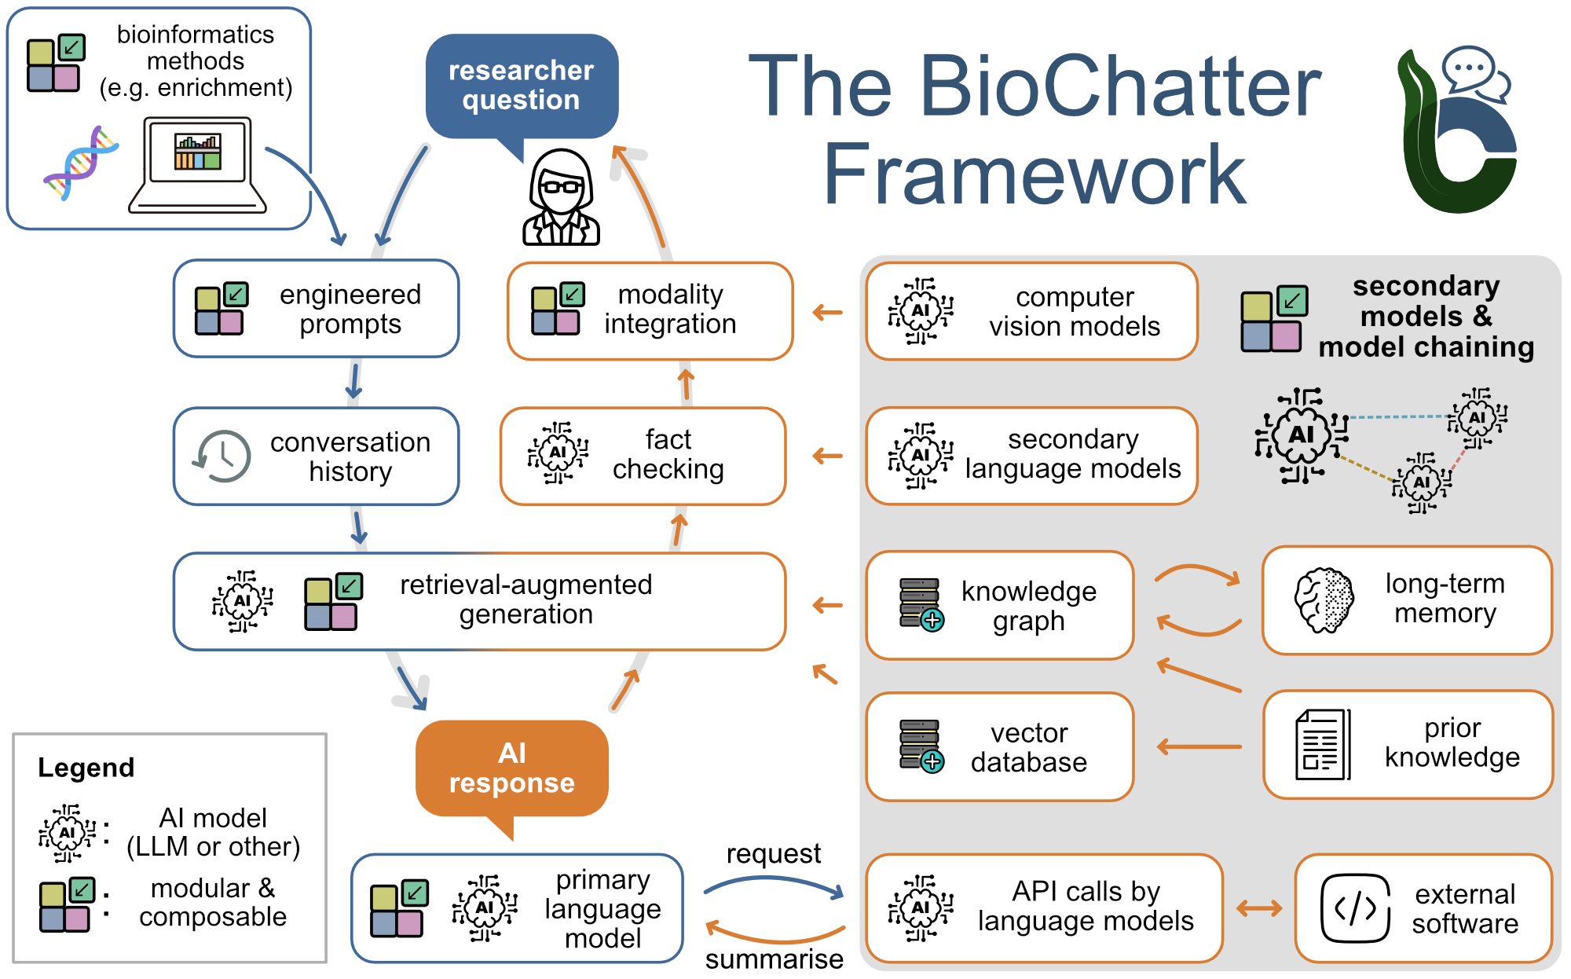
01 Biological Agents
Knowledge, Analysis and Experimental Decisions
These routes change different stages of research and use different kinds of feedback
BioChatter: integration framework
Knowledge graphs, RAG and model/API chains.
Integration needs external fact-checking.
Biomni: research environment
Retrieve tools/data, plan and execute code.
Public cases do not cover every structural task.
CellAgent: analysis workflow
Plan, execute and evaluate with tool retrieval.
Single-cell evidence depends on data and metrics.
BioDiscoveryAgent: experiment choice
Select the next round from perturbation feedback.
Data-based evaluation, not wet-lab automation.
BioChatter author-manuscript Fig. 1 (2024-02-23 snapshot)
Knowledge, execution and experiment-selection mechanisms still need domain-specific quality criteria.
08
Notes:
These routes change different stages of research and use different kinds of feedback
BioChatter: integration framework：Knowledge graphs, RAG and model/API chains.
Integration needs external fact-checking.
Biomni: research environment：Retrieve tools/data, plan and execute code.
Public cases do not cover every structural task.
CellAgent: analysis workflow：Plan, execute and evaluate with tool retrieval.
Single-cell evidence depends on data and metrics.
BioDiscoveryAgent: experiment choice：Select the next round from perturbation feedback.
Data-based evaluation, not wet-lab automation.
Knowledge, execution and experiment-selection mechanisms still need domain-specific quality criteria.
Left: BioChatter author-manuscript Fig. 1, snapshot 2024-02-23, preserving its original meaning. The other three systems do not share this diagram. CellAgent follows the 2024 preprint mechanism, without mixing later-version scores. BioDiscoveryAgent illustrates experimental selection, not an instrument-control protocol.
Sources and supporting material:
https://www.nature.com/articles/s41587-024-02534-3
https://biocypher.github.io/biochatter-paper/
https://github.com/snap-stanford/Biomni
https://arxiv.org/html/2407.09811v1
https://arxiv.org/abs/2405.17631
http://172.16.4.5:3188/prd/
http://172.16.4.5:3188/architecture/

Slide 9
01 Structural Biology Agents
Structural Agents: Software and Quality Gates
Scientific engines build, fit and refine models. Agents organize steps, constraints and review
Phenix AI Agent
CryoNet.Agent
StructAgent
Research task
Research task
Research task
Crystallography and cryo-EM
Workflows for maps, FASTA, models
cryo-EM building and revision
Control mechanism
Control mechanism
Control mechanism
LLM analysis and planning
Parameter allowlists, stage gates
Typed input catalogue
Shared session and job entry
Reasoning with local execution
Expert approval for major edits
Evidence
Evidence
Evidence
Official documentation and cases
Official catalogue and tutorials
Cases in the 2026 preprint
Boundary
Boundary
Boundary
Bounded by software and data
Final structures need expert review
An interface is not a blind test
Accept individual tools separately
Evidence supports bounded tasks
Not universal autonomous solving
Professional tools, domain rules and human checkpoints belong in the execution path.
09
Notes:
Scientific engines build, fit and refine models. Agents organize steps, constraints and review
Phenix AI Agent：Crystallography and cryo-EM：LLM analysis and planning
Parameter allowlists, stage gates：Official documentation and cases：Bounded by software and data
Final structures need expert review
CryoNet.Agent：Workflows for maps, FASTA, models：Typed input catalogue
Shared session and job entry：Official catalogue and tutorials：An interface is not a blind test
Accept individual tools separately
StructAgent：cryo-EM building and revision：Reasoning with local execution
Expert approval for major edits：Cases in the 2026 preprint：Evidence supports bounded tasks
Not universal autonomous solving
Professional tools, domain rules and human checkpoints belong in the execution path.
Phenix documents PERCEIVE, THINK, PLAN, BUILD, VALIDATE and OUTPUT; LLMs mainly participate in THINK and PLAN. CryoNet descriptions use the archived official HTML when live retrieval timed out. StructAgent here is Xiaohu Guo’s cryo-EM system, not the unrelated arXiv:2607.11388 namesake. Cases and product documentation cannot support direct success-rate comparisons.
Sources and supporting material:
https://www.phenix-online.org/documentation/reference/ai_agent.html
https://cryonet.ai/agent/
https://www.biorxiv.org/content/10.64898/2026.05.18.725842v1
https://github.com/bhgtiger/StructAgent
http://172.16.4.5:3188/prd/
http://172.16.4.5:3188/architecture/

Slide 10
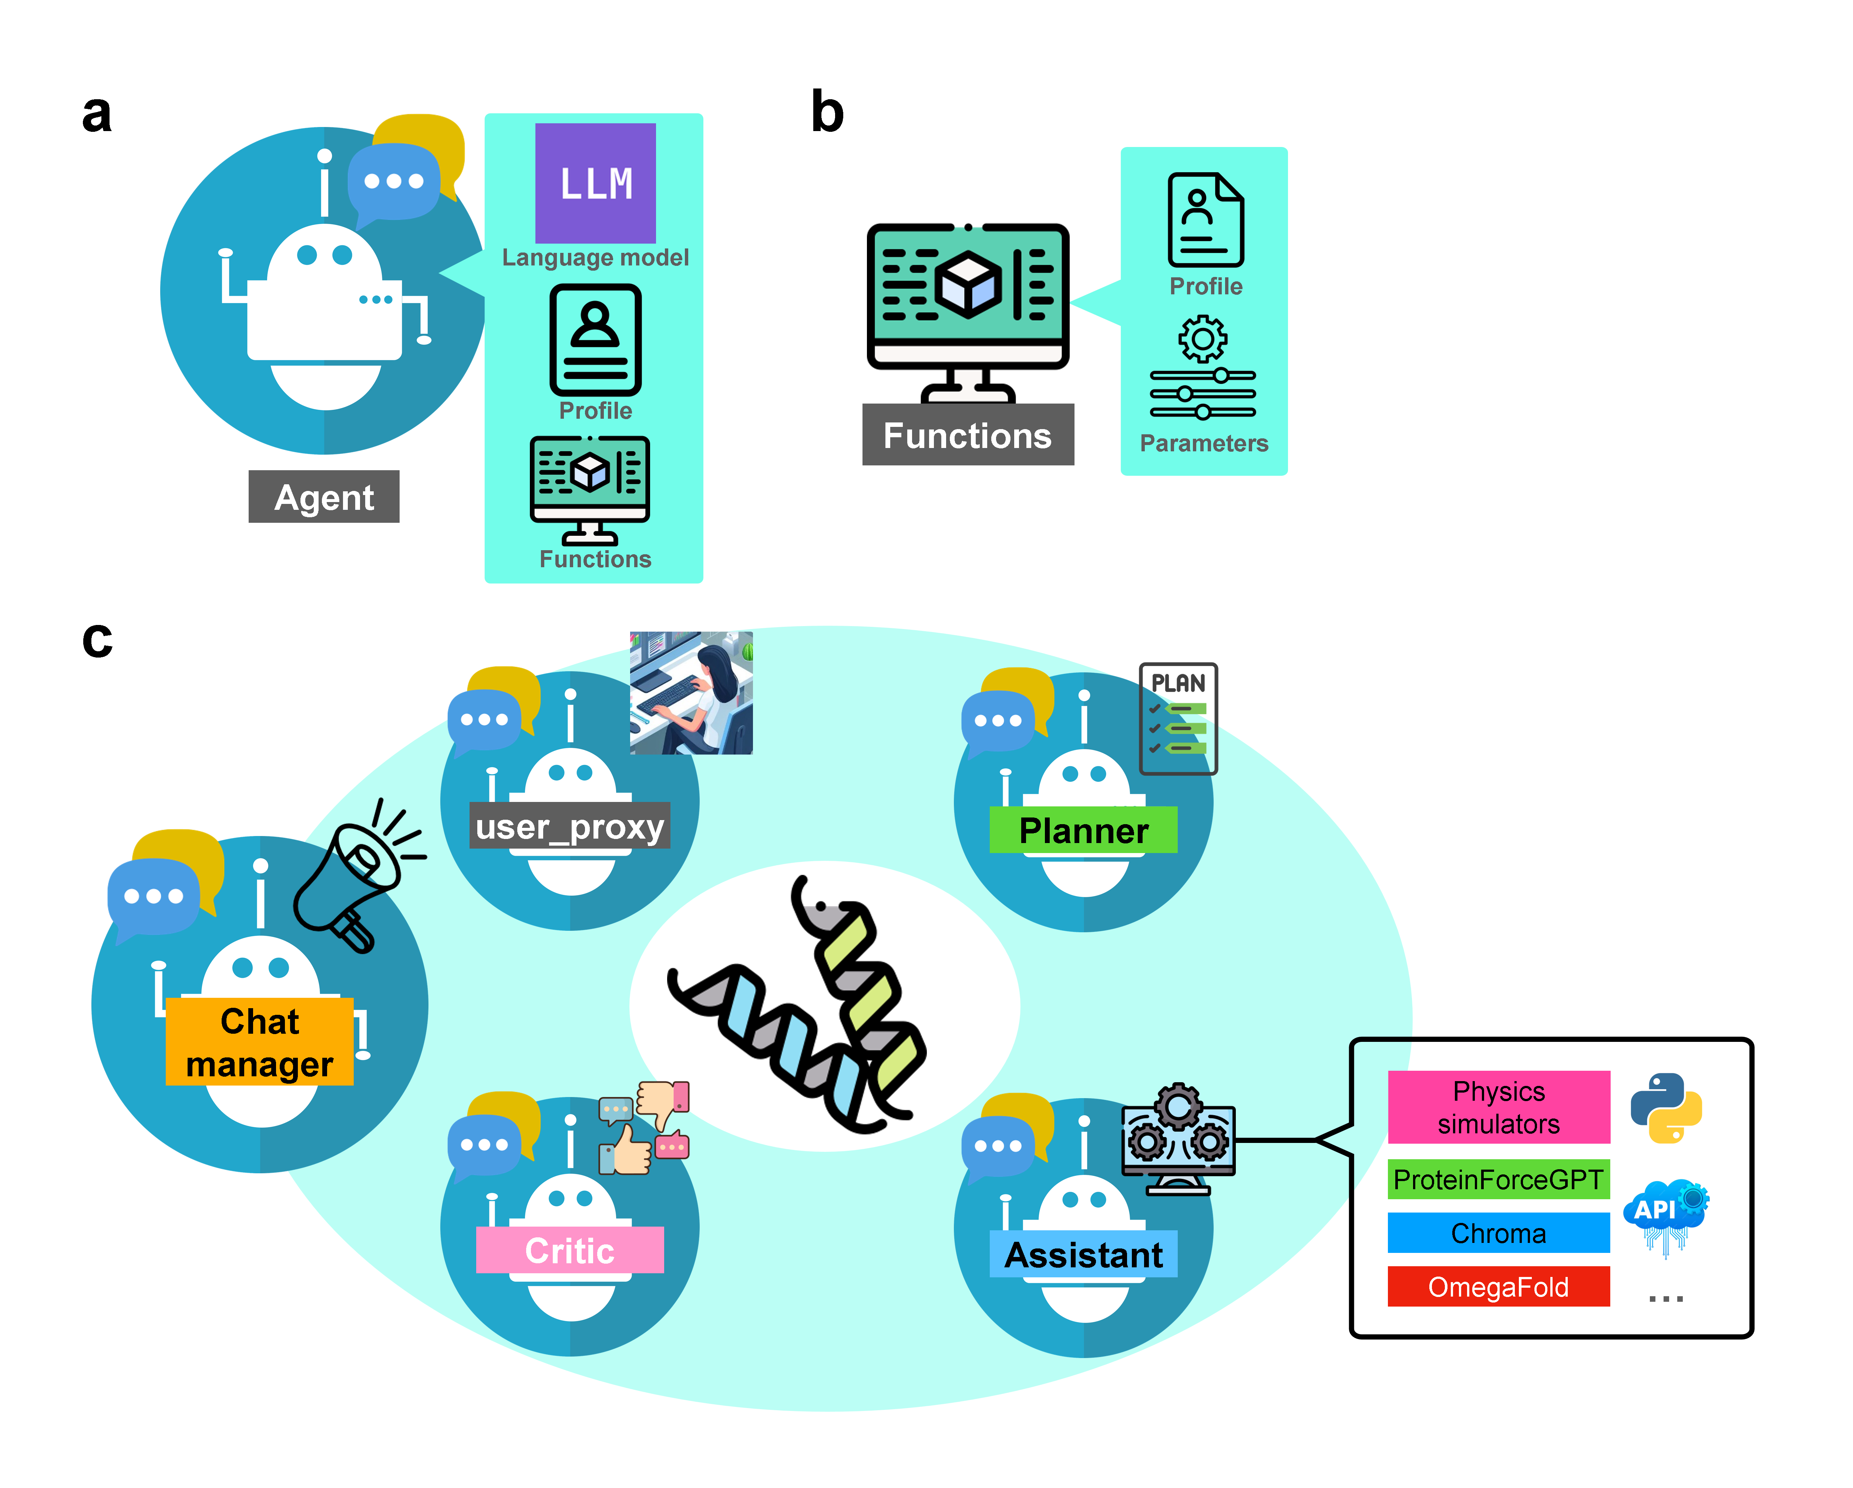
01 Protein Engineering Agents
Protein Engineering: Design and Hypothesis Tests
Generation, prediction, simulation and experimental validation support different levels of evidence
ProtAgents
Group chat coordinates planning and critique.
Tools combine generation, prediction and physics.
Computational design and physics examples.
Compare collaboration at matched budgets.
Sparks
Generator–reflection pairs organize research.
Code and analysis retain or revise hypotheses.
Computational studies of protein properties.
Limited by sampling, models and conditions.
ProtAgents Fig. 1 (arXiv 2024, original figure)
Generated scores, independent calculations and experiments provide different kinds of evidence.
10
Notes:
Generation, prediction, simulation and experimental validation support different levels of evidence
ProtAgents：Group chat coordinates planning and critique.
Tools combine generation, prediction and physics.：Computational design and physics examples.
Compare collaboration at matched budgets.
Sparks：Generator–reflection pairs organize research.
Code and analysis retain or revise hypotheses.：Computational studies of protein properties.
Limited by sampling, models and conditions.
Generated scores, independent calculations and experiments provide different kinds of evidence.
Left: original ProtAgents Fig. 1, preserving its meaning, not our architecture. ProtAgents demonstrates computational studies rather than a universal scientific benchmark. Sparks combines generation, prediction, secondary-structure/property models and MD. Surrogate scores or simulations do not establish experimental confirmation. External validation remains necessary.
Sources and supporting material:
https://pubs.rsc.org/en/content/articlehtml/2024/dd/d4dd00013g
https://arxiv.org/html/2402.04268v1
https://github.com/lamm-mit/ProtAgents
https://arxiv.org/html/2504.19017v1
https://github.com/lamm-mit/Sparks/
http://172.16.4.5:3188/prd/
http://172.16.4.5:3188/architecture/

Slide 11
01 Research Gaps
From Existing Systems to Our Research Questions
Existing work closes several research loops. Reliability across broader task combinations still needs testing
01
Scientific object semantics
02
Planning and execution
Keep chains, residues, coordinates, units, composition and sampling conditions consistent across tools.
Control branching and recovery when inputs are incomplete, tools fail, candidates fail or long jobs stop.
03
Artifacts and claims
04
Evidence of generality
Check files, execution and scientific conclusions separately, with traceable supporting evidence.
Test across objects, tasks and tool combinations using matched budgets, external scoring and injected faults.
These are empirical research questions. Untested differences between systems are not research findings.
11
Notes:
Existing work closes several research loops. Reliability across broader task combinations still needs testing
Scientific object semantics：Keep chains, residues, coordinates, units, composition and sampling conditions consistent across tools.
Planning and execution：Control branching and recovery when inputs are incomplete, tools fail, candidates fail or long jobs stop.
Artifacts and claims：Check files, execution and scientific conclusions separately, with traceable supporting evidence.
Evidence of generality：Test across objects, tasks and tool combinations using matched budgets, external scoring and injected faults.
These are empirical research questions. Untested differences between systems are not research findings.
Public methods and proposed project design. Capability availability requires implementation and reference-task acceptance. No unperformed performance results are reported.
Sources and supporting material:
http://172.16.4.5:3188/prd/
http://172.16.4.5:3188/architecture/

Slide 12
01 Research Hypotheses
Positioning and Testable Hypotheses
Study an extensible structural-biology agent for task organization and reliable scientific execution
H1 Task representation
Make objects, goals, conditions and acceptance rules explicit
Test reductions in identity errors and cross-tool inconsistency
H2 Constrained execution
Combine tool semantics, persistent state and bounded replanning
Test completion and recovery cost on new task combinations
H3 Evidence-based delivery
Use independent validation and bind report claims to artifacts
Test reductions in invalid artifacts and unsupported conclusions
Broad capability is the goal. Establish actual availability with adapters and reference tests.
12
Notes:
Study an extensible structural-biology agent for task organization and reliable scientific execution
H1 Task representation：Make objects, goals, conditions and acceptance rules explicit：Test reductions in identity errors and cross-tool inconsistency
H2 Constrained execution：Combine tool semantics, persistent state and bounded replanning：Test completion and recovery cost on new task combinations
H3 Evidence-based delivery：Use independent validation and bind report claims to artifacts：Test reductions in invalid artifacts and unsupported conclusions
Broad capability is the goal. Establish actual availability with adapters and reference tests.
These hypotheses and benefits remain to be tested. Start with one controller, extensible tools and validation rules. More agents, a model upgrade or a larger compute budget do not automatically establish improved scientific validity.
Sources and supporting material:
http://172.16.4.5:3188/prd/
http://172.16.4.5:3188/architecture/

Slide 13
02 Task Space
Capability Map I: Data, Building and Experiments
Organize tasks by modality across proteins, nucleic acids, ligands, glycans and complexes
Task family | Representative inputs and analyses | Outputs and validation focus
Data and knowledge | Sequences, structures, maps, literature, metadata | Normalized identity, provenance, missingness, consistency
Sequence / structure search | Search sequences, structures or local density; expand hits | Candidates, coverage, identity, out-of-library abstention
Prediction and building | Monomer/complex prediction, homology, completion | Models, composition, confidence, applicability
cryo-EM / ET | Inspect, segment, localize, build and refine maps | Coordinate transforms, local quality, map–model support
Crystallography | Diffraction, reflections, replacement, rebuilding, refinement | Data quality, geometry and cross-validation
NMR / integrative modeling | NMR, SAXS, XL-MS and multimodal restraints | Restraint satisfaction, ensembles and uncertainty
These are target task families. Executable scope depends on tool integration, inputs and reference tests.
13
Notes:
Organize tasks by modality across proteins, nucleic acids, ligands, glycans and complexes
Task family：Representative inputs and analyses：Outputs and validation focus
Data and knowledge：Sequences, structures, maps, literature, metadata：Normalized identity, provenance, missingness, consistency
Sequence / structure search：Search sequences, structures or local density; expand hits：Candidates, coverage, identity, out-of-library abstention
Prediction and building：Monomer/complex prediction, homology, completion：Models, composition, confidence, applicability
cryo-EM / ET：Inspect, segment, localize, build and refine maps：Coordinate transforms, local quality, map–model support
Crystallography：Diffraction, reflections, replacement, rebuilding, refinement：Data quality, geometry and cross-validation
NMR / integrative modeling：NMR, SAXS, XL-MS and multimodal restraints：Restraint satisfaction, ensembles and uncertainty
These are target task families. Executable scope depends on tool integration, inputs and reference tests.
Public methods and proposed project design. Capability availability requires implementation and reference-task acceptance. No unperformed performance results are reported.
Sources and supporting material:
http://172.16.4.5:3188/prd/
http://172.16.4.5:3188/architecture/

Slide 14
02 Task Space
Capability Map II: Analysis, Simulation and Design
Analysis modules can run independently or form new research workflows through the agent
Task family | Representative analyses | Outputs and validation focus
Quality and conformation | Validation, correspondence, superposition, motion, ensembles | Quality tables, mappings, transforms, comparison definitions
Surfaces and interactions | Interfaces, contacts, channels, ligands, nucleic acids, membranes | Units and limits of geometry, energies and scores
Docking and assembly | Protein/ligand docking, subunit placement, symmetry, clashes | Candidate poses, sampling and independent rescoring
Dynamics and thermodynamics | Trajectory processing, clustering, free energies, transitions | Sampling, convergence, errors and physical conditions
Mutation, design, screening | Stability/binding changes, sequence and structure design | Candidates, controls, failure risks and experimental tests
Multiscale interpretation | Coarse graining, networks, allostery, multimodal visualization | Model assumptions, evidence and scope of mechanisms
A capability adds a task contract, scientific tool, validator and reference tests.
14
Notes:
Analysis modules can run independently or form new research workflows through the agent
Task family：Representative analyses：Outputs and validation focus
Quality and conformation：Validation, correspondence, superposition, motion, ensembles：Quality tables, mappings, transforms, comparison definitions
Surfaces and interactions：Interfaces, contacts, channels, ligands, nucleic acids, membranes：Units and limits of geometry, energies and scores
Docking and assembly：Protein/ligand docking, subunit placement, symmetry, clashes：Candidate poses, sampling and independent rescoring
Dynamics and thermodynamics：Trajectory processing, clustering, free energies, transitions：Sampling, convergence, errors and physical conditions
Mutation, design, screening：Stability/binding changes, sequence and structure design：Candidates, controls, failure risks and experimental tests
Multiscale interpretation：Coarse graining, networks, allostery, multimodal visualization：Model assumptions, evidence and scope of mechanisms
A capability adds a task contract, scientific tool, validator and reference tests.
Public methods and proposed project design. Capability availability requires implementation and reference-task acceptance. No unperformed performance results are reported.
Sources and supporting material:
http://172.16.4.5:3188/prd/
http://172.16.4.5:3188/architecture/

Slide 15
02 Core Architecture
Structural Biology Agent: Core Architecture
Separate model cognition, deterministic control, scientific execution and evidence management
Control / action
Assets / state
Observation / validation feedback
Research interaction
Agent Core: cognition and control
Controlled computation
Research question
Goals / constraints
Task specification
Objects / acceptance
Capability retrieval
Meaning / scope
Action gateway
Rights / parameters
Objects / assets
Sequence / model / map
LLM planner
Plan / revise / act
Context builder
Spec / observations
Job execution
CPU / GPU / HPC
Report and review
Results / methods / limits
Plan compiler
Types / dependencies
Runtime controller
Budget / retry / state
Scientific tools
Search / build / analyze
Tool registry
schema / version
State / evidence
Tasks / artifacts / refs
Independent validation
Identity / quality / claims
Models propose plans and explanations. Runtimes enforce permissions. Validators inspect actual artifacts.
15
Notes:
Separate model cognition, deterministic control, scientific execution and evidence management
Cognition and planning：Task specifications, capability/knowledge retrieval, context assembly, LLM planning and revision
Deterministic control：Plan compilation, type checks, state machine, budgets and recovery
Controlled computation：Permission gateway, job scheduling, scientific tools and real artifacts
Evidence and validation：Tool contracts, state/artifact references, independent quality checks and report support
Scientific delivery：Validated results, methods, limitations and human review
Models propose plans and explanations. Runtimes enforce permissions. Validators inspect actual artifacts.
Proposed system architecture, not a linear workflow. Research tasks and data enter through specification. A context builder combines retrieved capabilities and recorded observations for the planner. Actions pass deterministic plan checks, a permission gateway and job management. Independent validation writes structured observations into evidence/state for later decisions. Tool documentation, checkpoints and immutable artifacts remain logically separate. The legend distinguishes control, assets/state and feedback.
Sources and supporting material:
https://docs.langchain.com/oss/python/langgraph/overview
https://www.phenix-online.org/documentation/reference/ai_agent.html
http://172.16.4.5:3188/prd/
http://172.16.4.5:3188/architecture/

Slide 16
02 Agent Control
The Agent Loop: State, Actions and Validation
Explicit state supports action selection, controlled execution and the next state update
Context cₜ
Specs, observations, asset refs
Allowed tools and budget
Policy πθ
Choose a structured action
or revise a local plan
Action checks
Types, rights, preconditions
Budget and stopping rules
Wait / reject / stop
Rejected
Accepted
State sₜ₊₁
Plan nodes and artifacts
Checkpoints and actual usage
Observation oₜ₊₁
Results and errors
Independent validation summary
Execution
Sync tools / async jobs
Attempts and artifacts
Model: action selection, candidate ranking and bounded revision
External controls: permissions, budget and scientific criteria
Persist actions, observations and decision summaries. Internal reasoning is not computational evidence.
16
Notes:
Explicit state supports action selection, controlled execution and the next state update
Context cₜ：Specs, observations, asset refs
Allowed tools and budget
Policy πθ：Choose a structured action
or revise a local plan
Action checks：Types, rights, preconditions
Budget and stopping rules
Execution：Sync tools / async jobs
Attempts and artifacts
Observation oₜ₊₁：Results and errors
Independent validation summary
State sₜ₊₁：Plan nodes and artifacts
Checkpoints and actual usage
Persist actions, observations and decision summaries. Internal reasoning is not computational evidence.
A plan is a candidate execution scheme, not a scientific fact. The policy may revise a local plan using observations. Changed scientific intent requires a new specification version. Runtime and scientific checks are external constraints: a model cannot turn failure into success through explanation. Stop on exhausted budgets or unrecoverable failures.
Sources and supporting material:
http://172.16.4.5:3188/prd/
http://172.16.4.5:3188/architecture/

Slide 17
03 Specifications
Task Specifications Make Intent Computable
Example request: compare two complex interfaces and identify which contacts change
Natural-language request
“Compare the interfaces of two complexes”
Scientific objects
Two models, target chain pairs, residue correspondence, ligand and atom selection
Question definition
Compare contact counts, contact composition, geometry or energy changes?
Calculation rules
Alignment strategy, distance threshold, units, missing residues and alternate conformers
Acceptance and delivery
Auditable mappings and contact tables; change lists, views and limitations
Clarify missing conditions. Version specification changes instead of silently changing the question.
17
Notes:
Example request: compare two complex interfaces and identify which contacts change
Scientific objects：Two models, target chain pairs, residue correspondence, ligand and atom selection
Question definition：Compare contact counts, contact composition, geometry or energy changes?
Calculation rules：Alignment strategy, distance threshold, units, missing residues and alternate conformers
Acceptance and delivery：Auditable mappings and contact tables; change lists, views and limitations
Clarify missing conditions. Version specification changes instead of silently changing the question.
This illustrates task understanding and specification, not JSON that an existing endpoint necessarily accepts. Other tasks need modality-specific fields: map voxel/origin/axis, trajectory topology/periodicity/time units, or reflection data with working and validation sets.
Sources and supporting material:
http://172.16.4.5:3188/prd/
http://172.16.4.5:3188/architecture/

Slide 18
03 Planning
Planning Combines Retrieval and Dependencies
Retrieve applicable capabilities, then compose steps with compatible input and output conditions
Branch A: geometry
Regional geometry table
Inspect objects / normalize inputs
Validate / deliver
Artifact references
Branch B: contacts
Contact-change table
Illustration: independent branches can run after shared preprocessing
Retrieval and static checks constrain inputs, types, resources and mandatory validation
Treat plans as hypotheses for execution. Run tool actions only after the relevant checks.
18
Notes:
Retrieve applicable capabilities, then compose steps with compatible input and output conditions
Capability retrieval：Filter tools by semantics, input types, preconditions, versions and resources
Plan compilation：Build a dependency DAG and identify the artifact passed on every edge
Static checks：Check available inputs, type compatibility, resources and required validation
Bounded revision：Use observations to adjust candidates or local steps within revision and total-cost limits
Treat plans as hypotheses for execution. Run tool actions only after the relevant checks.
Public methods and proposed project design. Capability availability requires implementation and reference-task acceptance. No unperformed performance results are reported.
Sources and supporting material:
https://arxiv.org/abs/2312.04511
https://docs.langchain.com/oss/python/langgraph/overview
http://172.16.4.5:3188/prd/
http://172.16.4.5:3188/architecture/

Slide 19
03 Tool Integration
The Registry Makes Scientific Tools Discoverable
A tool contract describes semantics, execution conditions and verifiable artifacts
Field | Required information from the tool adapter
Task semantics | Supported questions, unsupported claims, valid data and method assumptions
Inputs and outputs | Structured schemas, asset refs, coordinates/units, types and postconditions
Environment and resources | Container, software/weights/database versions, CPU/GPU, licenses, services
Failures and recovery | Error classes, timeouts, idempotency keys, checkpoints and retry conditions
Validation and status | Companion validator; registration, environment health and reference-test status
Admit a tool to planning only after its adapter and reference tests pass.
19
Notes:
A tool contract describes semantics, execution conditions and verifiable artifacts
Field：Required information from the tool adapter
Task semantics：Supported questions, unsupported claims, valid data and method assumptions
Inputs and outputs：Structured schemas, asset refs, coordinates/units, types and postconditions
Environment and resources：Container, software/weights/database versions, CPU/GPU, licenses, services
Failures and recovery：Error classes, timeouts, idempotency keys, checkpoints and retry conditions
Validation and status：Companion validator; registration, environment health and reference-test status
Admit a tool to planning only after its adapter and reference tests pass.
Public methods and proposed project design. Capability availability requires implementation and reference-task acceptance. No unperformed performance results are reported.
Sources and supporting material:
http://172.16.4.5:3188/prd/
http://172.16.4.5:3188/architecture/

Slide 20
03 State and Recovery
State Controls the Next Action
The model reads recorded facts. An external state machine enforces actions and stopping rules
Needs clarification
Goal or object unclear
Plan ready
Frozen spec, valid plan
Running
Tools, observations, usage
Validating
Artifact and scientific checks
Terminal
Completed / failed / cancelled
Recoverable failure: bounded retry after validation
Missing specification: request clarification
Recoverable failures permit bounded revision. Store scientific quality separately from job status.
20
Notes:
The model reads recorded facts. An external state machine enforces actions and stopping rules
Needs clarification：Goal or object unclear
Plan ready：Frozen spec, valid plan
Running：Tools, observations, usage
Validating：Artifact and scientific checks
Terminal：Completed / failed / cancelled
Recoverable failures permit bounded revision. Store scientific quality separately from job status.
Record action requests, observations and decision summaries. State handles waiting, recovery and termination. Language cannot override failed validation. Account for all attempts when enforcing budgets.
Sources and supporting material:
http://172.16.4.5:3188/prd/
http://172.16.4.5:3188/architecture/

Slide 21
03 Execution
Long Jobs Are Independent of Model Sessions
Use one job interface for small synchronous tools, asynchronous CPU/GPU work and remote computation
Admission checks
Scheduling
Async observation
Result registration
Bind frozen specifications, parameters, permissions and resource budgets
Run small tools directly
Queue long tasks
Allocate workers
job_id, heartbeat, progress, logs, actual usage and cancellation
Input/output hashes, tool versions, attempts and a complete artifact manifest
Shared job protocol: job_id, state, artifact references and actual usage
Resume from persistent state after network loss. Idempotent submission prevents duplicate expensive jobs.
21
Notes:
Use one job interface for small synchronous tools, asynchronous CPU/GPU work and remote computation
Admission checks：Bind frozen specifications, parameters, permissions and resource budgets
Scheduling：Run small tools directly
Queue long tasks
Allocate workers
Async observation：job_id, heartbeat, progress, logs, actual usage and cancellation
Result registration：Input/output hashes, tool versions, attempts and a complete artifact manifest
Resume from persistent state after network loss. Idempotent submission prevents duplicate expensive jobs.
Public methods and proposed project design. Capability availability requires implementation and reference-task acceptance. No unperformed performance results are reported.
Sources and supporting material:
http://172.16.4.5:3188/prd/
http://172.16.4.5:3188/architecture/

Slide 22
03 Context and Memory
Context, State, Knowledge and Artifacts
Give the model sufficient decision context while keeping scientific data in controlled storage
01
Context
02
Runtime state
Current goal, observation summaries, candidate actions and asset IDs
Spec versions, plan nodes, past attempts, budgets and questions awaiting confirmation
03
Retrieved knowledge
04
Artifacts and evidence
Tool documentation, methods, validated workflows and applicability conditions
Raw files, models/maps/trajectories, logs, metrics and transform chains
Memory provides reusable experience. Current artifacts provide evidence. Check versions and applicability.
22
Notes:
Give the model sufficient decision context while keeping scientific data in controlled storage
Context：Current goal, observation summaries, candidate actions and asset IDs
Runtime state：Spec versions, plan nodes, past attempts, budgets and questions awaiting confirmation
Retrieved knowledge：Tool documentation, methods, validated workflows and applicability conditions
Artifacts and evidence：Raw files, models/maps/trajectories, logs, metrics and transform chains
Memory provides reusable experience. Current artifacts provide evidence. Check versions and applicability.
Public methods and proposed project design. Capability availability requires implementation and reference-task acceptance. No unperformed performance results are reported.
Sources and supporting material:
http://172.16.4.5:3188/prd/
http://172.16.4.5:3188/architecture/

Slide 23
03 Validation
Validation Separates Execution from Science
One agent framework uses different scientific validators according to the task specification
Integrity
Scientific quality
Claim support
Delivery decision
Files, schema, provenance
Objects, parameters, run records
Structures: mapping, geometry
Maps: coordinates, density support
Trajectories: sampling, convergence
Claims cite real artifacts
Verify numbers and objects
Accept / reject / insufficient
Keep unresolved limits
Load policies by task: structures / maps / diffraction / trajectories / design
Exit code 0 usually means software-defined success. Scientific results still require independent validation.
23
Notes:
One agent framework uses different scientific validators according to the task specification
Integrity checks：Files, schema, provenance
Objects, parameters, run records
Domain checks：Structures: mapping, geometry
Maps: coordinates, density support
Trajectories: sampling, convergence
Claim checks：Claims cite real artifacts
Verify numbers and objects
Delivery decision：Accept / reject / insufficient
Keep unresolved limits
Exit code 0 usually means software-defined success. Scientific results still require independent validation.
Public methods and proposed project design. Capability availability requires implementation and reference-task acceptance. No unperformed performance results are reported.
Sources and supporting material:
https://www.ebi.ac.uk/emdb/va/help/
https://www.rcsb.org/docs/general-help/assessing-the-quality-of-3d-structures
http://172.16.4.5:3188/prd/
http://172.16.4.5:3188/architecture/

Slide 24
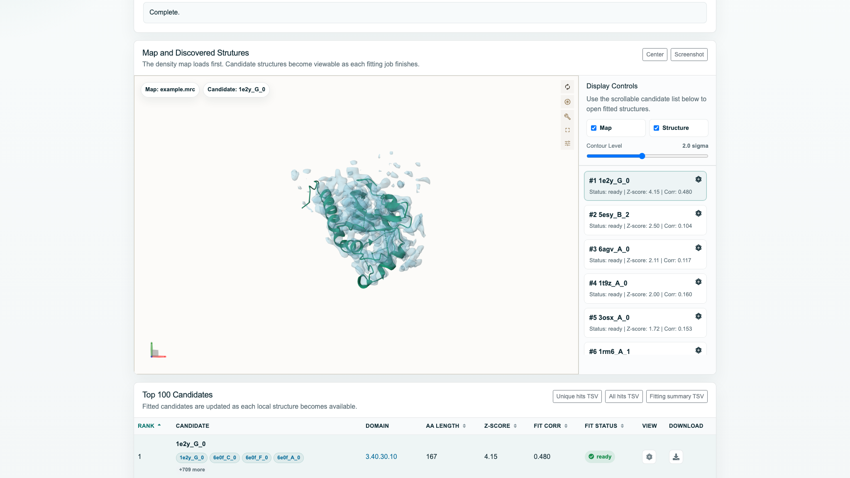
03 Scientific Example
Example I: Unknown Density to Candidate Models
With only a density region, the system selects branches according to available inputs
Task specification
Confirm map region, coordinates, candidate scope and required evidence
Planning
Search map-first, or build a backbone before structural retrieval
Execution and validation
Check fit, density and geometry.
Flag insufficient evidence.
Scientific delivery
Rank candidates with evidence.
Link views and follow-up tasks.
Official CryoNet.Discovery example, not a project result
Reuse the architecture with replaceable tools. A top retrieval score alone cannot establish protein identity.
24
Notes:
With only a density region, the system selects branches according to available inputs
Task specification：Confirm map region, coordinates, candidate scope and required evidence
Planning：Search map-first, or build a backbone before structural retrieval
Execution and validation：Check fit, density and geometry.
Flag insufficient evidence.
Scientific delivery：Rank candidates with evidence.
Link views and follow-up tasks.
Reuse the architecture with replaceable tools. A top retrieval score alone cannot establish protein identity.
Illustrative proposed workflow. The figure is an official CryoNet.Discovery example, not a run of this project’s agent. Figure: https://cryonet.ai/static/img/cd_imgs/11_display_map_and_structure.png
Sources and supporting material:
https://cryonet.ai/agent/
https://github.com/3dem/model-angelo
https://github.com/steineggerlab/foldseek
http://172.16.4.5:3188/prd/
http://172.16.4.5:3188/architecture/

Slide 25
03 Scientific Example
Example II: Motion and Interfaces in Trajectories
Question: how do domain motion and interfacial contacts change together during this simulation?
Domain motion
Topology / trajectory
Shared indices
Joint validation
Errors / convergence
Contacts and states
Inputs: topology, units, periodic boundaries, regions and sampling windows
Outputs: time series, conformations, change lists and statistical limitations
Trajectory adapters and validators reuse the control design. Correlated changes do not establish causality.
25
Notes:
Question: how do domain motion and interfacial contacts change together during this simulation?
Task specification：Topology/trajectory, time units, periodic boundaries, chains/regions and analysis definitions
Planning：Unwrap and align; run geometry, contacts and clustering as dependencies permit
Execution and validation：Check atom mappings, sampling windows, correlation, convergence and uncertainty
Scientific delivery：Time series, representative conformations, statistics and limits of physical interpretation
Trajectory adapters and validators reuse the control design. Correlated changes do not establish causality.
Proposed scenario, not a completed MD analysis. Parallel branches must share preprocessing versions and time indices. Mark limited evidence when sampling is inadequate; trajectory frames are not independent samples.
Sources and supporting material:
http://172.16.4.5:3188/prd/
http://172.16.4.5:3188/architecture/

Slide 26
03 Deployment
Deployment: Services, Workers and Evidence
Separate cognition, job execution and scientific data, coordinating them through persistent state
Interaction and services
Workbench
Inputs / reports
Task / asset API
Auth / specs / versions
Agent service
State / model / context
Job service / queue
Lease / cancel / dedup
Compute
CPU Worker
Checks / search / geometry
GPU Worker
Predict / build / analyze
HPC / Remote
Batch / remote computation
Validation
Quality / evidence
Evidence
Task / state database
Versions / permissions
Object storage
Models / maps / trajectories
Registry and knowledge
Contracts / docs / validation
Telemetry
Usage / audit
Fix module contracts and pass real reference tasks before enabling dynamic model-driven composition.
26
Notes:
Separate cognition, job execution and scientific data, coordinating them through persistent state
Interaction and API：Web workbench and task/asset models, e.g. FastAPI/Pydantic
Agent service：A state graph such as LangGraph, model adapters and retrieval
Job service：Queue, leases, idempotency, cancellation and events
Compute and evidence：CPU/GPU/HPC workers, object storage, metadata and independent validation
Fix module contracts and pass real reference tasks before enabling dynamic model-driven composition.
Recommended design. Web/API and agent services do not directly execute arbitrary scientific commands. The job service invokes isolated workers. A relational database stores tasks, state, versions and permissions. Object storage holds models, maps, trajectories and logs. Registries and validators are versioned separately. The first release need not implement every GPU/HPC backend.
Sources and supporting material:
https://docs.langchain.com/oss/python/langgraph/overview
https://docs.langchain.com/oss/python/langgraph/persistence
http://172.16.4.5:3188/prd/
http://172.16.4.5:3188/architecture/

Slide 27
04 Evaluation
Experiments Measure the Agent’s Contribution
Hold tools and data capabilities fixed while comparing decision and control mechanisms
B0 Fixed workflow
Execute a preset plan
as a stable task baseline
B1 Basic agent
Same model, tools, budget
Choose steps dynamically
B2 Contracts + validation
Add task constraints,
quality gates and bounded revision
One frozen external scorer: success / scientific errors / abstention / cost / time
Paired task comparisons, with matched tools and resource capabilities
Report task success, scientific errors, abstention quality, total cost and elapsed time without assumed gains.
27
Notes:
Hold tools and data capabilities fixed while comparing decision and control mechanisms
B0 Fixed workflow：Execute a preset plan
as a stable task baseline
B1 Basic agent：Same model, tools, budget
Choose steps dynamically
B2 Contracts + validation：Add task constraints,
quality gates and bounded revision
External scoring：Use one frozen scorer
and retain all tasks in denominators
Report task success, scientific errors, abstention quality, total cost and elapsed time without assumed gains.
Public methods and proposed project design. Capability availability requires implementation and reference-task acceptance. No unperformed performance results are reported.
Sources and supporting material:
http://172.16.4.5:3188/prd/
http://172.16.4.5:3188/architecture/

Slide 28
04 Evaluation and Optimization
Optimization Starts with Failure Attribution
Held-out combinations and mechanism ablations test generalization as well as cost
01
Data and generalization
02
Mechanism ablations
Hold out families, objects or task combinations. Freeze databases and preprocessing; track contamination.
Remove task contracts, runtime validation feedback and recovery policies separately.
03
Fault injection
04
Failure attribution
Missing fields, wrong mappings, incomplete artifacts, timeouts, unavailable tools and malicious content.
Separate intent, planning, tool, data, validation and explanation errors. Regress after changes.
Use tasks or families as statistical units, with paired comparisons and intervals. Attempts are not independent.
28
Notes:
Held-out combinations and mechanism ablations test generalization as well as cost
Data and generalization：Hold out families, objects or task combinations. Freeze databases and preprocessing; track contamination.
Mechanism ablations：Remove task contracts, runtime validation feedback and recovery policies separately.
Fault injection：Missing fields, wrong mappings, incomplete artifacts, timeouts, unavailable tools and malicious content.
Failure attribution：Separate intent, planning, tool, data, validation and explanation errors. Regress after changes.
Use tasks or families as statistical units, with paired comparisons and intervals. Attempts are not independent.
Public methods and proposed project design. Capability availability requires implementation and reference-task acceptance. No unperformed performance results are reported.
Sources and supporting material:
http://172.16.4.5:3188/prd/
http://172.16.4.5:3188/architecture/

Slide 29
04 Safety and Operations
Safety Controls Are Part of Execution
A model must respect the tool gateway, data policies and resource boundaries
01
Execution controls
02
Data and inputs
Tool allowlists, parameter/path checks, isolation, quotas and idempotent submission
Project isolation, private-structure egress policies, restricted import of untrusted PKL/directories
03
Human checkpoints
04
Operational safeguards
Bind expensive computation, sensitive egress and scientific-spec changes to concrete approvals
Tracing, alerts, recovery, backups, rollback and reproducibility bundles
Release gates combine safety tests with scientific regression tests, enforced outside the model.
29
Notes:
A model must respect the tool gateway, data policies and resource boundaries
Execution controls：Tool allowlists, parameter/path checks, isolation, quotas and idempotent submission
Data and inputs：Project isolation, private-structure egress policies, restricted import of untrusted PKL/directories
Human checkpoints：Bind expensive computation, sensitive egress and scientific-spec changes to concrete approvals
Operational safeguards：Tracing, alerts, recovery, backups, rollback and reproducibility bundles
Release gates combine safety tests with scientific regression tests, enforced outside the model.
Public methods and proposed project design. Capability availability requires implementation and reference-task acceptance. No unperformed performance results are reported.
Sources and supporting material:
http://172.16.4.5:3188/prd/
http://172.16.4.5:3188/architecture/

Slide 30
04 Delivery
Development Roadmap and Delivery Gates
Progress by verifiable system capabilities while expanding scientific task coverage
Stage | Core deliverables | Gate to the next stage
1 Contracts and baselines | Task families, asset model, tool/validator schemas, reference tasks | Defined inputs/outputs and an independent scorer
2 Real execution | Fixed workflows, adapters, persistent jobs and artifacts | Reproducible, cancellable, diagnosable runs
3 Agent control loop | Model planning, observations, bounded revision, evidence delivery | Budget-matched controls, ablations and fault tests
4 Expansion and service | More tasks, GPU/HPC adapters and operational support | Reference-task and operational acceptance per capability
One agent architecture, an expanding scientific tool ecosystem, and independently auditable delivery.
30
Notes:
Progress by verifiable system capabilities while expanding scientific task coverage
Stage：Core deliverables：Gate to the next stage
1 Contracts and baselines：Task families, asset model, tool/validator schemas, reference tasks：Defined inputs/outputs and an independent scorer
2 Real execution：Fixed workflows, adapters, persistent jobs and artifacts：Reproducible, cancellable, diagnosable runs
3 Agent control loop：Model planning, observations, bounded revision, evidence delivery：Budget-matched controls, ablations and fault tests
4 Expansion and service：More tasks, GPU/HPC adapters and operational support：Reference-task and operational acceptance per capability
One agent architecture, an expanding scientific tool ecosystem, and independently auditable delivery.
Implementation roadmap for the 30-slide proposal. Existing PRD 0.2 remains the defined development baseline. Extend contracts and adapters for new scientific tasks rather than creating a parallel baseline. This update delivers research/design material, not a newly deployed agent service.
Sources and supporting material:
http://172.16.4.5:3188/prd/
http://172.16.4.5:3188/architecture/

