Slide 1

Final Project
Platform of Walmart
Sanchuan Hu, Yijing Mao
Qiaoqi Sun, Xiang Wang
Yilin Wei, Jialu Yan
Dec. 3rd, 2014
Notes:
Track 连 delivery
删掉brand表

Slide 2

Why Walmart?
Large retail corporation
Typical online store
Large number of users
Complete functional website

Slide 3
Why These Functions Important?
Register
Track order
Change address
Search
Find my local store
Trends
Select one category from one department
Multiple filters
Store availability
Price: low to high
Customer information
Customer service
Easier to shopping online
Product information
Notes:
These ten functions we care about relate to user experience and how Walmart directly connect to user.
Register, track order and change address relate to customer information. These are basic functions Walmart want to keep users in the long term.
Search and find my local store mainly provide customer service, these are the functions how user use the website.
Trends, select one category form one department help user shop online much easier.
Store availability and price relate to product information. These are basic functions for users to know product status.

Slide 4
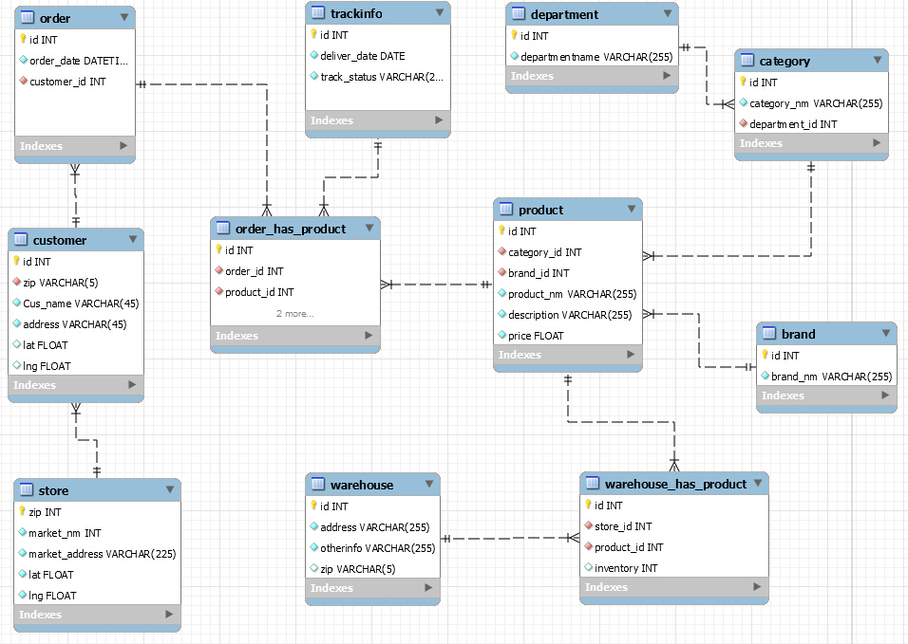
ER Model

Slide 5
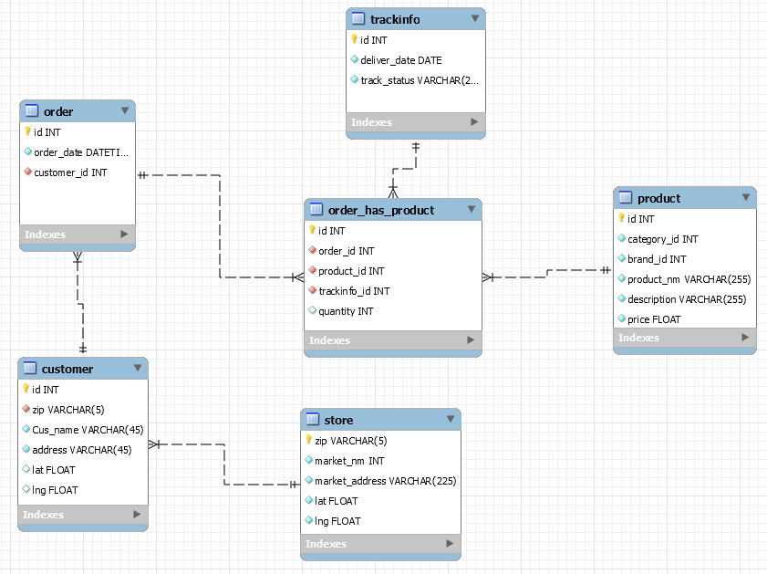
ER Model
Notes:
1. The relationships between store and customer is 1: N, ID in customer entity is PK, ZIP in store entity is PK, and also ZIP in customer entity is the FK refer to the ZIP in store table.
2. The relationships between order and customer is 1: N, ID in customer entity is PK, ID in order entity is PK, and also CUSTOMER_ID in order entity is the FK refer to the ID in customer table.
3. The relationships between order and product is N: M, so we need a bridge table, order_has_product entity, between them, in this entity, ID is the PK and ORDER_ID is the FK relate to ID in the order entity, PRODUCT_ID is the FK refer to the ID in the product table.
4. The relationships between order_has_product and trackinfo is 1: N, ID is the PK in the trackinfo table, and the TRACKINFO_ID in the order_has_product is the FK.

Slide 6
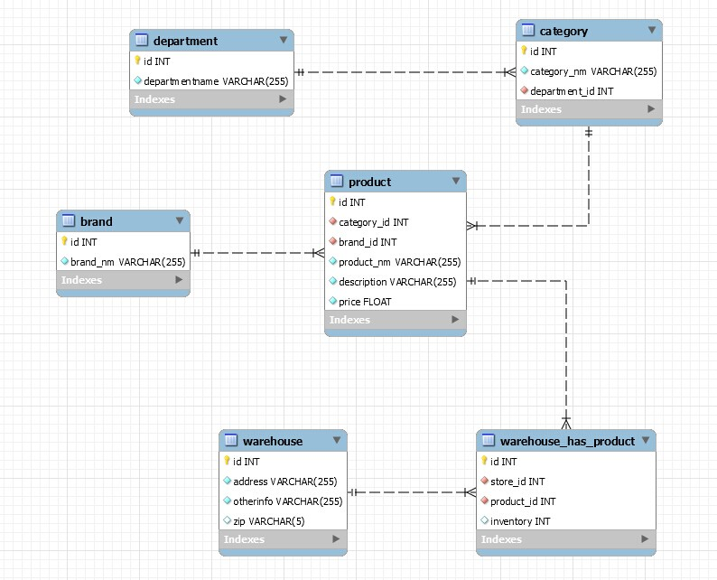
ER Model
Notes:
1,the relationship between department and category is one to many, because one department can have multiple categories. For example, the electronics department always has lots of categories like laptops, cellphones, cameras. The department ID in category is a foreign key referring to department ID in department.
2,in these two tables, the relationships is one to many. One category can have multiple products. Because there are always various kind of cellphones like iphone 6, samsung galaxy, blackberry. The foreign key category id in product table is pointing at category id in category table.
And the brand id here is related to brand id in brand entity. Cause there are companies have various kind of products. For instance, Philips company produces razor, moniter, cellphone. So the relationship is one to many.
3, The relationship between product and warehouse is many to many. A kind of product can be in different warehouses and one warehouse can have a lot of products. So the relationship between them is many to many. Then I create a bridge entity Warehouse_has_product. The foreign keys here are store id and product id. And product id in this entity is referring to product id in product entity.

Slide 7
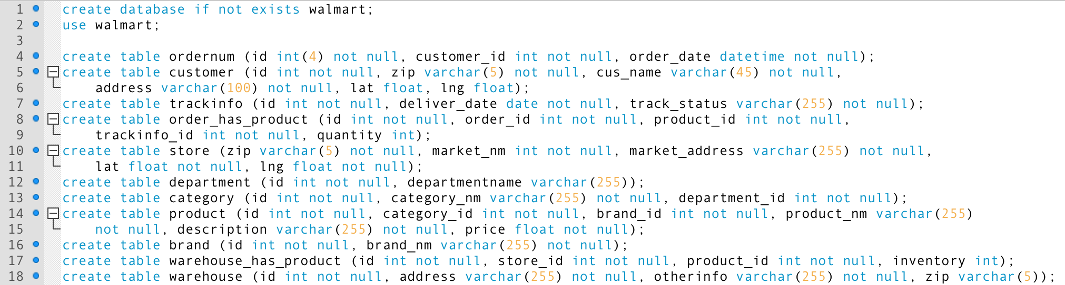
Create Tables
Notes:
Following are the detailed MySQL queries we used for these 10 functions.
Firstly, we created a database of Walmart, and 11 tables according to the ER model.
We need to pay attention to the type of zip, which is character, not integer numbers, because “int” type cannot start with “0”; and we also define all the variables which are not null here.
Set “not null” for variables
Assign a unique id for each table to avoid errors when using “JOIN” statement
Set different length for different character variable. Eg name, address

Slide 8
10 Functions
Register
Track order
Search
Find my local store
Trends
Change address
Select one category from one department
Store availability
Price: low to high
Multiple filters

Slide 9
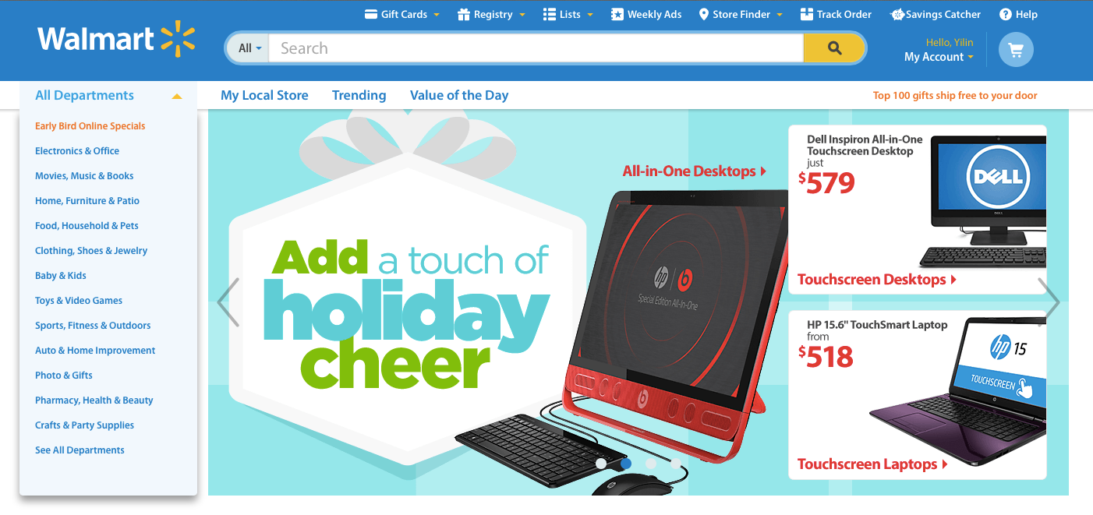

Function
3.
1.
2.
1.
2.
3.
Notes:
Function 1:
We use “INSERT INTO VALUES” to create account for customers. In this SQL query, the order of the content after value should follow the order of variables in customer table.
Because we use latitude and longitude to calculate the distance between customer and local stores, we also record the geographic information about users.
Function 2:
In this SQL query, we try to look all the order information for customer 400001, as an example.
Function 3:
Here we search the products based on the their name and description.
We use “%” to find out similar results.

Slide 10
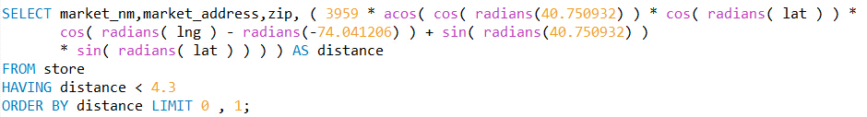
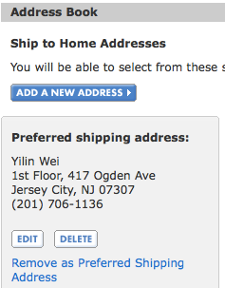


Function
4.
5.
4.
5.
6.
6.
Notes:
Function 4:
In this SQL, we use the latitude and longitude to find the closest local store for customers. In this example, we know that the latitude an longitude of Sam (whose “Customer ID” is “400001”) is 40.750932 and -74.041206. The formula in “select” statement calculates the distance. The “having” statement means that we want to find a store which is within 4.3 miles from the customer. If we want to search by kilometers, 3959 should be replaced by 6371. The “limit” statement means that we just want to find ONE store.
Function 5:
This function shows the product that most customers TEND to buy.
Function 6:
In this statement, we update the address information of the customer.

Slide 11
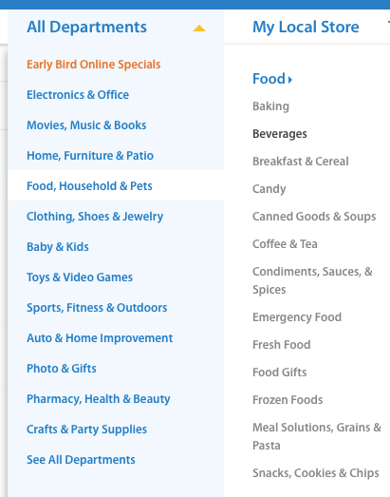

Function
7.
Notes:
Function 7:
This function helps the customers to search products from specific category. Here in the example, we are going to search “Beverages” under “Food”.

Slide 12
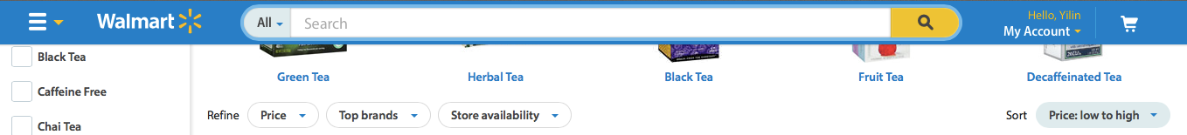
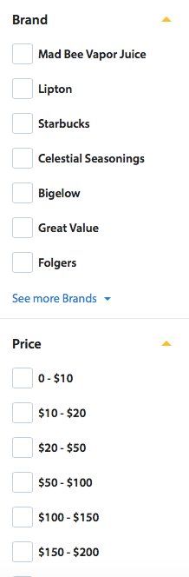


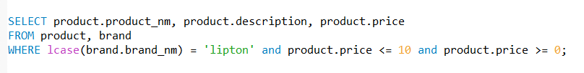
Function
10.
8.
9.
8.
9.
10.
Notes:
Function 8:
In function 8, it shows the warehouses and product information that have specific products in the inventory.
Function 9:
In function 9, we use “order by” to sort the goods by “price”.
Function 10:
Here we want to find the goods whose brand is “Lipton”, and the price of which is between 0 and 10. When filtering the brand, we use “lcase()” funciton to change the brand name to lower case, because brand is character and is case sensitive.

Slide 13
THANK YOU

