Slide 2
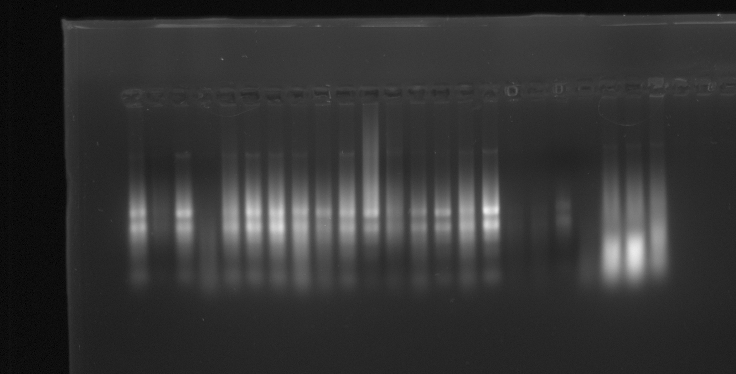
Pp-7-23-1 | Pp-7-23-2 | Pp-7-23-3 | Pp-7-23-4 | Pp-10-4-1 | Pp-10-4-2 | Pp-10-4-3 | Pp-10-2-1 | Pp-10-2-2 | At4-2-2 | At4-2-3 | At4-2-4 | At4-1-2 | At4-1-3 | At4-1-5 | At4-1-7 | 4pco-2 | 4pco-4 | 4pco-7 | 4pco-8 | C-2 | C-3 | C-6

Slide 3
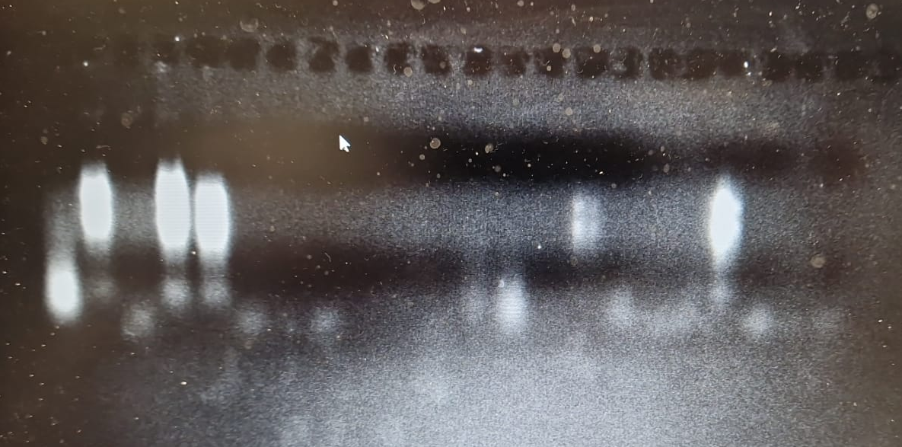
C-1 | C-4 | C-5 | C-8 | 4pco-1 | 4pco-3 | 4pco-5 | 4pco-6 | At4-1-1 | At4-2-4 | At4-1-1 | At4-1-6 | Pp-10-2-3 | Pp-10-2-4 | Pp-7-23-5 | Pp-7-23-6 | 4co-2 | 4pco-4 | 4pco-7 | 4pco-8

